Slide 1
Women Heart Programs: Developing the Business Case

Slide 2
Nuts and Bolts on How to Develop a Business Plan
Telling Your Story to Get Results
ACC22
Denise Busman, MSN
VP, Care Transformation, MedAxiom
dbusman@medaxiom.com

Slide 3
A goal without a plan is just a wish
-Antoine De Saint-Exupery

Slide 4
Why do I need one?
Provides insight into what is needed
Outlines steps to take
Establishes a timeline
Helps track progress
Anticipates and plans for potential risks
4
Notes:
Why can’t I just go to leadership and share my passion for Women’s Heart Health? Shouldn’t appealing to their better angels be enough?!

Slide 5
Getting Started
Gather a clinical and operational team
Clarify the clinical need and how your program will address it
Determine your source of patients
Decide what care you will provide
Determine what structure is needed to accomplish your goal
Notes:
Clarify the focus of your program – primary vs secondary?
And/or disease focus – e.g. SCAD, Takotsubo cardiomyopathy, fibromuscular dysplasia, pregnancy related cardiomyopathy, familial hypercholesterolemia, and coronary microvascular dysfunction.

Slide 6
But I didn’t go to business school!
Fortunately, there’s a recipe…
Executive Summary
Program Description
Operating Plan
Market Analysis & Marketing Strategy
Financial Plan

Slide 7
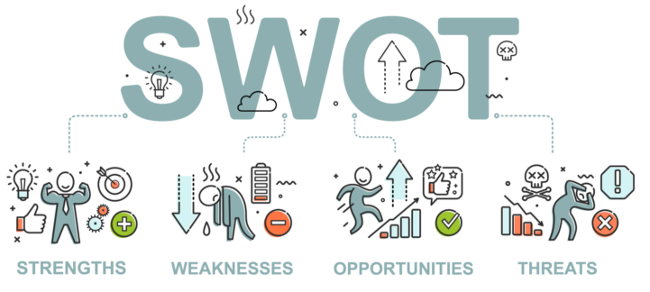
Getting Started
The burning platform elevator speech
Understand current state to provide future direction
SWOT Analysis
Be specific and realistic in your assessment
Executive Summary
Vision and Mission
Can serve to identify goals
The time to convey your passion!
Notes:
While an executive summary is the first element of a business plan, it may not be the first part you write. May instead write it at the conclusion of your work as a summary statement.

Slide 8
Program Description/Operating Plan
What are you trying to solve and how will the program address it?
Summarize what the program will do
Outline initial goals informed by clinical need
Market Analysis & Marketing Strategy
Where will your patients come from? Know your referral patterns
Make sure you have buy-in from other providers
What existing programs can you connect to?
Financial Plan
Partner with your business manager/ CFO
Develop a pro forma (financial assumptions/projections)
Keep payor mix in mind
Describe the ROI
Notes:
Market analysis: What relationships can you leverage?

Slide 9
Be Prepared
Before presenting your plan to leadership, walk through it and answer possible questions they may ask
What might you be asked to scale back on or do without?
What levers could you use to adjust the plan?

Slide 10
Make the pitch!
“It’s a TED Talk, not a dissertation”
“Tell me about the ROI – it may be more than just dollars”
Notes:
Start strong. You have less than 30 seconds to grab their emotional attention.
A great saying goes, Don’t adapt to the energy in the room, influence the energy in the room

Slide 11
A Good Plan Makes All the Difference
If you don’t know where you’re going, you’ll end up someplace else.
-Yogi Berra
“
”

Slide 12
Women’s Heart Program :
How To Reduce Bias in Your Institution and Community
Jennifer H. Mieres, MD, MASNC, FAHA , FACC,
Associate Dean Faculty Affairs
Professor of Cardiology
Zucker School of Medicine at Hofstra/ Northwell
NY
@DrJMieres
JMieres@Northwell.edu
Notes:
Hello, I am Dr Jennifer Mieres from the Zucker SOM Department of Cardiology at Northwell Health . I am honored to be join in my colleagues in this session to provide a snapshot of the evolving evidence on the prognosis, long term risk, the importance of cardiac rehab and the contents of the patient/ medical team discussion in the patient post spontaneous dissection of a Coronary Artery ( SCAD)>

Slide 13
Pamela S. Douglas, MD, MACC, Co-Chair
Michael J. Mack, MD, MACC, Co-Chair
David A. Acosta, MD
Emelia J. Benjamin, MD, ScM, FACC
Cathleen Biga, MSN, RN, FACC
Lisa Jay-Fuchs, MSN MBA RN
Sharonne N. Hayes, MD, FACC
Nkechinyere N. Ijioma, MBBS, FACC
2022 Building Respect, Civility, and Inclusion in the Cardiovascular Workplace
Akshay K. Khandelwal, MD, FACC
John A. McPherson, MD, FACC
Jennifer H. Mieres, MD, FACC
Robert O. Roswell, MD, FACC, FACP
Partho P. Sengupta, MD, FACC
Natalie Stokes, MD, MPhil
Enid A. Wade, JD
Clyde W. Yancy, MD, MACC
Notes:
The American College of Cardiology (ACC) has a long history of developing documents (e.g., decision pathways, health policy statements, appropriate use criteria) to provide its members with guidance on both clinical and nonclinical topics relevant to cardiovascular (CV) care. In most circumstances, these documents have been created to complement clinical practice guidelines and to inform clinicians about areas where evidence may be new and evolving or where sufficient data may be more limited. Despite this, numerous care gaps continue to exist, highlighting the need for more streamlined and efficient processes to implement best practices in service to improved patient care.
Central to the ACC’s strategic plan is the generation of “actionable knowledge”—a concept that places emphasis on making clinical information easier to consume, share, integrate, and update

Slide 14
The Why ? - ACC Health Policy Statement on Building Respect, Civility and Inclusion in the Cardiovascular Workplace.
Addressing bias, discrimination, bullying and harassment within cardiovascular medicine is of critical importance;
highly prevalent
Patient care outcomes can be adversely impacted when the environment in which cardiovascular team members learn and practice is hostile or non-inclusive.
Organizations with high levels of uncivil behavior are at risk for increased staff burnout and turnover, higher employment and care costs, and are at risk for litigation.
The Health policy Statement makes the case that addressing these behavior and creating a more welcoming and inclusive cardiovascular workforce is everyone’s responsibility- because it’s everyone’s problem.
Notes:
Addressing bias, discrimination, bullying and harassment within cardiovascular medicine is of critical importance. These experiences are highly prevalent, regardless of individual or organizational demographics or locale and it’s not only the individuals or groups who are targeted for these behaviors who are harmed. Patient care outcomes can be adversely impacted when the environment in which cardiovascular team members learn and practice is hostile or non-inclusive. Organizations with high levels of uncivil behavior are at risk for increased staff burnout and turnover, higher employment and care costs, and are at risk for litigation.
The HPS document makes the case that addressing these behavior and creating a more welcoming and inclusive cardiovascular workforce is everyone’s responsibility- because it’s everyone’s problem. There is an important role for leadership, but also individuals, who must recognize that reporting uncivil behavior, practicing allyship and being upstanders can improve the work environment. Additionally, there is also a special role for the American College of Cardiology and other professional societies.
These organizational and individual changes and activities cannot happen without leadership support and their modeling a culture of respect and having an organizational structure with adequate resources that can be dedicated to addressing these behaviors. Those tasked to work in these structures must have proper subject matter expertise.

Slide 15
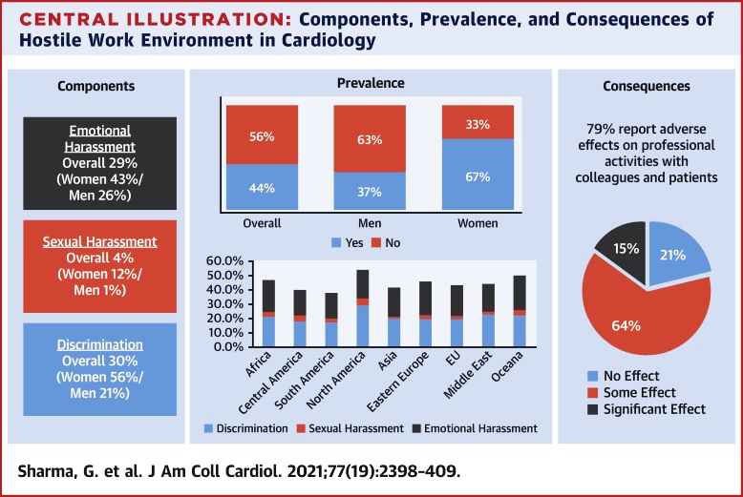
2022 ACC Health Policy Statement on Building Respect, Civility and Inclusion in the Cardiovascular Workplace Why Is This Document Needed?
Uncivil behavior is common
Adverse effects on individuals, teams, institutions and patients
Risks: Legal, regulatory, funding, wellbeing
Building a culture of respect requires:
Institutional leadership, resources, policies
Individual education and upstander practice
Continuous improvement/culture change
JACC 2021 77:2398
Notes:
Original Investigation: Global Prevalence and Impact of Hostility, Discrimination, and Harassment in the Cardiology Workplace
Garima Sharma , Pamela S. Douglas , Sharonne N. Hayes ,Roxana Mehran , Anne Rzeszut , Robert A. Harrington ,Athena Poppas ,Mary Norine Walsh ,Toniya Singh
,Ranna Parekh ,Roger S. Blumenthal and Laxmi S. Mehta
Survey : ~ 6,000 cardiologist
JACC 2021> In this issue of the Journal, Sharma et al. (1) report the results from a global survey that was conducted to assess workplace culture within cardiovascular practices. The investigators report data from responses by 5,931 cardiologists who participated in the survey. The results of this survey are disturbing, to say the least. A hostile work environment was highly prevalent. This survey was conducted across all major regions of the world and reported similar trends globally. The most striking finding was that hostile work environment was reported by almost one-half of the participants, 44% to be precise. Although both sexes reported hostile work environment, it was reported more than twice as often by women (67%) than by men (37%). he specific components included emotional harassment reported by 29% of the respondents (women 43% vs. men 26%), discrimination by 30% (56% of women vs. 21% of men), and sexual harassment by 4% (women 12% vs. men 1%). These dynamics were associated with untoward consequences. Four in 5 reported adverse effects of hostile work environment on their professional activities, including impact on colleagues as well as patients. These results raise concerns that need to be understood and addressed.
Editorial : JACC May 2021: Hostile Work Environment: A Case of the Emperor’s New Clothes∗
Editorial Comment Javed Butler and Ileana L. Piña
“In the case of the emperor’s new clothes, ignoring the existence of hostility in the workplace, fits the fable. Whereas gender and race discrimination are being recognized more frequently by the society, a more holistic perspective on the challenges that individuals face at work within the cardiology community are often overlooked.”

Slide 16
2022 ACC Health Policy Statement on Building Respect, Civility and Inclusion in the Cardiovascular Workplace Overview -1
12 ACC Principles that support a culture of respect: The ACC believes…..
Background and significance
General approach to building respect, civility, and inclusion
Special role of medical societies and the ACC
Defining a meaningful response to Bias, Discrimination, Bullying, Harassment (BDBH)
Institutional responsibilities and structures
Institutional policies and environment
Organizational consequences of inaction: Institutional harms, and legal considerations
Notes:
Speaker Note:
The ACC Health Policy Statement on Building Respect, Civility and Inclusion in the Cardiovascular Workplace include 12 principles that outline beliefs and recommended strategies and Best Practices to support a culture of respect And outlines a general approach to building respect, stability and inclusion in cardiovascular organizations and practices. This includes high level outlines of what is a meaningful ( as opposed to empty /in affect) responses to bias, discrimination, bullying and harassment as well as what structures and policies and procedures may need to be put in place in order to achieve goals.
This slide and the following list the outline of the HPS, beginning with a general approach (this slide) followed by (next slide)…

Slide 17
2022 ACC Health Policy Statement on Building Respect, Civility and Inclusion in the Cardiovascular Workplace Overview -2
Strategies to address bias, discrimination, bullying, and harassment (BDBH)
Education and training
Unbiased, objective hiring strategies, evaluations, and reviews of individuals and departments
Confidential reporting systems for BDBH with transparency, consequences, and support for targeted individuals
Web resources and tools. See www. ACC.org/Guidelines
Bibliography
Slide decks
Advice to people who feel they are being harassed
Sample policies
Notes:
Speaker Note: …..specific strategies to address BDBH
Importantly, in addition to the document, there are a suite of web tools and resources available at ACC.org/Guidelines that include….

Slide 18
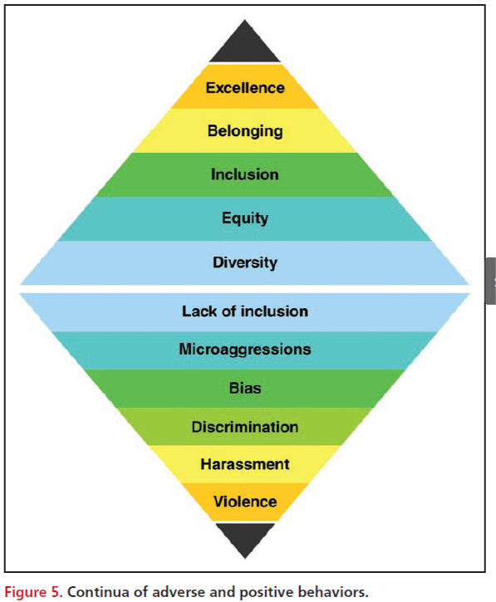
Spectrum of Civil and Uncivil Behaviors
Notes:
Speaker Note: This graphic illustrates the spectrum of behaviors and situations that are often present in the cardiovascular workplace.
The ACC believes that civil behavior and respect are inherent in its core values of Teamwork and Collaboration and Professionalism and are essential to its mission of “transforming cardiovascular care and improving heart health”. The Health Policy Document aims to provide the background, business case, and a foundational knowledge and guidance to help start addressing these uncivil behaviors and begin the journey towards Excellence. Emphasizing positive behaviors is a critical preventive step in reducing adverse behaviors and should be prioritized.
ACC also believes that all organizations and individuals providing cardiovascular care, education, and/or research should be familiar with the breadth and severity of negative consequences of the behaviors on the bottom section of this graphic and acknowledge their substantial adverse impact on well-being, patient safety, and organizational success.

Slide 19
Components of a Successful Program to Build Respect, Civility and Inclusion
Organizational culture and climate
Ongoing Evaluation of Effectiveness
Educational programs
Policies and procedures
Holistic reviews and hiring
Confidential reporting
Subject matter expertise
Dedicated structure(s), resources, funds
Strategic Plan with data driven, longitudinal assessments
Organizational and leadership commitment to reducing BDBH
Notes:
Speaker Note: this graphic represents a number of the components, both of foundations and the pillars necessary to start the journey of improving organizational climate, promoting diversity, equity, inclusion, and belongings and eliminating bias, discrimination, bullying and harassment in our organizations. The ultimate goal is a positive, respectful culture and climate
Foundations include (read horizontal bars) and pillars include ( read vertical bars)

Slide 20
Cycle of Improvement in Hiring and Promotions

Slide 21
Putting It Into Practice:
Case Presentations and Discussion Guide
2022 ACC Health Policy Statement on Building Respect, Civility and Inclusion in the Cardiovascular Workplace
Slide set adapted from the ACC 2022 Health Policy Statement on Building Respect, Civility, and Inclusion in the Cardiovascular Workplace to be published in the Journal of the American College of Cardiology
Nkechinyere Ijioma MBBS, FACC
Pamela Douglas MD, MACC
Sharonne Hayes MD, FACC
Notes:
Speaker Note:
This activity supports the 2022 ACC Health Policy Statement on Building Respect, Civility and Inclusion in the Cardiovascular Workplace and aims to provide context and practical approaches to commonly observed and experienced incidences of bias, discrimination, bullying and harassment in healthcare, and specifically in cardiovascular medicine.

Slide 22
THANK YOU!
JMieres@Northwell.edu
@DrJMieres

Slide 23
Designing and Building a Women’s Cardiovascular clinic
Cathleen Biga, MSN, FACC
President/CEO
Cardiovascular Management of Illinois
cbiga@cardiacmgmt.com

Slide 24
Care Organized Across The Continuum
Horizontal CV Care Stream Across Traditional Vertical Structures
Cardiovascular services organized the way patients experience them.
Consolidated Strategy – Budget – Operations - Management
Notes:
Historically, CV care was organized vertically in departments of cardiology – imaging, procedures, clinical cardiology, etc. As noted – the need to change to a more horizontal alignment creates a much more patient centric approach. Aligning the siloes through clinical, financial and quality management creates a more cohesive approach to patient care delivery and improved utilization of CV resources. In addition, we are able to align resources such as staffing, information technology and processes across the delivery system which drives down waste and redundancy. The cardiovascular service line provides a consolidated strategy for budgets, operations and management.

Slide 25
SUB-SPECIALTY CLINICS start with CARE PATHWAYS AND DEFINITION
“Schedules of medical and nursing procedures, including diagnostic tests, medications, and consultations designed to effect an efficient, coordinated program of treatment”
Anderson, , ed. Mosby's Medical, Nursing, & Allied Health Dictionary. 4th ed. N.p.: n.p., 1994. Print.
Care pathways determine locally agreed, multidisciplinary practice, based on guidelines and evidence where available for a specific patient population.

Slide 26
WOMAN

Slide 27
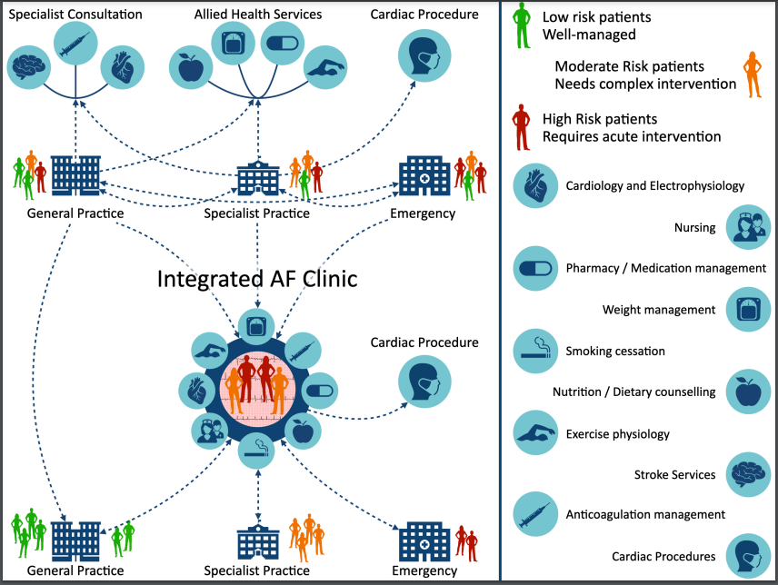
Integrated Women’s clinic

Slide 28
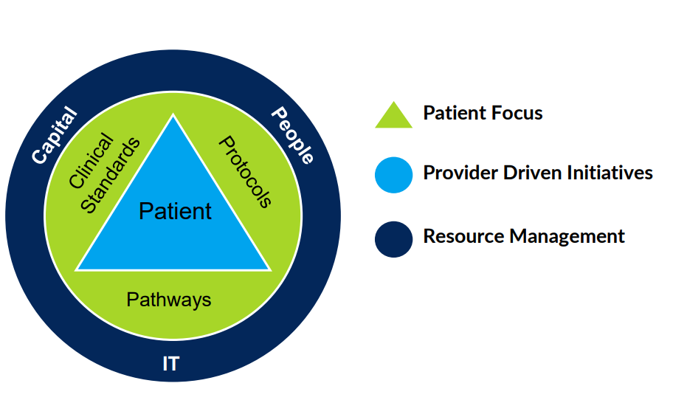
Critical programmatic elements

Slide 29
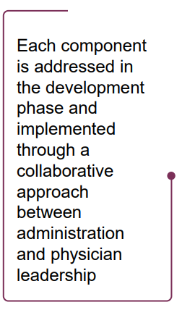
Essential Program Elements

Slide 30
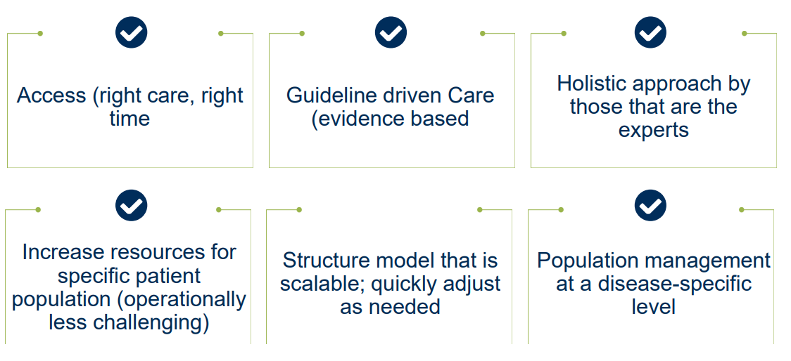
Objectives for a sub-specialty clinic

Slide 31
Challenges & Solutions

Slide 32
Sustainable Sub-Specialty Care
How will you train your team?
Clinical Education, Practice Education
Establish workflows for registries of patient and clinic data
Identify focus experts – create a culture of innovation
Communicate Measurable Endpoints
Define “success/iterate” prior to starting
Emphasize access and process improvement
Blended Care: Find the Right Fit
Provider and patient groups
Determine the magnitude of digital solution

Slide 33
Measuring & Improving Outcomes
Piccini JP, et al. Heart Rhythm. 2020 Oct;17(10):1804-1832.

Slide 34
Important Outcomes Data
Time to visit
Can patients/referring physicians access the service?
Patient satisfaction
Are patients happy with the service?
Referring practices
Are referring providers happy with the service?
Response to patient communication
How responsive is the service?
Health outcomes
How effective is the service?

Slide 35
What is that elevator speech?
Sub-spec clinics are multidisciplinary approach - focused on combining multiple specialties for effective management
Reach out to other sub-specialties
Put the proforma in place
Decide your referral pattern – independent physicians? Employed
Switzerland
In your office
Understand the financials
Timeshare agreements
Billing TIN and taxonomy codes

Slide 36
Cross-Disciplinary Structural Design: Building a Community
Annabelle Santos Volgman, MD, FACC

Slide 37
Crafting a Research & Training Plan
Margo B. Minissian, PhD, ACNP, FAHA, FNLA, AACC
Executive Director, Geri and Richard Brawerman Nursing Institute
Simms/ Mann Family Foundation Endowed Chair in Nurse Education, Innovation and Research
Assistant Professor, Cardiology
Director, Postpartum Heart Health Program
Speaker Twitter Handle (Ariel Regular)

Slide 38
Evolve Clinical Practice

Slide 39
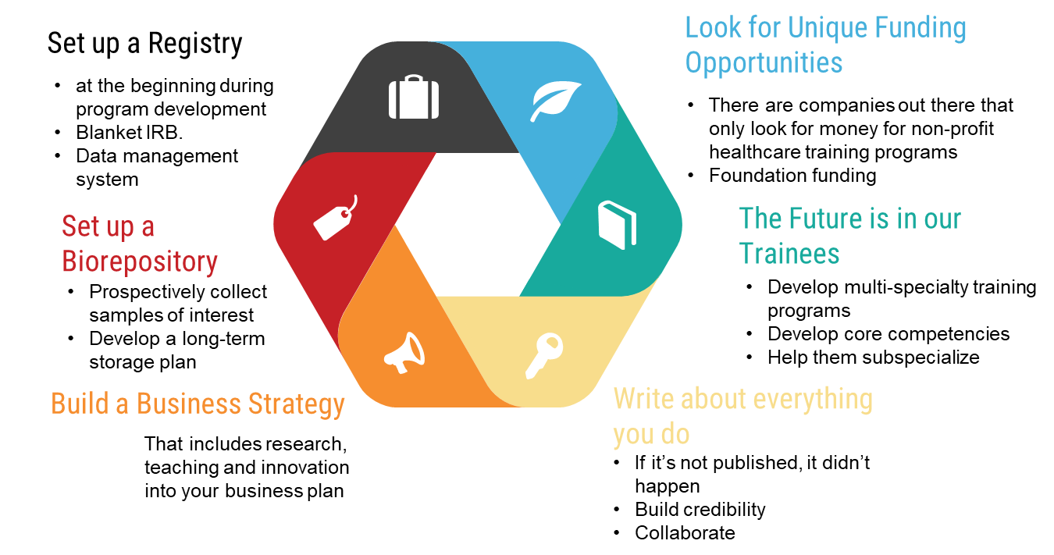
Developing Your BEST Research & Training Program

Slide 40
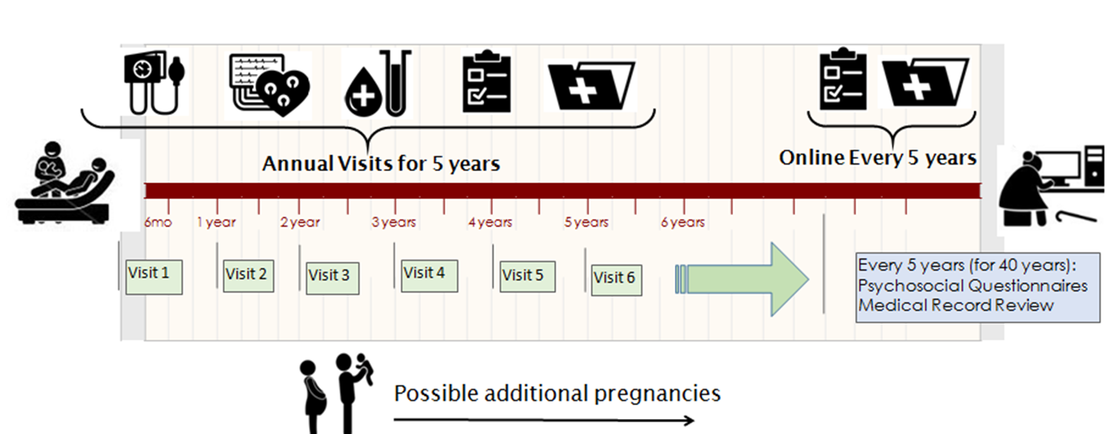
Postpartum Heart Health Registry

Slide 41
World-Class Research
Outstanding Clinical Care
Philanthropy
Community Outreach
Reaching those who cannot come to us
Increasing Awareness
Advocacy
Health Policy

Slide 42
Women Heart Programs:
Developing the Business Case
Gina P Lundberg MD
Emory Women’s Heart Center
ACC WIC Chair Elect
@Gina_Lundberg

Slide 43
Engaging Patients into Their own Health

Slide 44
Emory Women’s Heart Center Objectives
Personal assessment & education for women on their individual CVD risk factors
Provide comprehensive cardiovascular care for adult women of all ages at all stages of life
Decrease disparities in care for all women
Screen & educate metro Atlanta women through community programs

Slide 45
Strategic Plan
Clinical | Community Service & Education | Education & Training | Research
Gina Lundberg MD Clinical Director | Gina Lundberg MD Puja Mehta MD | Ijeoma Isiadinso MD Nanette Wenger MD Gina Lundberg MD Puja Mehta MD Susmita Parashar MD | Puja Mehta MD Translational Research Director
CVD Risk Assessments- Stacy Jaskwhich NP Dee Blalock NP | 10,000 Women HTN Screening Events- Ogechi Opara | Annual Women & Heart Disease Conference- Gina Lundberg MD Ijeoma Isiadinso MD | 10,000 Women HTN Screening Data
EWHC Consultations- Ijeoma Isiadinso MD Susmita Parashar MD Carolina Gongora MD Alexis Cutchins MD Modele Ogunniyi MD Stacey Westerman MD Rebecca Leleiko MD Ozlem Bilen MD Lakshmi Tummala MD Ifeoma Onuorah MD Olga Toleva MD Alanna Morris MD | EWHC Screening events | Residents & Fellows Medical students NP and PA students | Quarterly Sex-specific Biology Conference Research Team- Fauzia Rashid Student Researchers
Associated Consultants: Jonathan Kim MD- Sports Medicine | Annual Red Dress Events- ESJ, EUH, EUMH | Cardio OB Work Group- Erin Ferranti PhD Carolina Gongora MD Lakshmi Tummala MD Ifeoma Onourah MD | Associated Researchers- Robert Taylor MD PhD Sandra Dunbar RN PhD Telisa Spikes RN PhD
 | Annual Reward Your Heart event- Gina Lundberg MD Carolina Gongora MD Ogechi Opara

Slide 48
Educate, Engage and Empower Women

Slide 49
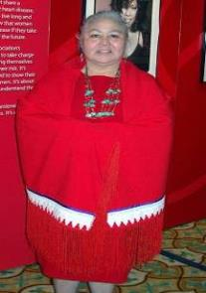
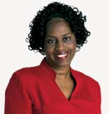
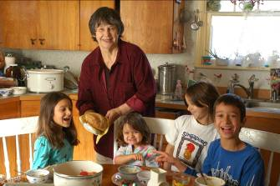
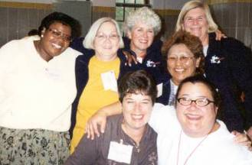
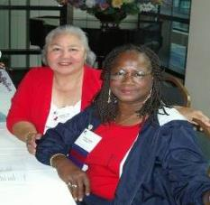
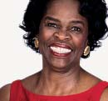
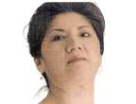
Leveraging National Organizations: Together We Go Far
Sharonne N. Hayes MD, FACC, FAHA
Professor of Cardiovascular Medicine
Women’s Heart Clinic, Mayo Clinic
@SharonneHayes

Slide 50
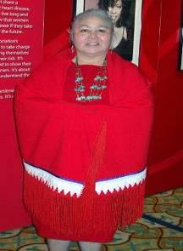
Financial Relationships (None)
Off Label Usage (None)
I am not going to talk about ACC or AHA
Notes:
Engaging in your professional organizations is a time honored and effective way of learning, raising your visibility, networking, and developing leadership skills. Regardless of your type of practice, this is important for you, particularly if you have a niche or sub-sub- specialty, which some might consider would be heart disease in women. But I’m going to give some examples of orgs specific to women’s heart programs

Slide 51
So, you’ve started a Women’s Heart Program & now….
How can I better SUPPORT my patients?
How can I get broader PARTICIPATION in my research?
Who might help FUND my research?
How can I ↑ the VISIBILITY of my practice (& me)
My patients need EDUCATIONAL resources (that I don’t have)
And…Who has time for more VOLUNTEER work!
YOU DO! What you give, gives back

Slide 52
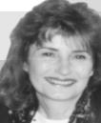
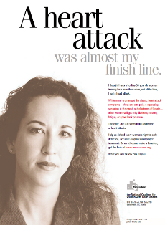
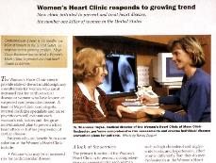
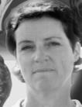
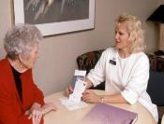
Women’s Heart Program
1998
“I feel like I survived my heart attack for an important reason: To make a difference in women’s lives.”
@SharonneHayes
Notes:
1998
Opening of Mayo Clinic WHC-
Founding of WomenHeart

Slide 53
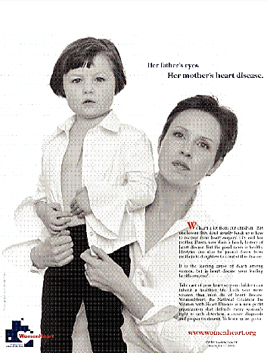
@SharonneHayes

Slide 54
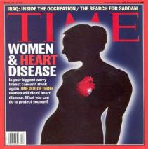
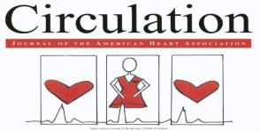
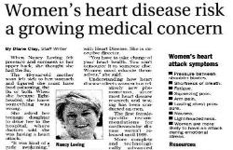
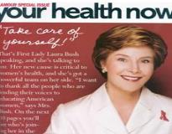
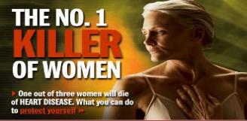
SM
@SharonneHayes
Notes:
2004
Kick off of Go Red/Heart Truth
Circulation
2003 Heart Truth “Heart Disease doesn’t care what you wear”.

Slide 55
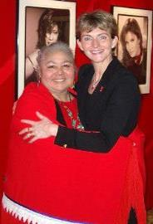
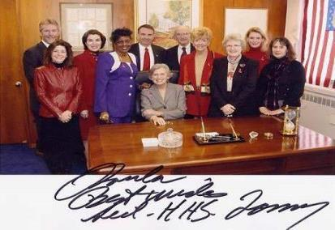
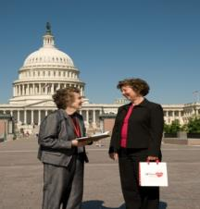
Advocacy
@SharonneHayes

Slide 56
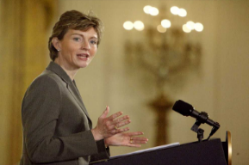
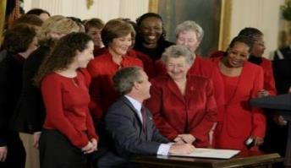
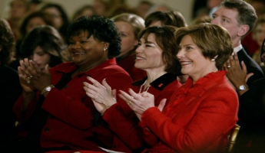
Heart Month at the White House February 2, 2004
@SharonneHayes

Slide 57
@SharonneHayes

Slide 58
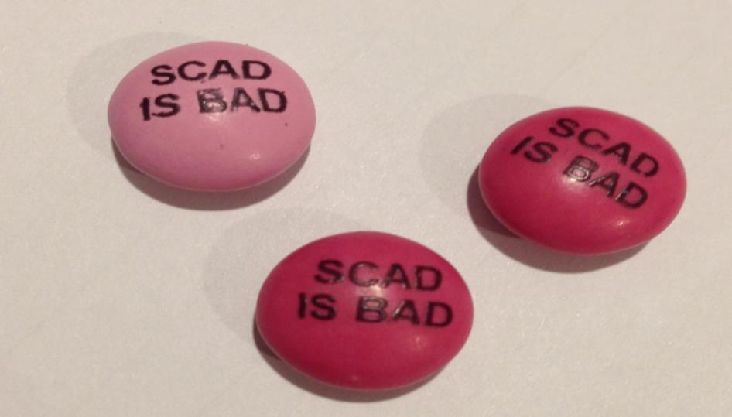
@SharonneHayes

Slide 59
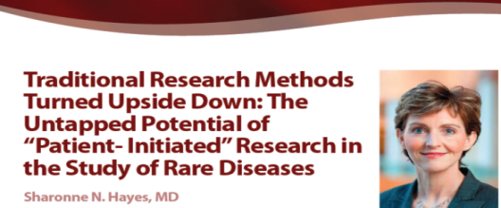
“ Active recruitment was unnecessary because 18 women had requested study information within 7 days of IRB approval ”
Mayo Clinic Proceedings, 2011
@SharonneHayes

Slide 60
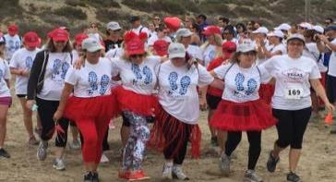
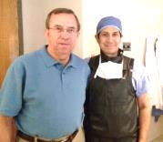
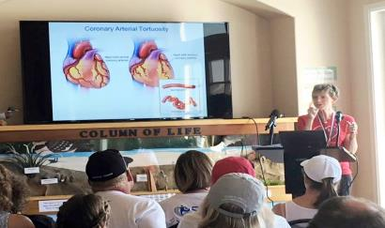
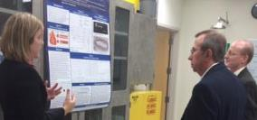
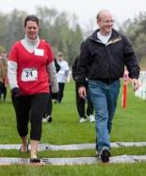
@SharonneHayes
Notes:
Their story- Our Story

Slide 61
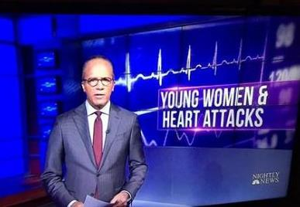
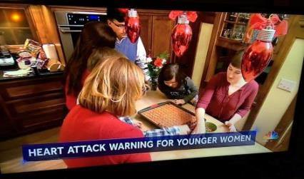
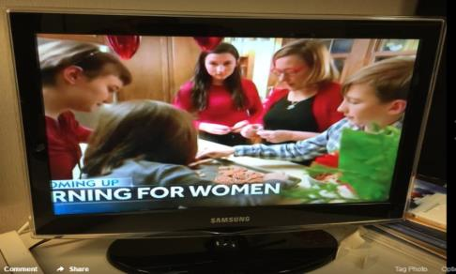
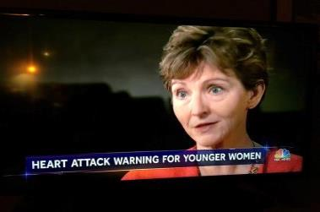
@SharonneHayes

Slide 62
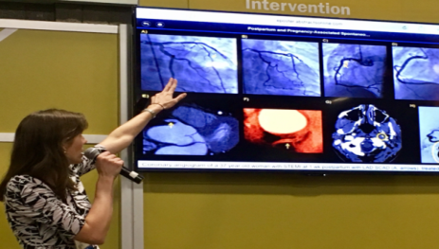
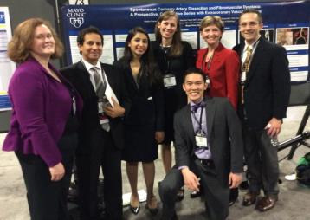
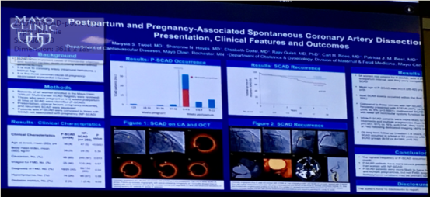
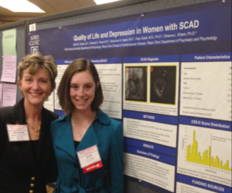
@SharonneHayes

Slide 63
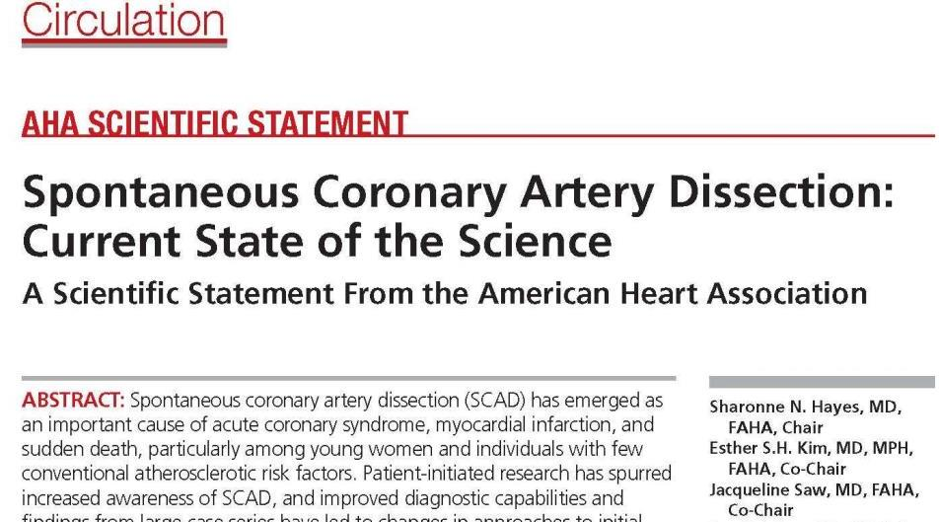
@SharonneHayes

Slide 64
@SharonneHayes

Slide 65
Organizations Improving the Health of Members & Communities
@SharonneHayes

Slide 66
Mayo/Links Incorporated Initiatives
“You Can Make a Difference” about the importance of participating in health-related research
Leverages mutual interest in promoting research participation by minorities and women
Member survey identified high degree of willingness to participate in research
Funded NIH R21 with Links/Mayo Co-PI’s
@SharonneHayes

Slide 67
@SharonneHayes
Hayes.Sharonne@Mayo.edu
@MayoClinicCV

Slide 68
Panel Discussion

