Slide 1

Transitioning to a New Job:
How to Thrive in Your New Role
and
Ensure it is the Perfect Long-term Fit for You
Sponsored by the Virginia ACC Chapter and the Early Career Leadership Council

Slide 2

Moderators
Aditya Bharadwaj, MD, FACC
ACC Early Career Leadership Council, Leader of Early Career Chapter Work Group
Associate Professor of Medicine, Director of Complex Coronary Interventions
Director of Cardiovascular Research and Outreach Programs
Loma Linda University
Benjamin Galper, MD, MPH, FACC
Early Career Representative, ACC Virginia Chapter
Director, Structural Heart Disease Program, Mid-Atlantic Permanente Medical Group (MAPMG)
Assistant Chief of Cardiology, Northern Virginia MAPMG service area
Medical Director, Structural Heart Disease Program, Virginia Hospital Center

Slide 3
Agenda
Negotiating a Job Contract
Michael Valentine, MD, FACC
Q&A for the Panelists (5 mins)
Creating Your Niche & Building a Program
Srihari Naidu, MD, FACC
Q&A for the Panelists (5 mins)
Dos and Don’ts for an Early Career Cardiologist
Evan Ownby, MD, FACC
Q&A for the Panelists (5 mins)

Slide 4

Learning Objectives
Understand the art of negotiating a job contract
Learn to create a niche for yourself and build a practice
Become aware of the dos and don’ts for transitioning into a new job
Understand setting priorities to ensure you reach your highest potential and achieve professional development

Slide 5
Moderator
Benjamin Galper, MD, MPH, FACC
Early Career Representative, ACC Virginia Chapter
Director, Structural Heart Disease Program, Mid-Atlantic Permanente Medical
Assistant Chief of Cardiology, Northern Virginia MAPMG service area
Medical Director, Structural Heart Disease Program, Virginia Hospital Center

Slide 6
Panelists
Poonam Velagapudi, MD, MS, FACC
Chair, ACC Early Career Section
Assistant Professor of Medicine, Associate Program Director
Cardiology Fellowship Director, Division of Cardiovascular Medicine
University of Nebraska Medical Center, Omaha, NE
@Pooh_Velagapudi
Anthony A. Hilliard, MD, FACC
Southern California ACC Chapter Governor
Chief of Cardiology, Associate Professor of Medicine Loma Linda University Health
COO, Loma Linda University's Faculty Medical Group
Senior Vice-President of Loma Linda University Healthcare
@AAHilliardMD @CaliforniaACC

Slide 7

Negotiating Your Contract
When, Where and How?
C. Michael Valentine, MD, MACC
ACC Past President
Division of Cardiology
University of Virginia Health System
Charlottesville, VA.

Slide 8

Disclosures

Slide 9

Choosing the Right Practice
The 3 “C’s” of Evaluation
Culture
Compensation
Call

Slide 10
Culture
What is the “culture” and personality of the group?
Do they foster growth, or eat their young?
How do partners work together, is it a group, or individuals working as individuals?
What is the possibility for leadership, if desired?
Are there accommodations for work life balance issues?
Bad culture cannot justify a lot of comp

Slide 11
Compensation
Socialism or capitalism?
For independent groups, what is the path to partnership?
What is the buy in to reach partnership when you are eligible?
For system employed models: know your guarantee period, the comp plan design, and the RVU conversion factors before you start?

Slide 12
Call
This Will be a reflection of the “Culture”
Is there an internship mentality about frequency and call duties?
Get commitments of frequency, regardless of independent vs employed groups.
What is the “no call” policy, is this an option?
When you’re old and tired what is the expectation for continued call duty?

Slide 13
Preparing for Your Interviews
Know Your 3 C’s
Prioritize Your Asks
Do Your Research
Pre-Network
Understand the Market
Organize Your Questions

Slide 14
Final Offer Checklist
Alignment with 3 C’s
Optimal Practice Setting
Financial Stability
Contract/Legal Clarity
Partner Support
Administration Support
Adequate Benefits
Location, Location, Location

Slide 15
Negotiating-Where ?
Academic Practice-Few options
Integrated Practice-Options determined by size of group, supply-demand
Private Practice-More room for options and negotiation

Slide 16
Integrated Practice
Large groups have standard contracts that all have signed
Ask about areas of possible negotiation after reviewing the contract
Supply and Demand is CRITICAL-How much do they really need you?

Slide 17
Private Practice
Legal Structure: LLC, S-Corp, C-Corp
By-laws
Shareholder Agreements
Employment Agreements
Key elements:
  Benefits – pension/401/457
  Health Care/Dental/LTD/STD
  Business Expenses – Licenses, CME, MOC, etc.

Slide 18
Key Areas …..
Compensation arrangement
Termination clauses
Medical Malpractice
Non-compete clauses
  time and geographical base
  watch medical staff bylaws
  Different for sub-specialties?
  Know the market

Slide 19
Duties and Responsibilities
When do I work
Where do I work
Time commitment for admin and supervision
Can I moonlight
Outside income – clinical and non-clinical
Can I lecture/write books/chapters/do research
Who owns intellectual property
How are patients assigned
How do I grow my practice

Slide 20
Benefits
Relocation
Sign on
Personal insurance
PTO
Malpractice – specifically if you leave (tail)
Reimbursement of business expenses (licensure, MOC, Boards, medical
staff fees, DEA, mileage, etc.)
Retirement
  Deferred comp, vesting

Slide 21
Negotiations
Allow adequate time—listen first!
Money is important – governance is critical
Don’t forget benefits
Compare TOTAL package
Understand non-clinical competencies/rewards
Reimbursement no longer rewards production alone
Understand care team delivery/support

Slide 22
Where can things go Wrong?
Poor Timing-Don’t ask too early
Incomplete prep and unclear goals
Incomplete or incorrect evaluation of your position
Ground rules & timeline
Metrics for evaluating performance

Slide 23
Contract Negotiation-Top 10 Rules
Do your homework in advance
Know the marketplace
Know the practice and culture
Never ask to negotiate in the first interview
Know the partner that you can work with to ask questions
Understand what can be negotiated
See the BIG picture- Long Term-”Don’t sweat the small stuff”
Listen to “Practice Made Perfect” Podcast on negotiations
Use an attorney if there are major negotiations possible
Always create a Win-Win

Slide 24
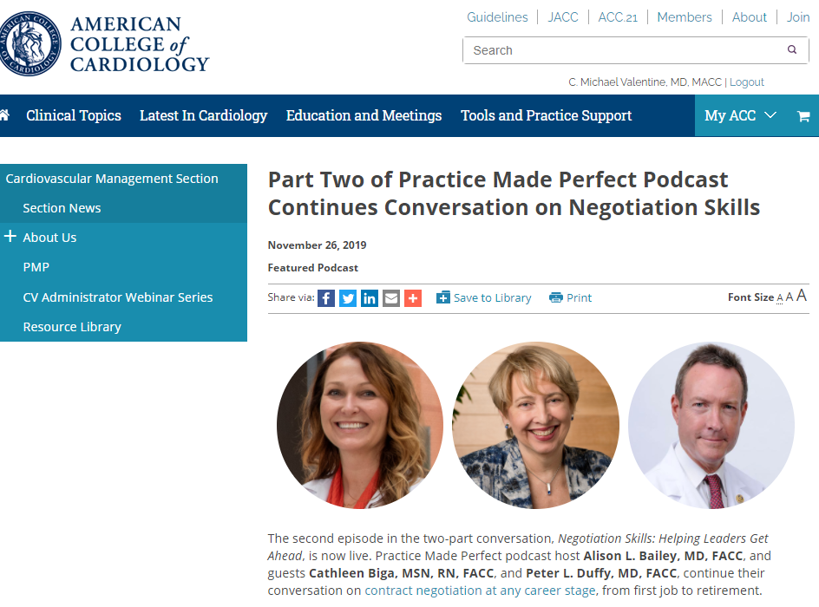

Slide 25
Thank You

Slide 27
Creating Your Niche
& Building a Program:
Advice for the Early Career Cardiologist
Srihari S. Naidu, MD, FACC, FAHA, FSCAI
Director, Cardiac Catheterization Labs and
Hypertrophic Cardiomyopathy Center of Excellence
Westchester Medical Center Health Network, Valhalla, New York
Professor of Medicine, New York Medical College
President – NY ACC ; Trustee – SCAI ; Trustee Emeritus – Brown University

Slide 28
What is a niche?
“A specialized segment of the market”
Market = Cardiovascular Medicine
Segment = IC, HF, EP, Imaging, CC, Outpatient General, Prev
Specialized Segment = Structural Imager, HCM, pHTN

Slide 29
My current clinical niches
Hypertrophic Cardiomyopathy and Alcohol Ablation
  Largest Alc Ablation Program in Country
  Top 5 Busiest HCM Centers in Country
  Live Proctoring Course and National Proctoring
  HCM Textbook and Guidelines
Cardiogenic Shock Diagnosis and Management
  SCAI SHOCK Course Launch and First 3 Years as Chair
  SCAI SHOCK Classification Consensus Document 2019 & 2022
  Mechanical Support Devices Literature and Expertise
  Interventional Heart Failure and Hemodynamics

Slide 30
Why have a clinical niche?
Job satisfaction and sense of accomplishment and authority around a subject or procedure
Aids in building a practice based on appropriate referrals for specialized management or treatment (the community needs you)
Easier to build a dossier for academic promotion, as lecture requests, invited papers, research are conducive to specialized topics
Job security given relatively few doing what you are doing at your institution (or regionally); also aids in marketing yourself for the next job

Slide 31
How do the BEST niches take shape?
Cultivate niches where “talent and passion” intersect
Use those niches to drive dominance in all three areas of the triple threat (clinical, research, & education)
Use your developing prominence to gain resources locally, and roles regionally, and nationally
  Ex: HCM as an example of a niche
    #1 Talent & passion drive clinical excellence, patient volume, referrals, and both experience and expertise – ask for resources incrementally
    #2 Use #1 to spread the word via national lectures, grand rounds, unique curricula, training / proctoring – raise your regional/national reputation
    #3 Publish on the topic, creating a network of researchers, your own database, major presentations, LBCT, Exec Cmte or National PI of RCT
    When done right, #2 and #3 feedback and drive more of #1, which over time grows from individual expertise to institutional expertise (i.e. Program/Center)

Slide 32
Pre-Existing Niche vs. Creating a New One
At any given time, there are niches that already exist, and indeed all sub-specializations are niches
Creating a new niche means predicting the future
  Predicting the future takes vision to see it, relationships to sell it, and strength to build it
  Takes creativity, vision, perseverance, the ability to convince others (elevator pitch),resources, and time (and some risk-taking)
This means also that niches have to evolve over the course of your career → keep predicting ….

Slide 33


Slide 34
Building a Niche
    “Predicting the future takes vision to see it, relationships to sell it, and strength to build it” ~ Srihari S. Naidu, MD
    vision to see it (visionary – separating out the game changing ideas from all the rest that just waste your time)
    relationships to sell it (build the right team to help launch it and help sustain it – gaining buy-in and resources)
    and strength to build it (fight the naysayers, as if you are right, they will eventually come around – takes time and perseverance)

Slide 35
Pearls of Building a Niche
Invest the time and effort to truly become great at something very much needed now or in the future that you are talented in and have passion for
  Be honest with yourself – am I really good at this, or can I really get good at this? What can I be great at – so great that people will refer to me?
Niches take time – at least 5 years, and oftentimes those closest to you will refer the least (and last)
As volume grows, track it so you can ask for resources that allow for exponential growth

Slide 36
The Three A’s – are they enough?
Ability – competent to do the job
Affability – easy-going, approachable
Availability – easy to reach

Slide 37
Examples of Blazing a Trail (Creating a Niche)
That Few Believed In …… My Niches
Alcohol Septal Ablation and HCM Center
  15-year process
Leadership Development and SCAI ELM Program
  12-year
Interventional Heart Failure and Cardiogenic Shock
  10-year process

Slide 38
ACTION is Needed to Build a Program
Ease of Access for both patients and referrings
Comprehensive care that is detail-oriented
Ability to build Trust and a long-term relationship with both patients and referrings
Continue to evolve as the field progresses (cutting edge, Innovative)
Offer a product that surpasses all others based on Outcomes (clinical, patient satisfaction)
Make it have something Novel nationally (why your program over the others?)

Slide 39
Summary
Niches can be either something already existing, in which case you’d like to do it better than others or fill that role at your hospital or practice, or they can be created anticipating the future landscape
In all cases, niches are not static
Niches provide job satisfaction and security that allow you to weather times of stress or burnout
The 3 A’s are great for early-career to build an individual reputation as a team player who can take care of patients efficiently and competently

Slide 40
Summary
ACTION is needed to form a real program that grows and evolves into a national center
Resources are required along the way, as you prove yourself and your program – incremental investment in the program over time
Be a Kirk! Creativity and measured risk taking are absolutely vital to create a national program
Not everyone can create and build, nor should they

Slide 41
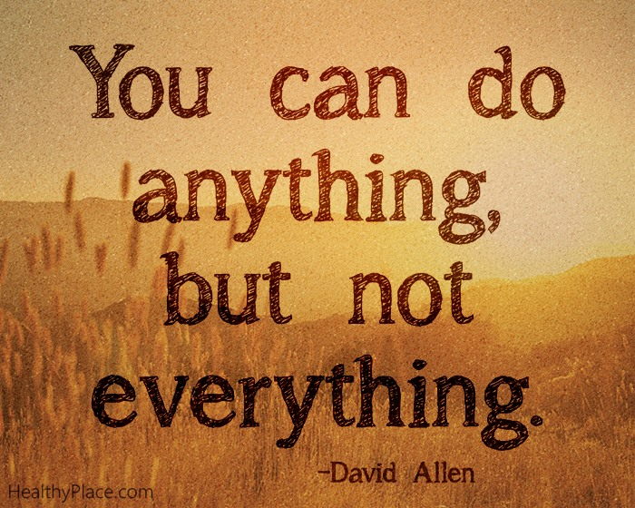

Slide 43
Dos and Don’ts for an
Early Career Cardiologist
Evan D. Ownby, MD, FACC, FSCAI
Governor, Virginia ACC Chapter
Interventional Cardiology
Heart & Vascular Institute, Centra Health

Slide 44

Do – Focus on the culture of “YES”

Slide 45

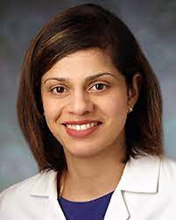
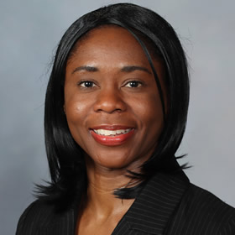
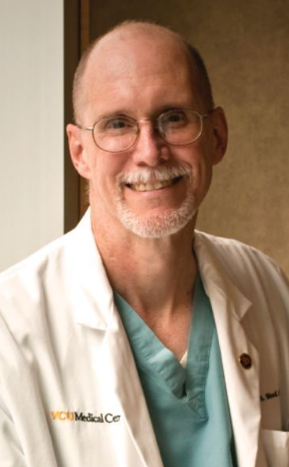
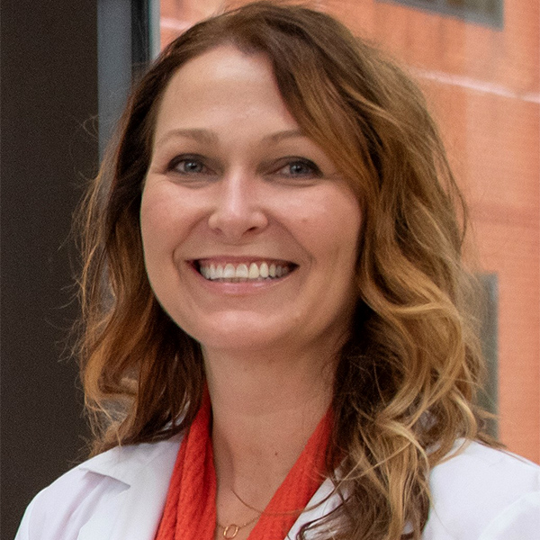
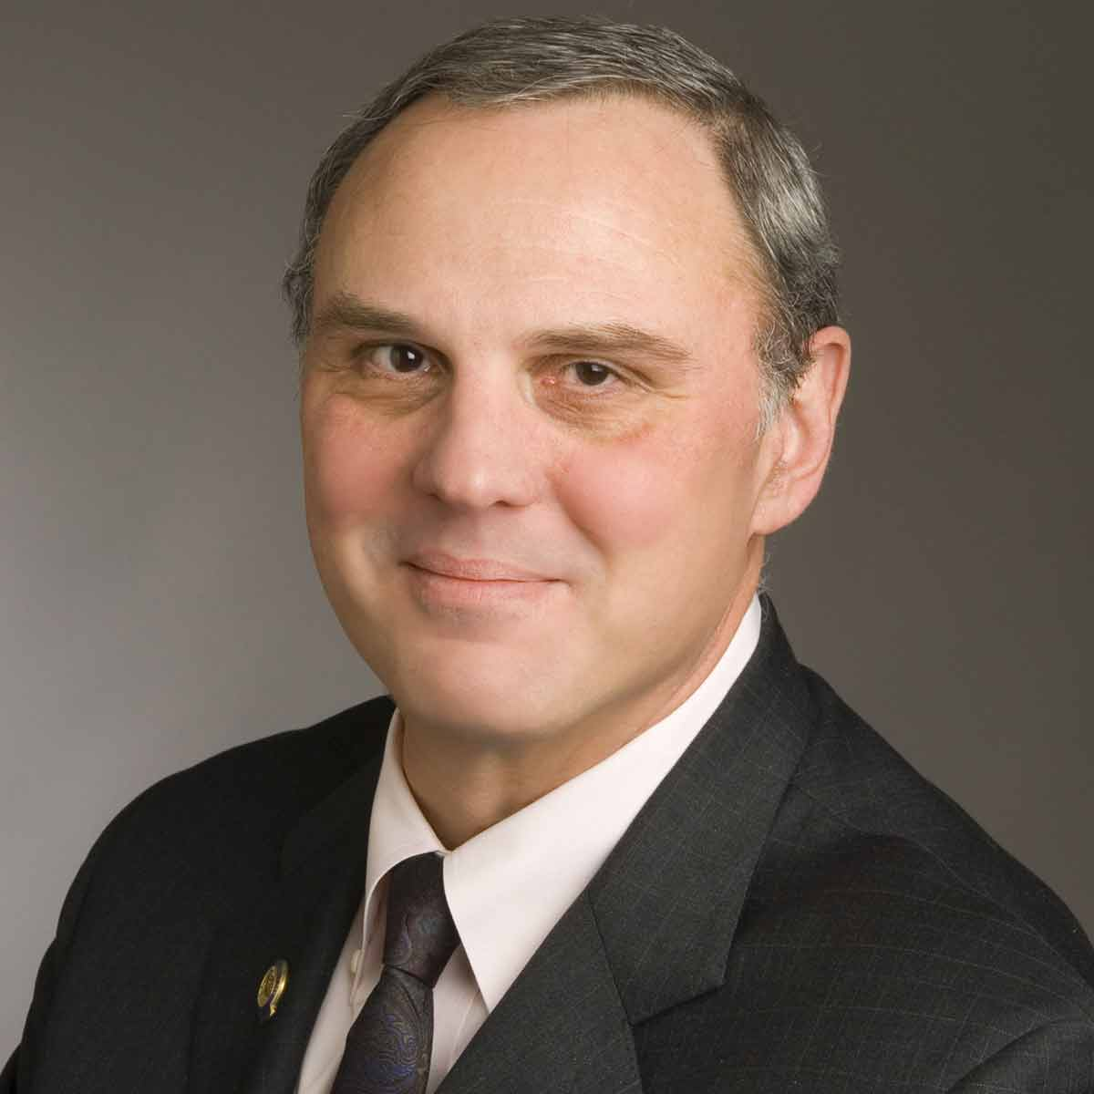
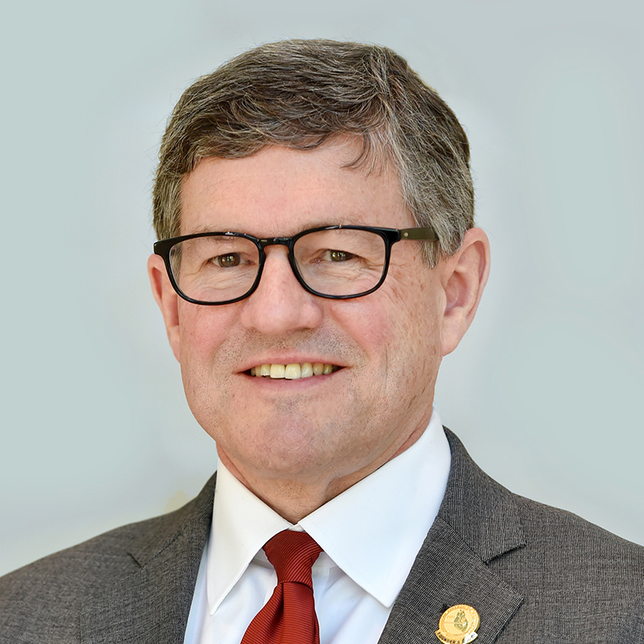
Do – Be a champion for culture
Do – Identify Mentors

Slide 46

Don’t - Forget the Chain of Command

Slide 47
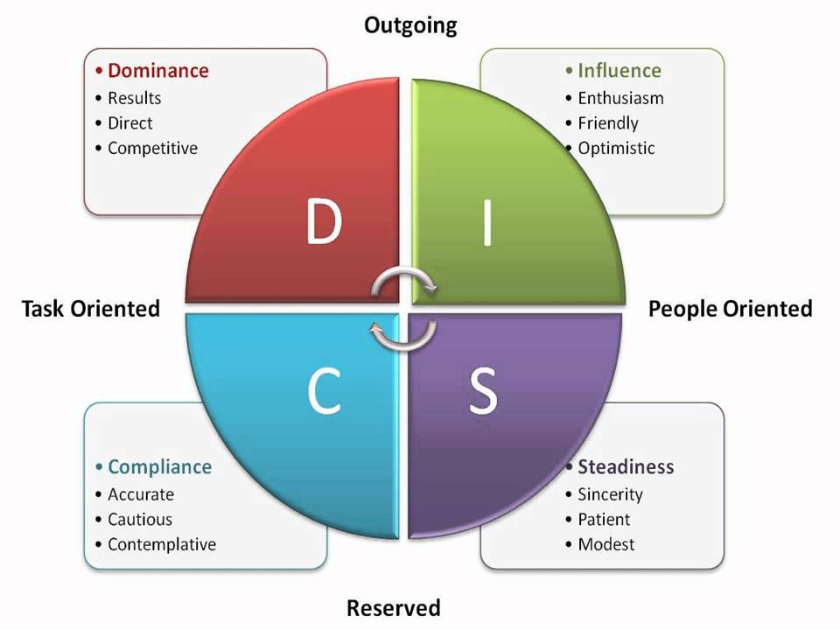


Do – Remember the
Importance of a Team
Don’t – Yell at Nurses
Don’t – Use the phrase:
“In Fellowship we did _____”

Slide 48



Don’t - Forget to Plan
(finances, leadership opportunities, career milestones, restrictive covenants)

Slide 49
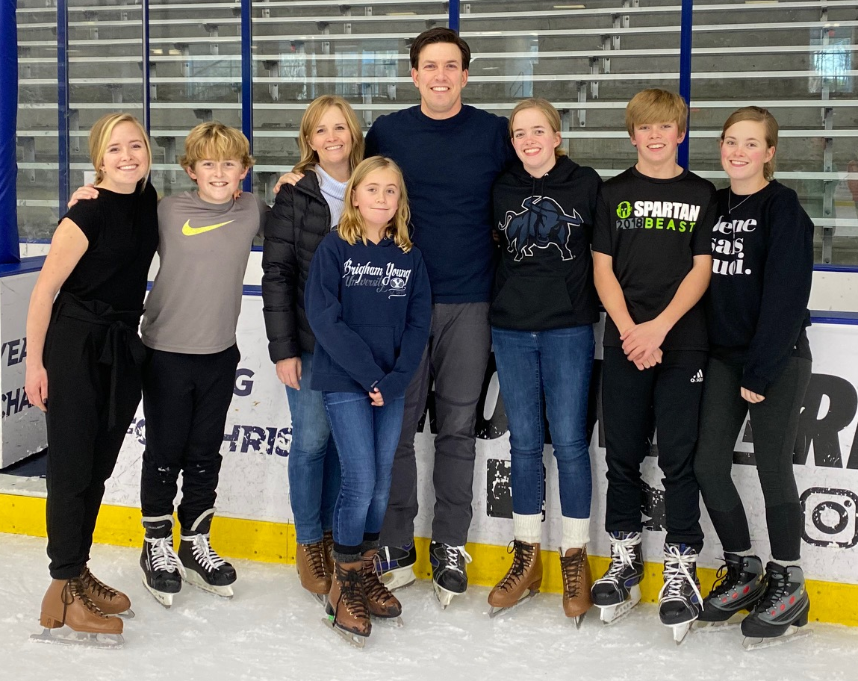
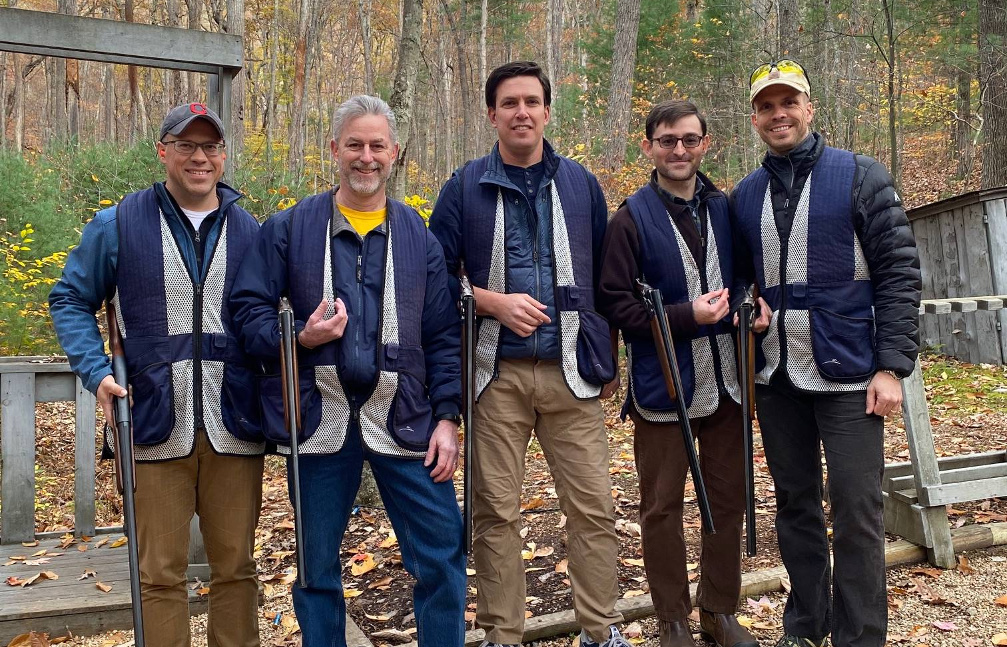
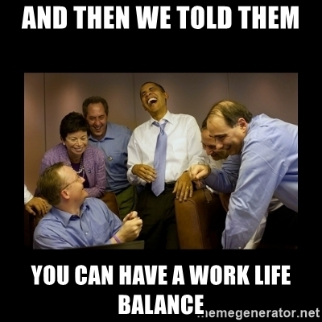

Do – Remember Work/Life balance

Slide 50
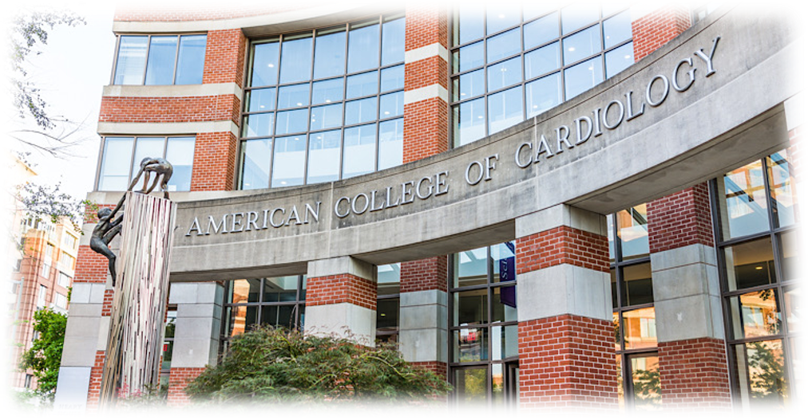
Don’t – Forget about
Your Professional Home

