Slide 1
Applying for Cardiology Fellowship:
Insights from Program Directors & Trainees
Thursday, June 2nd, 7:00 pm-8:30 pm
Sponsored by the PDGME and FIT Member Sections
Notes:
Kimarie to talk here and introduce the program

Slide 2
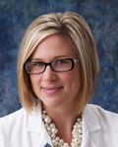
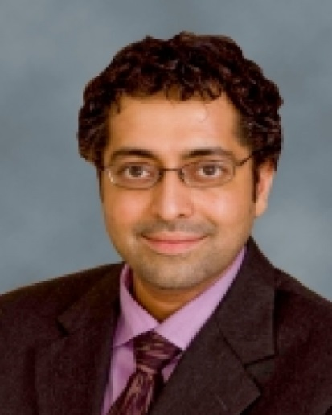
Moderators
Program Moderators:
Lisa Rose-Jones, MD, FACC, Program Director at University of North Carolina
Harsimran Singh, MD, FACC, Program Director at New York Presbyterian-Weill Cornell
Notes:
Kimarie to talk and introduce moderators

Slide 3
Program Overview
Fellowship Application Timeline
So, You’ve Decided to Apply to Cardiology: What are Programs Looking For?
Virtual Interview Etiquette
Best Practices for an In-Person Interview
FIT Council Introduction
Cardiology Applicant Mentorship Program
Best Practices for Clear Communication with Program Coordinators
Ask the Experts Panel Discussion
Notes:
Lisa Rose Jones to talk here and welcome people to the program

Slide 4
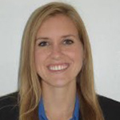
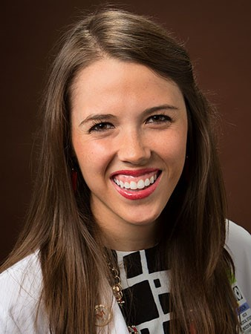
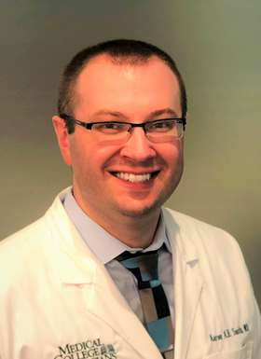
Digital Moderators
Chat Moderators:
Emily Zern, MD, FIT Council Chair
Carson Keck, MD, FIT Council Member
Aaron Smith, MD, FIT Council Member
Notes:
Lisa Rose Jones talking during this slide and introduce the moderators

Slide 5
Adult Cardiology Fellowship Timeline
Carson Keck, MD
General Cardiology
Medical University of South Carolina
No disclosures
Notes:
Simran talking here to introduce Carson

Slide 6
Application Timeline
June 8, 2022: ERAS 2022 season begins!
June 9, 2022: Applicants can register in myERAS and start working on applications
July 6, 2022:Applicants can begin submitting applications
July 20, 2022: Fellowship programs can begin reviewing applications
September 28, 2022: Rank order lists open
November 16, 2022: Rank order list deadline
November 30, 2022: Match day!
Notes:
Carson Talking here

Slide 7
Particulars of the 2023 Match
Delay for programs to review applications removed
Programs will begin reviewing 7/20 rather than in August
Normal interview season duration
Application season will likely be a combination of virtual and in-person
Notes:
Carson Talking here

Slide 8
Real Timeline
July 16th – Completed ERAS application
July 30th – First Rejection
July 30th – First Interview Invitation
August 8th – Last Letter of Recommendation Uploaded
September 13th – First Interview
October 15th – Last Interview
November 12th – Certified Rank Order List
November 28th - Matched
Notes:
Carson Talking here

Slide 9
Pre-Interview Tips
Make sure all components are uploaded to MyERAS by 7/20:
Personal Statement
PD LoR and 3 supplemental LoRs
Medical School Transcript/Dean’s Letter (MSPE)
USMLE Transcripts
Photo
Have friends, family and colleagues review personal statement
Interview season is dynamic: have PD and faculty advocate for interviews and advocate for yourself
Make sure you known your application inside and out
Coordinate coverage with colleagues early
Notes:
Carson Talking here

Slide 10
Post Interview Tips
Consider sending ‘Thank You’ notes/emails
Don’t read too much into post interview communications
Remember to register for NRMP ID
Ask current fellows about programs you are interested in
Talk over your rank list with friends/family and don’t make changes immediately before submission
Notes:
Carson Talking here

Slide 11
So, You've Decided to Apply to Cardiology: What are Programs looking for?
Notes:
Lisa to talk here

Slide 12
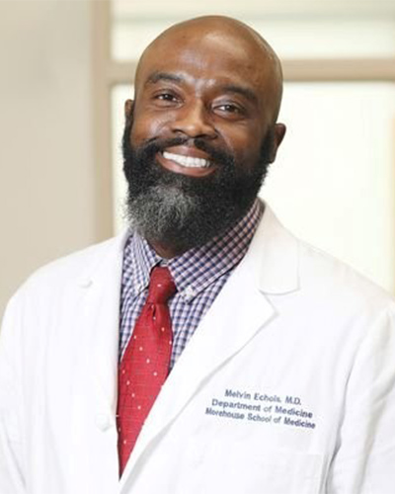
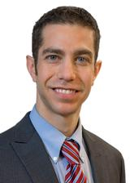
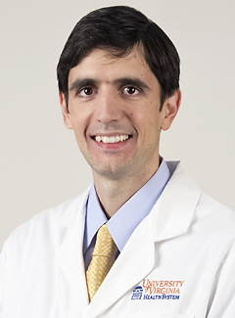
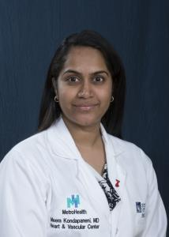
Melvin Echols, MD, FACC, PD at Morehouse School of Medicine
Benjamin Freed, MD, FACC, PD at Northwestern University
Victor Soukoulis, MD, FACC, PD at , University of Virginia
Meera Kondapaneni, MD, FACC, PD at MetroHealth/Case Western Reserve
Notes:
Lisa to introduce panelists. You can take down the slides after they are introduced and while the panel is speaking.

Slide 13
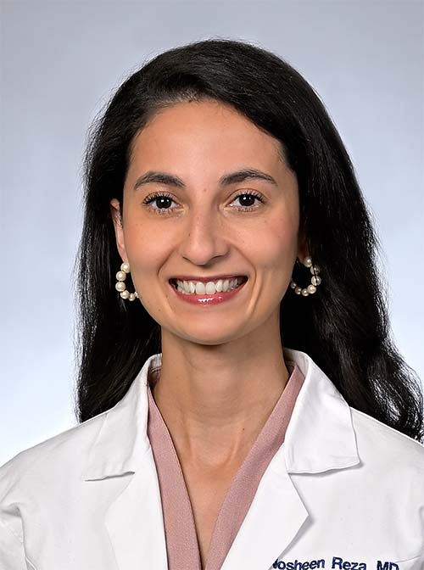
Best Practices for the
Virtual Fellowship Interview
Nosheen Reza MD, FACC, FHFSA
Assistant Professor of Medicine
Penn Center for Inherited Cardiovascular Disease
Section of Advanced Heart Failure, Transplantation, and Mechanical Support
Assistant Program Director, Cardiovascular Disease Fellowship
Director, Penn Women in Cardiology Program
@noshreza
Notes:
Simran to introduce Nosheen.

Slide 14
Objectives
General best practices for the virtual interview
How to prepare in advance
What to expect
How to bring “your best self”
@noshreza
Notes:
Nosheen will be talking through these slides
General best practices for the virtual interview
How to prepare in advance
What to expect
How to bring “your best self” for the interview

Slide 15
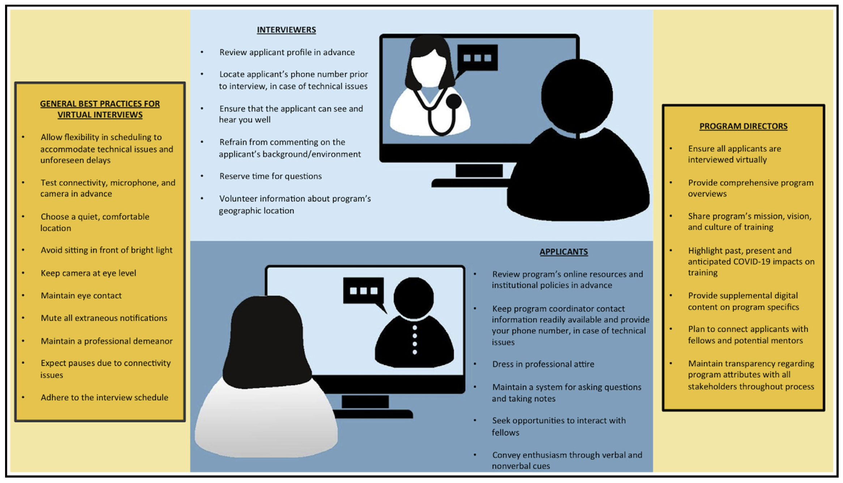
Reza N et al. JACC Case Reports 2020
@noshreza
Notes:
Nosheen will be talking through these slides

Slide 16
Plan for a flexible schedule on interview day
Avoid being on-call/working a shift
Reza N et al. JACC Case Reports 2020
@noshreza
Notes:
Nosheen will be talking through these slides

Slide 17
Can the interviewer see you? Hear you?
Trial run your desk, light, mic, camera set up
Is the lighting ok throughout the day?
Is the wifi fast enough?
Does your program provide reserved space?
Have a backup device plan
Reza N et al. JACC Case Reports 2020
@noshreza
Notes:
Nosheen will be talking through these slides

Slide 18
Minimize and mute distractions
Be on time, if not early, to each interview
Reza N et al. JACC Case Reports 2020
@noshreza
Notes:
Nosheen will be talking through these slides

Slide 19
Expect hiccups!
Wrong Zoom rooms, interviews running overtime, last minute schedule changes
Reza N et al. JACC Case Reports 2020
@noshreza
Notes:
Nosheen will be talking through these slides

Slide 20
Reza N et al. JACC Case Reports 2020
@noshreza
Notes:
Nosheen will be talking through these slides

Slide 21
Dress the part
Maintain eye contact with the camera
Use nonverbal cues to convey interest, enthusiasm
Have program coordinator contact information readily available
Reza N et al. JACC Case Reports 2020
@noshreza
Notes:
Nosheen will be talking through these slides

Slide 22
Review program websites, social media accounts
Look up your interviewers
Know your CV, ERAS, personal statement, research, narrative
Have questions prepared
Take breaks!
Reza N et al. JACC Case Reports 2020
@noshreza
Notes:
Nosheen will be talking through these slides

Slide 23
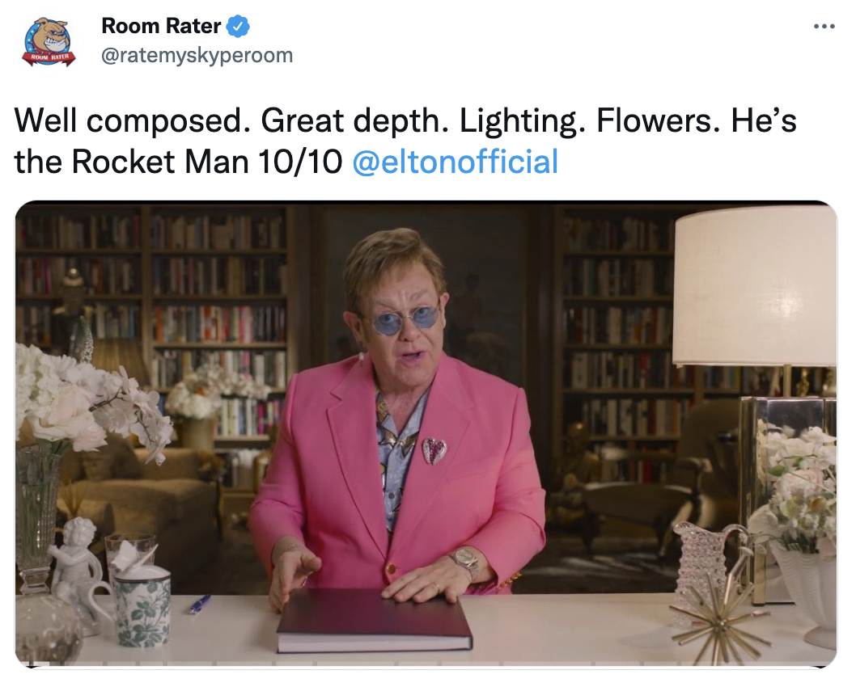
Have fun!
@noshreza
Notes:
Nosheen will be talking through these slides

Slide 24
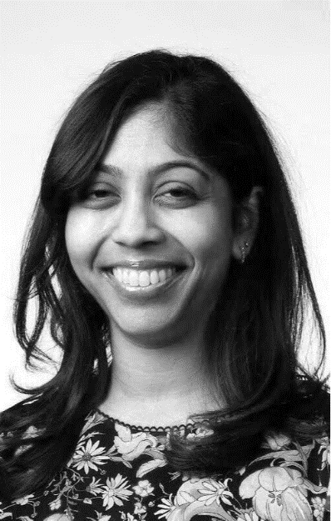
Best Practices for the In-Person Interview
Lakshmi Tummala, MD, FACC
Assistant Professor of Medicine
Emory University School of Medicine
Notes:
Lisa to introduce. After this slide, we can take down the slide deck while Lakshmi presents.

Slide 25
Introduction to the FIT Council
Emily Zern, MD
FIT Council Chair
Cardiology/Critical Care Fellow At Mass General
Notes:
Simran to introduce

Slide 26
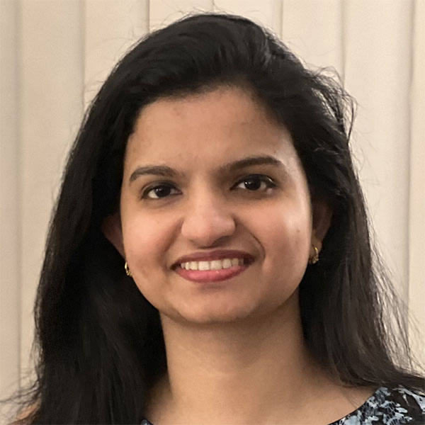
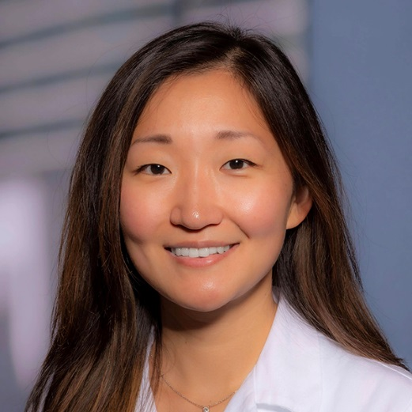
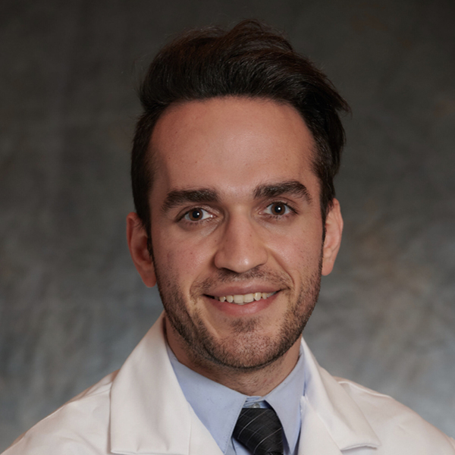
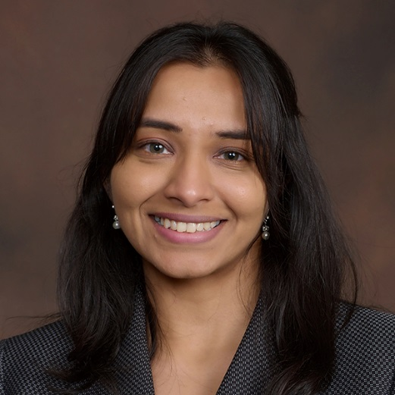
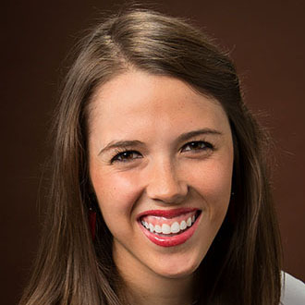
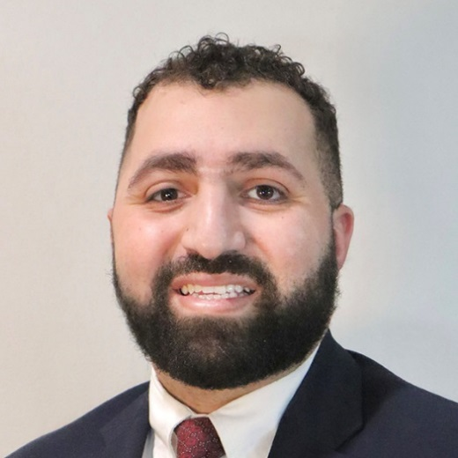
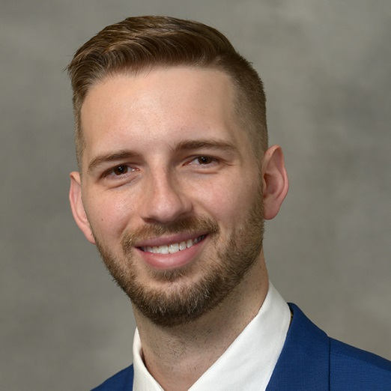
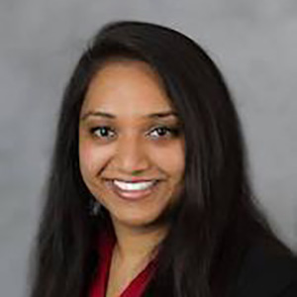
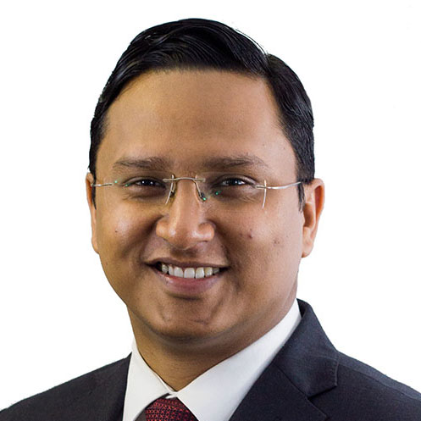
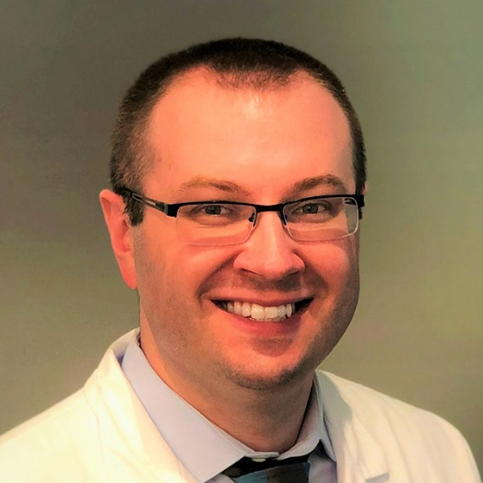
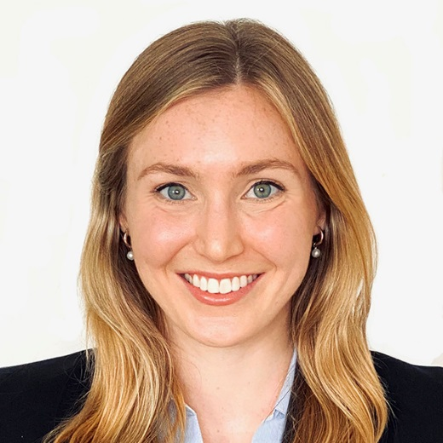
Current FIT Council
Sonu Abraham, MD
Lahey Hospital & Medical Center
HJ Ryoo Ali, MD
Houston Methodist Hospital
Omid Amidi, MD
UCLA
Tripti Gupta, MD
Ochsner Medical Center
Carson Keck, MD
MUSC
Mo Khattab, MD
University of Oklahoma
Ryan Mallory, MD
Indiana University
Ashley Patel, MD
Baylor
Shubha Deep Roy, MD
University of Iowa
Aaron Smith, MD
Medical College of Wisconsin
Jenna Spears, MD
Lankenau Medical Center
Emily Zern, MD
Mass General
Ashley Patel, MD
Baylor
Notes:
Emily to talk here

Slide 27
Cardiology Applicant Mentorship Program
Aaron Smith, MD
FIT Council Member
Fellow in Cardiovascular Disease
Medical College of Wisconsin
Notes:
Simran to introduce aaron

Slide 28
Notes:
Aaron to talk

Slide 29
Cardiology Applicant Mentorship Program
A highly popular program started in 2020
Each applicant (you!) will be paired with a cardiology fellow/recent graduate from a separate institution
Your mentor will contact you directly at which time we will ask that you given them your CV and personal statement for review
Your mentor will also conduct a ~30-minute mock interview via video-conferencing software
After your interview, your mentor will provide feedback followed by additional time for questions about the interview process
Notes:
Aaron to talk

Slide 30
Join the ACC as a Medical Resident
https://www.acc.org/membership/
join-us/trainees-students
Notes:
Aaron to talk

Slide 31
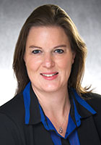
Best Practices For Clear Communication With Program Coordinators During Interview Season
Cari Harland
ACC FACET Chair
Cardiology Fellowship Coordinator
University of Iowa
Notes:
Lisa to introduce Cari

Slide 32
Etiquette for Telephone, Email and ERAS communication
Notes:
Cari to present

Slide 33
Read the interview invitations in detail, some may go into depth more than others
For Example,
University of Iowa virtual invitation will include:
Interview Dates
How to schedule your interview
How many applicants we plan to interview per session
Time zone converter
Length of each interview
Number of interviewers
Link to our program website
Includes videos about living in Iowa City
Interview platform that we plan to use
Zoom, Thalamus, Microsoft Teams, WebEx
Notes:
Cari to present

Slide 34
Reply to email/ERAS communication promptly
Some programs may send out invites one week and start interviews the next week
For in person interviews, we would send out invites 2-3 weeks before the first interview to allow applicants time to make travel arrangements
Some programs may provide more details in confirmation, if interviewing in person
Hotels near the hospital
Nearby airports with distance to Iowa City
Notes:
Cari to present

Slide 35
Keep calls to program coordinators to a minimum
Each program has their own internal timeline
Our program receives around 500 applications per year, it takes time to get through them all
Check program’s website for target date to send out interview invitations
Notes:
Cari to present

Slide 36
Communication Before Interview Day
Notes:
Cari to present

Slide 37
Confirmation of the interview date
Tips for successful virtual interview day
Interview Schedule will be sent with zoom link/other interview platform information
Program Welcome
Confirmation of phone number in case there are technological issues on interview day
If you need to cancel your interview, please do so in a timely manner
Notes:
Cari to present

Slide 38
Advice for Interview Day
Notes:
Cari to present

Slide 39
Use your first and last name when you log in for your interview
Be on time/not too early
Make sure your mic/camera are working properly
Make sure you have a reliable internet connection
Dress as if you were in an in-person interview
Interview in an area free of distractions
If you are not comfortable with the program’s interview platform request a trial run
If you turn off your camera, communicate with the program coordinator
Notes:
Cari to present

Slide 40
What a Virtual Interview Day Will Look Like at the University of Iowa
Notes:
Cari to present

Slide 41
We will interview 6 applicants per half day session with a total of 10-12 sessions
Morning sessions start at 8:30 AM, afternoon sessions start at 1:00 PM
Log into zoom 10 minutes before start time
Short welcome by program director 5 minutes before start time
Directions on how you will virtually be moved around to each interview
Will be 5-6 interviews
Chat session with fellows which includes information on calls/rotations in our program
Notes:
Cari to present

Slide 42
What an In-Person Interview Day Will Look Like at the University of Iowa
Notes:
Cari to present

Slide 43
Pre-interview dinner the night before downtown Iowa City
Arrive at the hospital between 7:30 and 8:00 AM CST
Full or half day interviews
Interview with at least 4 faculty
Tour of the hospital
Lunch with current fellows
Some programs may have you join in on a conference
Notes:
Cari to present

Slide 44
After Interview Day
Notes:
Cari to present

Slide 45
Set up additional interviews if needed
Additional question and answer sessions with fellows
After interview are complete
In place of pre-interview dinners
Post-interview happy hours
Thank you note
Notes:
Cari to present

Slide 46
In closing, remember:
Be patient
We are all in this together
Read every line of emails you receive from programs
Notes:
Cari to present

Slide 47
Ask the Experts Panel Discussion
Harsimran Singh, MD, FACC, PD at New York Presbyterian-Weill Cornell
Melvin Echols, MD, FACC, PD at Morehouse School of Medicine
Benjamin Freed, MD, FACC, PD at Northwestern University
Victor Soukoulis, MD, FACC, PD at , University of Virginia
Meera Kondapaneni, MD, FACC, PD at MetroHealth/Case Western Reserve
Nosheen Reza, MD, FACC
APD at
University Of Pennsylvania Medical Center
Notes:
Lisa to introduce the program. After the panelists are presented, we can take down the slide deck

Slide 48
Sign Up for the Cardiology Application Mentorship Program
https://accmembership.wufoo.com/forms/2022-mock-interview-application-for-residents/
Notes:
Kimarie to talk as we progress through these slides

