Slide 1
Challenging Cases with New Approaches: Perspectives from Around the World
Brought to you by the Early Career International Work Group

Slide 2
Moderators
Auras R. Atreya, MD, MPH, FACC
AIG Institute of Cardiac Sciences and Research, India
Poojita Shivamurthy, MD
Louisiana Heart Rhythm Institute, USA

Slide 3
Learning Objectives
Learn about new technologies and techniques in electrophysiology
Learn about managing change in your clinic
Know the challenges of introducing new methods

Slide 4
Faculty
Dhanunjaya (DJ) R. Lakkireddy, MBBS, FACC
Kansas City Heart Rhythm Institute, KS, USA
Pamela Mason, MD, FACC
University of Virginia - School of Medicine, VA, USA
José Carlos Pachón, MD, PhD
São Paulo University, Brazil
Kevin Vernooy, MD, PhD
Maastricht University, The Netherlands

Slide 5
Case Presenters
Sotirios Nedios, MD, PhD, FACC
Assistant Professor of Medicine, Cardiology-Electrophysiology
Heart Center, University of Leipzig, Germany
Miriam Gravellone, MD
Division of Cardiology, Infermi Hospital
Biella, Italy

Slide 6
Agenda
Introduction
Ablation for Refractory Syncope: Can we cure fainting?
Sotirios Nedios, MD, PhD, FACC
Discussion with Questions and Answers
Physiological Pacing: New Ways for an Old Problem
Miriam Gravellone, MD
Discussion with Questions and Answers

Slide 7
Sotirios Nedios, MD, PhD, FACC
Assistant Professor of Medicine, Cardiology-Electrophysiology
Heart Center, University of Leipzig, Germany

Slide 8
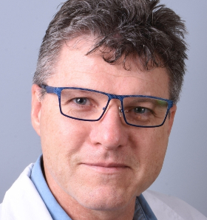
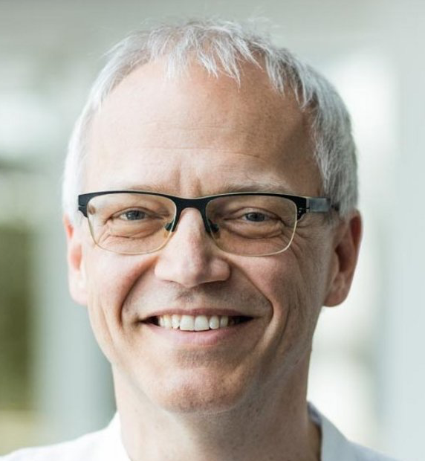
Dan Wichterle, MD, PhD
Roman Gebauer, MD
Associate Professor, Prague, Czech Republic
Institute for Clinical & Experimental Medicine
Pediatric Cardiologist/Electrophysiologist
Heart Center, University of Leipzig, Germany

Slide 9
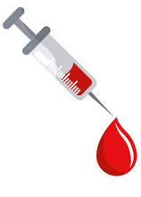
#RF4Syncope: Can we cure fainting?
15 year old boy
Fainting every time he sees OR talks about blood
Last episode during Biology class
No other health problems

Slide 10
Pause by i.v. access

Slide 11
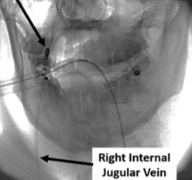
Vagal stimulation
30 Hz (1.800/min)
0.5-1.0 V/kg,
max. 70V@0.05ms
5s
without RA pacing
with RA pacing

Slide 12
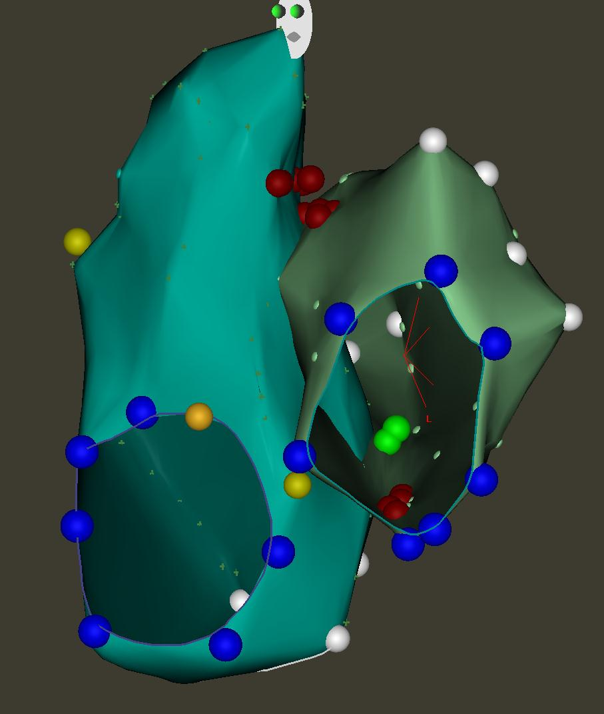
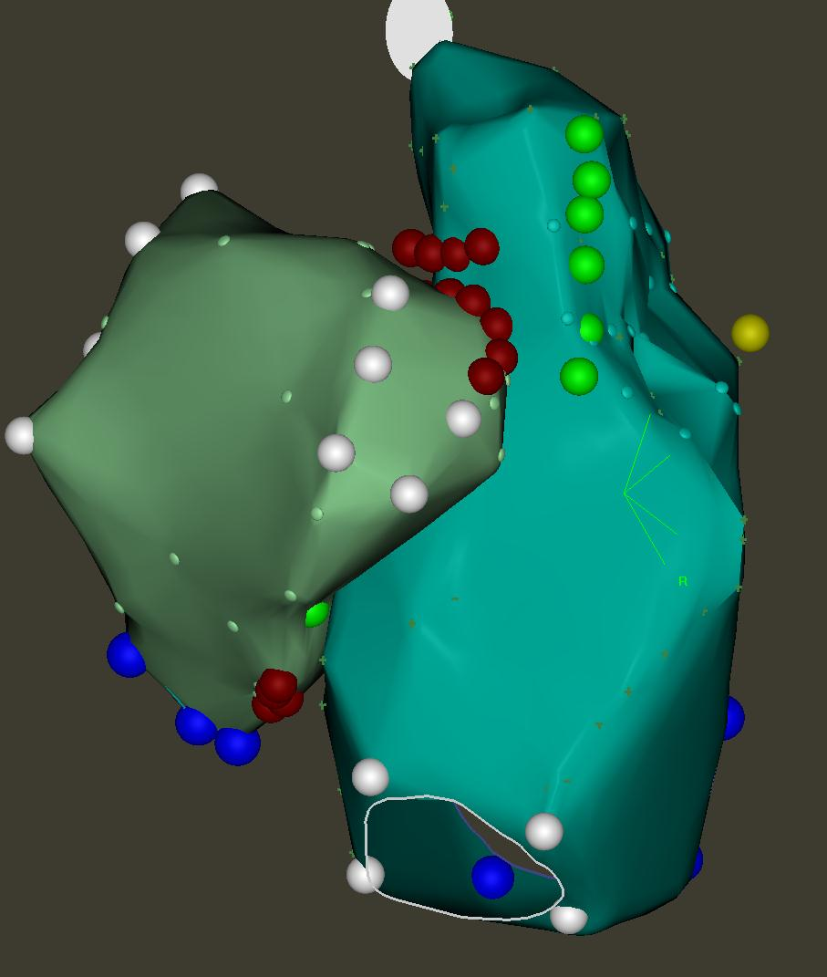
RF-Ablation in RA
A
B
C

Slide 13
Vagal stimulation after RF in RA
5s

Slide 14
RF-Ablation in LA
A
B
C

Slide 15
Vagal stimulation after RF in RA+LA
5s

Slide 16
Follow-up after RF ablation
12 months without any symptoms, not even in provocative situations (no nausea/discomfort)
Holter | before | after | @ 12 months
min. HR | 41 | 76 | 55
mean HR | 70 | 84 | 85
max. HR | 108 | 106 | 164

Slide 17
Challenges
How to choose the right patient?
Where/how to perform vagal stimulation?
Can we do without it? Is HR a good endpoint?
What if RF does not eliminate the response?
Long-term effect of sympathetic hyperactivity?

Slide 18
Questions?

Slide 19
Miriam Gravellone, MD
Division of Cardiology, Infermi Hospital
Biella, Italy

Slide 20
Physiological pacing: the patient
70 year old male with HTN, DM2, HLP
PVI 2018, Re-Do 2019→ rate control (perm. AF)
Metoprolol 100 mg bid; Diltiazem 60 mg tid; Apixaban 5 mg bid
Recurrent hospitalizations →
PACE & ABLATE

Slide 21
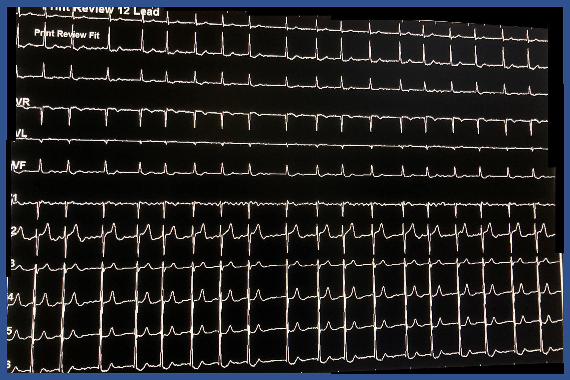
Decision: RVA vs. His-Bundle pacing
Narrow QRS: 105 ms
Preserved LV-EF: 58%
Expected pacing: 100%
RVA vs. HB pacing

Slide 22
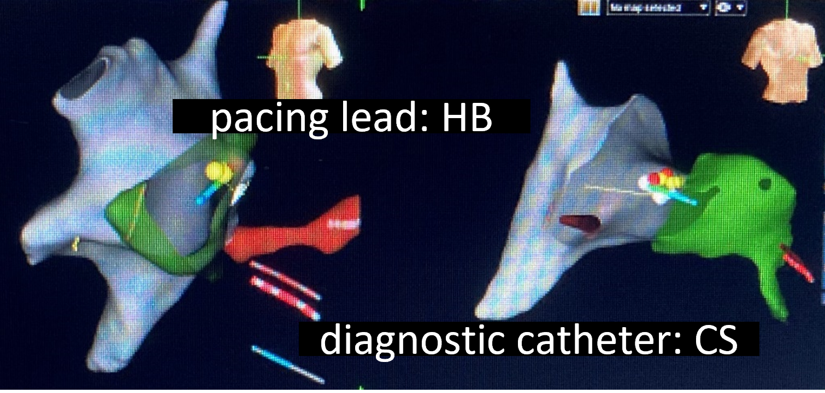
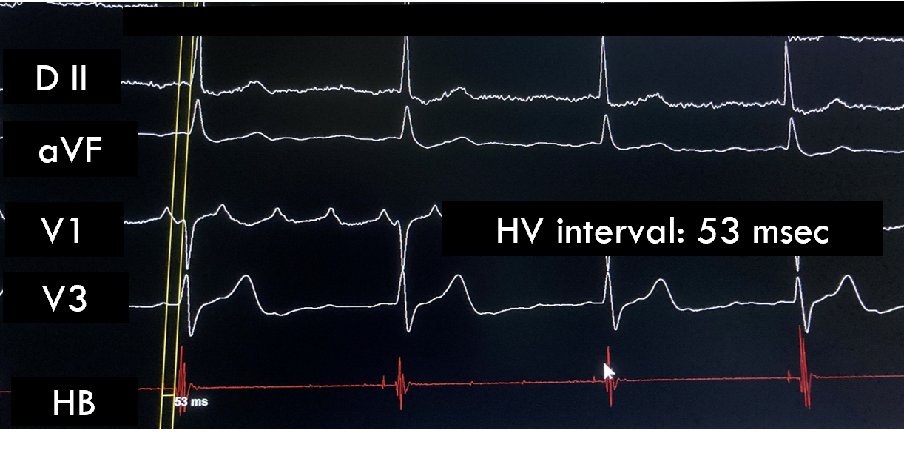
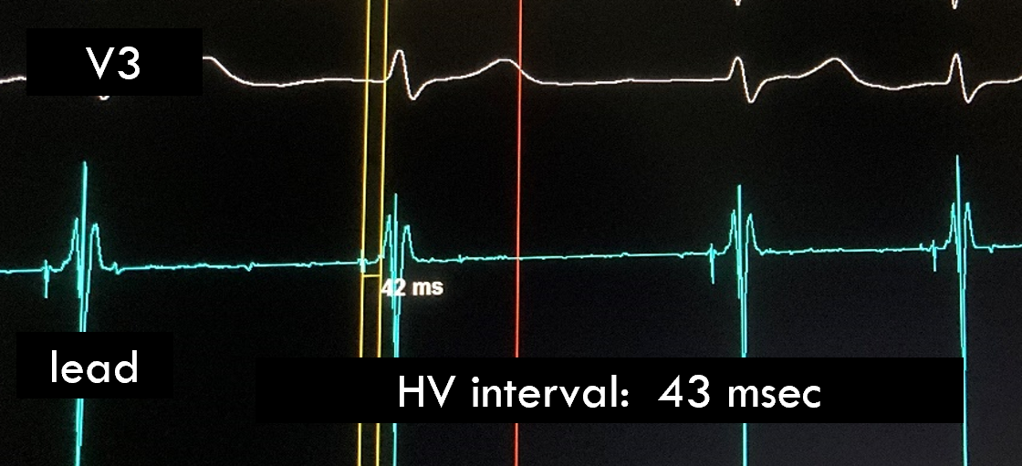
Challenge: How to pace His bundle?
1st Step: diagnostic catheter
2nd Step: pacing lead Tendril™ (Abbott)
Sensing:
5 mV
Impedance:
500 Ohm
Threshold:
1.25V x 1.5 ms
1
3
plus
backup
apical lead
2
4

Slide 23
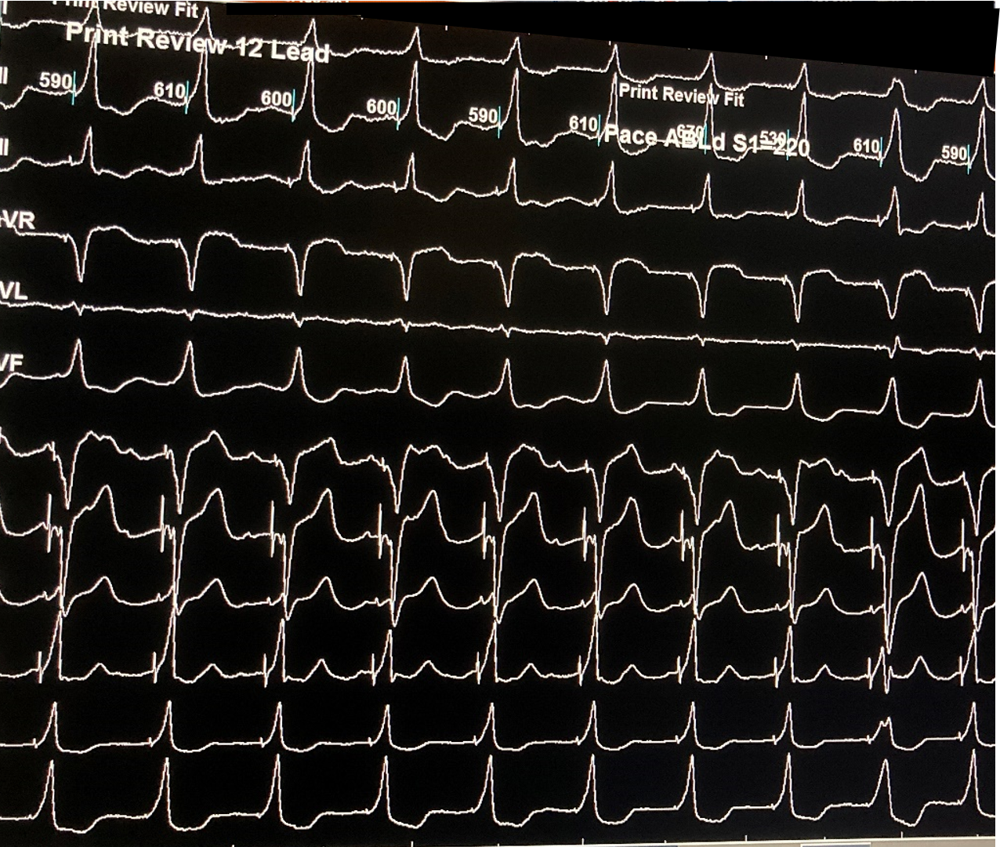
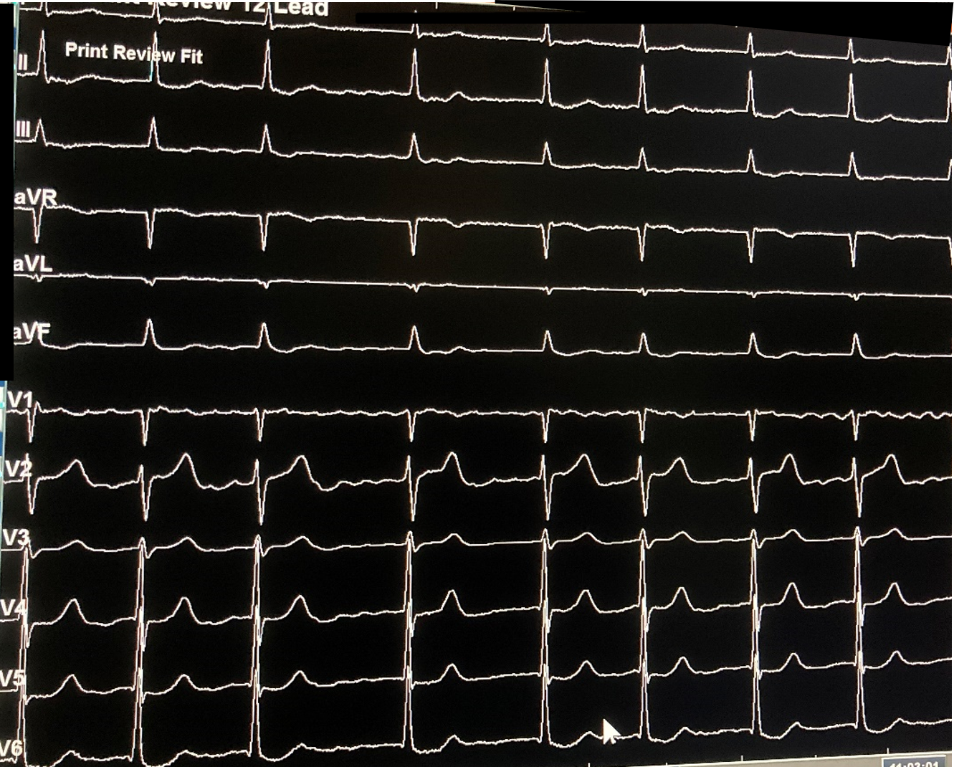
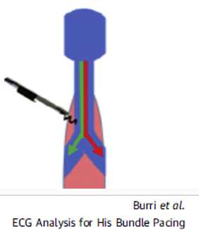
Challenge: selective vs. non-selective HBP
Paced QRS
Native QRS
QRS: 110 ms
pseudo-delta wave,
QRS axis concordance

Slide 24
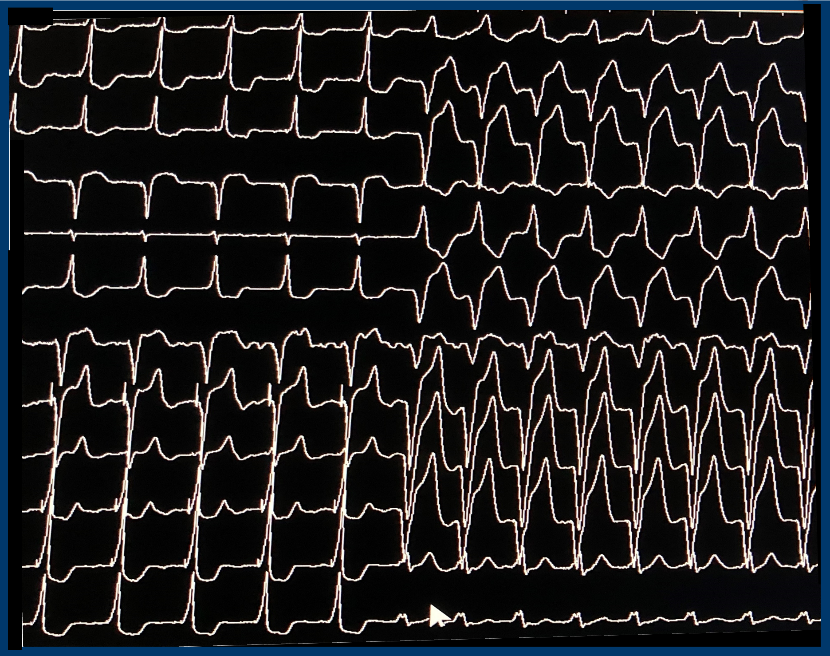
Challenge: selective vs. non-selective HBP
Paced QRS: threshold test/reducing output
Native QRS

Slide 25
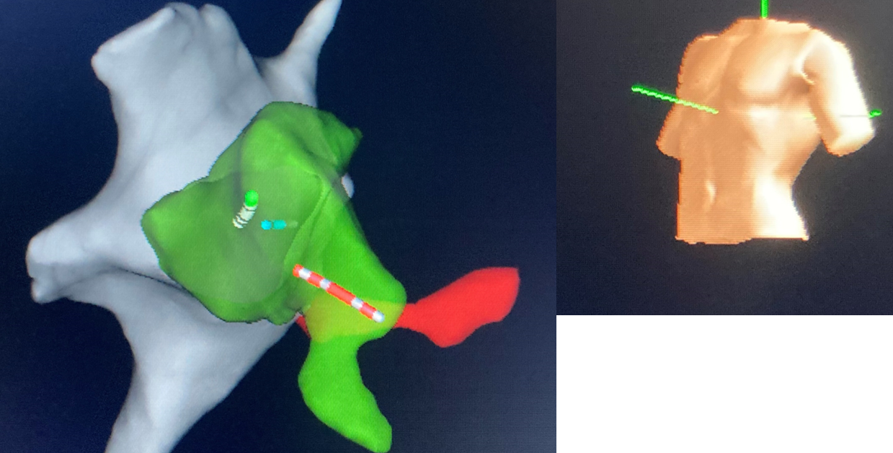
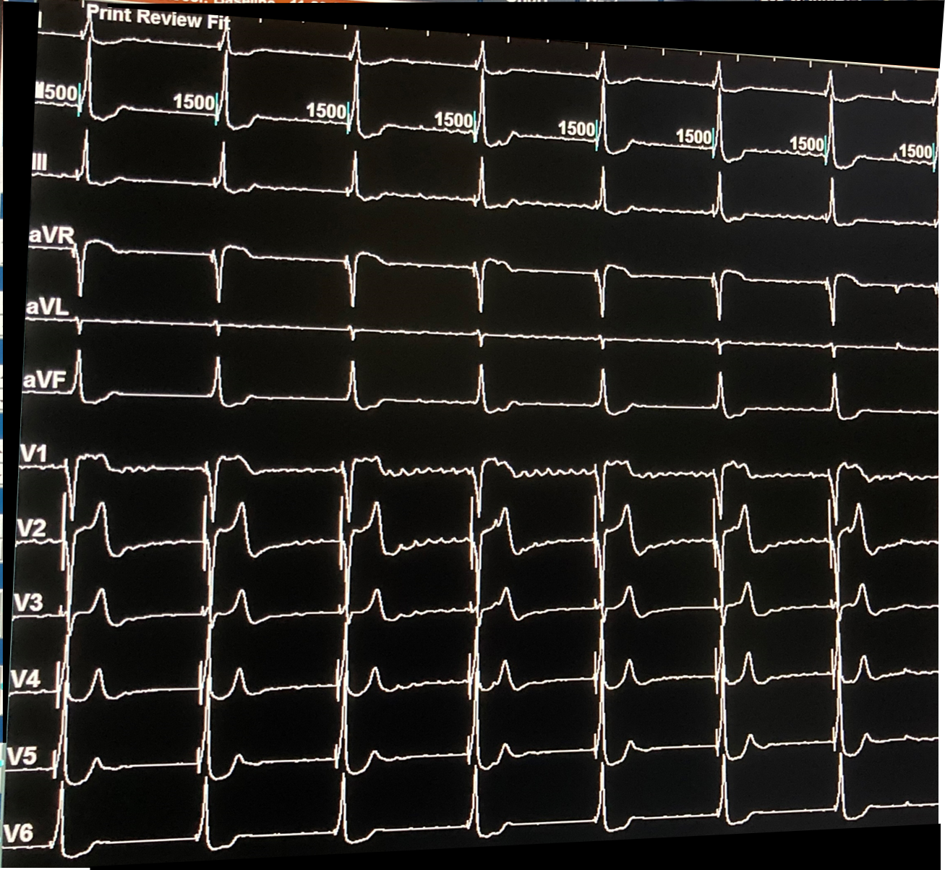
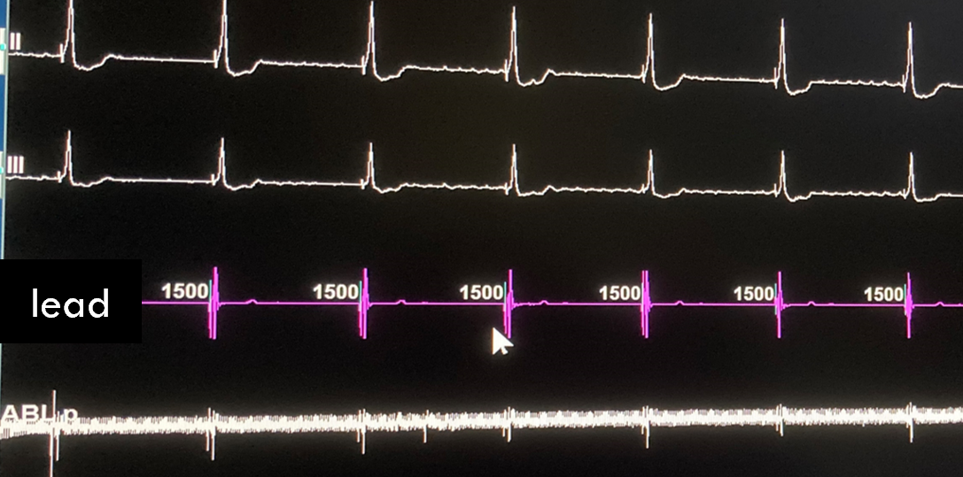
Challenge: AV junction ablation
3
1
2

Slide 26
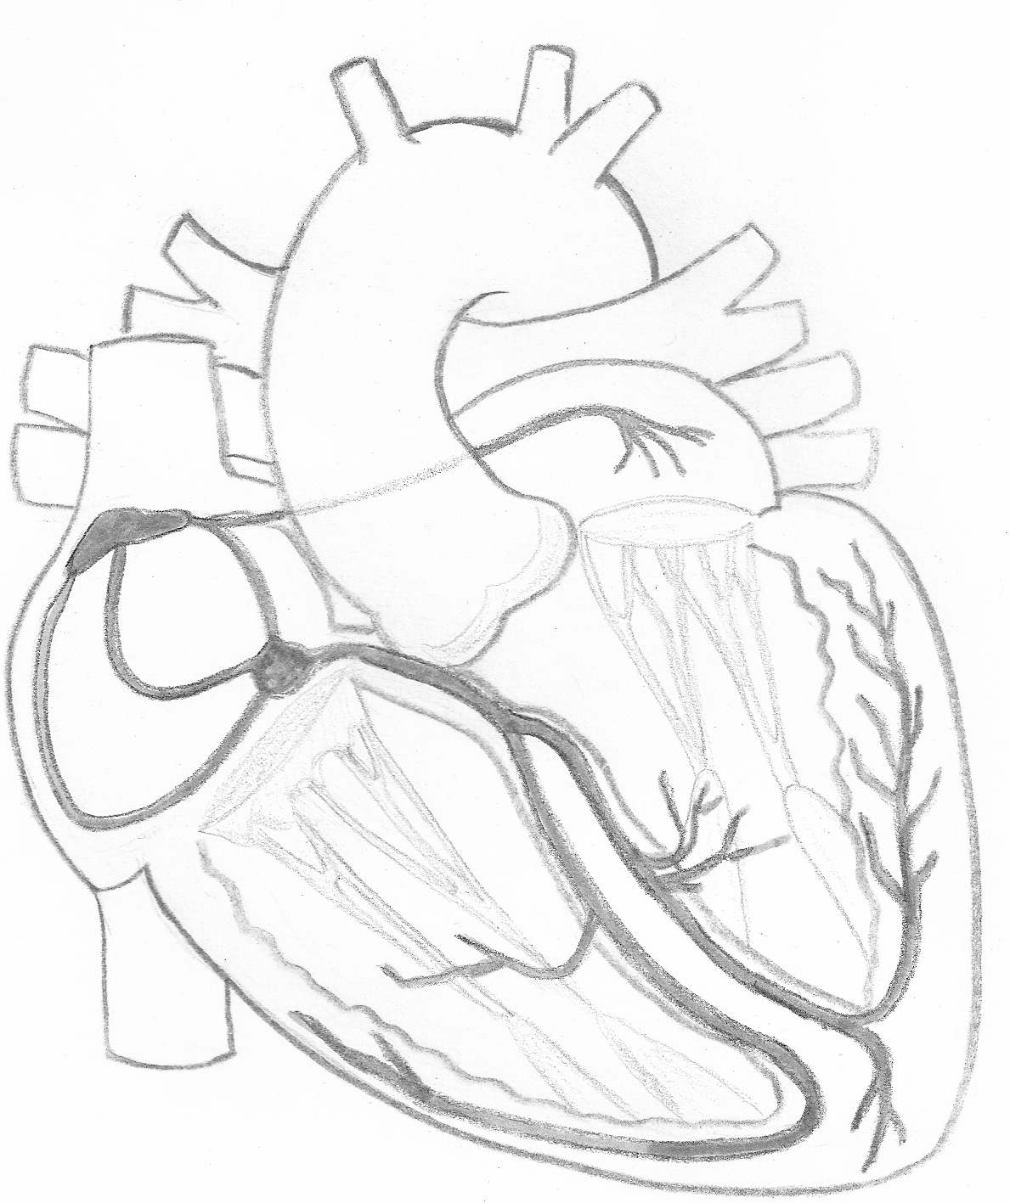
Challenge: device programming
DDDR pacemaker
HB lead connected to atrial port
RVA lead connected to ventricular port
TROUBLESHOOTING
Avoid oversensing→ sensing only on RVA lead
Avoid unnecessary RVA pacing→ optimized AV delay
Avoid battery consumption→ optimized capture (automatic off)
DVIR 60/min (48 Hour periprocedural: DVI 80/min)
AV delay 90 msec → Ap 97%, Vp 1,5%
HB lead capture: 3,5 V x 1,5 msec
RVA lead capture: 2,5 V x 0,5 msec

Slide 27
Questions?

