Slide 2
Teaching the Teacher: Lectures
Lakshmi S. Tummala, MD FACC
DC VA Medical Center
Assistant Professor, Georgetown University School of Medicine
May 2020
No disclosures
With input from: Parul U. Gandhi, MD FACC and Nicolas Thibodeau-Jarry, MD MMSc
Notes:
(Hello! My name is Lakshmi Tummala, and I am an academic cardiologist with a strong interest in medical education. I’m thrilled to be working with ACC’s CV Training section to bring you this Teaching the Teacher series, geared towards fellows interested in pursuing academic/teaching careers. The slide decks are designed to be interactive – however you end up using them, fellows, I hope they are helpful to you as you refine your own teaching skills sets.)
Teaching the teacher: Lectures
Didactic lectures are an integral part of medical education, from Grand Rounds to noon conferences to national meetings. Though the scope varies, they are always an excellent opportunity to share knowledge. Done correctly, an hour can transmit a wealth of information, but done poorly, it is a waste of time for both the instructor and the audience. We’ll go over some key components of a good lecture, as well as point out common pitfalls to avoid, during this discussion.

Slide 3
ACC Resources
Faculty Development Center
“The Art of Presentation”
https://www.acc.org/education-and-meetings/products-and-resources/faculty-development; JACC 2015;65(12):1373-1376
Notes:
First, though, I want to make sure you are aware of some ACC resources that are available to you on this topic.
PROMPT
The first is the Faculty Development Center. It’s got lots of practical tips as well as many illustrative examples that can really help you improve your teaching and presentations, so definitely check it out.
PROMPT
And the second is this JACC article from 2015 entitled “The Art of Presentation” with an accompanying commentary. Again, it is full of specific recommendations, and I would suggest re-reading it every time you start putting a lecture together.

Slide 4
Before the lecture
Notes:
Generally speaking, for a one hour lecture, it takes 6-10 hours to prep, assuming some familiarity with subject matter content. Putting together a good didactic lecture cannot be rushed, so plan accordingly. Here are some other things to consider:

Slide 5
Needs Assessments
Teacher goals = learner goals
Can be formal or informal
Formal example: questionnaire
Informal example: sentence completion
Curriculum Development for Medical Education 2016
Notes:
Number one – do you need to do a needs assessment? Needs assessments are often done before giving a lecture, starting a course, or developing a new program of study. They offer the instructor an opportunity to ensure a good match between teacher goals and learner goals. They also help assess the current status of learners with respect to their knowledge base or interest, for example.
Needs assessments can range from a test or questionnaire administered over email a month in advance to a brief statement at the beginning of a lecture. They are helpful because they allow for individualization and prioritization of learning goals and objectives. They also minimize waste (i.e. time spent on things the audience already knows). On the other hand, they take time and forethought to administer, and when done informally, can require the capacity for on-the-fly adjustments by the lecturer.

Slide 6
Learning Objectives
Learning goals
Diagnose aortic stenosis
Learning objectives
By the end of the hour, as assessed with a checklist, fellows will be able to list three echocardiographic criteria to characterize severe aortic stenosis
J Educ Perioper Med 2017;19(4):E610
Notes:
Number two – what are your learning objectives for this lecture? Learning objectives are different from learning goals, and what we often see listed as objectives are actually goals, so let’s take a minute to review the difference.
A learning goal is “a broad statement of an expected learning outcome of a course or curriculum” and it ”provide[s] a vision for the future and often summarize[s] the intention or topic area of several learning objectives.” Versus, a learning objective is “a description of what the learner must be able to do upon completion of an educational activity.” These definitions are from this Chatterjee article cited here.
PROMPT
You can think of a learning goal as the broad, overarching heading, like “diagnose aortic stenosis,” while the objectives are the specific components that fall underneath it – PROMPT – such as, “By the end of the hour, as assessed with a checklist, fellows will be able to list three echocardiographic criteria to characterize severe aortic stenosis.”

Slide 7
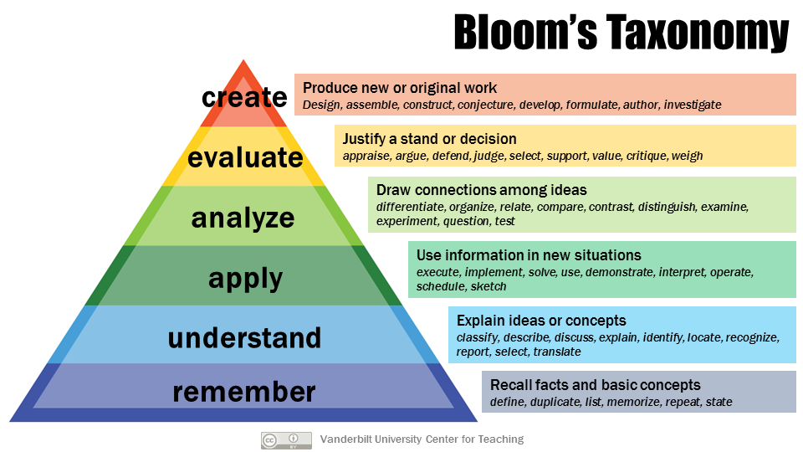
Learning Objectives
SMART criteria
Specific
Measureable
Attainable
Relevant
Timely
Bloom’s Taxonomy
J Educ Perioper Med 2017;19(4):E610; https://cft.vanderbilt.edu/guides-sub-pages/blooms-taxonomy/
Notes:
In writing learning objectives for your lecture, use the SMART criteria. Your objectives should be specific, measureable, attainable, relevant, and timely.
PROMPT
What you ask your learner to do will depend on their pre-existing knowledge and level of learning. For a medical student lecture, your objective might be for them to list the components of typical angina, whereas for a senior resident lecture, it might be to compare and contrast management of a STEMI versus an NSTEMI. This difference in tasks – list versus compare/contrast – brings us to Bloom’s taxonomy, a helpful hierarchy that orders the level of thinking and processing required to learn and retain.

Slide 8
PowerPoint slides
Black/white or yellow/blue color scheme
No distractions
Limited text (minimum size 24 font)
Good quality pictures
Notes:
Number three: what are the core tenets of using PowerPoint?
Let’s take some time to think about lectures you have attended which were good. With respect to slides, what did the presenter do well? What did not help you learn?
PROMPT
Here are some basic rules of utilizing PowerPoint slides: use a common color scheme with no distractions, limit your text, and opt for good quality pictures.
Less is more – stick with routine colors and backgrounds that are not too distracting, so the learner can focus on the text. Too much activity on the slides causes cognitive overload, which impedes the learner’s ability to process and retain information. This idea applies to animation as well: avoid anything fancy.
With respect to your text, make sure you’ve pared it down, and that it aligns with your spoken words. You don’t want to read off your PowerPoint slides, but you also don’t want the audience to listen to you saying one thing while the slides say something else. Use your written and verbal content to reinforce each other. Think about when you can turn a paragraph of text into a flowchart for easier digestion by the learner. Don’t include a slide with a lot of text and then apologize for it; instead, fix the slide when you make the presentation. In general, learners tolerate many slides with fewer text better than fewer slides with more text.
Finally, optimize your use of graphics. Pictures are great: they should be high-resolution, and clearly labeled and credited. Again, don’t include a picture with poor resolution and then apologize for it. If it’s that bad, take it out. If you include a graph, make sure the axes are clearly labeled and that the labels are physically close to what they represent (as stated in the Issa article).
I have to give credit here to Dr. Rachel Caskey at UIC who spoke on this topic at the Women in Medicine Summit in 2019 – many of these specifics came from her really excellent lecture.

Slide 9
Examples
Medical Education 2011;45:818-826
Notes:
Here are some examples of good slides on the right, and their not-so-good precursors on the left.
In this case, we can see how the presenter replaced blocks of texts with a simplified flowchart, making the slide much easier to process. Chunky phrases allow for complete reading and comprehension while still listening.

Slide 10
Examples
Medical Education 2011;45:818-826
Notes:
Here, again, text has been minimized, and there is a clear picture to go with each bullet point. Captions are appropriately spaced and labeled. Arrows emphasize the points of interest within the graphics.

Slide 11
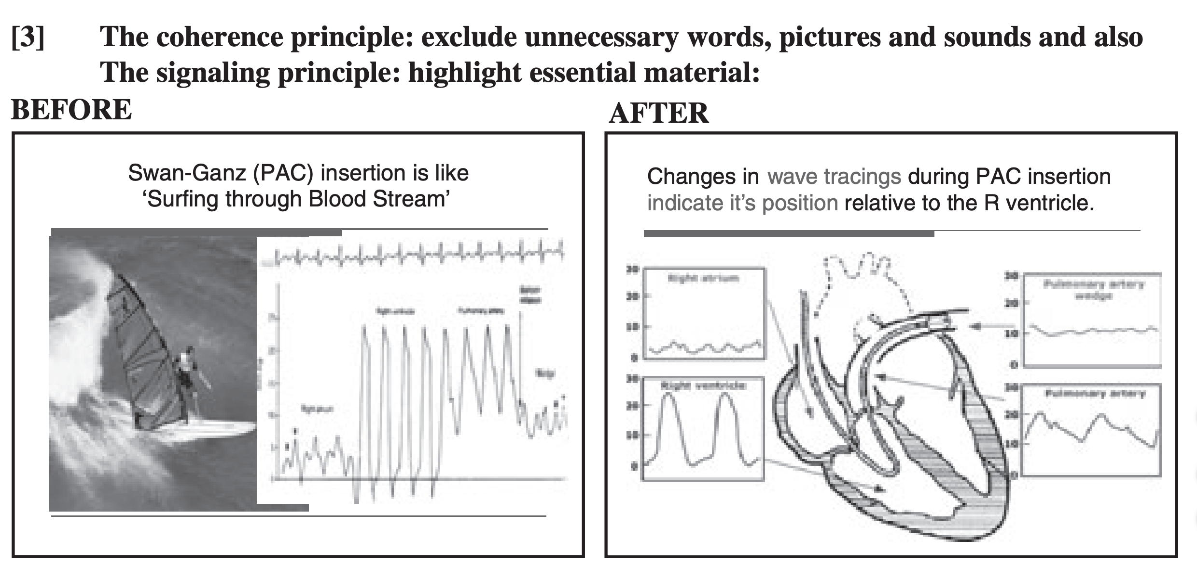
Examples
Medical Education 2011;45:818-826
Notes:
And finally, a third example. In this instance, extraneous information that does not help the learner (the surfing picture) has been removed, and instead reinforcement between RHC tracings and the location of those tracings is offered in the context of an anatomically correct heart sketch. Audience members will most likely have seen a picture of the heart before, so even if the right heart cath numbers themselves are new, this approach to lecturing allows the learner to build on his/her prior knowledge, thereby improving comprehension and retention. What still has room for improvement? The image quality of the heart and tracings on the right.

Slide 12
Ask for feedback
Needs assessment?
Learning objectives?
PowerPoint slides?
Feedback?
Notes:
Last but not least, number four of prepping for a lecture: who can you ask for feedback? When your slides are complete, and before you start practicing narration, ask someone you trust to look over your content. When you’ve really dived deep into material, it can be hard sometimes to step back, and in those scenarios, a fresh pair of eyes will always be helpful. Someone’s else’s input can ensure that your flow is good, that your take-home points are clear, and that you haven’t missed any typos.
PROMPT
To recap, in preparing your lecture, ask yourself these four questions. Do you need to do a needs assessment? What are your learning objectives? Have you optimized your PowerPoint slides? Did you incorporate your feedback?
You can see that we’re spending about half of this time on stuff that comes before the lecture. I cannot emphasize enough how important preparation is in delivering a good presentation, for you and for your learner.

Slide 13
During the lecture
Notes:
Okay, so now you’ve done the pre-work and you have an excellent set of slides and a prepared lecture.
What comes next? How can you present an engaging talk that will help your learners learn?

Slide 14
Questions for discussion
Should didactic lectures be part of med ed?
What makes a lecture engaging?
What makes a journal club engaging?
Should you call on people by their names?
What is the optimal way to end a didactic lecture?
How can we better utilize cases in lectures?
What do you remember best after a lecture?
Notes:
Again, let’s think about past lectures you have attended. I’ve put together some discussion questions here – remember that for many of these prompts, there is no single right answer. It’s actually a really exciting time to be in medical education in that we are restructuring some of how we have traditionally approached the task of noon conference. Most of you know by now how you learn best; this group is a great opportunity to get some insight into how others learn, too.
With all that in mind, here are some questions:
PROMPT – Should didactic lectures even be part of medical education?
PROMPT – How can we better utilize cases in lectures?
PROMPT – What else makes a lecture engaging? What about for journal club?
PROMPT – Should you call on people by their names during a lecture?
PROMPT – What is the optimal way to end a lecture? What do you remember best?
<After discussion>
Great. I’d like to delve a little more now into two topics related to lectures: active learning and multimedia in presentations.

Slide 15
Active learning
Case-based learning
Think-pair-share
Role Play
Jigsaw
Pause procedure
Concept maps
Simulation
Problem- or team-based learning
Medical Teacher 2007;29:38-42; The Journal of Emergency Medicine 2015;48(1):85-93; Western Journal of Emergency Medicine 2016;17(3):337-343
Notes:
What is active learning, exactly? As the name suggests, it is a category of teaching techniques and tools that aim to engage the learner more fully during teaching (as opposed to passive listening). By asking your learners to speak, to stand, to reflect in real time, and to confer with each other, you can change how they process the information they receive, resulting in better cognition and retention.
Here are some examples of active learning techniques. There is a lot of data on active learning in the medical education literature, and pretty much all of it suggests that active learning is preferred over passive learning. A lot of these strategies are things you already see in practice; my hope is that reviewing them here will make it easier for you to implement them as a teacher.

Slide 16
Active learning
Think-pair-share
Who gets a primary prevention ICD?
Role play
Practice goals of care conversation
Problem- or team-based learning
Review medical therapy for HFrEF
Medical Teacher 2007;29:38-42; The Journal of Emergency Medicine 2015;48(1):85-93; Western Journal of Emergency Medicine 2016;17(3):337-343
Notes:
Let’s look at a few of these teaching tools in depth.
PROMPT
The think-pair-share approach asks a learner to commit to an answer and then share it with his/her neighbor. The simple act of committing improves learning; discussing it engages even more cognition. You can utilize this technique by including a multiple choice or open-ended question in your presentation, and then waiting a few minutes for the audience discussions.
PROMPT
For instance, ask your learners to think-pair-share on, Who gets a primary prevention ICD? When you’re at the front of the room, even 30 seconds can feel like a long time, so try using the timer on your phone for a full 1-2 minutes. Placed strategically, these pauses will enhance learning for your audience and provide them with some needed breaks in their passive listening.
PROMPT
Role play is ideally suited for small groups. Although these are lower fidelity simulations, the task of pretending to be the doctor, patient, medical student, or whomever in a scenario engages the learner more fully than personal reflection, again because they are in a sense committing to the role. Role play is also a good way to engage everyone in the group, as observers can provide feedback at the end, in addition to that coming from the instructor.
PROMPT
Role play is probably better suited for learning affective or psychomotor objectives than cognitive ones. For example, goals of care discussions with patients who have end-stage heart failure are well suited for role play or practice with a standardized patient.
PROMPT
Problem-based learning is underutilized in graduate medical education, in my opinion. A similar concept is the jigsaw technique. Basically these active learning approaches take advantage of peer teaching, and the idea that to teach something one has to know it really well. They work better for a multiple-part didactic series where the learners have some time of their own to research and follow-up.
PROMPT
An illustration here is when I am in the CCU doing a two week stint. In this context I have four didactic sessions with the same group of trainees, which is an excellent time to assign and incorporate some trainee-directed teaching around medical management of heart failure.

Slide 17
Active learning
Optimal methods depend on
Topic?
Group size?
Education mix?
Requires planning and practice
Notes:
So how do you decide which technique(s) are right for your lecture? We alluded to it in the previous slide – basically, it depends on your subject matter as well as the size and heterogeneity of the group and your prior relationship with them. Some of these techniques work well in a large group, like the think-pair-share during a Grand Rounds lecture, while others are more suited for an intimate Clinic didactic, like role play.
As you become more familiar with active learning techniques, they will become easier to use. In the beginning, it may feel strange to pause, or prompt your audience to chat with their neighbors, or ask your students to role play. Trust in the data that says these methods work, and remember, practice makes perfect.

Slide 18
Videos in teaching
Use signaling (e.g. key words, arrows)
Limit to six minutes
Avoid background music
Link to interactive questions
CBE – Life Sci Educ 2016;15:es6
Notes:
I also want to take a few minutes to talk about multimedia in teaching. Technology is everywhere, and I am sure that you have seen it used well and used poorly in your experience as a learner. There is some data in the med ed literature on the role of multimedia in teaching; let’s look specifically at instructional videos.
When you include a video in your lecture, make sure it plays seamlessly (practice beforehand). Use signaling to clarify or emphasize key points. Segment videos into chunks – anything too long is too much to process; the learner will stop paying attention. Again with an eye towards cognitive load, avoid distracting extraneous content like background music. Speak naturally, not too formally, when you’re narrating a video. Finally you can use educational videos as a springboard for your questions – include them in the video, or follow up immediately afterwards with an engaging prompt.

Slide 19
After the lecture
Notes:
Okay, so you’ve made it through the lecture! What can you do now to ensure that your learners retain some of the information they received from you?

Slide 20
Before you leave
Three things I learned today
Or TIL (Today I Learned)
One minute paper
One thing I learned
One thing that remains unclear
Notes:
Challenging them to actively process and summarize information will improve their cognition and retention. Really, it’s an extension of active learning. Two methods I have observed to be particularly effective are the:
PROMPT
Three things I learned today, where the audience is not formally dismissed until they can share three new things (a variation on this depending on audience size is to have each person share one thing), and the
PROMPT
One minute paper, where every audience member writes down one thing they learned and one thing that is still unclear.
Our culture of medical education has not made this type of feedback routine yet, so again, it may feel strange to you to pause and ask the audience for this content in real time, and it may feel unusual for them to provide it. I particularly like that the one-minute paper allows space for shy or quiet students to give feedback, too. No matter which option you choose, I want to assure you that active processing of the information leads to better understanding and retention, so definitely try one of these or some other method of summary at the end of your lecture. Not only is it helpful for your learners, but the information you receive will also help you for the next time you present that same material. It generally takes a few presentations of the same content to get it right.

Slide 21
Teacher-learner mismatch
Senior fellow
First-year fellow/senior resident
Intern
Medical student
Adult Education Quarterly 1991;41:125
Notes:
I want to close with this older graphic from an article about the importance of teacher-learner mismatch. As you know, the content we choose and our method of delivery vary widely depending on our target audience, and there is a fair amount of heterogeneity in medicine.
PROMPT
When I’m putting talks together, I find this chart to be a helpful reminder of where my audience is (note the columns could easily be substituted with M1-M2-M3-M4, or F1-F2-F3-early career attending, depending on the teacher’s level) as well as what teaching style I should employ to maximize the yield for my audience.

Slide 22
References
American College of Cardiology Faculty Development Center. Accessed from https://www.acc.org/education-and-meetings/products-and-resources/faculty-development on May 4, 2020.
Armstrong P. Bloom’s Taxonomy. Vanderbilt University Center for Teaching. Accessed from https://cft.vanderbilt.edu/guides-sub-pages/blooms-taxonomy/ on May 4, 2020.
Brame CJ. Effective educational videos: Principles and guidelines for maximizing student learning from video content. CBE – Life Sci Educ 2016;15:es6
Chatterjee D & Corral J. How to write well-defined learning objectives. J Educ Perioper Med 2017;19(4):E610
El Sabbagh A & Killu AM. The art of presentation: A valuable skill in a contemporary era. JACC 2015;65(12):1373-1376
Graffam B. Active learning in medical education: Strategies for beginning implementation. Medical Teacher 2007;29:38-42
Grow GO. Teaching learners to be self-directed. Adult Education Quarterly 1991;41:125
Issa N, Schuller M, Santacaterina S, Shaprio M, Wang E, Mayer RE, DaRosa DA. Applying multimedia design principles enhances learning in medical education. Medical Education 2011;45:818-826
Hughes MT. Targeted needs assessment. In Curriculum Development for Medical Education 2016;Johns Hopkins University Press;Baltimore.
Notes:
Here are the references I cited –

Slide 23
References
Toohey SL, Wray A, Wiechmann W, Lin M, Boysen-Osborn M. Ten tips for engaging the millennial learner and moving an emergency medicine residency curriculum into the 21st century. Western Journal of Emergency Medicine 2016;17(3):337-343.
Wolff M, Wagner MJ, Poznanski S, Schiller J, Santen S. Not another boring lecture: Engaging learners with active learning techniques. The Journal of Emergency Medicine 2015;48(1):85-93

Slide 24
Further reading
Bate E, Hommes J, Duvivier R, Taylor DCM. Problem-based learning (PBL): Getting the most out of your students – Their roles and responsibilities: AMEE Guide No. 84. Medical Teacher 2014;36(1):1-12
Joyner B & Young L. Teaching medical students using role play: Twelve tips for successful role plays. Medical Teacher 2006;28(3):225-229.
Stead DR. A review of the one-minute paper. Active learning in higher education 2005;6(2):118-131.
Notes:
And in addition to my first slide, some other resources that you may find helpful in refining your approach to lectures. Good luck!

