Slide 2
Teaching the Teacher: Feedback
Lakshmi S. Tummala, MD FACC
DC VA Medical Center
Assistant Professor, Georgetown University School of Medicine
May 2020
No disclosures
With input from: Parul U. Gandhi, MD FACC, Nicolas Thibodeau-Jarry, MD MMSc, and Tariq Siddiqui, MD FACC
Notes:
(Hello! My name is Lakshmi Tummala, and I am an academic cardiologist with a strong interest in medical education. I’m thrilled to be working with ACC’s CV Training section to bring you this Teaching the Teacher series, geared towards fellows interested in pursuing academic/teaching careers. The slide decks are designed to be interactive – however you end up using them, fellows, I hope they are helpful to you as you refine your own teaching skills sets.)
Teaching the teacher: Feedback
Feedback is one area of medical education in which we have a fair amount of experience and knowledge, and yet, we still seem to fall short in actual practice. Let’s talk a little more about feedback – why we do it, and how you can do it better.

Slide 3
What is feedback?
Formative v summative intent
“Specific information about the comparison between a trainee’s observed performance and a standard, given with the intent to improve the trainee’s performance.”
Medical Education 2008;42:189-197
Notes:
To begin with, you need to understand that assessment and feedback can be formative or summative. Formative means the intent is to improve the learner (or course, or program); an example of this type is the verbal feedback you get from your attending at the end of your rotation. Summative, on the other hand, refers to a final judgment about performance with varying stakes. Your Step 2 Clinical Skills exam was a summative assessment.
Most of the feedback we give and receive during training is formative, so we’ll focus on that aspect here. Remember that while feedback can be both formative and summative, it is generally helpful for the learner to designate it as primarily one or the other.
PROMPT
I really like this operational definition of feedback in clinical teaching: “Specific information about the comparison between a trainee’s observed performance and a standard, given with the intent to improve the trainee’s performance” (emphasis mine). What do you think?

Slide 4
Good versus bad feedback
Notes:
All of us have received, and many of us have given, feedback before. Let’s take a few minutes to reflect on those experiences.

Slide 5
Feedback experience
Can you share an example
of bad feedback? of good feedback?
What is most important
on the receiving end? on the giving end?
Notes:
Can you think of a time when you received “bad” feedback? Why was it bad? How about good feedback?
PROMPT
Now think about your experience as a learner. What is the most important aspect of feedback from your current perspective? What about when you’re giving feedback to your resident or medical student? Is it the same thing, or different?

Slide 6
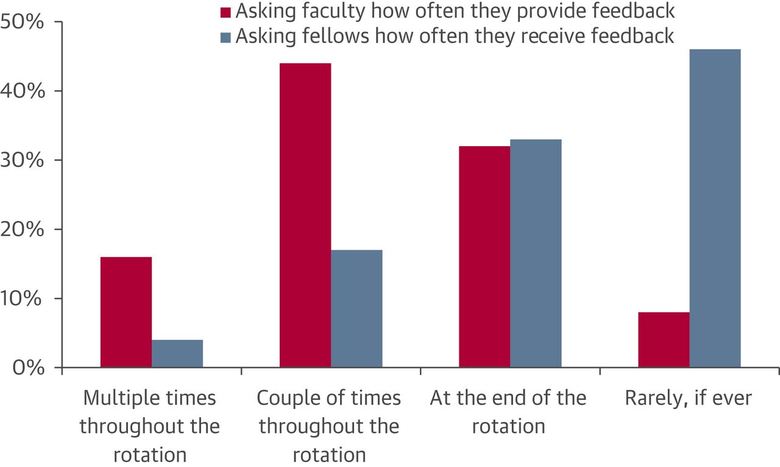
Feedback barriers
Logistics
Time
Label
Standards
Competencies
Subjectivity
A Practical Guide for Medical Teachers 2013; JACC 2015;66(6):748-752
Notes:
There are lots of reasons why giving good feedback during training is hard. Here are some of the barriers that have been identified in the medical education literature.
PROMPT
For one thing, we work in busy clinical settings, with limited time to directly observe our learners as well as discuss those observations. We don’t always use the label of feedback when we’re giving and receiving it, which might explain this discrepancy we see between attending and fellow views on feedback.
PROMPT
Our operational definition of feedback included the need for a standard of comparison. But what are those standards? Where do they come from? We have milestones to guide us in ensuring that learners reach the appropriate competencies, but, much of this assessment is subjective. The lack of a clearly defined universal standard makes giving feedback in relation to that theoretical standard difficult.

Slide 7
Feedback barriers
Teacher-student rapport
Communication skills
Culture of medicine
Faculty development
Hierarchy
A Practical Guide for Medical Teachers 2013; JACC 2015;66(6):748-752
Notes:
Also, effective feedback requires some level of trust and rapport between the giver and receiver. In our fellowship program, for instance, we have core faculty, and there’s a good chance our fellows trust feedback from one of them more than they do from an attending they work with only once a year. In that same vein, it can be hard to give good feedback to residents when you only work with them for a week or two at a time.
PROMPT
Even in situations where there are clear standards and good rapport, the teacher has to have the necessary communication skills to convey information effectively. Particularly in cases of constructive feedback, the trainee has to be ready to hear it, and when he/she is not, we have to navigate that defensive, or angry, or whatever, reaction without closing the line of communication.
PROMPT
Finally, some inherent problems with feedback stem from our current medical culture. Even though this is an important skill set, we haven’t vested enough time and energy into our faculty development to ensure that we do it well. My hope is that you will not have the same problem when you become faculty as a result of this time we are spending now. There is also a clear hierarchy in medicine, such that comments from seniors to juniors are generally perceived as judgment, which sometimes leaves no room for construction or improvement, even if that is the intent. This hierarchy makes some facets of 360* feedback untenable.

Slide 8
Good feedback is also
Specific
Objective
Accurate
Credible
Relevant
Timely
Practical Guide to the Evaluation of Clinical Competence 2019
Notes:
The thing is, we also know how to give good feedback. Good feedback is specific, objective, accurate, credible, relevant, and timely.
It is specific to the behavior, not the person. It is objective, meaning it compares one’s performance to that clearly defined standard we talked about earlier. It needs to be accurate and credible, which often means that it has to come from someone with more experience. It must be relevant to a learner with respect to his/her needing to use the observed skill set one day, and it should be given in a timely manner, in some instances even that same moment or day.

Slide 9
Good feedback is also
Specific
Objective
Accurate
Credible
Relevant
Timely
Actionable
Confidential
Regular
Learner-driven
Practical Guide to the Evaluation of Clinical Competence 2019; Medical Teacher 2012;34:787-791; Med Educ Online 2014;19:25141; JACC 2015;66(6):748-752
Notes:
Good feedback needs to be all those things, and more:
It needs to be actionable – you need to meet your learner where he/she is – and confidential (this probably goes without saying, but just in case). Good feedback is regular: if we could make it a routine part of our clinical training, it would undoubtedly be a more positive experience for both student and teacher, so we need to start carving out protected time now. Lastly, we need to change our culture so that feedback is driven by learners, too, in addition to teachers. We talk a lot about a learner-directed approach in medical education, but this idea hasn’t permeated the specific topic of feedback yet – learners should feel empowered, and have the skill set, to ask for feedback of their own accord.

Slide 10
Feedback = Coaching
https://www.newyorker.com/magazine/2011/10/03/personal-best
Notes:
In talking about feedback, there are two important, related concepts to consider. The first idea is that of feedback as coaching, very vogue right now. So let me ask, how many of you had a coach for something growing up? What was your coach’s job? For most of us, it was to make us better at sinking the basket or earning the encore.
I love this 2011 article from Atul Gawande, where he talks about coaching to refine his operating skills. The underlying idea in coaching is the constant, deliberate nudge towards perfection. We may never get there, but we should always strive for it. Framing feedback as coaching can make the receiver more open to the content; I find this is a particularly helpful approach in more advanced learners who already feel confident in their performance. As Gawande says, athletes and musicians have coaches, so why not doctors? Think about feedback as the thing that makes good better.

Slide 11
Mindset
Fixed mindset
Ability is innate + static
Growth mindset
Hard work + challenges
→ increased ability
https://www.youtube.com/watch?v=_X0mgOOSpLU
Notes:
The second idea is this one of fixed versus growth mindsets from Stanford psychologist Carol Dweck. Basically, the idea is that we can view our intelligence or creativity or ability in one of two ways. A fixed mindset means these things are innate and static; we are born with them and cannot change them. A growth mindset views these things as modifiable – with hard work and challenges, some time and effort, we can improve them.
These mindsets dictate how we respond to many things including failure and feedback. Learners with fixed mindsets may be less receptive to your feedback, so recognizing and navigating their presence is key. The good news is that we can grow our growth mindset, no pun intended. Check out the TED Talk cited here by Dr. Dweck for more on understanding the growth mindset and improvement.

Slide 12
Feedback models
Notes:
There are many models for feedback that exist outside the ubiquitous “sandwich” one. The most important thing for you to do is to find a model you feel comfortable using, and then practice with it.
My personal approach is to ask my learner, “Tell me one thing you did well this rotation, and one thing to work on for next month?” I use the answer as a springboard to discuss the learner, the rotation, and the team including myself.

Slide 13
Pendleton model
The Obstetrician & Gynaecologist 2004;6:243-247
Notes:
It’s basically a variation on the Pendleton model of feedback, which starts with the positive and then works its way into the more constructive portion. The learner’s self-assessment is reinforced, and when needed, the teacher helps with solutions for problematic areas. Advocates of this model like how it creates a positive and safe environment to begin with; critics argue it can be artificial and/or inefficient.

Slide 14
R2C2 Model
MedEdPORTAL 2016;12:10387
Notes:
Another model that is evidence-based with helpful resources is the R2C2 model. This model has four stages with discrete goals.
According to their approach,
Stage 1: Rapport building
Goal: To engage the resident, build relationship, build respect and trust, understand their context
Stage 2: Explore reactions
Goal: For resident to feel understood and that his/her views are heard and respected
Stage 3: Explore content
Goal: For the resident to be clear about what the assessment data mean for his/her practice and the opportunities identified for change and development
Stage 4: Coach for change
Goal: For the resident to engage in developing an achievable learning plan

Slide 15
Key phrases from R2C2 model
“We only just met on Monday and we’ve barely had time to talk; tell me a bit about yourself.”
“How do these data compare with how you think you were doing? Any surprises?”
“Was there anything that struck you as something to focus on?”
“What resources will you need? What might get in the way?”
MedEdPORTAL 2016;12:10387
Notes:
I found some of these example phrases from the R2C2 model to be particularly helpful so wanted to share them here. You can see how these words build rapport, explore the reaction of the learner, delve into the particular feedback content, and then finally make a specific plan for change. If you’re interested in learning more, there are some great resources in the appendices of this publication on MedEd Portal.

Slide 16
Practice makes perfect
Notes:
As I said, the only way to get good at giving feedback is to practice, and to that end, I compiled some sample scenarios to work through.

Slide 17
Feedback scenarios
Your intern on consults says she wants to go into cardiology – but it’s March, and she cannot list the components of typical angina.
Your fourth-year Sub-I in the CCU get visibly nervous every time he presents: his voice shakes, he sweats, and he drops his papers.
Your co-fellow says Saturday call wasn’t too bad, and then proceeds to sign out to you: still pending are two CCU admissions, five consults, and three echos.
Your third-year medical student’s presentations are bad: incomplete, disorganized, and with poorly thought-out assessments and plans.
Notes:
Let’s practice giving verbal feedback in response to each of these scenarios.
PROMPT
Number 1: Your intern on consults says she wants to go into cardiology – but it’s March, and she cannot list the components of typical angina.
PROMPT
Number 2: Your fourth-year Sub-I in the CCU get visibly nervous every time he presents: his voice shakes, he sweats, and he drops his papers.
PROMPT
Number 3: Your co-fellow says Saturday call wasn’t too bad, and then proceeds to sign out to you: still pending are two CCU admissions, five consults, and three echos.
PROMPT
Number 4: Your third-year medical student’s presentations are bad: incomplete, disorganized, and with poorly thought-out assessments and plans.

Slide 18
Feedback scenarios
Your other third-year medical student’s presentations are average; she tells you she is at the top of her class and will match at a top-tier program.
Your senior resident is a true rockstar, to the point where you feel you are not adding anything to consult rounds.
Your CCU attending is having issues at home, and they have spilled over into work: he is irritable and snapping at the residents without cause.
Your cath lab attending won’t let you do anything except consent the patient – no access, no discussion during the case.
Notes:
Here are some more scenarios.
Number 5: Your other third-year medical student’s presentations are average; she tells you she is at the top of her class and will match at a top-tier program.
PROMPT
Number 6: Your senior resident is a true rockstar, to the point where you feel you are not adding anything to consult rounds.
PROMPT
Number 7: Your CCU attending is having some issues at home, and it has spilled over into work: he is irritable and snapping at the residents without cause.
PROMPT
And, number 8: Your cath lab attending won’t let you do anything except consent the patient – no access, no discussion during the case.
<After discussion>
How did that go? What did you do well? What do you need to work on with respect to giving feedback going forward? What tips did you pick up that you can now integrate into your feedback?

Slide 19
Upward feedback
Anticipate response
Wait for invite
Annual faculty evals
Share specifics
From your perspective
Use the hierarchy
Remember
Attendings are human
Reflect on your part
https://hbr.org/2010/03/how-to-give-your-boss-feedback
Notes:
Before we close, I want to delve into those last two scenarios a little more, because they are tough ones, and we’ve all been there. Unfortunately, the medical education literature doesn’t have much helpful information for these situations. When we look outside to the business world, though, there are some helpful guiding principles that likely apply to us, too.
PROMPT
For one thing, try to gauge if your attending will be receptive to what you have to say. If the answer is an unequivocal no, it is probably not worth getting into it.
PROMPT
Even if the answer is yes, if you can, wait to be asked for the feedback. Many programs have an annual retreat or survey, which is a good opportunity to share constructive thoughts. Alternatively, a change in the program – a restructuring or implementation of a new initiative, for instance – might be a good opportunity to volunteer feedback. Certainly you should be filling out written faculty evaluations on a routine basis in your program, and you absolutely have to document problems here in order to see change, that’s simply how programs work. Finally, use the way your attending reacts to help you navigate the next time. You’ll learn from their response what they are open to hearing about, and what they are not.
PROMPT
We already said that people respond better to specific feedback than general, and this is true in both directions. This article from HBR also cautions that subordinates should only share their own perspectives, not assume the perspective of the boss (or attending), as the truth is, you don’t know what a job entails until you do it yourself. As an early career attending, I can absolutely vouch for the truth of this statement.
PROMPT
I’ll add in some observations of my own. First, the hierarchy in medicine can be helpful in this context. Your chief fellows are fantastic advocates who have a seat at the table and can keep you anonymous, so use them! Same goes if you serve on a hospital committee and have connections to people who have power. Second, don’t lose your humanity during your training. Remember that attendings are people, too, and that they have life stresses and difficult patient cases, just like you. Follow the Golden Rule. In those instances of a single, really difficult experience, take some time to reflect on your own part before you share feedback about how your attending could have done better. In stressful and/or emotional situations, we all lose our perspective a little bit. Asking your attending for permission to debrief and letting him/her go first might make for more helpful takeaways at the end of those days (credit to Dr. Shatzer).

Slide 20
References
Algiraigri AH. Ten tips for receiving feedback effectively in clinical practice. Med Educ Online 2014;19:25141
Chowdhury RR & Kalu G. Learning to give feedback in medical education. The Obstetrician & Gynaecologist 2004;6:243-247
Cullen MW. Filling the feedback gap in cardiovascular education. JACC 2015;66(6):748-752
Dweck C. The power of believing that you can improve. TED Talk September 2014, Nörrkoping, Sweden, accessed from https://www.youtube.com/watch?v=_X0mgOOSpLU on May 2, 2020
Gallo A. How to give your boss feedback. Harvard Business Review 2010, accessed online April 27th, 2020
Gawande A. Personal Best. The New Yorker 2011, accessed from https://www.newyorker.com/magazine/2011/10/03/personal-best on April 27, 2020
Krackov SK. Giving feedback. In A Practical Guide for Medical Teachers 2013;Churchill Livingstone
Sargeant J, Armson H, Driessen E, Holmboe E, Konings K, Lockyer J, Lynn L, Mann K, Ross K, Silver I, Soklaridis S, Warren A, Zetkulic M, Boudreau MA, Chearer C. Evidence-informed facilitated feedback: The R2C2 feedback model. MedEdPORTAL 2016;12:10387
Sargeant JM & Holmboe ES. Feedback and coaching in clinical teaching and learning. In Practical Guide to the Evaluation of Clinical Competence 2018;Elsevier;Philadelphia
Van de Ridder JMM, Stokking KM, McGaghie WC, ten Cate OT. What is feedback in clinical education? Medical Education 2008;42:189-197
Notes:
Thank you for the opportunity to share. I hope you found this discussion useful.
Here are the references I cited during this talk –

Slide 21
Further reading/resources
Milan FB, Parish SJ, Reichgott MJ. A model for educational feedback based on clinical communication skills strategies: Beyond the “feedback sandwich.” Teaching and Learning in Medicine 2006;18(1):42-47
Lefroy J, Watling C, Teunissen PW, Brand P. Guidelines: The do’s, don’t’s, and don’t knows of feedback for clinical education. Perspect Med Educ 2015;4:284-299
Ramani S & Krackov SK. Twelve tips for giving feedback effectively in the clinical environment. Medical Teacher 2012;34:787-791
Watling CJ & Ginsburg S. Assessment, feedback and the alchemy of learning. Medical Education 2019;53:76-85
Harvard Medical School: https://meded.hms.harvard.edu/teaching-tools
Johns Hopkins Medicine: https://www.hopkinsmedicine.org/fac_development/flash/
Tulane University: https://medicine.tulane.edu/education/office-medical-education/faculty-development/clinical-teaching/effective-feedback
University of Alabama at Birmingham: https://www.uab.edu/medicine/home/residents-fellows/current/cert/effective-feedback
University of Central Florida College of Medicine: https://med.ucf.edu/faculty-and-academic-affairs/faculty-development/teaching-resources-2/clinical-teaching-2/clinical-teaching-guides/
Notes:
As well as some additional resources you might find helpful. Many medical school websites have videos, powerpoints, etc., you can use as you continue practicing giving good feedback – I’ve sampled some of them here, be sure to check out your own! Good luck!!

