Slide 1

The New Era of LDL-C Lowering:
Evolving therapies, evolving evidence
Name
Title
Institution Name

Slide 2
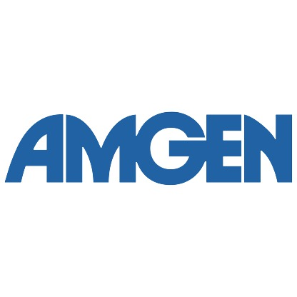
Thank you
This program was made possible with Amgen’s support
for the ACC

Slide 3
Disclosures

Slide 4
Objectives
By the end of this activity, participants will be able to:
Discuss residual cardiovascular risk evaluation and management
Review recent CV outcomes trials with addition of non-statin medication to statin therapy
Compare and contrast 2 major RCTs with PCSK9 inhibitors (PCSK9i)
Identify major groups of patients who have demonstrated benefit with PCSK9i

Slide 5
Pre-Assessment

Slide 6

Optimal Lipid Lowering:
Current treatments and residual risk

Slide 7

INTERHEART: Multiple Risk Factors
All inhabited continents
Yusuf S Lancet 2004;364:937-952
Notes:
KEY POINT:
>90% of attributable burden for AMI is due to 9 modifiable risk factors, of which lipids (followed by smoking) play the greatest role!
General notes for speaker if needed:
We know that multiple risk factors contribute to CVD, and, specifically, that there are 9 risk factors, which, combined, account for nearly all of the risk for AMI
Canadian-­led global study (INTERHEART) identified 9 easily measured risk factors (smoking, lipids, hypertension, diabetes, obesity, diet, physical activity, alcohol consumption, and psychosocial factors) that account for over 90% of the risk of acute myocardial infarction (AMI)--(all P < .0001 except alcohol, P = .03)
These risk factors are consistent in all regions, ethnic groups, and in men and women worldwide
Strong, graded relation was seen between number of cigarettes smoked and risk of AMI
5 factors (smoking, lipids, hypertension, diabetes, and obesity) accounted for ~80% of population attributable risk
Daily consumption of fruits and vegetables, moderate or strenuous exercise, and consumption of alcohol (≥ 3 times per week) were protective
Source
Yusuf S, Hawken S, Ounpuu S et al. Effect of potentially modifiable risk factors associated with myocardial infarction in 52 countries (the INTERHEART study): case-control study. Lancet (London, England) 2004;364:937-52.

Slide 8
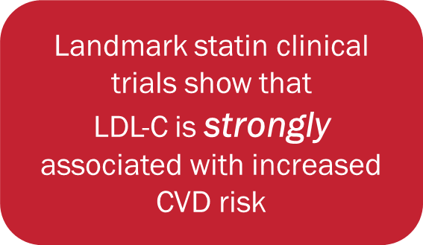
Lowering LDL-C Reduces ASCVD
Study | Statin | Mean Baseline LDL-C (mg/dL) | Mean LDL-C Reduction (%) | % Reduction in Coronary Events
Primary Prevention
WOSCOPS | Pravastatin 40mg | 192 | 26 | 31 (P<0.001)
AFCAPS/ TEXCAPS | Lovastatin 20-40mg | 150 | 25 | 37 (P <0.001)
ASCOT | Atorvastatin 10mg | 133 | 35 | 36 (P <0.001)
HOPE-3 | Rosuvastatin 10 mg | 128 | 26 | 24 (P <0.002)
JUPITER | Rosuvastatin 20 mg | 108 | 44 | 44 (P <0.000001)
Secondary Prevention
4S | Simvastatin 20-40mg | 188 | 35 | 34 (P <0.0001)
CARE | Pravastatin 40mg | 139 | 32 | 24 (P = 0.003)
LIPID | Pravastatin 40mg | 150 | 25 | 24 (P <0.0001)
CTTC meta-analysis showed that for every
1 mmol/L (38.7 mg/dL) reduction in LDL-C there is a 20%-25% reduction in major CV end points.
Statins are the mainstay of therapy!
Table adapted from Maron DJ, et al. Circulation. 2000;101:207-213; *CTTC. Lancet. 2010; 376(9753):1670-1681
Notes:
Notes
Several large-scale trials examined the effects of lipid-lowering pharmacologic therapy on CVD events and demonstrated that statins substantially reduce CV morbidity and mortality in primary + secondary prevention in both genders and in all age groups
most compared a fixed dose of a single pharmacologic agent with placebo, with both groups receiving basic, limited lifestyle counseling
A large number of meta-analyses have also been performed to analyze the effects of statins in larger populations and in subgroups
Lipid Clinics Research trial was the first major outcomes trial to show that lowering cholesterol reduced cardiovascular events
Early landmark trials of statin use in primary and secondary prevention (e.g. West of Scotland Coronary Prevention Study (WOSCOPS), Scandinavian Simvastatin Survival Study [4S]) have shown that cholesterol lowering resulted in a decreased CHD risk and mortality of approximately 25% to 35%.
4S trial was a landmark clinical trial of cholesterol lowering with simvastatin in patients with coronary artery disease (CAD) and severely elevated levels of LDL-C that was designed to look at total mortality as the primary endpoint
4S showed for the first time that lowering LDL-C levels by 35% with simvastatin resulted in a 30% reduction in total mortality with a 42% reduction in CHD deaths and a 34% reduction in the risk of Major Coronary Events
Several subsequent trials extended these results to populations with CHD with low levels of LDL-C and to subjects without known CAD (primary prevention) with high or low levels of LDL-C
The JUPITER trial (Justification for the Use of Statins in Prevention: an Intervention Trial Evaluating Rosuvastatin) (2008) also showed significant reductions in cardiovascular events and all-cause mortality in apparently healthy patients with elevated hsCRP ≥2.0 mg/L treated with rosuvastatin 20 mg compared to placebo.[Ridker 2008] This study suggests a benefit to statin use in a widely expanded primary prevention population with levels of increased inflammation.
A meta‑analysis of individual data from 26 randomized trials of statins reported a 10% proportional reduction in all‑cause mortality and a 20% proportional reduction in CV death/1.0 mmol/L (40 mg/ dL) low‑density lipoprotein‑cholesterol (LDL‑C) reduction. The risk of major coronary events was reduced by 23%, and the risk of stroke was reduced by 17%/mmol/L (40 mg/ dL) LDL‑C reduction.[CTT 2010] For every 1 mmol/liter reduction in LDL cholesterol, there was a 20% to 25% reduction in major CV end points, including stroke.
Sources
Cannon CP, Braunwald E, McCabe CH, et al, for the Pravastatin or Atorvastatin Evaluation and Infection Therapy-Thrombolysis in Myocardial Infarction 22 Investigators. Intensive versus moderate lipid lowering with statins after acute coronary syndromes. N Engl J Med. 2004;350:1495-1504.
Heart Protection Study Collaborative Group. MRC/BHF Heart Protection Study of cholesterol lowering with simvastatin in 20,536 high-risk individuals: A randomised placebo-controlled trial. Lancet. 2002;360:7-22.
Randomised trial of cholesterol lowering in 4444 patients with coronary heart disease: The Scandinavian Simvastatin Survival Study (4S). Lancet. 1994;344:1383-1389.
Ridker PM, Danielson E, Fonseca FA,et al, JUPITER Study Group. Rosuvastatin to prevent vascular events in men and women with elevated C-reactive protein. N Engl J Med. 2008;359(21):2195.
Shepherd J, Cobbe SM, Ford I, et al. Prevention of coronary heart disease with pravastatin in men with hypercholesterolemia. West of Scotland Coronary Prevention Study Group. N Engl J Med. 1995;333:1301-1307.
Cholesterol Treatment Trials Collaboration. Efficacy and safety of more intensive lowering of LDL cholesterol: a meta-analysis of data from 170,000 participants in 26 randomised trials. Lancet. 2010; 376(9753):1670-1681
Table
Maron DJ, Fazio S, Linton MF. Current perspectives on statins. Circulation. 2000;101:207-213

Slide 9
On Treatment LDL-C and CVD Event Rates
30
25
20
15
10
5
0
Higher Risk=
Greater Benefit
Lower LDL-C =
Greater Benefit
4S-P
Secondary
4S-Rx
LIPID-P
% w/ CHD Event
LIPID-Rx
CARE-P
Primary
IDEAL80
CARE-Rx
HPS-P
WOSCOPS-P
HPS-Rx
WOSCOPS-Rx
TNT80
ASCOT-Rx
AFCAPS-P
ASCOT-P
Jupiter-P
AFCAPS-Rx
Jupiter-Rx
50 70 90 110 130 150 170 190
LDL-C at Follow-up
To convert mg/dL to mmol/L, divide by 38.67
J of Clin Lipid 9(2);2015:129
Notes:
Key Concepts: ASCVD risk reduction depends upon the baseline level of risk as well as the magnitude of LDL-C lowering. Higher risk patients with ASCVD have greater absolute risk reduction and lower achieved LDL-C levels are associated with greater risk reduction.

Slide 10
What do the guidelines suggest for LDL-C lowering goals in established CAD?
 | Primary Goal (in Secondary Prevention patients)
ACC/AHA 2018 | >50% Reduction in LDL-C; Threshold to consider treatment intensification: LDL-C > 1.8 mmol/L (> 70 mg/dL)
ESC/EAS 2019 | >50% Reduction in LDL-C and LDL-C goal of <1.4 mmol/L (<55 mg/dL)
ESC/EAS 2016 | LDL-C <70 mg/dl (<1.8 mmol/L) or >50% reduction in LDL-C
Canada 2016 | LDL-C <2 mmol/L (<77 mg/dL) or >50% reduction in LDL-C
AACE 2017 | Very high-risk: LDL-C <70 mg/dl (<1.8 mmol/L) Extreme risk: LDL-C <55 mg/dl (<1.4 mmol/L)
Notes:
Key Concept: Remarkable concordance across global guidelines for management of high-risk patients with clinical ASCVD.

Slide 11
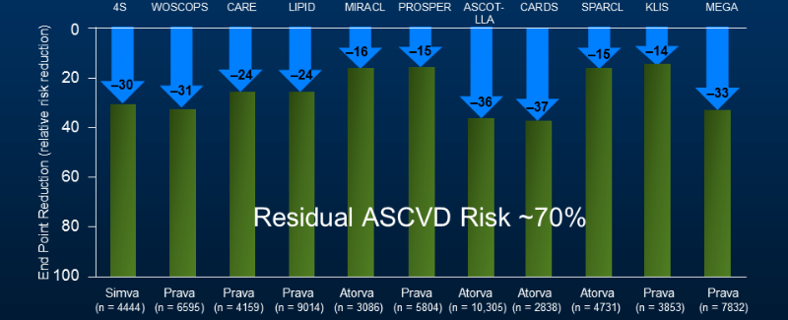
Residual Risk Persists Despite Statins
Lancet. 2005;366:1267-1278
Notes:
Key Concept: Residual risk (~70%) + high rates of statin intolerance in clinical practice generated significant interest in alternative pathways and mechanisms to lower lipoproteins

Slide 12
Why does residual risk occur in spite of ‘optimal’ statin therapy ?
LDL-C goal achieved on optimal statin therapy
    Other poorly controlled non-lipid risk factors in the high-risk patient
    Poor lifestyle
LDL-C goal not achieved despite optimal statin therapy
    Consider secondary causes of severe hyperlipidemia
    Interindividual variability in response to statin
    Statin intolerance
    Non-Adherence
    Genetic dyslipidemias
      Elevated Lipoprotein(a)
      Familial Hypercholesterolemia

Slide 13
Why does residual risk occur in spite of ‘optimal’ statin therapy ?
LDL-C goal achieved on optional statin therapy
    Other poorly controlled non-lipid risk factors in the high-risk patient
    Poor lifestyle
LDL-C goal not achieved despite optimal statin therapy
    Consider secondary causes of severe hyperlipidemia
    Interindividual variability in response to statin
    Statin intolerance
    Non-Adherence
    Genetic dyslipidemias
      Elevated Lipoprotein a
      Familial Hypercholesterolemia

Slide 14
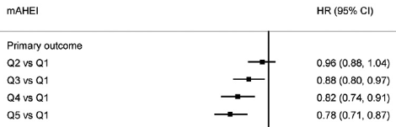
How beneficial is healthy eating when taking a statin?
Quintile 5 Healthiest : Mediterranean Style Diet
Quintile 1 Unhealthiest : Processed, sodium
n=19,055
Primary outcome = CV Death, MI, Stroke, or CHF
*Modified Alternative Healthy Eating Index
p<0.001 for Trend
Statin benefits are greatest in patients on healthiest diet.
Benefits significantly lessened on poor diet.
ONTARGET & TRANSCEND Trials Circ 2012;126:2705-2712
Notes:
Key Concept: Lifestyle intervention is critical to reduce residual risk even on maximally tolerated statin therapy. Benefits are greatest in individuals following healthy diet and patients with poor diet achieve LDL-C reduction, but less ASCVD event reduction.

Slide 15
Why does residual risk occur in spite of ‘optimal’ statin therapy ?
LDL-C goal achieved on optional statin therapy
    Other poorly controlled non-lipid risk factors in the high-risk patient
    Poor lifestyle
LDL-C goal not achieved despite optimal statin therapy
    Consider secondary causes of severe hyperlipidemia
    Interindividual variability in response to statin
    Statin intolerance
    Non-Adherence
    Genetic dyslipidemias
      Elevated Lipoprotein a
      Familial Hypercholesterolemia

Slide 16
Secondary Causes of Dyslipidemia
Most Commonly Encountered
Secondary Cause | Elevated LDL-C
Diet | Excess saturated or trans fats, weight gain, anorexia
Drugs | Diuretics, cyclosporine, glucocorticoids, amiodarone
Diseases | Biliary obstruction, nephrotic syndrome
Disorders of metabolism | Low T4, obesity, pregnancy*
* Statin contraindicated (& w/ lactation)
HLD=Hyperlipidemia
2013 ACC/AHA Cholesterol Guidelines
Vodnala et al Secondary causes of dyslipidemia. Am J Cardiol. 2012;110(6):823.

Slide 17
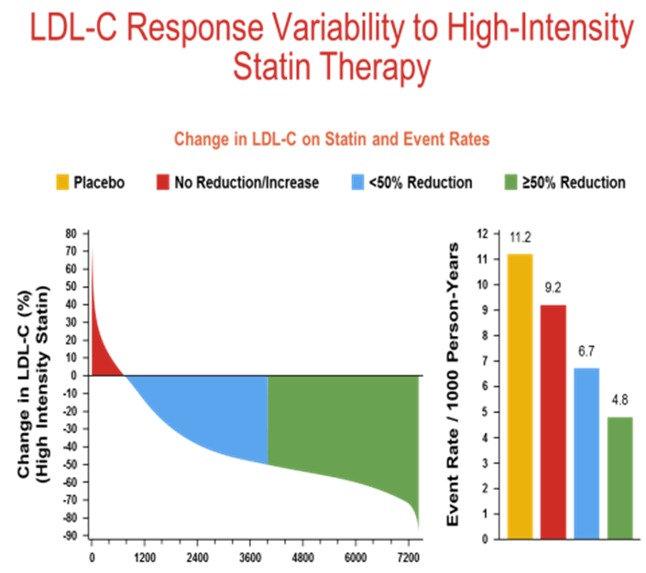
Variation in Response to Statins
JUPITER Study: Rosuvastatin 20mg
Reduction in ASCVD events greatest in those with greatest % reduction in LDL-C
Interindividual variability in response to therapy
Adherence issues
Ridker et al, Eur Heart J 2016
Lloyd-Jones, JACC 2017
Notes:
Eur Heart J. 2016 May 1;37(17):1373-9. doi: 10.1093/eurheartj/ehw046. Epub 2016 Feb 24.
Percent reduction in LDL cholesterol following high-intensity statin therapy: potential implications for guidelines and for the prescription of emerging lipid-lowering agents.
Ridker PM¹, Mora S², Rose L²; JUPITER Trial Study Group.
Author information
¹The Center for Cardiovascular Disease Prevention, Brigham and Women's Hospital, Harvard Medical School, 900 Commonwealth Avenue, Boston, MA 02215, USA pridker@partners.org.
²The Center for Cardiovascular Disease Prevention, Brigham and Women's Hospital, Harvard Medical School, 900 Commonwealth Avenue, Boston, MA 02215, USA.
Abstract
AIMS:
Current statin guidelines in Europe and Canada advocate achieving a fixed LDL target or the attainment of a ≥50% reduction in low-density lipoprotein cholesterol (LDLC), while current US guidelines advocate the use of statin therapies that reduce LDLC by <50% (moderate intensity) or ≥50% (high intensity). Data are limited, however, linking the achievement of these % reduction thresholds to subsequent cardiovascular outcomes particularly for contemporary high-intensity regimens.
METHODS AND RESULTS:
In a randomized trial of 17 082 initially healthy men and women with median baseline LDLC of 108 mg/dL (interquartile range 94-119), we (i) used waterfall plots to assess the variability in LDLC response to rosuvastatin 20 mg daily and (ii) evaluated the impact of reaching ≥50% reductions in LDLC on risk of developing the first cardiovascular events. Among rosuvastatin allocated participants, 3640 individuals (46.3%) experienced an LDLC reduction ≥50%; 3365 individuals (42.8%) experienced an LDLC reduction >0 but <50%; and 851 individuals (10.8%) experienced no reduction or an increase in LDLC compared with baseline. These % LDLC reductions directly related to the risks of first cardiovascular events; at trial completion, incidence rates for the primary endpoint were 11.2, 9.2, 6.7, and 4.8 per 1000 person-years for those in the placebo, no LDLC reduction, LDLC reduction <50%, and LDLC reduction ≥50% groups, respectively. Compared with placebo, the multivariable adjusted hazard ratios for sequentially greater on-treatment per cent reductions in LDLC were 0.91 (95%CI 0.54-1.53), 0.61 (95%CI 0.44-0.83), and 0.43 (95%CI 0.30-0.60) (P < 0.00001). Similar relationships between % reduction and clinical outcomes were observed in analyses focusing on non-HDLC or apolipoprotein B.
CONCLUSIONS:
As documented for low- and moderate-intensity regimens, variability in % LDLC reduction following high-intensity statin therapy is wide yet the magnitude of this % reduction directly relates to efficacy. These data support guideline approaches that incorporate % reduction targets for statin therapy as well as absolute targets, and might provide a structure for the allocation of emerging adjunctive lipid-lowering therapies such as PCSK9 inhibitors should these agents prove broadly effective for cardiovascular event reduction.
TRIAL REGISTRATION:
ClinicalTrials.gov NCT00239681.

Slide 18
Statin Intolerance
No “gold standard” diagnostic tool
Statin intolerance:
  True statin intolerance is uncommon.
  Most commonly reported symptoms are muscle-related complaints.
Systematic approach to evaluation of statin-related adverse effects is critically important to encourage adherence to evidence-based statin treatment.
Lloyd-Jones et al ACC Expert Consensus Decision Pathway, JACC 2017

Slide 19
Statin Intolerance
Definition of statin intolerance
  Unacceptable muscle-related symptoms that resolve with discontinuation of therapy and occur with re-challenge on at least 2-3 statins
  1 of which is prescribed at the lowest approved dose.
Approach to statin dosing:
  If lowest dose of multiple statins cannot be tolerated on a daily basis, consider alternative dosing strategies (use of statins with long half-life administered 3 times per week or once per week).
Non-statin therapies should be considered to be an alternative to evidence-based statin therapy only after statin intolerance has been systematically evaluated and documented.

Slide 20
Summary
Statin therapy significantly reduces CV events
~23% relative risk reduction with 38.7 mg/dL (1 mmol/L) reduction
Greater CV event reduction with greater LDL-C lowering
Statins are mainstay of therapy for CVD prevention
Residual risk persists despite optimal statin therapy
Ballantyne CM, et al. Am Heart J. 2005;149:464-73. Karalis DG, et al. Cholesterol. 2012;2012:861924.
Sullivan D, et al. JAMA. 2012;308(23):2497-2506. Kataoka Y, et al. Arterioscler Thromb Vasc Biol. 2015;35(4):990-5.
Stein EA, et al. Am J Cardiol. 2003;92(11):1287-93. Stark Casgrande S, et al. Diabetes Care. 2013;36(8):2271-9.

Slide 21
The Role of Non-statin Therapies:
Evolving evidence, evolving guidance

Slide 22
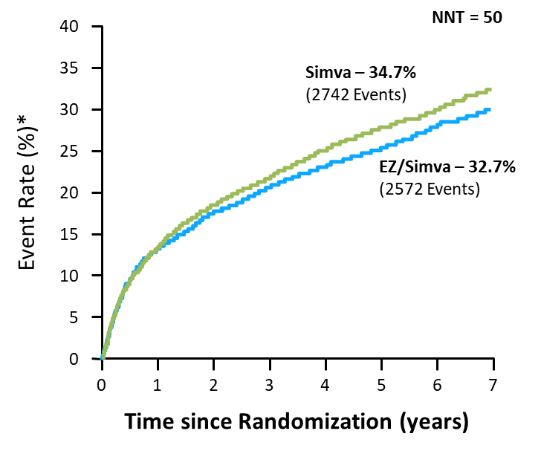
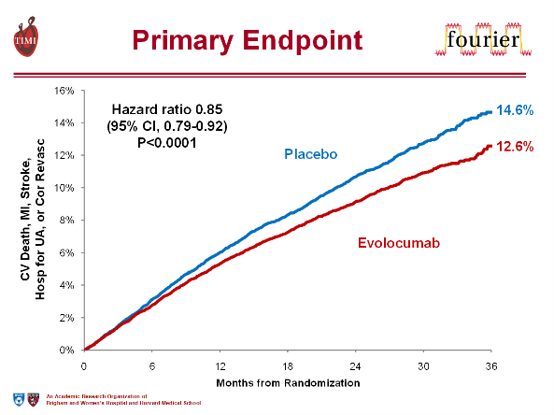
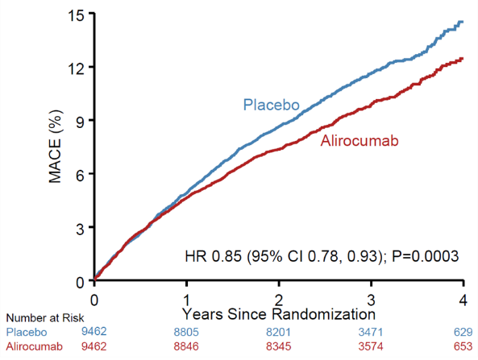
Evolving Evidence, Evolving Guidance
IMPROVE-IT¹
FOURIER²
ODYSSEY Outcomes³
CI = confidence interval; Cor Revasc = coronary revascularization; EZ = ezetimibe; HR = hazard ratio; MACE = major adverse cardiovascular events; MI = myocardial infarction; NNT = number needed to treat; Simva = simvastatin; UA = unstable angina.
Cannon CP, et al. N Engl J Med. 2015;372(25):2387-97.
Sabatine MS, et al. N Engl J Med. 2017;376(18):1713-22.
Steg PG. Evaluation of Cardiovascular Outcomes After an Acute Coronary Syndrome During Treatment With Alirocumab - ODYSSEY OUTCOMES. March 10, 2018. http://www.acc.org/latest-in-cardiology/clinical-trials/2018/03/09/08/02/odyssey-outcomes.
Notes:
Key Concept: At the time of publication of the 2013 ACC/AHA guidelines there were no available large RCTs of non-statin therapies for LDL-C lowering. However, recent evidence with ezetimibe, evolocumab, and alirocumab support the benefits of the addition of non-statin therapies to maximally tolerated statin in appropriate high-risk patients.

Slide 23
Impact of Ezetimibe in ACS
IMPROVE-IT Study
18,144 ACS patients randomized to simvastatin (40 mg QHS) or simvastatin/ezetimibe (40 mg/10 mg QHS) for 7 years
100
40
Simvastatin
35
Simvastatin
90
Ezetimibe/simvastatin
Ezetimibe/simvastatin
30
80
25
Mean LDL-C (mg/dL)
Event Rateª (%)
70
20
60
Median time average
69.5 (1.8) vs 53.7 (1.4) [mg/dL (mmol/L)]
15
10
50
5
HR 0.936, P=.016
40
0
QE
R
1
4
8
12
16
24
36
48
60
72
84
96
0
1
2
3
4
5
6
7
Time Since Randomization (Months)
Years

Slide 24
PCSK9 Inhibition in clinical practice:
Mechanisms of action and prescription of therapy

Slide 25
PCSK9 Inhibitors (PCSK9i)
Proprotein Convertase Subtilisin/Kexin type 9
  Fully humanized monoclonal antibody
  Subcutaneous injection
New and unique opportunities for CVD risk reduction
  Additional LDL-C lowering when used in combination with statin + ezetimibe

Slide 26
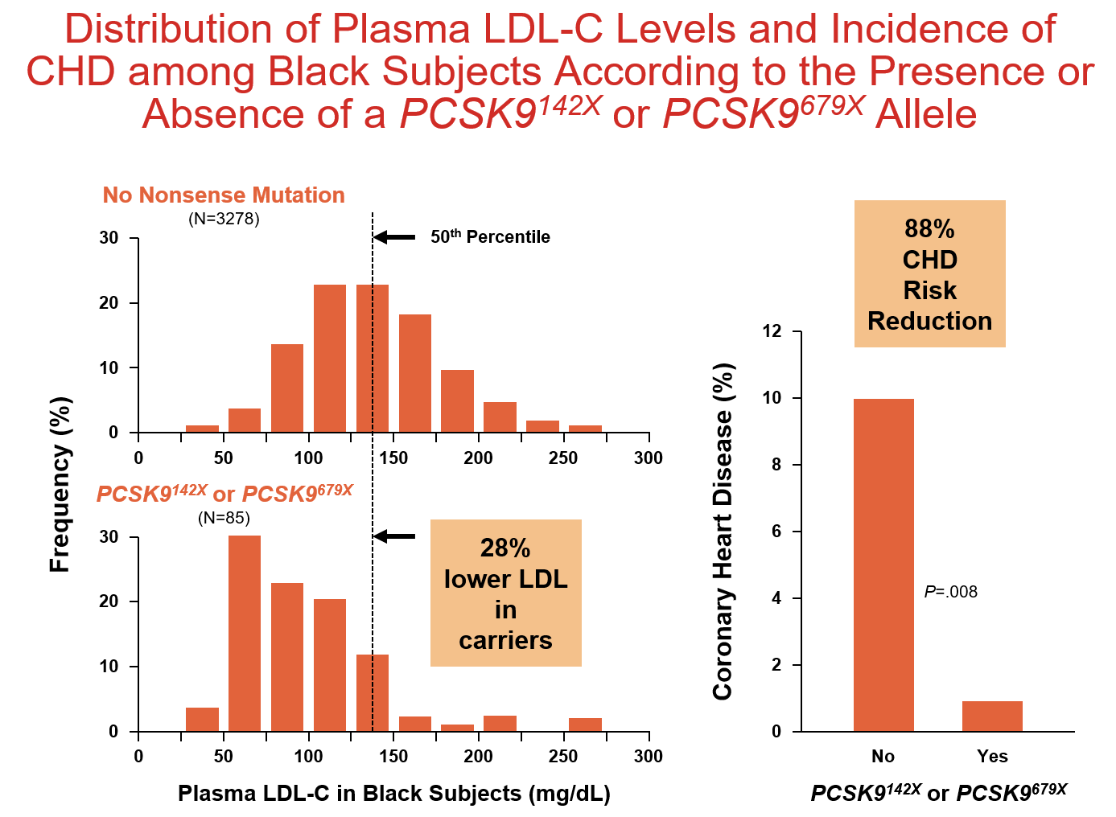
Discovering the role of PCSK9 in LDL-C regulation and ASCVD risk
He LOF mutations found in 1-3% of population
Associated w/ : lifelong modestly lower serum LDL-C
Lower incidence of CHD due to prolonged LDL-C reduction
1 Cohen et al NEJM 2006;354:1264-1272 3 Benn et al JACC 2010;55:2833-2842
2 Cohen et al Nat Genet 2005;37:161-165 4 Zhao et al Jrnl of Hum Gen 2006;79:514-534

Slide 27
Duration of LDL-C Lowering : Genetics vs Statins
-100%
-80%
-60%
-40%
-20%
0%
PCSK9
Y142X
C679X
Genetic Variants
Lifelong
Lifelong reductions in PCSK9 reduce CHD
NPC1L1
PCSK9
R46L
Reduction in CHD
WOSCOPS
4S
HPS
LDLR
ABCG8
CARE
Statin Trials
5 Years
APOB
0% -10% -20% -30% -40%
Reduction in LDL-C
CHD=Coronary Heart Death
Willer Nat Gen 2008; Linsel-Nitchke PlosOne 2008; Stender JACC 2014; Stitziel NEJM 2014

Slide 28
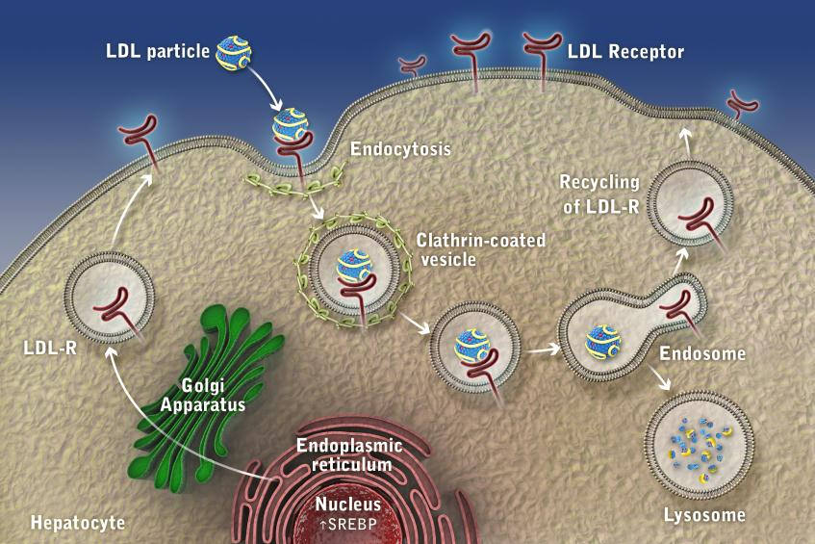
LDL Receptor (LDL-R) Function and Life Cycle
Receptor
re-used
~200x
LDL
Reduction
Hepatocyte

Slide 29
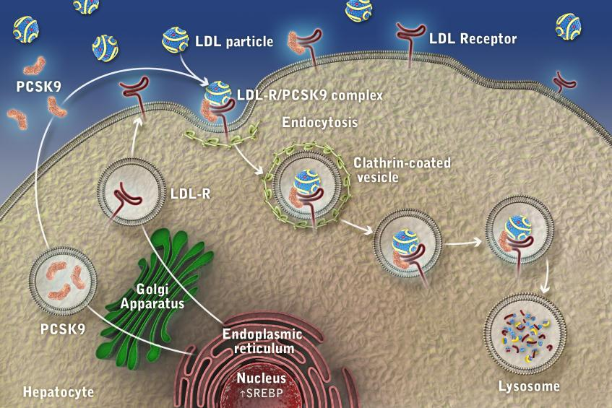

Role of PCSK9 in the Regulation of LDLR Expression
X
LDLR
destroyed
Reduced LDLR density
No LDL-C
Reduction
Hepatocyte

Slide 30
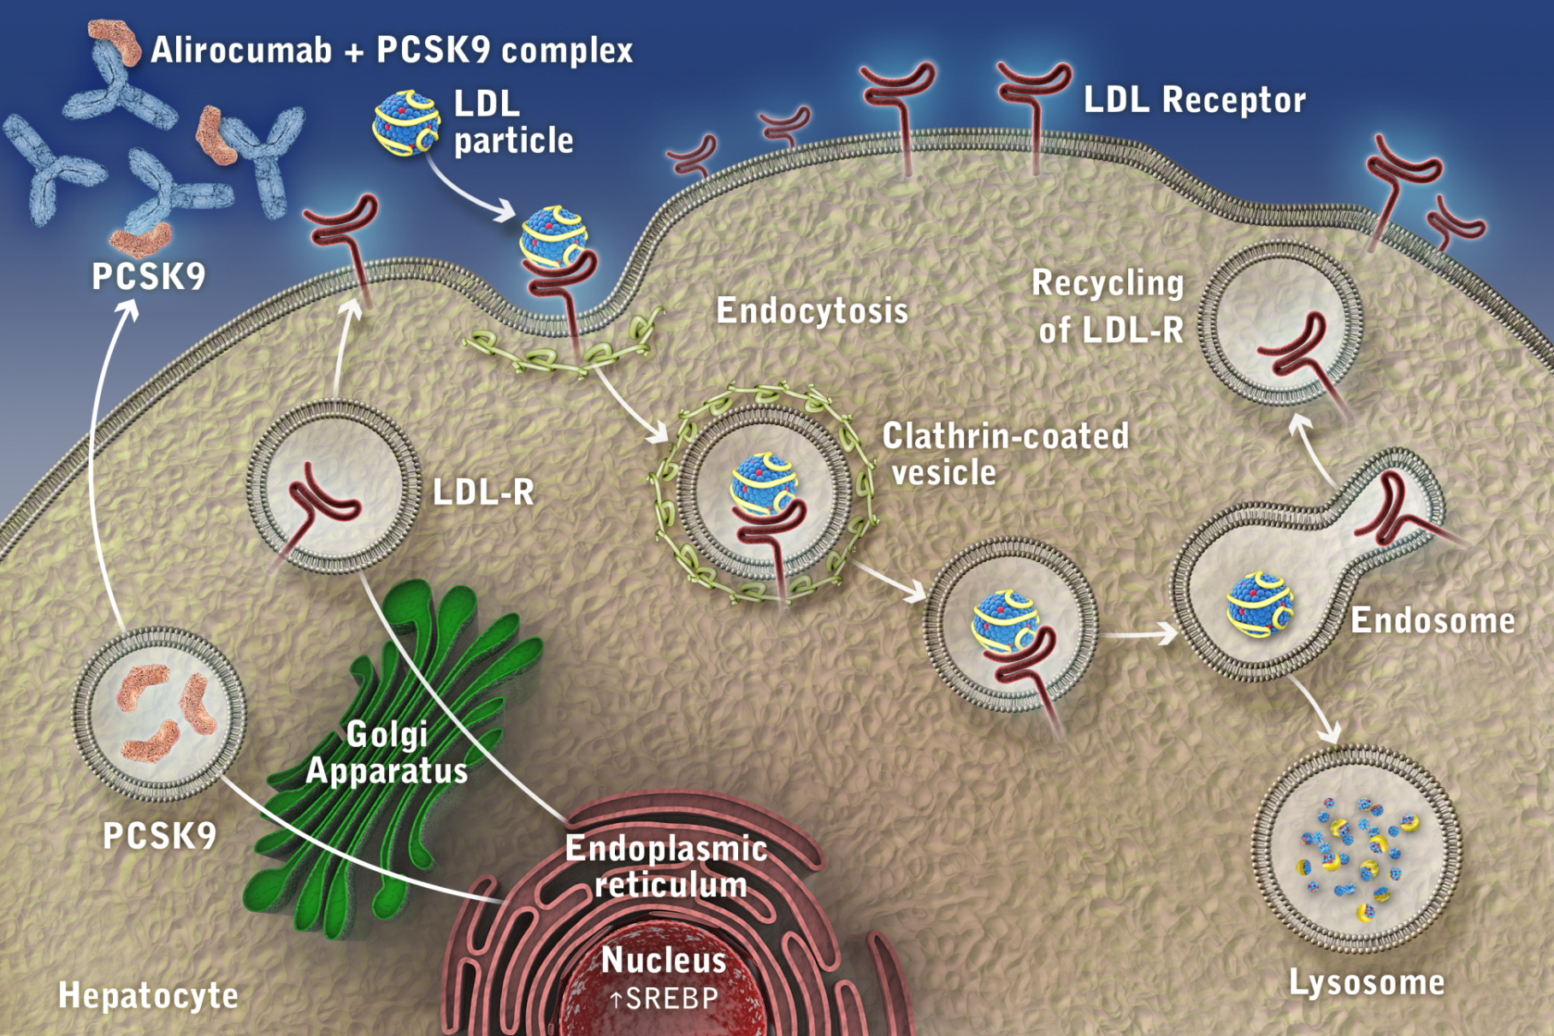
Impact of PCSK9i on LDLR Expression
PCSK9 mAb-PCSK9 Complex
Receptor
recycled
~200x
PCSK9
antibody
Increased
LDLR density
LDL-C
Reduction

Slide 31
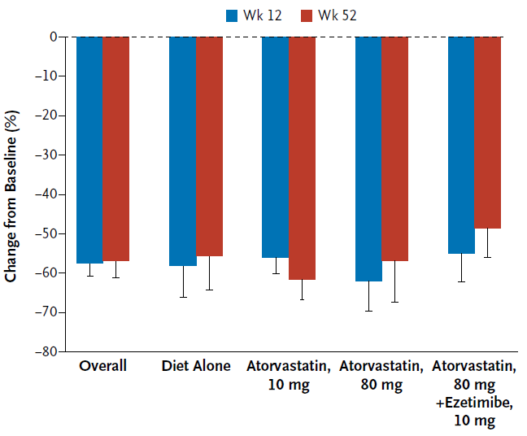
Efficacy of evolocumab added to baseline therapies
% LDL Reduction from Baseline w/ Evolocumab Added
Approximate additional 60% reduction in LDL-C
Important to continue baseline therapy for greatest reduction in LDL-C
Baseline
Treatment
Overall
Diet
Only
Atorva
10 mg
Atorva
80 mg
Atorva 80 mg
+ Ezetimibe 10
N Engl J Med 2014;370:1809-19.
Notes:
This data shows the reduction in LDL with evolocumab added to statin. For instance if patient’s baseline LDL is 240 mg/ dL then adding a low-dose statin may lower the patient’s LDL 16% to 200; adding PCSK9 at this point may lower it 60 percent to a final LDL of 80 mg/dL. However if the patient can tolerate high-dose statin and lower the LDL 50 percent to 120 then a further 60 percent reduction with resultant LDL of 48 mg/dL. This is because statins will up regulate LDL receptor numbers and PCSK9 levels allowing a greater response to therapy by the PCS K 9 inhibitor .

Slide 32
Scientific Evidence for PSCK9 Inhibition: Advanced LDL-C Lowering

Slide 33
Objectives
Assess latest clinical evidence regarding outcomes benefits
Compare and contrast the 2 major clinical trials
Assess efficacy and safety of very low levels of LDL-C
LDL-C = low-density lipoprotein cholesterol; PCSK9 = proprotein convertase subtilisin/kexin type 9 serine protease.

Slide 34
Key PCSK9 Inhibitor CV Outcomes Trials
 | Evolocumab (AMG 145) | Alirocumab (SAR236553 / REGN727)
Trial | FOURIER | ODYSSEY Outcomes
Sample size | 27,564 | 18,924
Patients | Stable ASCVD (MI, stroke, or PAD) with high-risk features | 4-52 weeks post-ACS
Age | 63 | 58
Statin High-intensity statin No statin | Atorvastatin ≥20 mg or equivalent 69% 0.2% | Evidence-based medical Rx 89% 2.5%
LDL-C mg/dL (mmol/L): inclusion Baseline LDL-C mg/dL (mmol/L) | ≥70 (≥1.8) 92 (2.4) | >70 (<1.8) 87 (2.3)
PCSK9 inhibitor dosing | Q2W or Q4W | Q2W
Endpoint | 1°: CV death, MI, stroke, revascularization, or hospitalization for UA Key 2°: CV death, MI, or stroke | CHD death, MI, ischemic stroke, or hospitalization for UA
Median Follow-up | 26 months | 34 months
CHD = coronary heart disease; CV = cardiovascular; PAD = peripheral arterial disease; Q2W/Q4W = every 2 weeks/every 4 weeks; UA = unstable angina.
www.clinicaltrials.gov
Notes:
Key Concepts: differences in patient populations (ASCVD with high-risk features vs ACS within 4-12 months), both studies required maximally tolerated statin therapy, similar LDL-C >1.8 mmol/L or 70 mg/dL, median duration of follow-up slightly less in FOURIER.

Slide 35

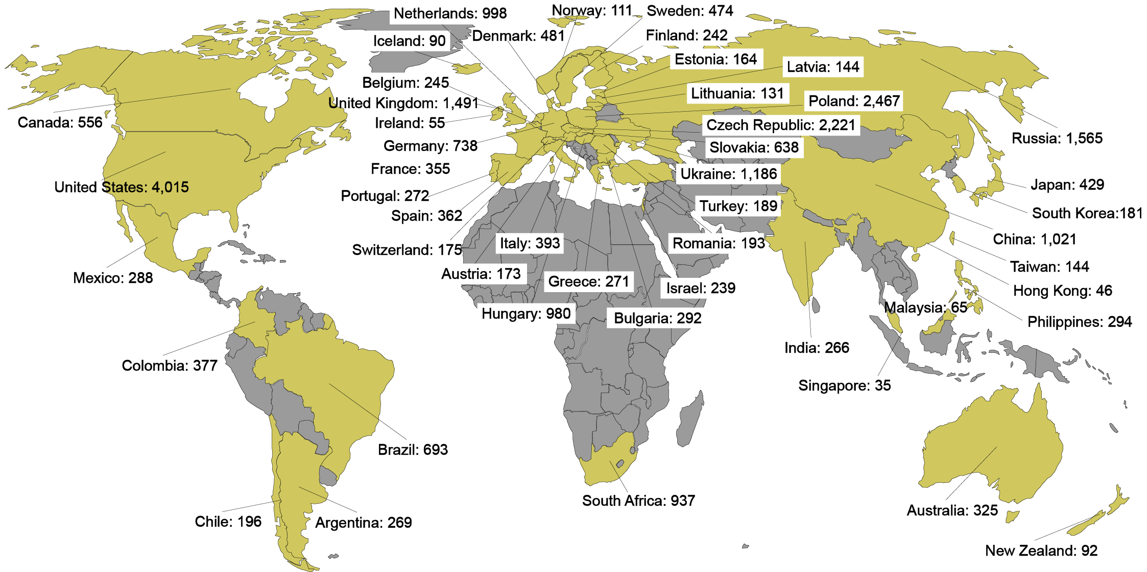
Global Enrollment
27,564 patients randomized at 1242 sites
in 49 countries between 2/2013 – 6/2015
Notes:
MAY HIDE THIS SLIDE FOR SAUDI ARABIA

Slide 36
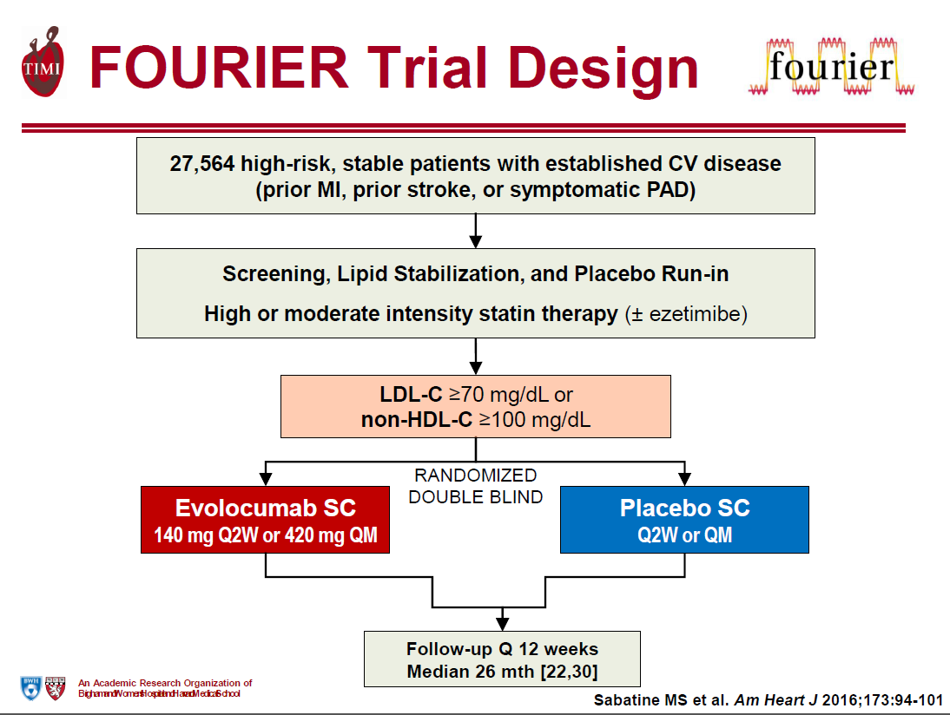
(>1.8 mmol/L)

Slide 37
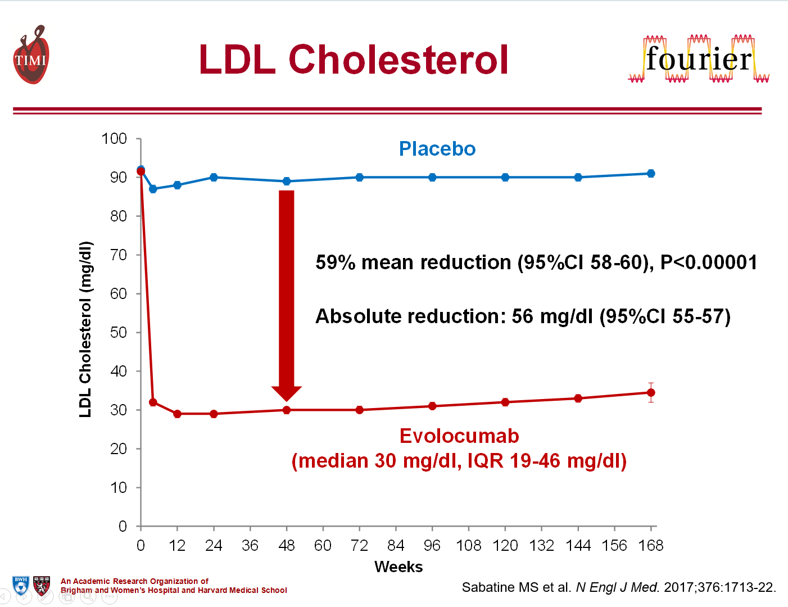
Evolocumab in Stable, High-Risk ASCVD
(1.45 mmol/L)
(0.78 mmol/L)

Slide 38
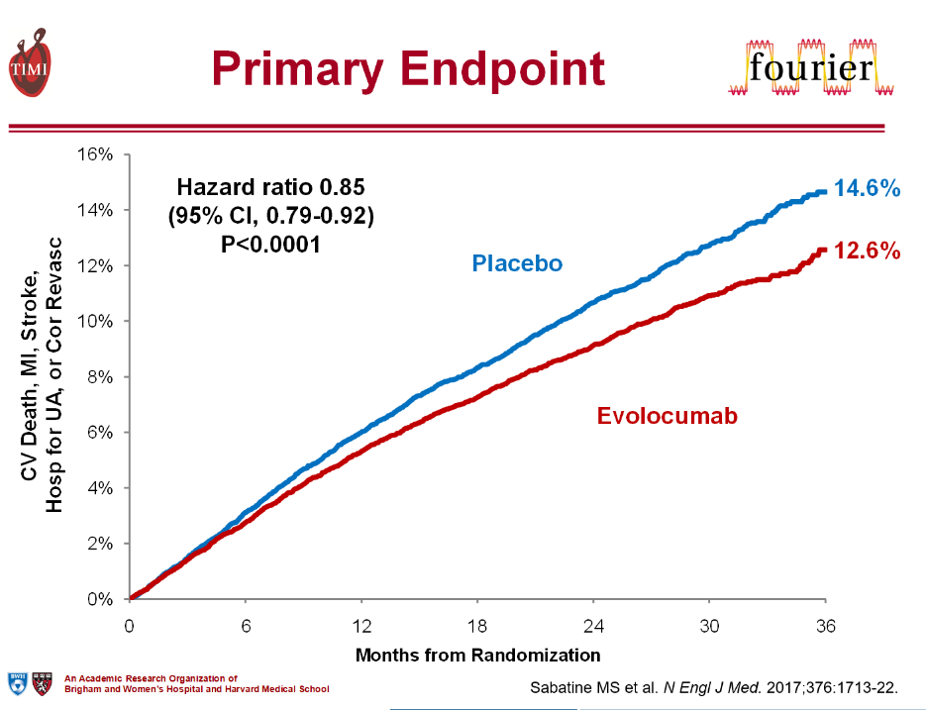
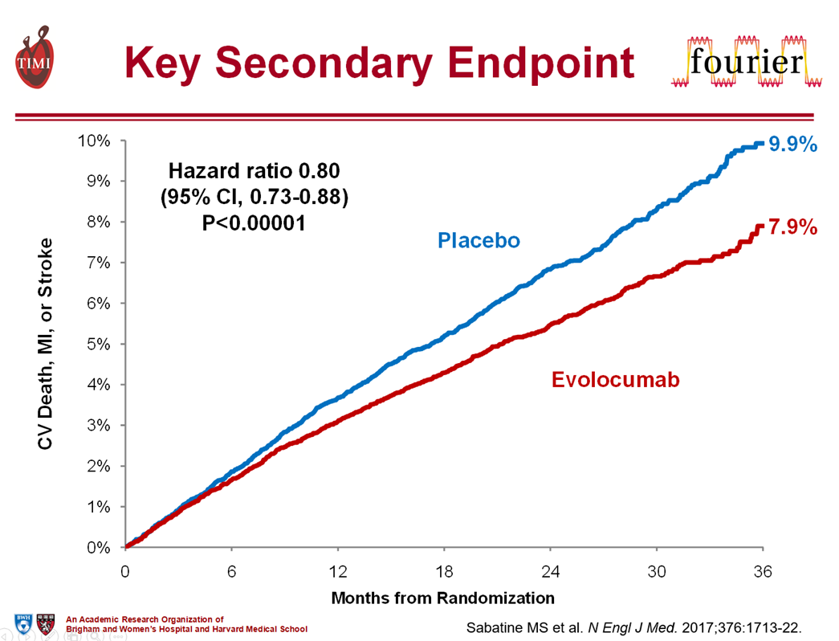
Evolocumab in Stable, High-Risk ASCVD
-15%
20%

Slide 39
Evolocumab in Stable, High-Risk ASCVD
-16%
-25%

Slide 40


Safety with evolocumab by achieved LDL-C at 4 Weeks
% Patients (n/N)
Adjusted P values for trend >.10
for each comparison
% Patients
AE = adverse event; DM = diabetes mellitus; SAE = serious adverse event.
Notes:
KEY Concept: This is analysis evaluated adverse events based on achieved level of LDL-C in the evolocumab group. No difference in side effects even down to very low levels of LDL-C <20 mg/dl or 0.5 mmol/L. However, remember relatively short duration of follow-up of 26 months.

Slide 41
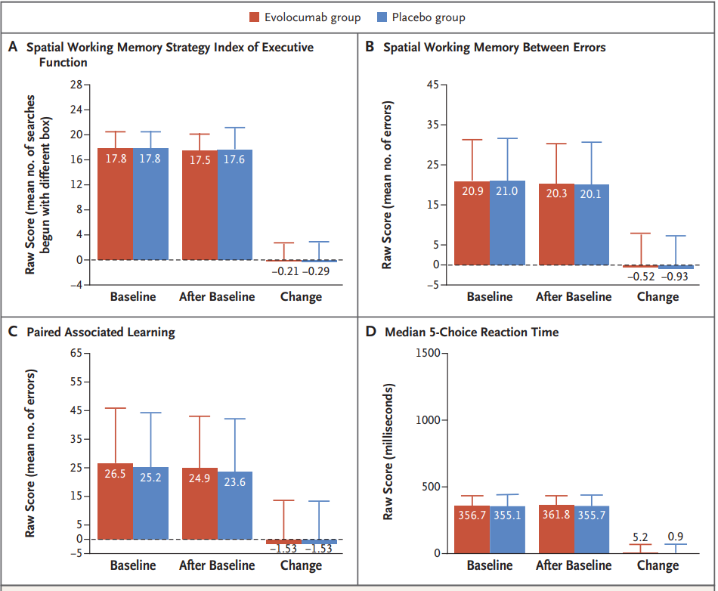
EBBINGHAUS Study of cognitive function during treatment with evolocumab
Subgroup of FOURIER
1204 patients, 19 months
Assessed cognitive function during treatment
  Cambridge Neuropsychological Test Automated Battery
No significant differences
N Engl J Med 2017;377:633-43.
Notes:
BACKGROUND Findings from clinical trials of proprotein convertase subtilisin–kexin type 9 (PCSK9) inhibitors have led to concern that these drugs or the low levels of low-density lipoprotein (LDL) cholesterol that result from their use are associated with cognitive deficits.
METHODS In a subgroup of patients from a randomized, placebo-controlled trial of evolocumab added to statin therapy, we prospectively assessed cognitive function using the Cambridge Neuropsychological Test Automated Battery. The primary end point was the score on the spatial working memory strategy index of executive function (scores range from 4 to 28, with lower scores indicating a more efficient use of strategy and planning). Secondary end points were the scores for working memory (scores range from 0 to 279, with lower scores indicating fewer errors), episodic memory (scores range from 0 to 70, with lower scores indicating fewer errors), and psychomotor speed (scores range from 100 to 5100 msec, with faster times representing better performance). Assessments of cognitive function were performed at baseline, week 24, yearly, and at the end of the trial. The primary analysis was a noninferiority comparison of the mean change from baseline in the score on the spatial working memory strategy index of executive function between the patients who received evolocumab and those who received placebo; the noninferiority margin was set at 20% of the standard deviation of the score in the placebo group.
RESULTS A total of 1204 patients were followed for a median of 19 months; the mean (±SD) change from baseline over time in the raw score for the spatial working memory strategy index of executive function (primary end point) was −0.21±2.62 in the evolocumab group and −0.29±2.81 in the placebo group (P=0.85) for superiority). There were no significant between-group differences in the secondary end points of scores for working memory (change in raw score, −0.52 in the evolocumab group and −0.93 in the placebo group), episodic memory (change in raw score, −1.53 and −1.53, respectively), or psychomotor speed (change in raw score, 5.2 msec and 0.9 msec, respectively). In an exploratory analysis, there were no associations between LDL cholesterol levels and cognitive changes.
CONCLUSIONS In a randomized trial involving patients who received either evolocumab or placebo in addition to statin therapy, no significant between-group difference in cognitive function was observed over a median of 19 months. (Funded by Amgen; EBBINGHAUS ClinicalTrials.gov number, NCT02207634.)

Slide 42
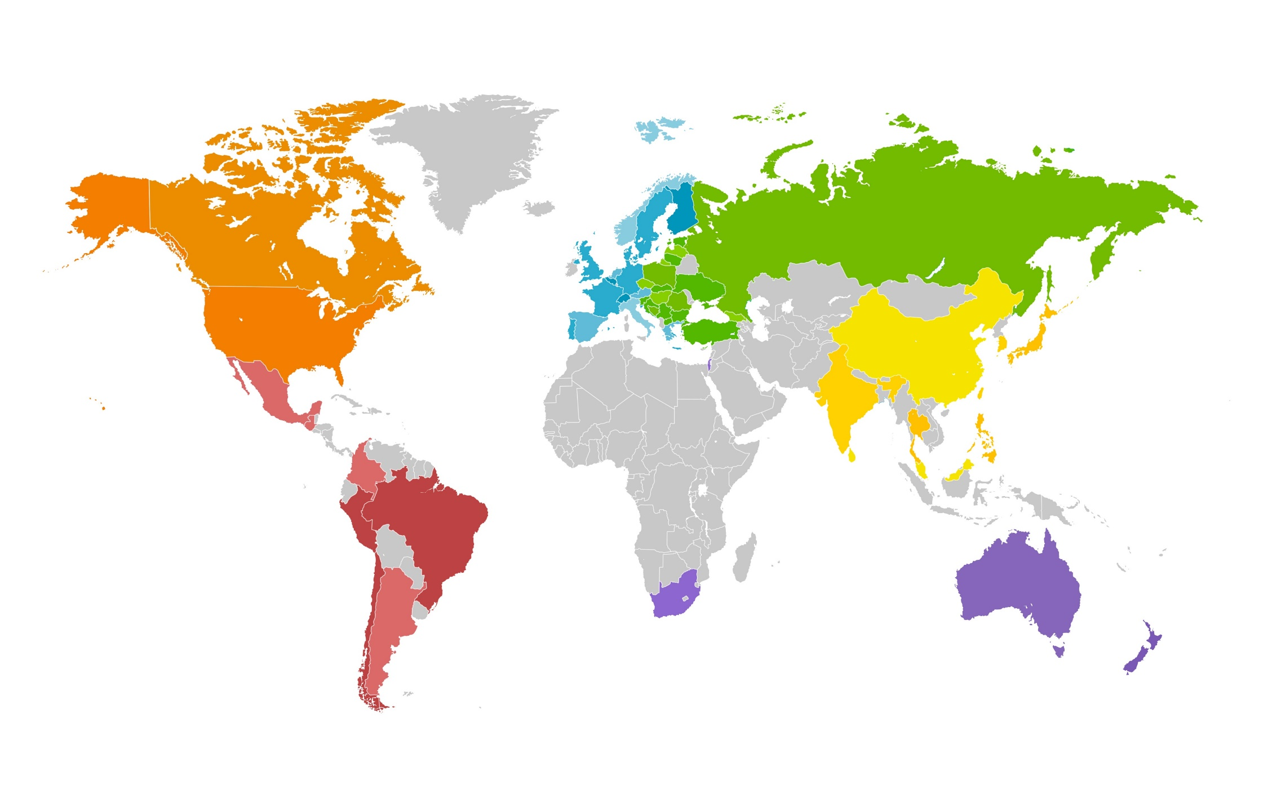

ODYSSEY OUTCOMES:
18,924 patients randomized at 1315 sites in 57 countries
Nov 2, 2012 − Nov 11, 2017
Canada/USA
Canada 361
US 2511
Central/Eastern Europe
Bosnia–Herzegovina 156 Macedonia 132
Bulgaria 333 Poland 926
Croatia 70 Romania 145
Czech Republic 381 Russian Federation 1109
Estonia 216 Serbia 255
Georgia 131 Slovakia 340
Hungary 224 Slovenia 36
Latvia 80 Turkey 78
Lithuania 188 Ukraine 639
Western Europe
Austria 58
Belgium 197
Denmark 352
Finland 116
France 185 Germany 509
Greece 70
Italy 275
Netherlands 686
Norway 97
Portugal 174
Spain 826
Sweden 250
Switzerland 88
UK 292
Asia
China 614
Hong Kong 17
India 521
Japan 204
Korea 94
Malaysia 110
Philippines 116
Singapore 49
Sri Lanka 314
Taiwan 93
Thailand 161
Latin America
Argentina 592
Brazil 928
Chile 132
Colombia 354
Guatemala 25
Mexico 349
Peru 208
Rest of World
Australia 216
Israel 582
New Zealand 257
South Africa 505
Notes:
MAY HIDE THIS SLIDE FOR SAUDI ARABIA

Slide 43

ODYSSEY Outcomes: Treatment Assignment
4 point MACE
  Time of first occurrence of:
    Coronary heart disease (CHD) death, or
    Non-fatal MI, or
    Fatal or non-fatal ischemic stroke, or
    Unstable angina requiring hospitalization
Post-ACS patients (1 to 12 months)
Run-in period of 2 to 16 weeks on high-intensity or maximum-tolerated dose of atorvastatin or rosuvastatin
At least one lipid entry criterion met
Randomization
Alirocumab SC Q2W
Placebo SC Q2W
Follow-up: median 2.8 years
8242 (44%) patients with potential f/u >3 years
Patient and investigators remained blinded to treatment and lipid levels for the entire duration of the study
Notes:
44% with follow-up >3 years

Slide 44
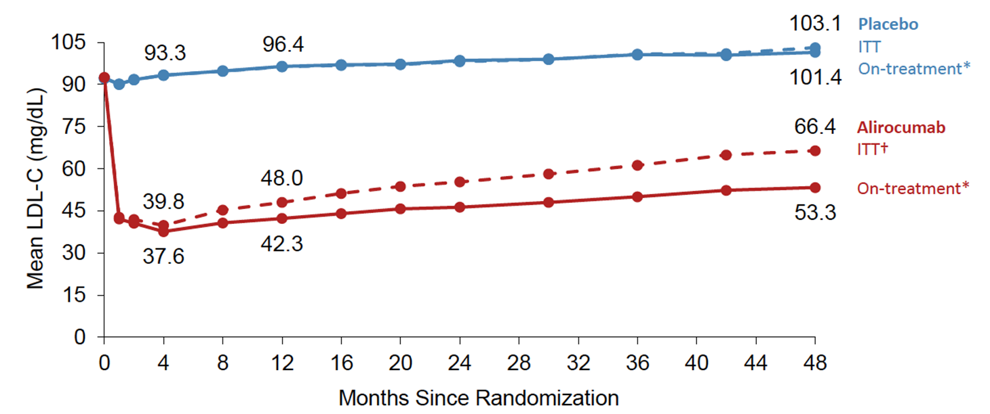
LDL-C: Intent-to-Treat and On-Treatment Analyses
(2.41 mmol/L)
(2.62 mmol/L)
53% reduction
in LDL-C
60% reduction
in LDL-C
(1.38 mmol/L)
(0.97 mmol/L)
ªExcludes LDL-C values after premature treatment discontinuation or blinded switch to placebo
^{b}All LDL-C values, including those after premature treatment discontinuation, blinded down titration, or blinded switch to placebo
Notes:
Includes all LDL-C values, regardless of blinded down titration or switch to placebo or premature treatment discontinuation
discontinuation, or blinded down titration or switch to placebo
Includes all LDL-C values, regardless of discontinuation or blinded down titration or switch to placebo

Slide 45
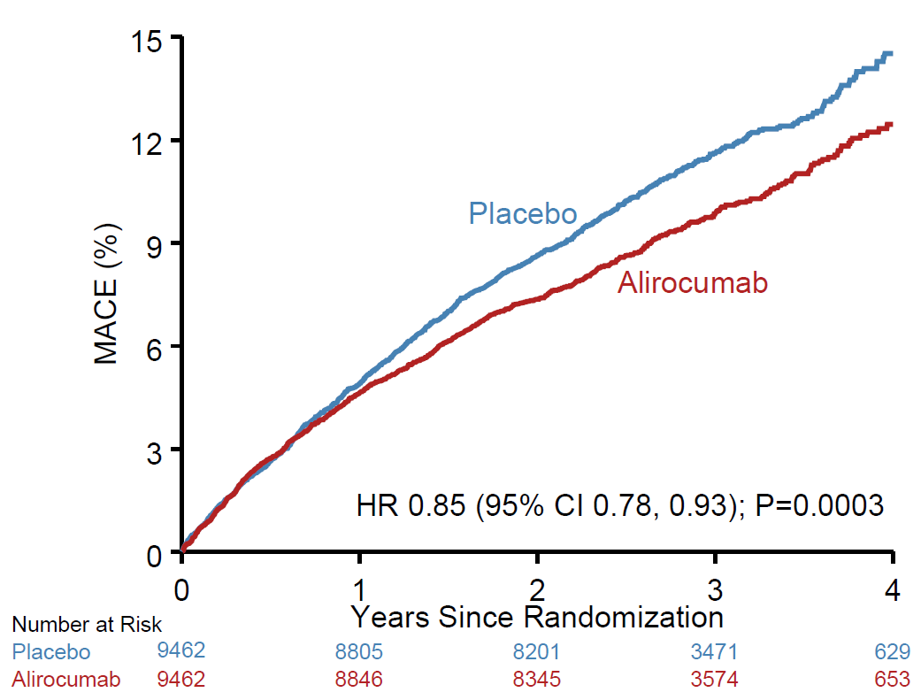
Primary Efficacy Endpoint: MACE
ARRª: 1.7%
-15%
  MACE: CHD death,
  non-fatal MI,
  ischemic stroke, or
  unstable angina requiring
  hospitalization
ªBased on cumulative incidence

Slide 46
ODYSSEY Outcomes: Safety
Treatment-emergent adverse events, n (%) | Alirocumab (N=9451) | Placebo (N=9443)
Any | 7165 (75.8) | 7282 (77.1)
Serious | 2202 (23.3) | 2350 (24.9)
Laboratory value | Alirocumab | Placebo
ALT >3 × ULN, n/N (%) | 212/9369 (2.3) | 228/9341 (2.4)
Creatine kinase >10 × ULN, n/N (%) | 46/9369 (0.5) | 48/9338 (0.5)
Diabetes worsening or diabetic complications: patients with diabetes at baseline, n/N (%) | 506/2688 (18.8) | 583/2747 (21.2)
New onset diabetes; patients without diabetes at baseline, n/N (%) | 648/6763 (9.6) | 676/6696 (10.1)
General allergic reaction, n (%) | 748 (7.9) | 736 (7.8)
Hepatic disorder, n (%) | 500 (5.3) | 534 (5.7)
Local injection site reaction, n (%)ª | 360 (3.8) | 203 (2.1)
Neurocognitive disorder, n (%) | 143 (1.5) | 167 (1.8)
Cataracts, n (%) | 120 (1.3) | 134 (1.4)
Hemorrhagic stroke, n (%) | 9 (<0.1) | 16 (0.2)
Notes:
Neutralizing anti-drug antibodies (available data)
42 (0.5%) in alirocumab
6 (<0.1%) in placebo
Roth EM, et al. NEJM 2017; 376:1589-1590

Slide 47
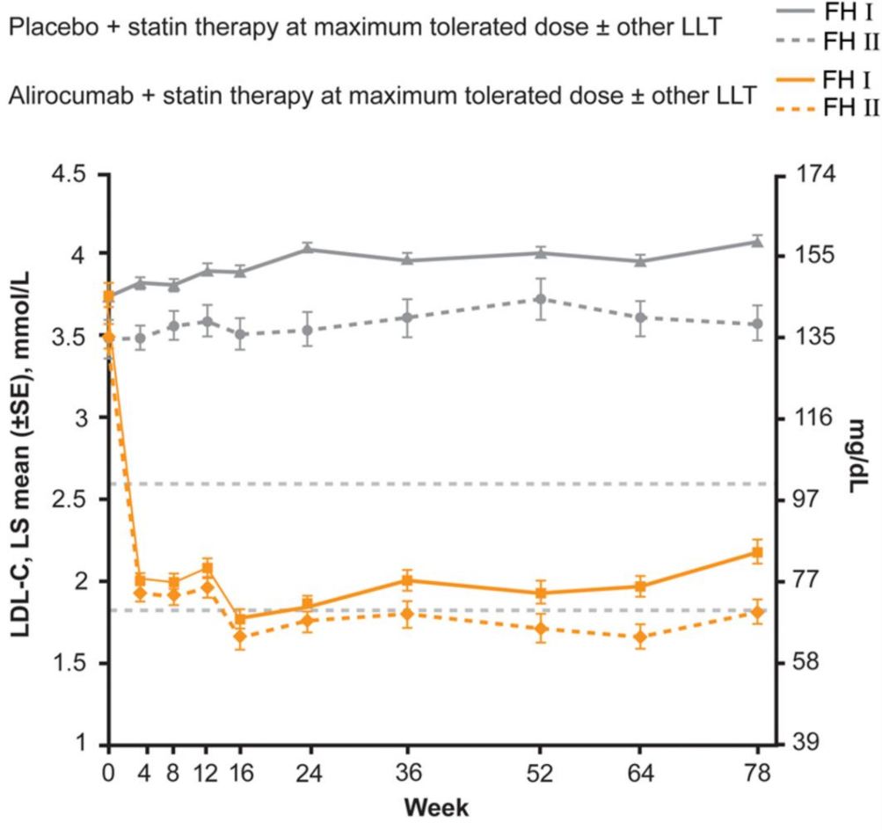
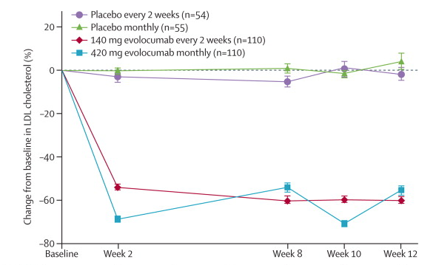
PCSK9 inhibition in HeFH: Efficacy
ODYSSEY FH I and FH II: 78 week results with alirocumab treatment in 735 patients with HeFH
Eur Heart J. 2015;36(43):2996-3003. doi:10.1093/eurheartj/ehv370
PCSK9 inhibition with evolocumab in HeFH (RUTHERFORD-2)
Lancet 2015; 385: 331–40
Notes:
Figure 2 Levels of calculated LDL-C over time (intention-to-treat analysis). ALI, alirocumab; PBO, placebo.
47

Slide 48
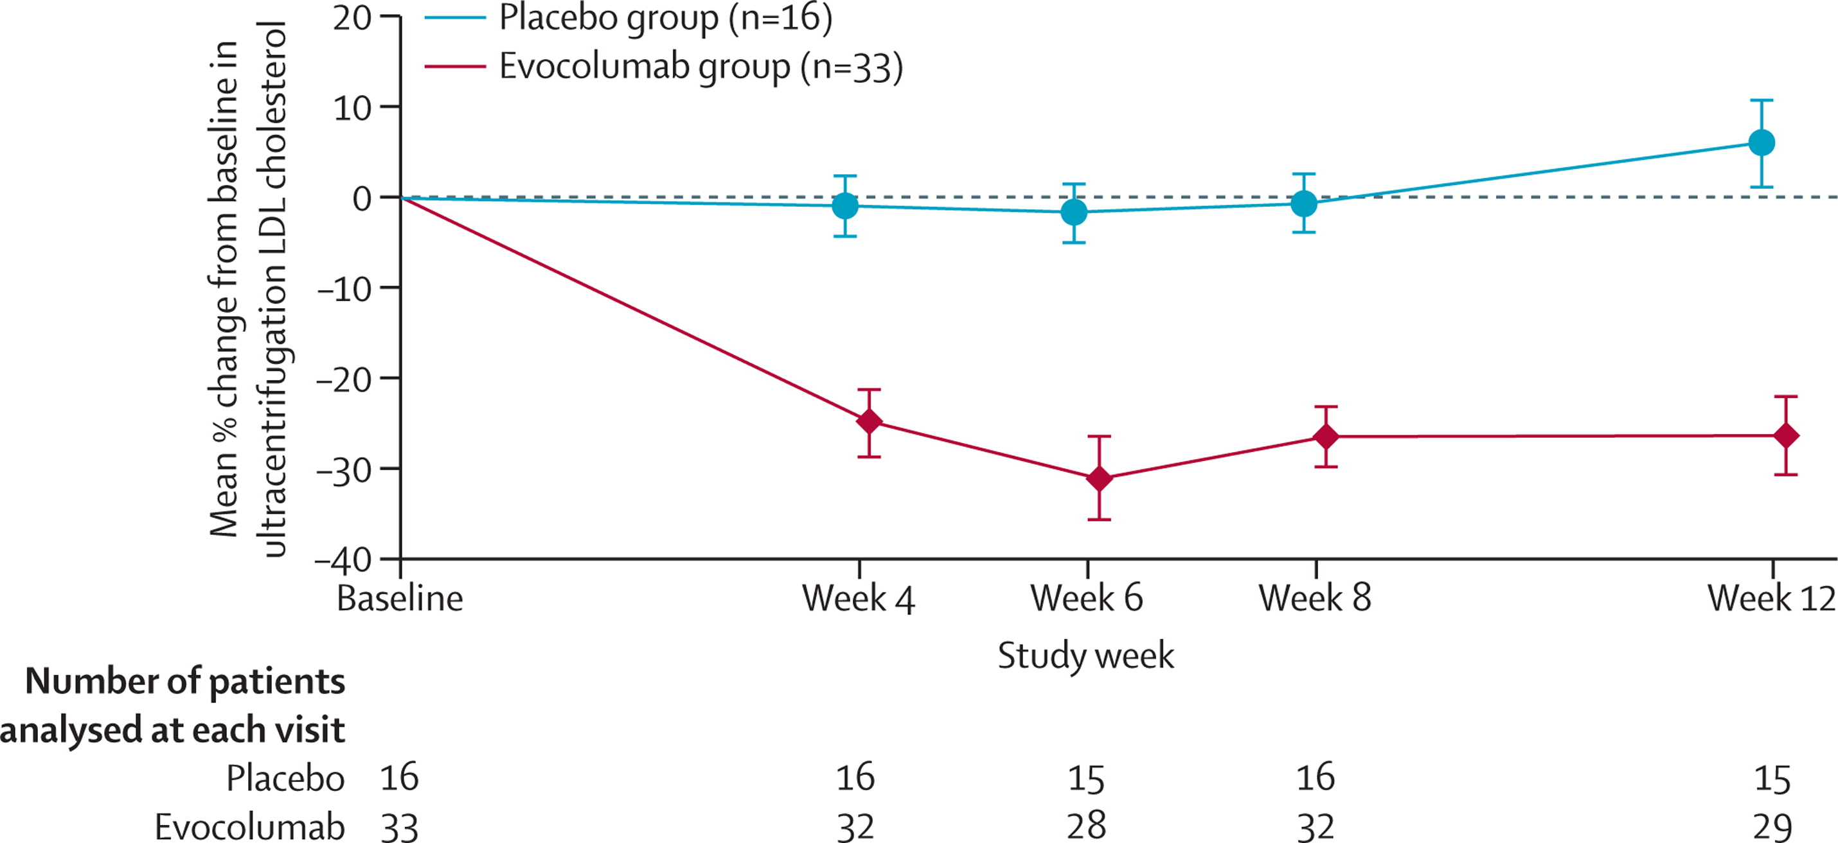
PCSK9 inhibition in HoFH vs HeFH: Efficacy
PCSK9 inhibition with evolocumab in HoFH (TESLA)
Lancet 2015; 385: 341–50
PCSK9 inhibition with evolocumab in HeFH (RUTHERFORD-2)
Lancet 2015; 385: 331–40
Notes:
Key Concept: PCSK9i may be slightly less effective in LDL-C lowering for patients with HoFH due to fewer or absent functioning LDL receptors.
48

Slide 49
Summary:
What we know about PCSK9 inhibitors…
Safe and highly effective in LDL-C lowering
Reduce CV events when added to statin therapy + ezetimibe
Very low levels of LDL-C appear to be safe and effective
Expensive in the US
    Important to identify high-risk patients with greatest benefit
LDL-C = low-density lipoprotein cholesterol; PCSK9 = proprotein convertase subtilisin/kexin type 9 serine protease.

Slide 50
For the Future:
What we have learned from sub-analyses?
Assess latest clinical evidence from sub-analyses regarding outcomes benefits
Identify higher-risk patients who have demonstrated benefit with PCSK9 inhibitor therapy
LDL-C = low-density lipoprotein cholesterol; PCSK9 = proprotein convertase subtilisin/kexin type 9 serine protease.

Slide 51
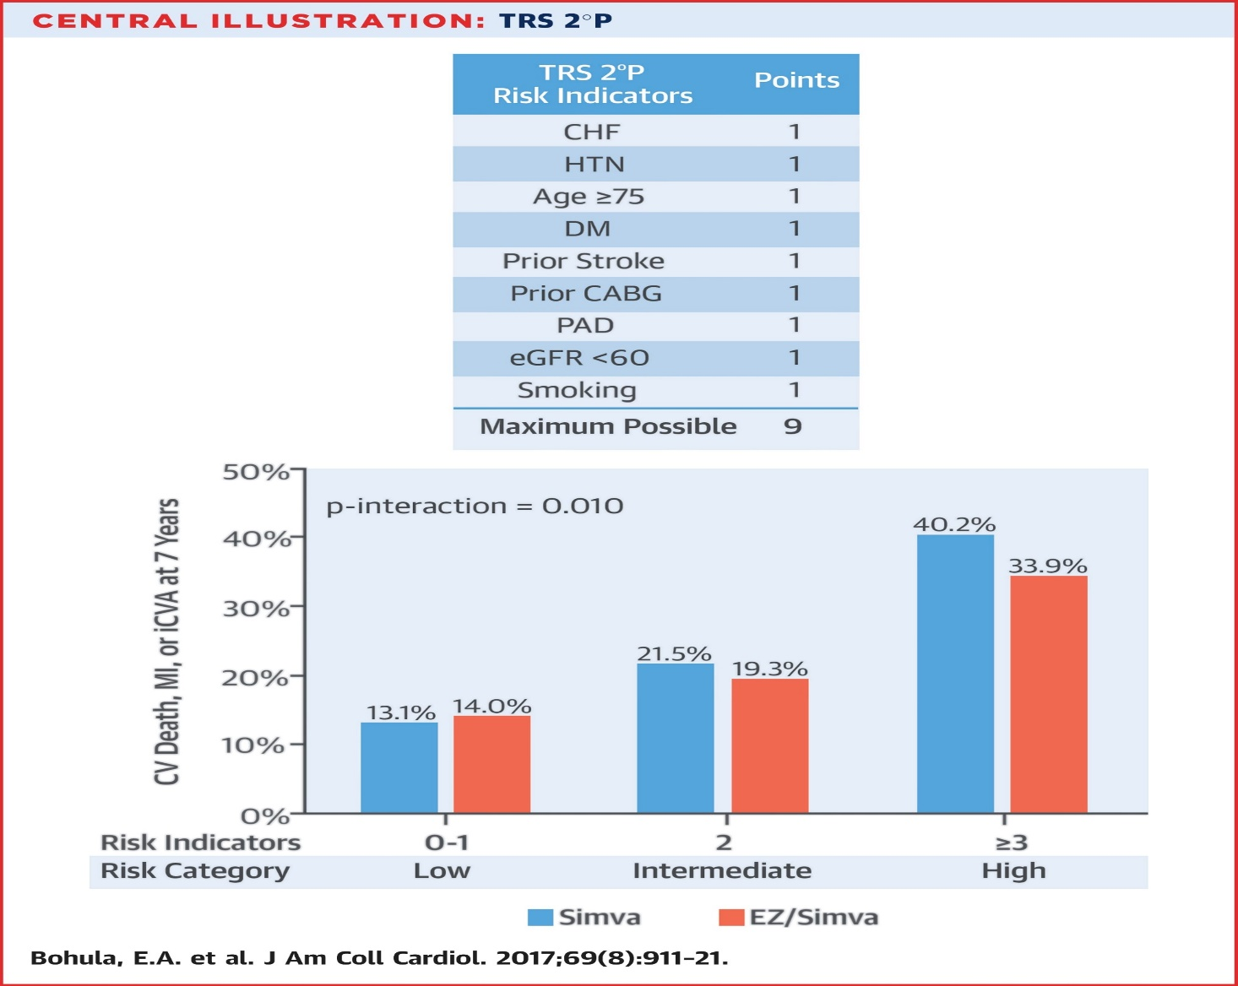
Why Do we Have a Very-High Risk Clinical ASCVD Category?- Learnings from IMPROVE-IT
ARR 6.3%, NNT 16
ARR 2.2%, NNT 45
Bonaca MP, et al. Lancet Diabetes Endocrinol. 2018 Dec;6(12):934-943.

Slide 52
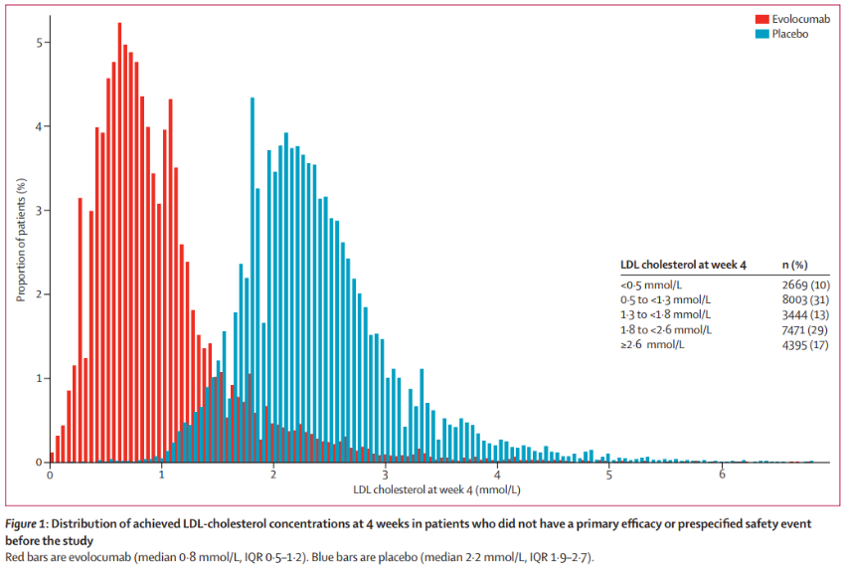
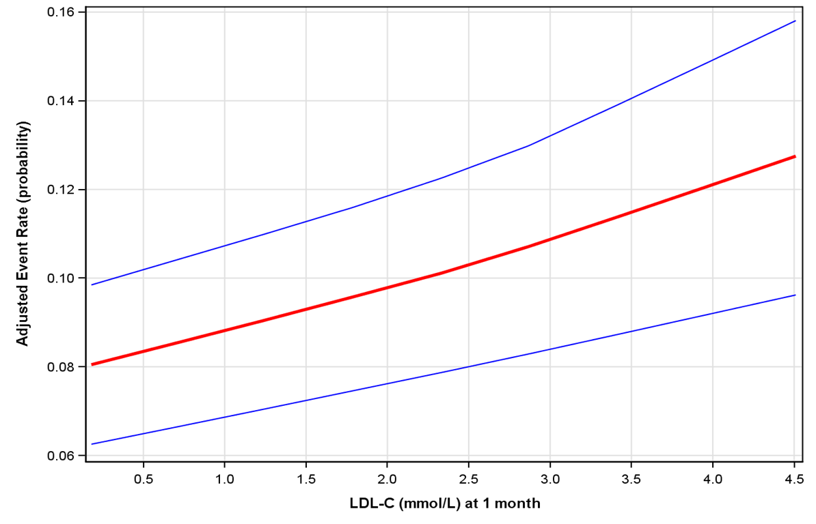
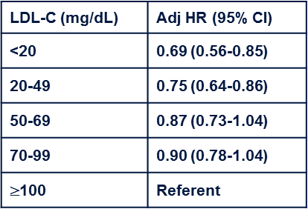
FOURIER: Efficacy and safety of very low levels of LDL-C with evolocumab
10% achieved LDL-C <0.5 mmol/L or 20 mg/dL
41% achieved LDL-C <1.3 mmol/L or 50 mg/dL
Monotonic relationship between achieved LDL-C and CVOTs down to LDL-C <0.2 mmol/L (<10 mg/dL).
No safety concerns with very low LDL-C levels over a median of 2.2 years.
Notes:
2669 (10%) of 25982 patients achieved LDL-cholesterol concentrations of less than 0·5 mmol/L (20 mg/dl), 8003 (31%) patients achieved concentrations between 0·5 and less than 1·3 mmol/L (20-50 mg/dl), 3444 (13%) patients achieved concentrations between 1·3 and less than 1·8 mmol/L 50-70 mg/dl), 7471 (29%) patients achieved concentrations between 1·8 to less than 2·6 mmol/L 70-100 mg/dl), and 4395 (17%) patients achieved concentrations of 2·6 mmol/L or higher (>100 mg/dl).
There was a highly significant monotonic relationship between low LDL-cholesterol concentrations and lower risk of the primary and secondary efficacy composite endpoints extending to the bottom first percentile (LDL-cholesterol concentrations of less than 0·2 mmol/L; p=0·0012 for the primary endpoint, p=0·0001 for the secondary endpoint). Conversely, no significant association was observed between achieved LDL cholesterol and safety outcomes, either for all serious adverse events or any of the other nine prespecified safety events.

Slide 53
Effect of Evolocumab by Universal MI Type
HR 0.73
P<.001
HR 0.68
P<.001
HR 1.09
P=NS
HR 0.65
P=.004
Wiviott SD, et al. Circulation 2017;136:A16714.
Due to small numbers, Types 3 and 5 are not presented individually

Slide 54


Effect of Evolocumab by MI Type:
NSTEMI and STEMI
NSTEMI
STEMI
HR 0.77
(95% CI 0.68-0.88)
P<.001
HR 0.64
(95% CI 0.49-0.84)
P<.001
3-Year KM Rate
Days from Randomization
Wiviott SD, et al. Circulation 2017;136:A16714.

Slide 55
CV Death, MI or Stroke in Patients With and Without Peripheral Artery Disease
Placebo
14%
Evolocumab
PAD
N=3642
27% RRR
HR 0.73
(0.59-0.91)
P=.0040
13.0%
12%
PAD
3.5% ARR
NNT_{2.5y} 29
10%
9.5%
8%
7.6%
No PAD
1.4% ARR
NNT_{2.5y} 72
CV Death, MI, or Stroke
6%
6.2%
No PAD
N=23,922
HR 0.81
95% CI (0.73-0.90)
P<.001
4%
2%
P_{interaction} =0.41
0%
0
90
180
270
360
450
540
630
720
810
900
Days from Randomization

Slide 56
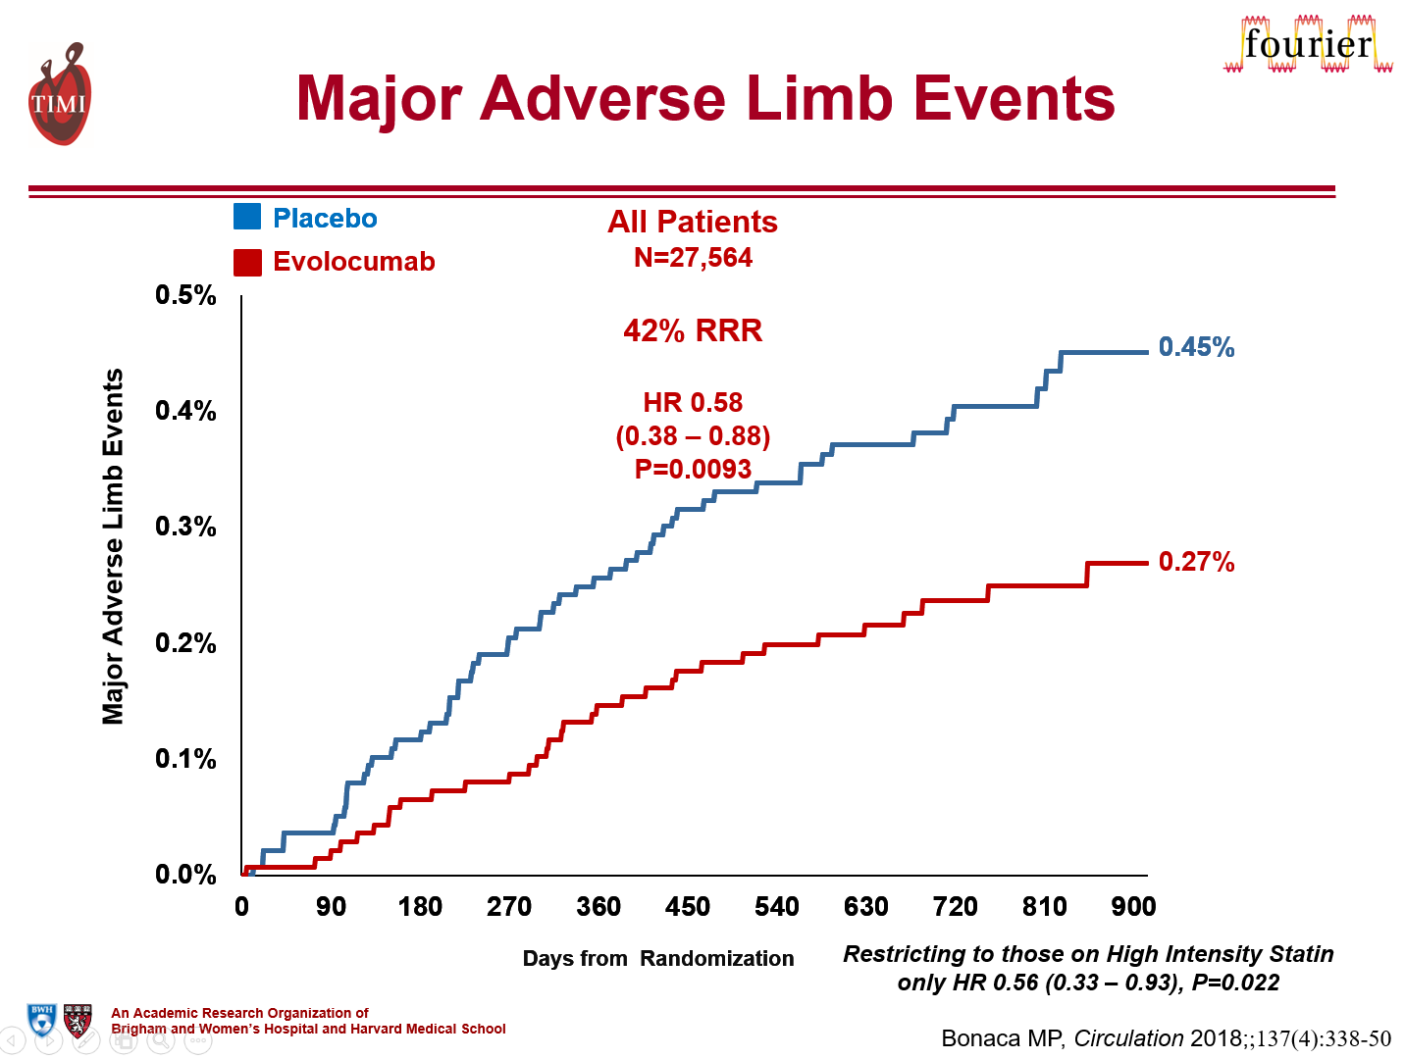


Slide 57
Clinical Benefits of PCSK9i by Extent of CAD and Baseline LDL-C levels
ARR: 1.6% vs. 3.4%;
NNT 64 vs. 29
Sabatine MS et al. Circulation. 2018 Aug 21;138(8):756-766; Schwartz GG et al. N Engl J Med. 2018 Nov 29;379(22):2097-2107.

Slide 58
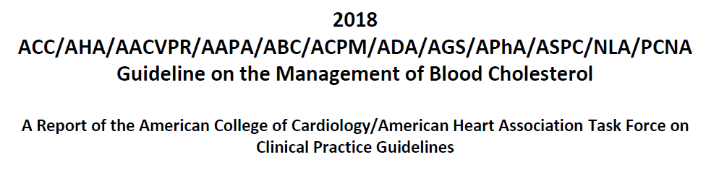
2018 ACC/AHA Blood cholesterol Guidelines
Classify ASCVD patients into 2 categories
  ASCVD not at very high-risk
  ASCVD at very high-risk
Based on RCTs, categories identify patients more likely to benefit from PCSK9i
https://www.ahajournals.org/doi/pdf/10.1161/CIR.0000000000000624

Slide 59
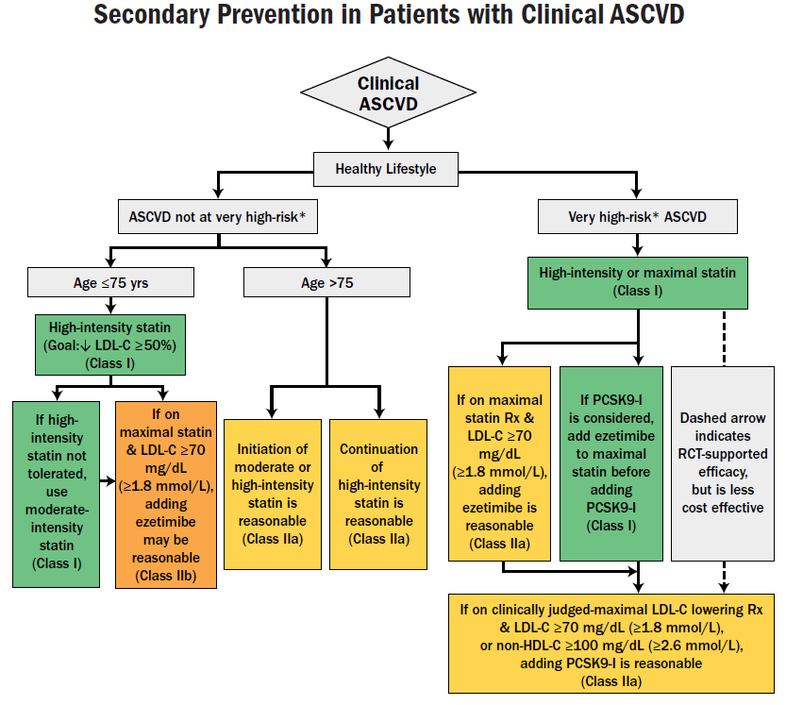
Major ASCVD Events:
Recent ACS
History of prior MI
History of ischemic stroke
Symptomatic PAD
High-Risk Conditions
Age >65 years
HeFH
Prior CABG or PCI
Diabetes
Hypertension
Chronic kidney disease
Current smoking
LDL-C > 2.6 mmol/L (100 mg/dL) despite maximally tolerated statin and ezetimibe
History of HF
Recurrent ASCVD events
Major ASCVD event with >1 risk conditions
*Very high risk includes a history of multiple major ASCVD events or 1 major ASCVD event and multiple high-risk conditions.
https://www.ahajournals.org/doi/pdf/10.1161/CIR.0000000000000624

Slide 60
In ASCVD patients NOT at VERY high risk, may be reasonable to add ezetimibe if inadequate lowering of LDL-C on maximally tolerated statin therapy
https://www.ahajournals.org/doi/pdf/10.1161/CIR.0000000000000624

Slide 61
In ASCVD patients at VERY high risk, initiate ezetimibe prior to consideration of PCSK9i if inadequate lowering of LDL-C on maximally tolerated statin therapy
https://www.ahajournals.org/doi/pdf/10.1161/CIR.0000000000000624

Slide 62
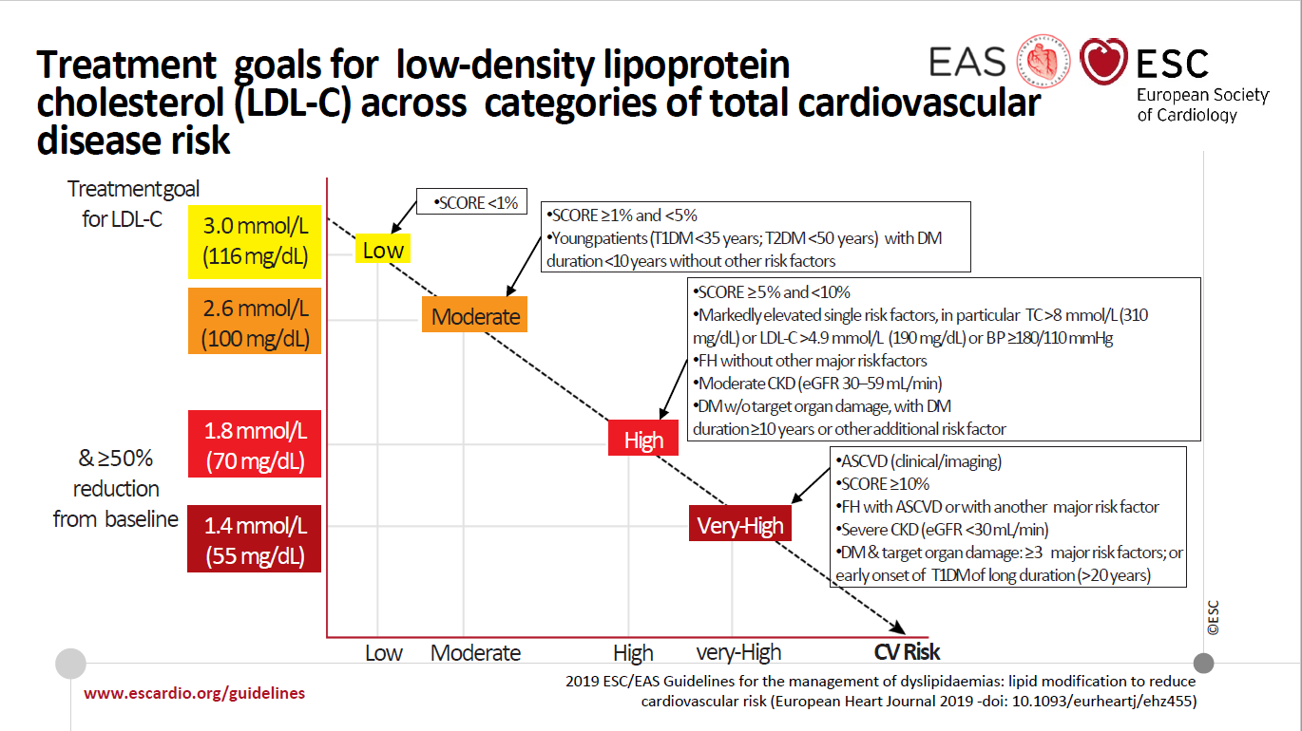

Slide 63
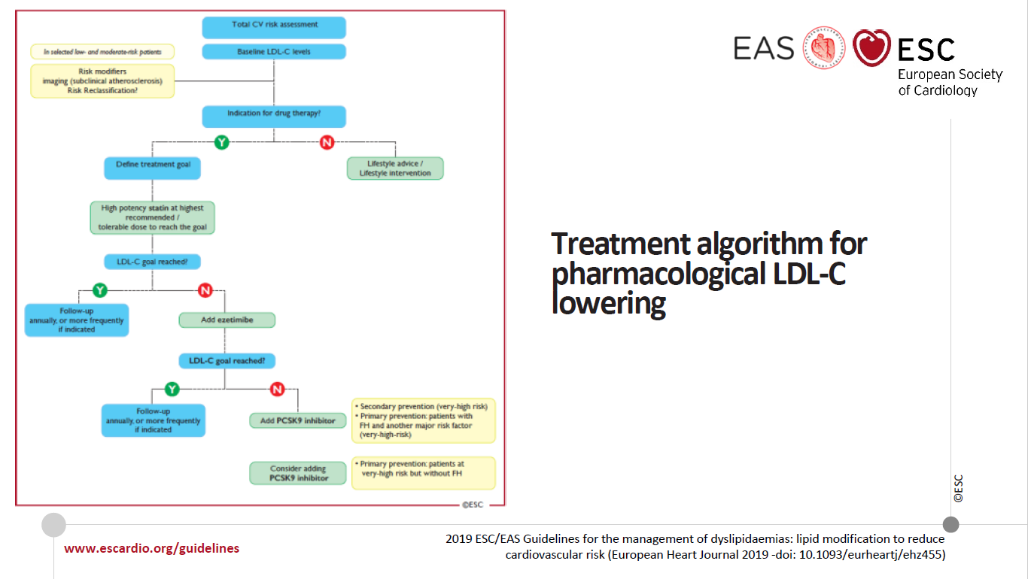

Slide 64
Summary:
Insights to identify the high-risk patient
PCSK9 inhibition in ASCVD Patient
    Greater benefit in patients with recent MI, greater extent of disease, type 1 MI, presence of PAD, higher baseline LDL-C
    “Very high-risk ASCVD” patients seem to derive the most benefit from PCSK9i (and ezetimibe)

Slide 65
Objectives
By the end of this activity, participants will be able to:
Discuss residual cardiovascular risk evaluation and management
Review recent CV outcomes trials with addition of non-statin medication to statin therapy
Compare and contrast 2 major RCTs with PCSK9 inhibitors (PCSK9i)
Identify major groups of patients who have demonstrated benefit with PCSK9i

Slide 66
Thank you!

Slide 67
Program Evaluation Assessment

Slide 68
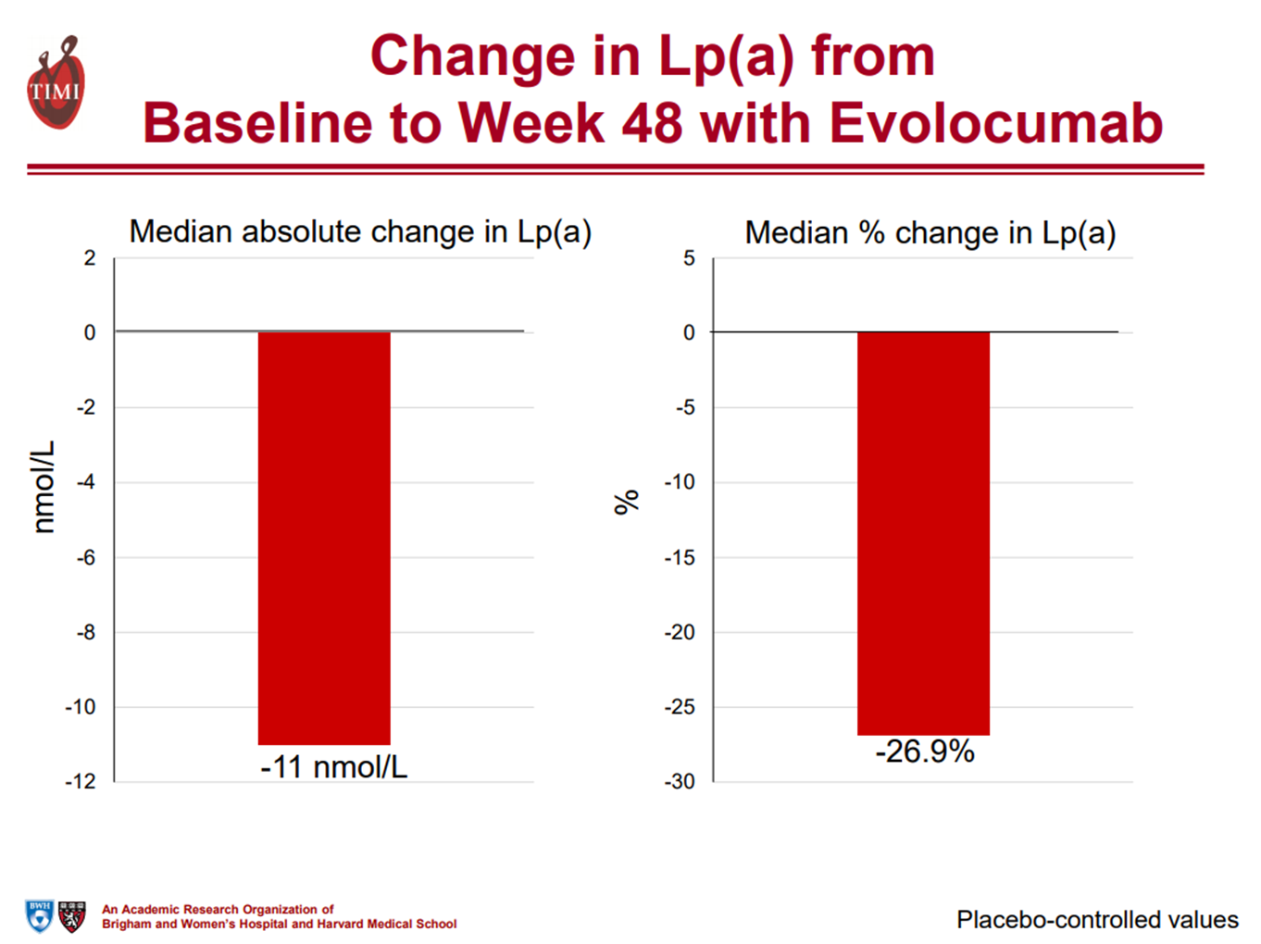
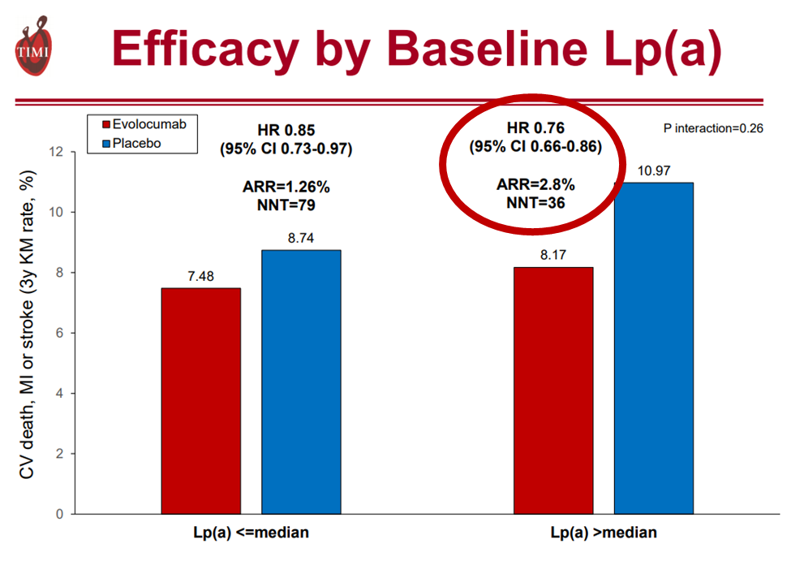

Lp(a), CV risk, and evolocumab: FOURIER
EAS, May 7, 2018

Slide 69
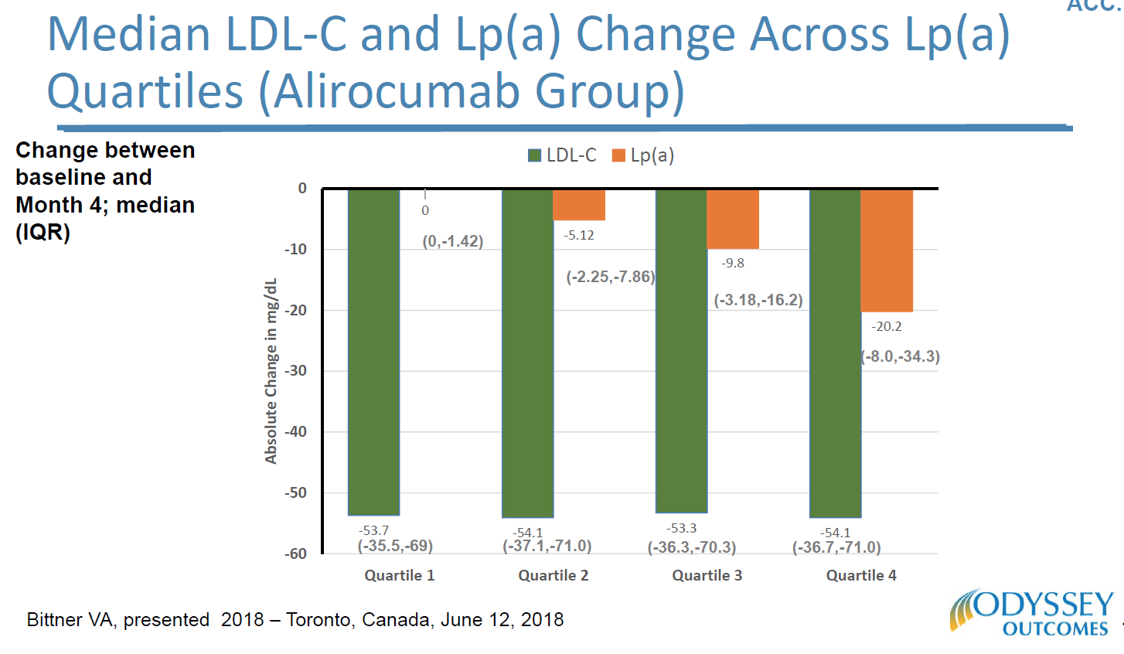

Lp(a) and alirocumab: ODYSSEY Outcomes
Bittner VA, presented ISA, 2018. Toronto, Canada, June 12, 2018

Slide 70
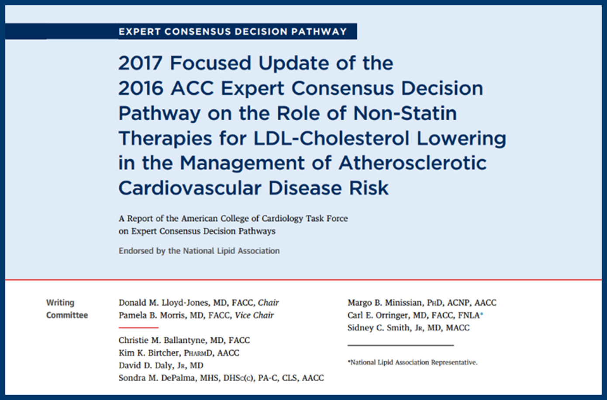
Populations to Consider for Non-statin Therapies
Patient Type | LDL-C (non HDL-C) Thresholds for Consideration of Net Benefit of Non-statin Therapy for Patients on Maximally Tolerated Statin | Therapy Recommendation
ASCVD without comorbidities | <50% LDL-C reduction or LDL-C >70 mg/dL (non HDL-C >100 mg/dL) | Ezetimibe 1st; PCSK9 inhibitor 2nd
ASCVD with comorbidities | <50% LDL-C reduction or LDL-C >70 mg/dL (non HDL-C >100 mg/dL) | Ezetimibe* or PCSK9 inhibitor†
ASCVD and baseline LDL-C ≥190 mg/dL | <50% LDL-C reduction or LDL-C >70 mg/dL (non HDL-C >100 mg/dL) | Ezetimibe* or PCSK9 inhibitor†
Baseline LDL-C ≥190 mg/dL without ASCVD | <50% LDL-C reduction or LDL-C >100 mg/dL (non HDL-C >130 mg/dL) | Ezetimibe* or PCSK9 inhibitor†
40-75 years without ASCVD and with DM and baseline LDL-C 70-189 mg/dL | <50% LDL-C reduction or LDL-C >100 mg/dL (non HDL-C >130 mg/dL) | Ezetimibe or bile acid sequestrant‡
40-75 years without ASCVD or DM and baseline LDL-C 70-189 mg/dL | <50% LDL-C reduction or LDL-C >100 mg/dL (non HDL-C >130 mg/dL) | Ezetimibe or bile acid sequestrant‡
Lloyd-Jones DM, et al. JACC. 2017;70(14)1785-1822.
Slide, Ty Gluckman

Slide 71
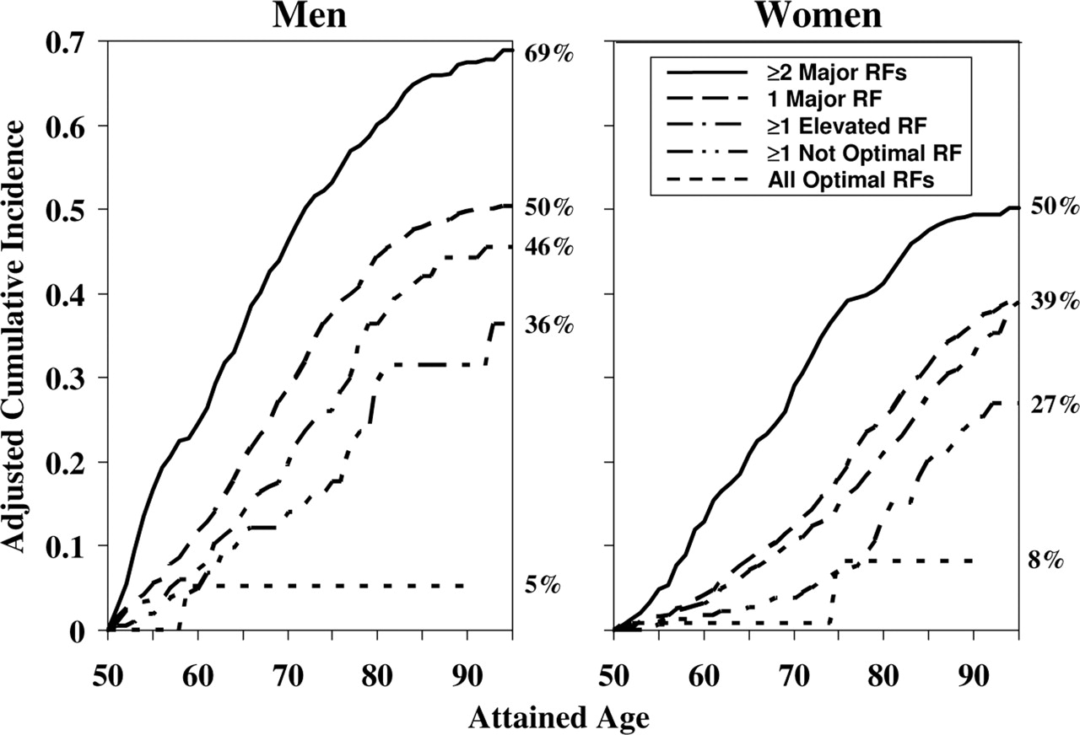
Lifetime Risk with Aggregate Risk Factor Burden
Lifetime risk with aggregate risk factor burden is more discriminating than any single risk factor alone.
Address ALL risk factors for optimal ASCVD risk reduction!
Lloyd-Jones D, et al. Circulation. 2006;113:791-798
Notes:
Notes
Lifetime risk for ASCVD had not previously been estimated, and the effect of risk factor burden on lifetime risk was unknown. A study estimated lifetime risks for all Framingham Heart Study participants who were free of CVD (myocardial infarction, coronary insufficiency, angina, stroke, claudication) at 50 years of age. The study followed 3564 men and 4362 women for 111,777 person-years:
1757 had CVD events and 1641 died free of CVD
At 50 years of age, lifetime risks were 51.7% (95% CI, 49.3 to 54.2) for men and 39.2% (95% CI, 37.0 to 41.4) for women, with median survivals of 30 and 36 years, respectively.
With more adverse levels of single risk factors, lifetime risks increased and median survivals decreased.
The absence of established risk factors at 50 years of age is associated with very low lifetime risk for CVD and markedly longer survival.
The figure shows that compared with participants with ≥2 major risk factors, those with optimal levels had substantially lower lifetime risks (5.2% versus 68.9% in men, 8.2% versus 50.2% in women) and markedly longer median survivals (>39 versus 28 years in men, >39 versus 31 years in women).
These findings support the concept of estimating global risk rather than focusing on single risk factors to make treatment decisions because of better discrimination of lifetime risk with aggregate risk factor burden than with any single risk factor alone, and relying solely on estimates of short-term absolute risk is problematic
Additional notes
Cumulative incidence of CVD adjusted for the competing risk of death for men and women according to aggregate risk factor (RF) burden at 50 years of age.
The numbers at the right of each graph represent the adjusted cumulative incidence to 95 years of age or the lifetime risk for CVD.
Optimal risk factors are defined as total cholesterol <4.65 mmol/L (<180 mg/dL), blood pressure <120/<80 mm Hg, nonsmoker, and nondiabetic.
Suboptimal risk factors are defined as total cholesterol of 4.65 to 5.15 mmol/L (180 to 199 mg/dL), systolic blood pressure of 120 to 139 mm Hg, diastolic blood pressure of 80 to 89 mm Hg, nonsmoker, and nondiabetic.
Elevated risk factors are defined as total cholesterol of 5.16 to 6.19 mmol/L (200 to 239 mg/dL), systolic blood pressure of 140 to 159 mm Hg, diastolic blood pressure of 90 to 99 mm Hg, nonsmoker, and nondiabetic.
Major risk factors are defined as total cholesterol ≥6.20 mmol/L (≥240 mg/dL), systolic blood pressure ≥160 mm Hg, diastolic blood pressure ≥100 mm Hg, smoker, and diabetic.
Source
Lloyd-Jones DM, Leip EP, Larson MG et al. Prediction of lifetime risk for cardiovascular disease by risk factor burden at 50 years of age. Circulation 2006;113:791-8.

Slide 72
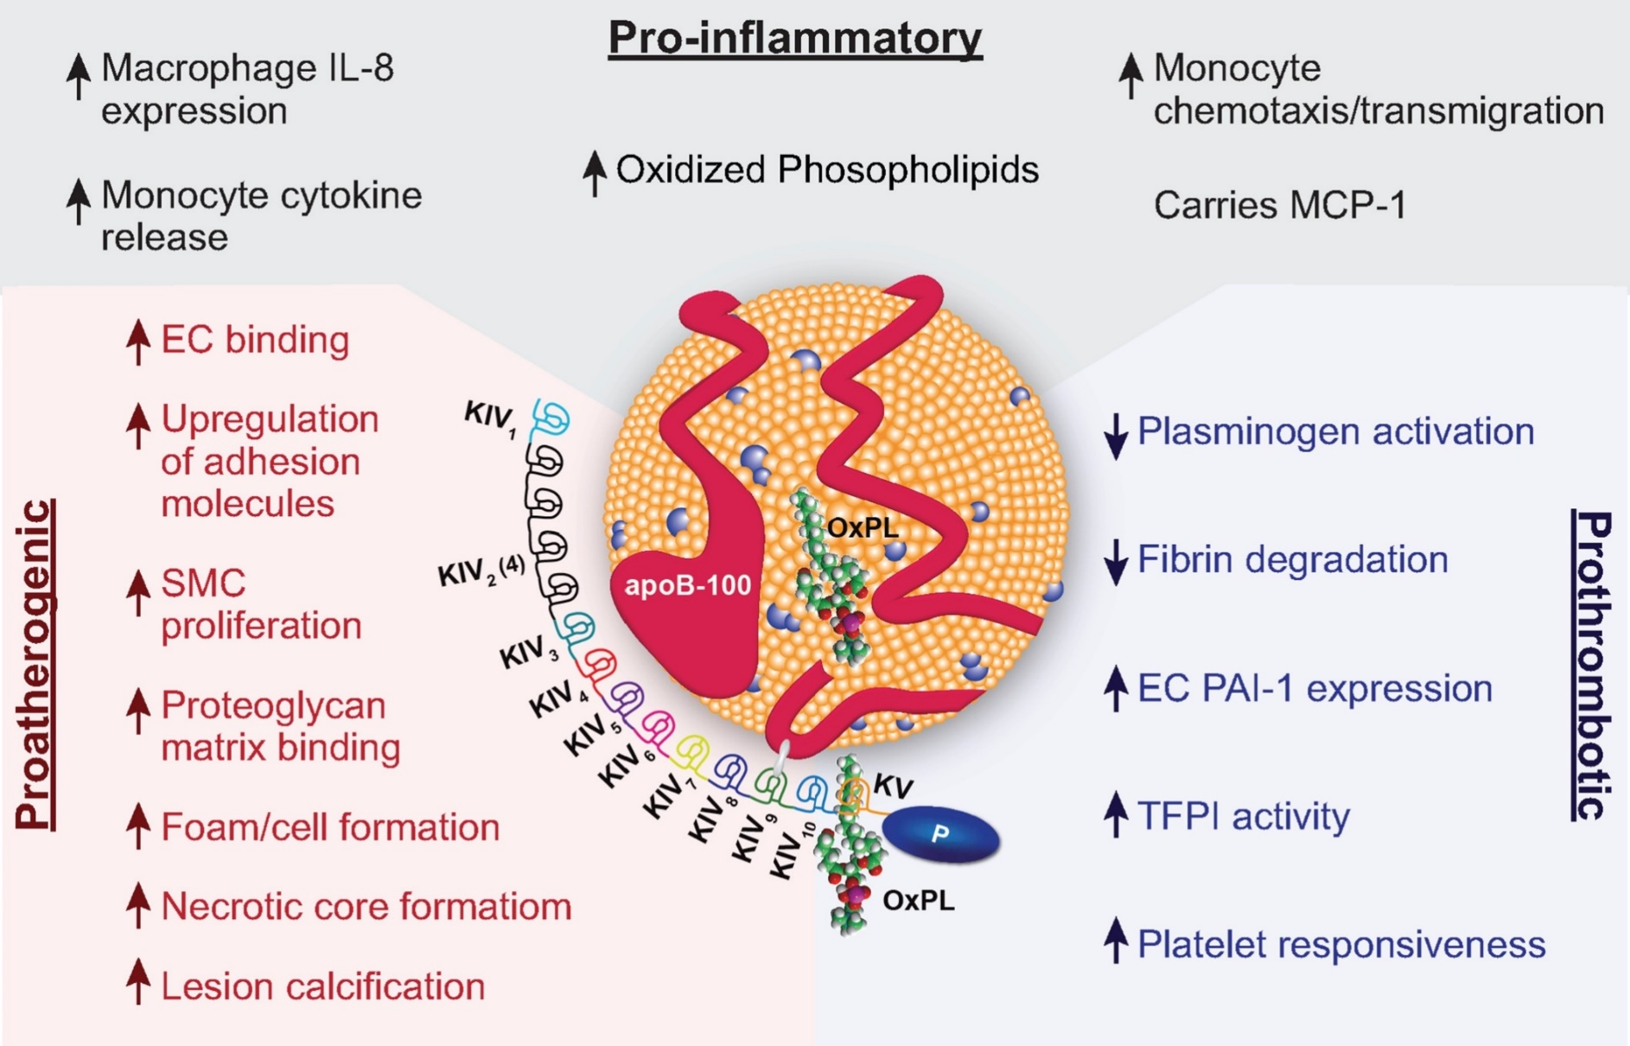
Lipoprotein (a): Effects on atheroma and CV events
Triple Threat:
Pro-atherogenic
Pro-inflammatory
Pro-thrombotic
Lp (a) increases
CAD Risk
Tsimikas S, JACC 2017;69:692-711.

Slide 73
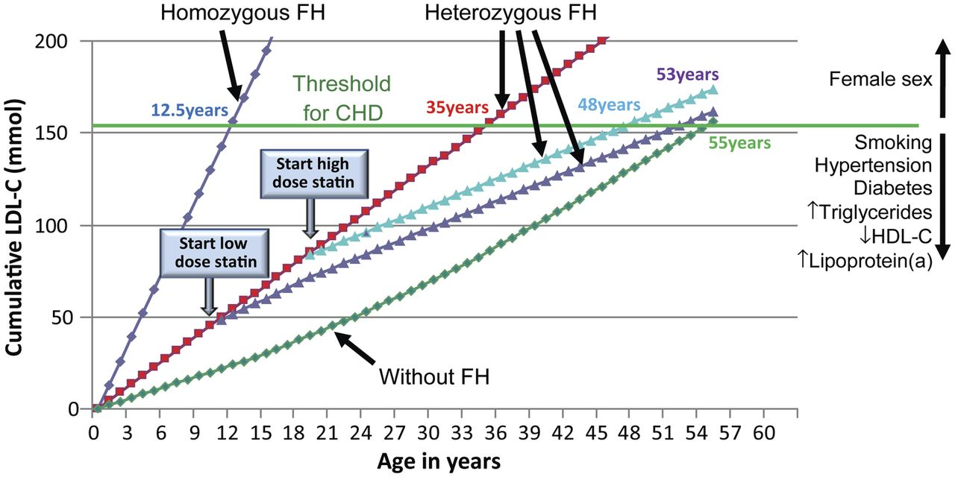
Familial hypercholesterolemia (FH) and ASCVD risk
European Heart Journal. doi:10.1093/eurheartj/eht273
Notes:
Key Concept: Patients with lifelong elevations of LDL-C (FH) have significantly increased risk of premature ASCVD and require early and intensive therapy to reduce risk.

Slide 74
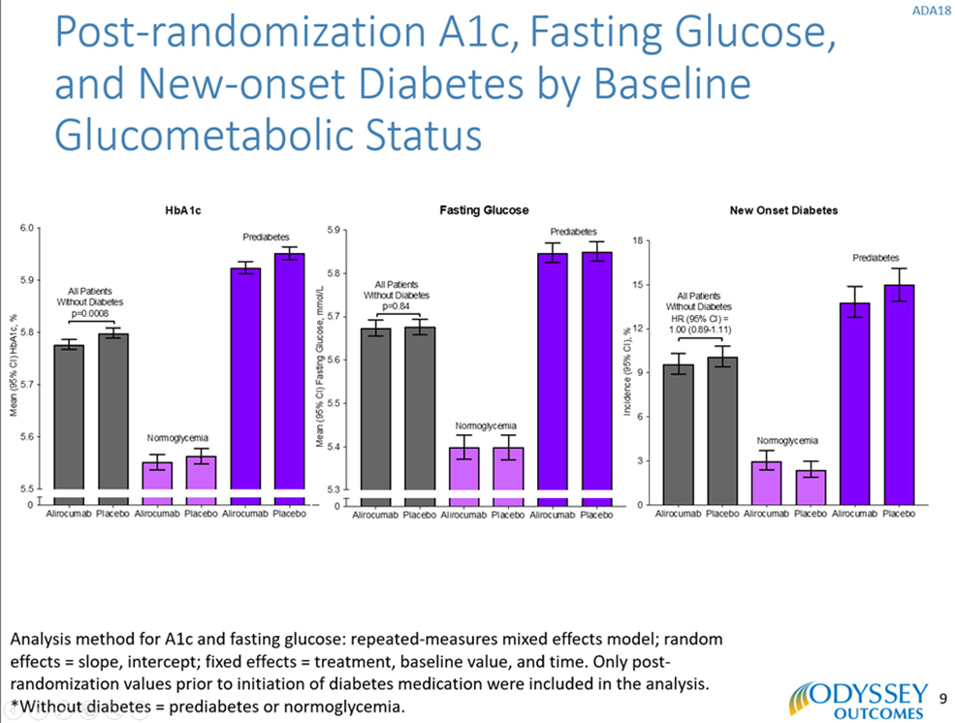
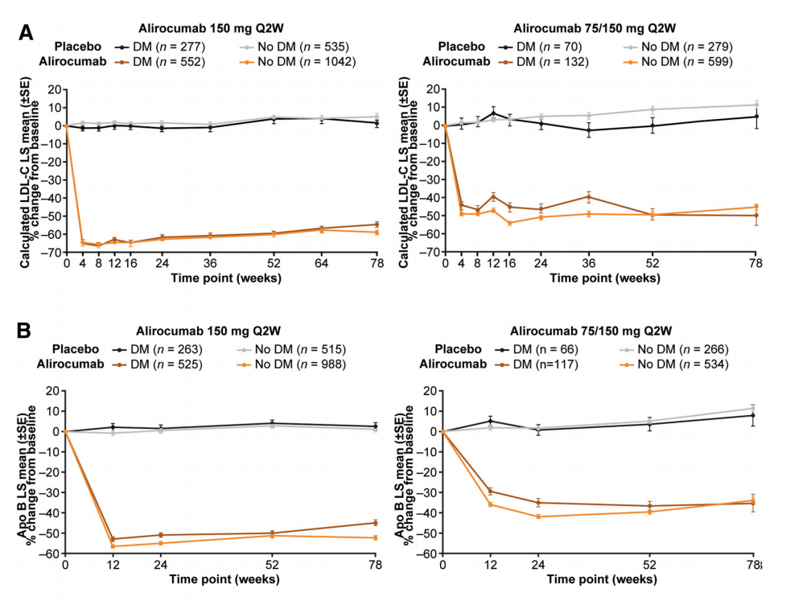
Efficacy and safety of alirocumab in DM: Pooled analyses from phase 3 trials
Diabetes Therap 2018;9:1317-1334; Ray KK, American Diabetes Association 2018 (Orlando, FL)

Slide 75
Prescribing PCSK9i in Clinical Practice

Slide 76
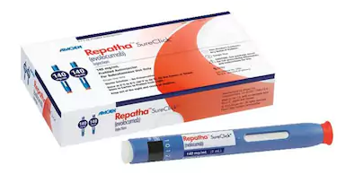

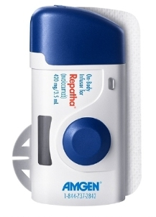
Prescribing, dosing, and administration: evolocumab
Dosing
  Single-use (1 time) prefilled autoinjector
  Single-use prefilled syringe
  Single-use on-body infuser with prefilled cartridge
    140 mg SQ every 14 days
    420 mg SQ once monthly
Store in refrigerator

Slide 77
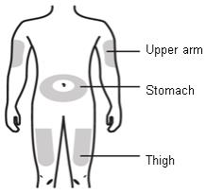
Prescribing, dosing, and administration: evolocumab
Administration
  Remove from refrigerator at least 30 minutes prior (pen injector) or >45 minutes (on-body infusor)
    Do not freeze
    Do not warm
  Wash hands
  Clean skin site with alcohol swab
Vary administration sites
  Thigh
  Periumbilical
  Upper arm

Slide 78
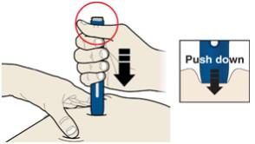
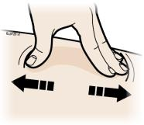


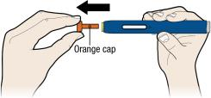
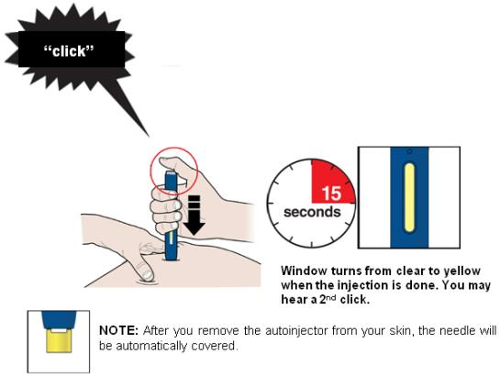

Prescribing, dosing, and administration: evolocumab
Single use pen injector
  Stretch or pinch skin
  Remove orange cap
  Press firmly and press start button
  Wait ~15 seconds or until “click”
  Dispose immediately

Slide 79









Prescribing, dosing, and administration: evolocumab
Single use on-body infuser
  Stretch or pinch skin (avoid hair, scars)
  Open cartridge door
  Clean bottom of cartridge
  Insert and press firmly
  Close cartridge door
  Remove adhesive, place on skin
  Press “Start” button
    9 minute injection
  When complete remove and dispose of device

Slide 80

Total Key Secondary Endpoint
Events: CV Death / MI / Stroke
1268
Additional Events
RR 0.79
(0.61-1.02)
1014
-254
-57
Total Events
RR 0.81
(95% CI 0.73-0.90)
P<.001
# Events
-197
1st Event
HR 0.80
(0.73-0.88)
Placebo
Evolocumab
Notes:
http://circ.ahajournals.org/content/136/Suppl_1/A15100

Slide 81


Safety and efficacy of evolocumab: Baseline LDL-C and statin therapy
Evolocumab was equally effective in reducing CV events in patients with stable ASCVD regardless of whether…
  Background statin was of maximal or submaximal potency
  Baseline LDL-C was <70 or >70 mg/dL
  <1.8 or >1.8 mmol/L
Notes:
Objective To compare outcomes of evolocumab vs placebo in patients with stable atherosclerotic cardiovascular disease and a baseline LDL-C of less than 70 mg/dL and in those receiving background treatment with a maximal-potency statin.
Design, Setting, and Participants This secondary ad hoc analysis of the Further Cardiovascular Outcomes Research With PCSK9 Inhibition in Subjects With Elevated Risk (FOURIER) trial compared randomized treatments in 2 subgroups of patients with stable atherosclerotic cardiovascular disease currently receiving statin. Patients were classified by a baseline LDL-C of less than 70 or at least 70 mg/dL and by statin intensity (maximal: atorvastatin calcium, 80 mg/d, or rosuvastatin, 40 mg/d; submaximal: all other dosages). Patients with baseline LDL of less than 70 mg/dL either had a final screening LDL-C of at least 70 mg/dL or a final screening non–high-density lipoprotein cholesterol level of at least 100 mg/dL. Data were retrieved from 2013 to 2016 and analyzed in 2017 based on intention to treat.
Main Outcomes and Measures The primary efficacy endpoint was the composite of cardiovascular death, myocardial infarction, stroke, hospitalization for unstable angina, or coronary revascularization. The secondary efficacy endpoint was the composite of cardiovascular death, myocardial infarction, or stroke. Safety outcomes included adverse events and events of interest identified in the FOURIER trial. Interaction testing was used to assess the consistency of results in patients who did vs did not satisfy the above criteria.
Results A total of 27 564 patients (75.4% men and 24.6% women; mean [SD] age, 62.5 [9.0] years) were included in the analysis. Of 2034 patients (7.4%) who had a baseline LDL-C of less than 70 mg/dL, evolocumab reduced the risk for the primary endpoint (hazard ratio [HR], 0.80; 95% CI, 0.60-1.07) to a similar degree as in the 25 529 patients who had baseline LDL-C of at least 70 mg/dL (HR 0.86; 95% CI, 0.79-0.92; P = .65 for interaction; 1 patient was missing baseline LDL-C data). Of 7533 patients (27.3%) receiving maximal-potency statins, evolocumab significantly reduced the primary endpoint (HR, 0.86; 95% CI, 0.75-0.98) to a similar degree as in the 20 031 patients not receiving a maximal-potency statin (HR, 0.85; 95% CI, 0.78-0.93; P = .88 for interaction). The key secondary endpoint was reduced to a similar degree in both analyses. No major safety concerns were identified.
Conclusions and Relevance Evolocumab was equally effective in reducing cardiovascular events in patients with stable atherosclerotic cardiovascular disease regardless of whether the baseline LDL-C was less than 70 or at least 70 mg/dL and whether the background statin was of maximal or submaximal potency.

Slide 82




CV safety and efficacy of evolocumab in patients with and without diabetes: FOURIER
ARR: 2.7%
ARR: 2.0%
No increase in new-onset diabetes
Equally effective in LDL-C lowering in patients with and without diabetes
ARR: 1.6%
ARR: 2.0%
Notes:
In this prespecified analysis of FOURIER, we investigated the efficacy and safety of evolocumab by diabetes status and the effect of evolocumab on glycaemia and risk of developing diabetes.
At study baseline, 11031 patients (40%) had diabetes and 16533 (60%) did not have diabetes (of whom 10344 had prediabetes [63%] and 6189 had normoglycaemia [37%]).
In this prespecified analysis, we investigated the effect of evolocumab on cardiovascular events by diabetes status at baseline, defined on the basis of patient history, clinical events committee review of medical records, or baseline HbA1c of 6·5% (48 mmol/mol) or greater or fasting plasma glucose (FPG) of 7·0 mmol/L or greater.
The primary endpoint was a composite of cardiovascular death, myocardial infarction, stroke, hospital admission for unstable angina, or coronary revascularisation. The key secondary endpoint was a composite of cardiovascular death, myocardial infarction, or stroke.
We also assessed the effect of evolocumab on glycaemia, and on the risk of new-onset diabetes among patients without diabetes at baseline.
HbA1c was measured at baseline then every 24 weeks and FPG was measured at baseline, week 12, week 24, and every 24 weeks thereafter, and potential cases of new-onset diabetes were adjudicated centrally.
In a post-hoc analysis, we also investigated the effects on glycaemia and diabetes risk in patients with prediabetes (HbA1c 5·7–6·4% [39–46 mmol/mol] or FPG 5·6–6·9 mmol/L) at baseline.

Slide 83



Clinical Benefit of Evolocumab by Extent of CAD
Sabatine MS, et al. Circulation. 2018 Apr 6. pii: CIRCULATIONAHA.118.034309.
Notes:
Background -The FOURIER trial recently showed that the PCSK9 inhibitor evolocumab significantly reduced major vascular events in patients with stable atherosclerotic cardiovascular disease, including patients with prior MI. Within the broad group of patients with prior MI, we hypothesized that readily ascertainable features would identify subsets that derive greater clinical risk reduction with evolocumab.
Methods -The 22,351 patients with a prior MI were characterized based on time from most recent MI, number of prior MIs, and presence of residual multivessel coronary artery disease (≥40% stenosis in ≥2 large vessels). The relative and absolute risk reductions in major vascular events including the primary endpoint (CV death, MI, stroke, hospitalization for unstable angina, or coronary revascularization) and the key secondary endpoint (CV death, MI or stroke) with evolocumab in these subgroups were compared.
Results -A total of 8402 patients (38%) were within 2 years of their most recent MI, 5285 patients (24%) had ≥2 prior MIs, and 5618 patients (25%) had residual multivessel CAD. In a multivariable adjusted model that simultaneously included all three high-risk features as well as other baseline covariates, more recent MI, multiple prior MIs, and residual multivessel coronary disease remained independent predictors of cardiovascular outcomes, with adjusted HRs for the primary endpoint of 1.37 (1.22-1.53), 1.78 (1.59-1.99) and 1.39 (1.24-1.56), all P<0.001. The relative risk reductions with evolocumab for the primary endpoint tended to be greater in the high-risk subgroups and were 20% (HR 0.80, 0.71-0.91), 18% (HR 0.82, 0.72-0.93), and 21% (HR 0.79, 0.69-0.91) for those with more recent MI, multiple prior MIs, and residual multivessel CAD, whereas they were 5% (HR 0.95, 0.85-1.05), 8% (HR 0.92, 0.84-1.02), and 7% (HR 0.93, 0.85-1.02) in those without, respectively. Given the higher baseline risk, the respective absolute risk reductions at 3 years exceeded 3% in the high-risk groups (3.4%, 3.7%, and 3.6%) vs. approximately 1% in the low-risk groups (0.8%, 1.3%, and 1.2%). Conclusions -Patients closer to their most recent MI, with multiple prior MIs or with residual multivessel CAD are at high risk for major vascular events and experience substantial risk reductions with LDL-C lowering with evolocumab.

Slide 84
Summary:
Insights to identify the high-risk patient
PCSK9 inhibition
  Diabetes
    Is not associated with new onset diabetes or worsening diabetes control
  ASCVD
    Greater benefit in patients with recent MI, greater extent of disease, type 1 MI

Slide 85
Summary:
Insights to identify the high-risk patient
PCSK9 inhibition
  PAD
    Reduces MACE in patients with symptomatic PAD
    Reduces major adverse limb events
  Lp(a)
    Lowers Lp(a) with greatest reductions in patients with higher baseline levels
    Greatest CV risk reduction in patients with high Lp(a)

Slide 86
2019 ESC/EAS Dyslipidemia Guidelines
Mach F, Baigent C, Catapano AL, et al. Eur Heart J. 2019 Aug 31

