Slide 1
2024 ACC/AHA/AACVPR/APMA/ABC/SCAI/SVM/SVN/SVS/SIR/VESS Guideline for the Management of Lower Extremity Peripheral Artery Disease
A Report of the American College of Cardiology/American Heart Association Joint Committee on Clinical Practice Guidelines
Developed in Collaboration With and Endorsed by the American Association of Cardiovascular and Pulmonary Rehabilitation, American Podiatric Medical Association, Association of Black Cardiologists, Society for Cardiovascular Angiography and Interventions, Society for Vascular Medicine, Society for Vascular Nursing, Society for Vascular Surgery, Society of Interventional Radiology, and Vascular & Endovascular Surgery Society

Slide 2
Citation
This slide set is adapted from the 2024 ACC/AHA/AACVPR/APMA/ABC/SCAI/SVM/SVN/SVS/SIR/VESS Guideline for the Management of Lower Extremity Peripheral Artery Disease. Published ahead of print May 14, 2024, available at: Circulation. https://www.ahajournals.org/doi/10.1161/CIR.0000000000001251 And Journal of the American College of Cardiology, published online ahead of print May 14, 2024. J Am Coll Cardiol. https://www.jacc.org/doi/10.1016/j.jacc.2024.02.013
© 2024 the American Heart Association, Inc. and the American College of Cardiology Foundation. All rights reserved. This article has been published in Circulation and the Journal of the American College of Cardiology.

Slide 3
2024 Writing Committee Members*
Heather L. Gornik, MD, FAHA, MSVM, Chair
Herbert D. Aronow, MD, MPH, FACC, FSCAI, FSVM, Co-Vice Chair
Philip P. Goodney, MD, MS, DFSVS, Co-Vice Chair
Shipra Arya, MD, SM
Luke Packard Brewster, MD, PhD, MA, RVT, DFSVS, FAHA†
Lori Byrd, MS‡
Venita Chandra, MD§
Douglas E. Drachman, MD, FACC, FAHA, FSCAI
Jennifer M. Eaves, DNP, MSN, RN
Jonathan K. Ehrman, PhD, FACC, FAHA, FAACVPR║
John N. Evans, DPM¶
Thomas S.D. Getchius
J. Antonio Gutiérrez, MD, MHS
Beau M. Hawkins, MD, FACC, FSCAI, FSVM
Connie N. Hess, MD, MHS, FACC, FAHA, FSCAI
Karen J. Ho, MD
W. Schuyler Jones, MD, FACC#
Esther S.H. Kim, MD, MPH, FAHA, FSVM**
Scott Kinlay, MBBS, PhD, FACC
Lee Kirksey, MD, MBA††
Debra Kohlman-Trigoboff, RN, MS, ACNP-BC, CVN
Chandler A. Long, MD
Amy West Pollak, MD, MSc
Saher S. Sabri, MD
Lawrence B. Sadwin‡
Eric A. Secemsky, MD, MSc, FACC, FAHA, FSCAI, FSVM
Maya Serhal, MD, FACC
Mehdi H. Shishehbor, DO, MPH, PhD, FACC, FSVM‡‡
Diane Treat-Jacobson, PhD, RN, MSVM, FAHA§§
Luke R. Wilkins, MD, FSIR║║
*Writing committee members are required to recuse themselves from voting on sections to which their specific relationships with industry may apply; see Appendix 1 for detailed information. †VESS Representative. ‡Layperson or patient representative. §SVS representative. ║AACVPR representative. ¶APMA representative. #AHA/ACC Joint Committee on Clinical Practice Guidelines liaison. **SVM representative. ††ABC representative. ‡‡SCAI representative. §§SVN representative. ║║SIR representative. ¶¶Former Joint Committee on Clinical Practice Guidelines member; current member during the writing effort.

Slide 4
Top 10 Take-Home Messages
2024 Guideline for the Management of Lower Extremity Peripheral Artery Disease

Slide 5
Top 10 Take Home Messages
Peripheral artery disease (PAD) is a common cardiovascular disease associated with increased risk of amputation, myocardial infarction, stroke, and death, as well as impaired quality of life, walking performance, and functional status.

Slide 6
Top 10 Take Home Messages
This guideline defines 4 clinical subsets of PAD:
Asymptomatic PAD (may have functional impairment)
Chronic symptomatic PAD (including claudication),
Chronic limb-threatening ischemia, and
Acute limb ischemia.

Slide 7
Top 10 Take Home Messages
Detection of PAD in most patients is accomplished through the history, physical examination, and the resting ankle-brachial index.

Slide 8
Top 10 Take Home Messages
Health disparities in PAD are associated with poor limb and cardiovascular outcomes and must be addressed at the individual patient and population levels, with interventions coordinated between multiple stakeholders across the cardiovascular community and public health infrastructure.

Slide 9
Top 10 Take Home Messages
Effective medical therapies for patients with PAD should be prescribed to prevent major adverse cardiovascular events and major adverse limb events for patients with PAD, including antiplatelet (generally single antiplatelet) and antithrombotic therapy, lipid-lowering (ie, high-intensity statin) and antihypertensive therapy, management of diabetes, and smoking cessation. Rivaroxaban (2.5 mg twice daily) combined with low-dose aspirin (81 mg daily) is effective to prevent major adverse cardiovascular events and major adverse limb events in patients with PAD who are not at increased risk of bleeding.

Slide 10
Top 10 Take Home Messages
Structured exercise is a core component of care for patients with PAD. It includes supervised exercise therapy and community-based (including structured home-based) programs.

Slide 11
Top 10 Take Home Messages
Revascularization (endovascular, surgical, or hybrid) should be used to prevent limb loss in those with chronic limb-threatening ischemia and can be used to improve quality of life and functional status in patients with claudication not responsive to medical therapy and structured exercise.

Slide 12
Top 10 Take Home Messages
Care for patients with PAD, and especially those with chronic limb-threatening ischemia, is optimized when delivered by a multispecialty care team.

Slide 13
Top 10 Take Home Messages
Foot care is crucial for patients with PAD across all clinical subsets and ranges from preventive care and patient education to advanced care in the setting of chronic limb-threatening ischemia. Podiatrists and other specialists with expertise in foot care, wound-healing therapies, and foot surgery are important members of the multispecialty care team.

Slide 14
Top 10 Take Home Messages
The PAD National Action Plan outlines 6 strategic goals to improve awareness, detection, and treatment of PAD nationwide. Implementation of this action plan is recognized as a top advocacy priority by the writing committee.

Slide 15
Table 2. Definitions of PAD Key Terms
Term | Definition
ALI | Acute (<2 wk) hypoperfusion of the limb that may be characterized by: pain, pallor, pulselessness, poikilothermia, paresthesias, and/or paralysis. ALI is further classified according to the Rutherford classification system (Table 4):
Anatomic level | Anatomic subsets to localize disease in the lower extremity. Patients with PAD can have multilevel arterial disease across multiple segments. Aortoiliac—Includes infrarenal abdominal aorta, common iliac, and external and internal iliac arteries. Femoropopliteal—Includes common femoral, profunda femoris, superficial femoral, and popliteal arteries. Infrapopliteal—Includes tibial-peroneal trunk, anterior tibial artery, posterior tibial artery, peroneal artery, plantar pedal loop, and pedal vessels (common plantar, medial plantar, and lateral plantar arteries).
ALI indicates acute limb ischemia; CLTI, chronic limb-threatening ischemia; MACE, major adverse cardiovascular events; MALE, major adverse limb events; MI, myocardial infarction; PAD, peripheral artery disease; and WIfI, wound, ischemia, foot infection.

Slide 16
Table 2. Definitions of PAD Key Terms (con’t.)
Angiosome-based blood flow | Uninterrupted arterial flow to the anatomic territory of a source artery in the skin and deep tissues. In the context of PAD, the angiosome refers to the skin region and underlying tissue, generally with a wound, supplied by a specific infrapopliteal artery.
Claudication | Fatigue, cramping, aching, pain, or other discomfort of vascular origin in the muscles of the lower extremities that is consistently induced by walking and consistently relieved by rest (usually within approximately 10 min). Claudication that limits functional status is known as functionally limiting claudication. Claudication is recognized as a manifestation of chronic symptomatic PAD (see Section 2.1, “Recognizing Clinical Subsets for PAD”).
ALI indicates acute limb ischemia; CLTI, chronic limb-threatening ischemia; MACE, major adverse cardiovascular events; MALE, major adverse limb events; MI, myocardial infarction; PAD, peripheral artery disease; and WIfI, wound, ischemia, foot infection.

Slide 17
Table 2. Definitions of PAD Key Terms (con’t.)
CLTI | A condition characterized by chronic (>2 wk) ischemic rest pain, nonhealing wounds and ulcers, or gangrene attributable to objectively proven arterial occlusive disease. Current nomenclature has evolved from the previous commonly used term of CLI to reflect the chronic nature of this condition and its potentially limb-threatening nature with associated risk for amputation and to distinguish it from ALI.
Endovascular revascularization | Catheter-based revascularization procedures employing modalities such as percutaneous transluminal (balloon) angioplasty, drug-coated balloon angioplasty, stenting (bare metal, drug coated, or covered), and atherectomy.
ALI indicates acute limb ischemia; CLTI, chronic limb-threatening ischemia; MACE, major adverse cardiovascular events; MALE, major adverse limb events; MI, myocardial infarction; PAD, peripheral artery disease; and WIfI, wound, ischemia, foot infection.

Slide 18
Table 2. Definitions of PAD Key Terms (con’t.)
Functional status | Patient’s ability to meet basic needs, fulfill usual roles, and maintain health and well-being (activities of daily living). Walking ability/performance and mobility are components of functional status.
Hybrid revascularization | Approach to revascularization that includes endovascular and surgical components either concomitantly or in a staged manner.
In-line (pulsatile) blood flow | Uninterrupted arterial flow via named infrapopliteal arteries to the foot.
Inflow versus outflow | Inflow refers to arteries proximal to the superficial femoral artery (aortoiliac, common femoral arteries). Outflow refers to arteries distal to the superficial femoral artery (popliteal and infrapopliteal arteries).
ALI indicates acute limb ischemia; CLTI, chronic limb-threatening ischemia; MACE, major adverse cardiovascular events; MALE, major adverse limb events; MI, myocardial infarction; PAD, peripheral artery disease; and WIfI, wound, ischemia, foot infection.

Slide 19
Table 2. Definitions of PAD Key Terms (con’t.)
MACE | Variably defined but usually includes death (all-cause or cardiovascular), MI, acute coronary syndrome (acute MI, unstable angina), and stroke. May also include heart failure, rehospitalization for cardiovascular causes, and other cardiovascular endpoints.
MALE | Variably defined but usually includes major amputation and endovascular or surgical lower extremity revascularization (initial or reintervention). May also include ALI.
ALI indicates acute limb ischemia; CLTI, chronic limb-threatening ischemia; MACE, major adverse cardiovascular events; MALE, major adverse limb events; MI, myocardial infarction; PAD, peripheral artery disease; and WIfI, wound, ischemia, foot infection.

Slide 20
Table 2. Definitions of PAD Key Terms (con’t.)
Multispecialty care team for PAD | A team of professionals representing different specialties and disciplines to assist in the evaluation and management of the patient with PAD and especially CLTI. For the care of patients with CLTI, the care team should include individuals who are skilled in endovascular revascularization, surgical revascularization, wound-healing therapies and foot surgery, and medical evaluation and care. Table 15 includes the list of multispecialty care team members. Patients and family members collaborate with the multispecialty care team for management of CLTI.
ALI indicates acute limb ischemia; CLTI, chronic limb-threatening ischemia; MACE, major adverse cardiovascular events; MALE, major adverse limb events; MI, myocardial infarction; PAD, peripheral artery disease; and WIfI, wound, ischemia, foot infection.

Slide 21
Table 2. Definitions of PAD Key Terms (con’t.)
Regions of the foot | Forefoot—Extends from the tarsometatarsal joint and incorporates the phalanges, metatarsal, and sesamoid bones. Midfoot—Begins at the transverse tarsal joint and extends to the tarsometatarsal joint, incorporating the navicular, cuboid, and cuneiform bones. Hindfoot—Begins at the ankle joint and ends at the transverse tarsal joint, incorporating the calcaneus and talus bones.
Structured exercise program | An exercise program planned by a qualified health care professional that provides recommendations for exercise training with a goal of improving functional status over time. The program provides individualized recommendations for frequency, intensity, time, and type of exercise.
ALI indicates acute limb ischemia; CLTI, chronic limb-threatening ischemia; MACE, major adverse cardiovascular events; MALE, major adverse limb events; MI, myocardial infarction; PAD, peripheral artery disease; and WIfI, wound, ischemia, foot infection.

Slide 22
Table 2. Definitions of PAD Key Terms (con’t.)
Structured community-based exercise program | A structured exercise program that takes place in the personal setting of the patient (eg, home, surrounding neighborhood, fitness facility). The program is self-directed with as-needed guidance of health care professionals who prescribe a structured exercise regimen similar to that performed in a supervised program setting. Community-based programs may incorporate behavioral change techniques, delivered by in-person or virtual health coaching or the use of activity monitors. Table 14 provides more detail regarding this form of structured exercise.
Supervised exercise therapy | A supervised, structured exercise program that takes place in a hospital or outpatient facility that is directly supervised by a physician or advanced practice provider and most often implemented by a clinical exercise physiologist or nurse. Table 14 includes more detail regarding this form of structured exercise.
ALI indicates acute limb ischemia; CLTI, chronic limb-threatening ischemia; MACE, major adverse cardiovascular events; MALE, major adverse limb events; MI, myocardial infarction; PAD, peripheral artery disease; and WIfI, wound, ischemia, foot infection.

Slide 23
Table 2. Definitions of PAD Key Terms (con’t.)
Surgical revascularization | Surgical procedures that may involve endarterectomy to remove plaque, thrombectomy, or bypass surgery to reconstruct arterial blood flow.
Thrombolysis | Administration of thrombolytic agents, generally through a catheter placed directly within an area of thrombus in an artery.
Tissue loss | Minor—Nonhealing ulcer, focal gangrene. Major—Tissue loss extending above the transmetatarsal level; functional foot no longer salvageable.
WIfI | A clinical staging system for patients with CLTI that incorporates the wound extent, degree of ischemia, and severity of foot infection. WIfI class correlates with CLTI outcomes, including time to wound healing, amputation rate, and amputation-free survival.
ALI indicates acute limb ischemia; CLTI, chronic limb-threatening ischemia; MACE, major adverse cardiovascular events; MALE, major adverse limb events; MI, myocardial infarction; PAD, peripheral artery disease; and WIfI, wound, ischemia, foot infection.

Slide 24
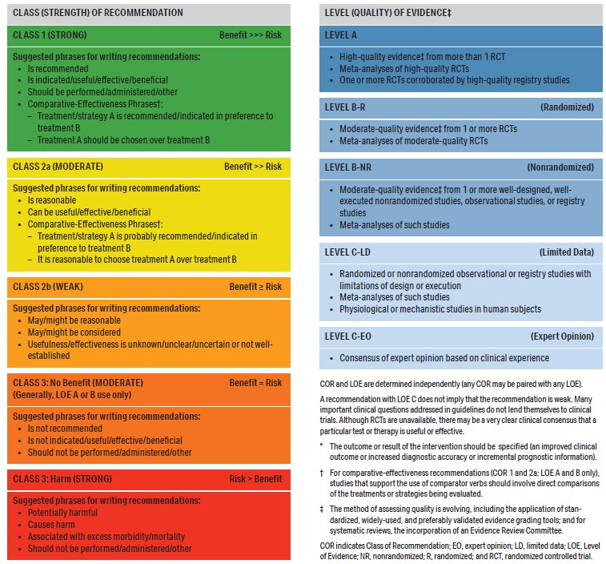
Table 3. Applying American College of Cardiology/American Heart Association Class of Recommendation and Level of Evidence to Clinical Strategies, Interventions, Treatments, or Diagnostic Testing in Patient Care* (Updated May 2019)

Slide 25
Clinical Assessment for PAD

Slide 26
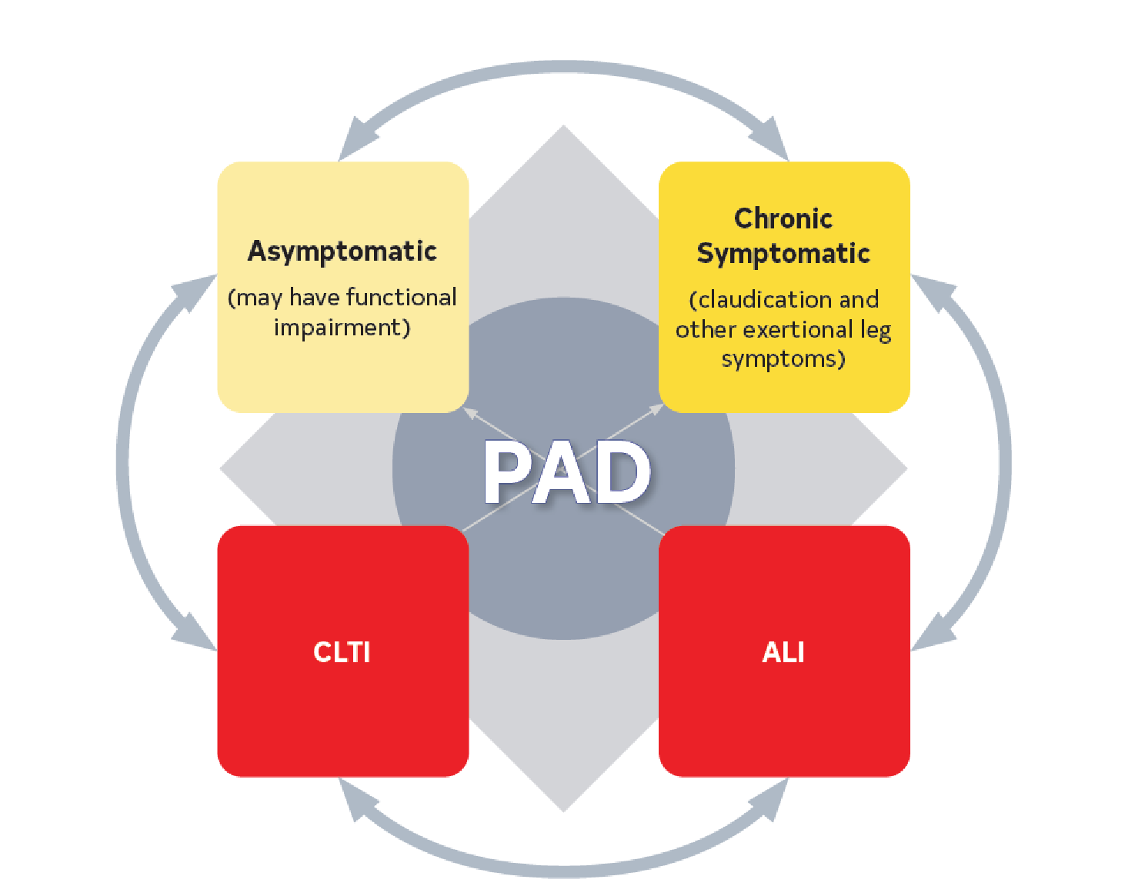
Figure 1. Clinical Subsets of PAD.
ALI indicates acute limb ischemia; CLTI, chronic limb-threatening ischemia; and PAD, peripheral artery disease.

Slide 27
Table 4. Clinical Subsets of Patients With PAD
Clinical Subset | Description/Characterization
Asymptomatic PAD (may have functional impairment) | Depending on the population assessed and method of assessment, 20%–59% of patients with objectively proven PAD report no leg symptoms. Patients classified as having asymptomatic PAD may self-limit and adapt their activity to remain below their ischemic threshold to avoid leg pain. A significant percentage of patients with asymptomatic PAD who report no exertional leg symptoms develop symptoms during an objective walking test. The prevalence of asymptomatic PAD varies depending on whether patients are recruited from a primary care or community setting (lower %) versus a vascular laboratory (higher %). Patients with PAD who are asymptomatic have functional impairment comparable to patients with claudication. Associated with increased risk of MACE including mortality.
ALI indicates acute limb ischemia; CLTI, chronic limb-threatening ischemia; PAD, peripheral artery disease; RCT, randomized controlled trial; and WIfI, wound, ischemia, and foot infection.

Slide 28
Table 4. Clinical Subsets of Patients With PAD (con’t.)
Chronic symptomatic PAD (includes claudication and other ischemia-related exertional leg symptoms) | Most common clinically evident subset of PAD; patients report claudication or other nonjoint-related exertional leg symptoms that can limit walking performance. Exertional leg symptoms (typical claudication or other) reported in up to 80% of patients with objectively proven PAD, depending on case series. Includes ischemia-related exertional leg symptoms, not present at rest, generally increasing with progressive exercise intensity and quickly relieved by rest (within 10 min). Typical claudication symptoms may be described as a pain, aching, cramping, or tired/fatigued feeling located in the buttocks, thigh, calf, or foot that occurs consistently during walking, does not start at rest, does not improve during walking, and is usually relieved within approximately 10 min of rest. Leg symptom descriptors also include tingling, numbness, burning, throbbing, or shooting. For some patients, exertional leg symptoms due to PAD are not typical of claudication because they may not limit walking or may take >10 min to resolve after rest. Chronic symptomatic PAD is associated with significant functional (walking) impairment, regardless of whether symptoms are typical of claudication.
ALI indicates acute limb ischemia; CLTI, chronic limb-threatening ischemia; PAD, peripheral artery disease; RCT, randomized controlled trial; and WIfI, wound, ischemia, and foot infection.

Slide 29
Table 4. Clinical Subsets of Patients With PAD (con’t.)
CLTI | Severe clinical subset of PAD. Among patients with known PAD, incidence of CLTI estimated to be between 11% and 20%. Manifests as ischemic rest pain, nonhealing wounds/ulcers, or gangrene with symptoms present for >2 wk. Responsible for most major and minor limb amputations related to PAD. Historically estimated 1-y mortality rate of 25%–35% and 1-y rate of amputation up to 30% among patients presenting with CLTI. Lower rates of mortality and amputation reported in a recent RCT of patients with CLTI undergoing revascularization. Ischemic rest pain often affects the forefoot and is worsened with limb elevation and relieved by dependency. Among vascular specialists, the Fontaine and Rutherford²⁴ classification systems are most commonly used to categorize severity of CLTI. The WIfI classification estimates risk of lower extremity amputation according to wound extent, severity of ischemia, and presence of foot infection and has been shown to correlate with clinical outcomes.
ALI indicates acute limb ischemia; CLTI, chronic limb-threatening ischemia; PAD, peripheral artery disease; RCT, randomized controlled trial; and WIfI, wound, ischemia, and foot infection.

Slide 30
Table 4. Clinical Subsets of Patients With PAD (con’t.)
ALI | Severe clinical subset of PAD. In a contemporary RCT of patients with symptomatic PAD who were observed for a mean of 30 mo, the incidence of ALI was 1.7%, or 0.8/100 patient-years. Previous lower extremity revascularization, atrial fibrillation, lower ABI values associated with increased risk of ALI in this population. Sudden decrease in arterial perfusion of the leg that threatens the viability of the limb. Acute clinical symptoms (<2 wk duration) include pain, pallor, pulselessness, poikilothermia (coolness), paresthesias, and potential for paralysis. Causes of ALI include embolism, thrombosis within native artery or at site of previous revascularization (graft or stent), trauma, peripheral aneurysm with distal embolization, or thrombosis (Table 20). Timing of presentation may vary depending on the underlying etiology. The status of the leg in ALI is further classified according to the Rutherford classification system. Class I. Viable (limb not immediately threatened)—No sensory loss; no motor loss; audible arterial and venous Doppler signals. Class IIa. Salvageable/marginally threatened (limb salvageable if promptly treated)—Mild-to-moderate sensory loss (limited to toes) but no motor loss, often inaudible arterial Doppler but audible venous Doppler signals. Class IIb. Salvageable/immediately threatened (limb salvageable if urgently treated)—Sensory loss involving more than the toes; mild-moderate motor weakness. Inaudible arterial but audible venous Doppler signals. Class III. Irreversible (major tissue loss or permanent nerve damage inevitable)—Complete sensory loss (anesthetic); complete loss of motor function (paralysis); inaudible arterial and venous Doppler signals.
ALI indicates acute limb ischemia; CLTI, chronic limb-threatening ischemia; PAD, peripheral artery disease; RCT, randomized controlled trial; and WIfI, wound, ischemia, and foot infection.

Slide 31
History and Physical Examination to Assess for PAD
Recommendations for History and Physical Examination to Assess for PAD Referenced studies that support the recommendations are summarized in the Online Data Supplement.
COR | LOE | Recommendations
1 | B-NR | In patients at increased risk of PAD (Table 5), a comprehensive medical history and review of symptoms to assess for exertional leg symptoms, lower extremity rest pain, and lower extremity wounds or other ischemic skin changes should be performed.
1 | B-NR | In patients at increased risk of PAD (Table 5), a comprehensive vascular examination and inspection of the legs and feet should be performed regularly (Table 6).

Slide 32
Table 5. Patients at Increased Risk for PAD
Age ≥65 y
Age 50–64 y, with risk factors for atherosclerosis (eg, diabetes, history of smoking, dyslipidemia, hypertension), chronic kidney disease, or family history of PAD
Age <50 y, with diabetes and 1 additional risk factor for atherosclerosis
Individuals with known atherosclerotic disease in another vascular bed (eg, coronary, carotid, subclavian, renal, mesenteric artery stenosis, or AAA)
AAA indicates abdominal aortic aneurysm; and PAD, peripheral artery disease.

Slide 33
Table 6. History and Physical Examination Findings Suggestive of PAD
History
Claudication Pain type: Aching, burning, cramping, discomfort, or fatigue Location: Buttock, thigh, calf, or ankle Onset/offset: Distance, exercise, uphill, how long for relief after rest (typically <10 min for typical claudication)
Other nonjoint-related exertional lower extremity symptoms (not typical of claudication) or symptoms of impaired walking function Lower extremity muscular discomfort associated with walking that requires >10 min rest to resolve Leg weakness, numbness, or fatigue during walking without pain
Ischemic rest pain
History of nonhealing or slow-healing lower extremity wound
Erectile dysfunction
Physical Examination
Abnormal lower extremity pulse palpation (femoral, popliteal, dorsalis pedis, or posterior tibial arteries)
Vascular bruit (eg, epigastric, periumbilical, groin)
Nonhealing lower extremity wound
Lower extremity gangrene
Other physical findings suggestive of ischemia (eg, asymmetric hair growth, nail bed changes, calf muscle atrophy, or elevation pallor/dependent rubor)
PAD indicates peripheral artery disease.

Slide 34
Table 7. Alternative Diagnosis for Leg Pain or Claudication Not Related to PAD (Normal Physiological Testing)
Condition | Location | Characteristic | Effect of Exercise | Effect of Rest | Effect of Position | Other Characteristics
Hip arthritis | Lateral hip, thigh | Aching discomfort | After variable degree of exercise | Not quickly relieved | Improved when not bearing weight | Symptoms variable; history of degenerative arthritis
Foot/ankle arthritis | Ankle, foot, arch | Aching pain | After variable degree of exercise; may also be present at rest | Not quickly relieved | May be relieved by not bearing weight | Symptoms variable
Nerve root compression | Radiates down leg | Sharp lancinating pain | Induced by sitting, standing, or walking (variable) | Often present at rest | Improved by change in position | History of back problems; worse with sitting; relief when supine or standing
PAD indicates peripheral artery disease.

Slide 35
Table 7. Alternative Diagnosis for Leg Pain or Claudication Not Related to PAD (Normal Physiological Testing) (con’t.)
Condition | Location | Characteristic | Effect of Exercise | Effect of Rest | Effect of Position | Other Characteristics
Spinal stenosis (eg, degenerative disc disease or tumor) | Often bilateral buttocks, posterior leg | Pain and weakness | May mimic claudication | Variable relief but can take a long time to recover | Relief by lumbar spine flexion | Worse with standing and extending spine
Symptomatic popliteal (Baker’s) cyst | Behind knee, down calf | Swelling, tenderness | With exercise | Also present at rest | None | Not intermittent
Venous claudication | Entire leg, worse in calf | Tight, bursting pain | After walking | Subsides slowly | Relief speeded by leg elevation | History of iliofemoral deep vein thrombosis; edema; signs of venous stasis
Chronic compartment syndrome | Calf muscles | Tight, bursting pain | After strenuous exercise (jogging) | Subsides very slowly | Relief with rest | Typically heavy muscled athletes
PAD indicates peripheral artery disease.

Slide 36
Diagnostic Testing for PAD

Slide 37
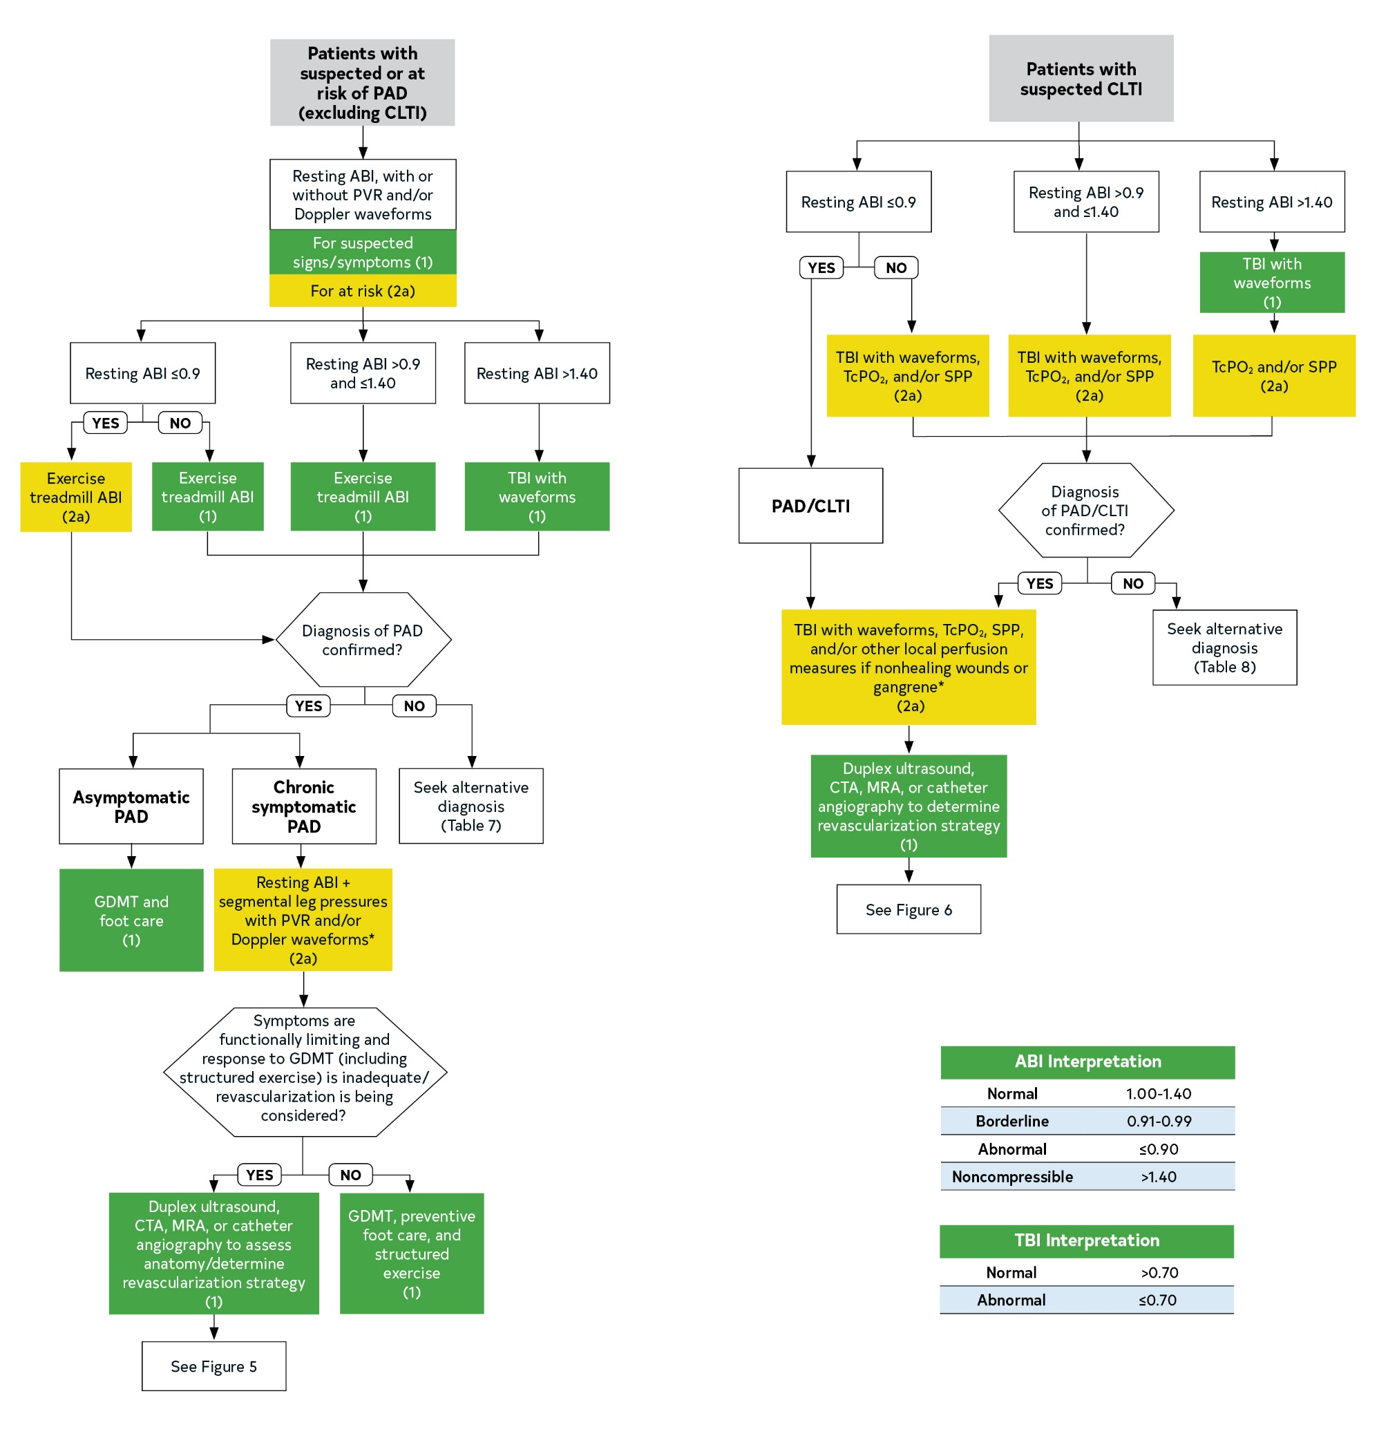
Figure 2. Algorithm for Diagnostic Testing for PAD.
Colors correspond to Table 3.
ABI indicates ankle-brachial index; CLTI, chronic limb-threatening ischemia; CTA, computed tomography angiography; GDMT, guideline-directed management and therapy; MRA, magnetic resonance angiography; PAD, peripheral artery disease; PVR, pulse volume recording, SPP, skin perfusion pressure; TBI, toe-brachial index; and TcPO2, transcutaneous oxygen pressure.
* If not already performed.

Slide 38
Resting ABI and Additional Physiological Testing
Recommendations for Resting ABI and Additional Physiological Testing Referenced studies that support the recommendations are summarized in the Online Data Supplement.
Resting ABI
COR | LOE | Recommendations
1 | B-NR | In patients with history or physical examination findings suggestive of PAD (Table 6), the resting ABI, with or without ankle pulse volume recordings (PVR) and/or Doppler waveforms, is recommended to establish the diagnosis.
1 | B-NR | The resting ABI should be reported as abnormal (ABI, ≤0.90), borderline (ABI, 0.91–0.99), normal (ABI, 1.00–1.40), or noncompressible (ABI, >1.40).

Slide 39
Resting ABI and Additional Physiological Testing (con’t.)
2a | B-NR | In patients at increased risk of PAD (Table 5), screening for PAD with the resting ABI, with or without ankle PVR and/or Doppler waveforms, is reasonable.
3: No Benefit | B-NR | In patients not at increased risk of PAD (Table 5) and without history or physical examination findings suggestive of PAD (Table 6), screening for PAD with the ABI is not recommended.

Slide 40
Resting ABI and Additional Physiological Testing (con’t.)
Exercise ABI and Additional Physiological Testing
1 | B-NR | In patients with suspected PAD, toe pressure/toe-brachial index (TBI) with waveforms should be performed when the resting ABI is >1.40 (noncompressible).
1 | B-NR | Patients with suspected chronic symptomatic PAD (ie, exertional nonjoint-related leg symptoms) and normal or borderline resting ABI (>0.90 and ≤1.40, respectively) should undergo exercise treadmill ABI testing to evaluate for PAD.
2a | B-NR | In patients with PAD and an abnormal resting ABI (≤0.90), the exercise treadmill ABI test can be useful to objectively assess, the functional status and walking performance.

Slide 41
Resting ABI and Additional Physiological Testing (con’t.)
2a | C-LD | In patients with chronic symptomatic PAD, it is reasonable to perform segmental leg pressures with PVR and/or Doppler waveforms in addition to the resting ABI to help delineate the anatomic level of PAD.
2a | B-NR | In patients with suspected CLTI, it is reasonable to use toe pressure/TBI with waveforms, transcutaneous oxygen pressure (TcPO₂), and/or or skin perfusion pressure (SPP) in addition to ABI for assessment of arterial perfusion and to establish the diagnosis of CLTI.
2a | B-NR | In patients with CLTI with nonhealing wounds or gangrene, it can be useful to use toe pressure/TBI with waveforms, TcPO₂, SPP, and/or other local perfusion measures to determine the likelihood of wound healing without or after revascularization.

Slide 42
Table 8. Alternative Diagnoses for Nonhealing Lower Extremity Wounds With Normal Physiological Testing (Not PAD Related)
Condition | Location | Characteristics and Causes
Autoimmune injury | Toes, foot, leg | With blisters (eg, pemphigoid, pemphigus, epidermolysis bullosa) Without blisters (eg, dermatomyositis, lupus, scleroderma)
Infection | Toes, foot, leg | Bacterial (eg, Pseudomonas, necrotizing Streptococcus) Fungal (eg, blastomycosis, Madura foot, chromomycosis) Mycobacterial Parasitic (eg, Chagas, leishmaniasis) Viral (eg, herpes)
Inflammatory ulcer | Toes, foot, leg | Necrobiosis lipoidica Pyoderma gangrenosum Granuloma annulare
Local injury | Toes, foot, leg | Trauma Insect or animal bite Burn

Slide 43
Table 8. Alternative Diagnoses for Nonhealing Lower Extremity Wounds With Normal Physiological Testing (Not PAD Related) (con’t.)
Condition | Location | Characteristics and Causes
Malignancy | Toes, foot, leg | Primary skin malignancy Metastatic malignancy Malignant transformation of ulcer
Medication-related ulcer | Toes, foot, leg | Drug reactions (eg, erythema multiforme) Medication direct toxicity (eg, doxorubicin, hydroxyurea, some tyrosine kinase inhibitors)
Neuropathic ulcer | Pressure zones of foot | Hyperkeratosis surrounds the ulcer Diabetes with peripheral neuropathy Peripheral neuropathy without diabetes Leprosy
Venous ulcer | Distal leg, especially above medial malleolus | Develops in regions of skin changes due to chronic venous disease and local venous hypertension Typically wet (ie, wound drainage) rather than dry lesion

Slide 44
Imaging for PAD
Recommendations for Imaging for PAD Referenced studies that support the recommendations are summarized in the Online Data Supplement.
COR | LOE | Recommendations
1 | B-NR | In patients with functionally limiting claudication with inadequate response to GDMT (including structured exercise) for whom revascularization is being considered, duplex ultrasound, computed tomography angiography (CTA), magnetic resonance angiography (MRA), or catheter angiography of the lower extremities is useful for assessment of anatomy and severity of disease and to determine potential revascularization strategy.

Slide 45
Imaging for PAD (con’t.)
1 | B-NR | In patients with CLTI, duplex ultrasound, CTA, MRA, or catheter angiography is useful to determine revascularization strategy.
2b | C-EO | In patients with suspected PAD (ie, potential signs and/or symptoms) with inconclusive ABI and physiological testing, noninvasive imaging with duplex ultrasound, CTA, or MRA may be considered to establish the diagnosis of PAD.
3: Harm | B-NR | In patients with a confirmed diagnosis of PAD in whom revascularization is not being considered, CTA, MRA, or catheter angiography should not be performed solely for anatomic assessment.

Slide 46
Special Considerations in PAD: Risk Amplifiers, Health Disparities, and PAD in Older Patients

Slide 47
Amplifiers of Cardiovascular and Limb-Related Risk in Patients With PAD
 | Recommendation for Amplifiers of Cardiovascular and Limb-Related Risk in Patients With PAD
COR | LOE | Recommendation
1 | C-EO | In the evaluation of patients with PAD, clinicians should assess for and incorporate the presence of PAD-related risk amplifiers (Table 9) when developing patient-focused treatment recommendations.

Slide 48
Table 9. PAD-Related Risk Amplifiers
Risk Factor | Epidemiology | Data Supporting Amplified Risk (MACE, MALE, or Both)
Older age (ie, ≥75 y) | See Section 4.3, “Considerations in Management of PAD in Older Patients” | See Section 4.3, “Considerations in Management of PAD in Older Patients”
Diabetes (see Section 5.5, “Diabetes Management for PAD”) | Among patients with diabetes, up to 20% of patients >40 y of age, 30% >50 y of age, and 70% >70 y of age have PAD. | Diabetes is associated with a higher risk of all-cause death (HR, 1.35 [95% CI, 1.15–1.60]) and MACE (HR, 1.47 [95% CI, 1.23–1.75]). Among patients undergoing endovascular revascularization, those with diabetes presented more commonly with CLTI: 46.1% versus 25.5% for those without diabetes (P<0.001). Diabetes is associated with a greater risk of lower extremity amputation (adjusted HR, 5.48 [95% CI, 4.16–7.22]).

Slide 49
Table 9. PAD-Related Risk Amplifiers (con’t.)
Ongoing smoking and use of other forms of tobacco (see Section 5.4, “Smoking Cessation for PAD”) | 80%–90% of patients revascularized for severe limb symptoms are current smokers. OR 2.4 for developing symptomatic PAD in current smokers. | Ongoing smoking is associated with a significant increase in PAD-related hospitalizations, revascularization procedures, and health care costs. The 5-y mortality rate with active smoking and chronic symptomatic PAD is 40%–50%.

Slide 50
Table 9. PAD-Related Risk Amplifiers (con’t.)
CKD Estimated glomerular filtration rate <60 mL/min/1.73 m². | Up to 25% of patients with CKD have PAD. In a cohort study of >40,000 patients with PAD, 20.2% had CKD stages 2 to 5. | CKD is associated with higher rates of the composite cardiovascular death, MI, and ischemic stroke (6.75 versus 3.72 events/100 patient-years; adjusted HR, 1.45 [95% CI, 1.30–1.63]). The rates of all-cause death, cardiovascular events, and lower-limb complications, including amputation, are higher among patients with CKD and PAD than those with only CKD. Patients with CKD have a 1.8-fold higher risk of CAD and a 2.5-fold increased risk of MI. Despite a high risk of MACE, in the EUCLID trial, the combination of PAD and CKD was not associated with an increased risk of MALE, hospitalization for ALI, or major amputation (adjusted HR, 0.92 [95% CI, 0.66–1.28]) compared with PAD alone. Revascularization for CLTI in patients with CKD has a lower mortality rate (3.7% versus 5.3%; adjusted OR, 0.78 [95% CI, 0.72–0.84]) and major amputation rate (adjusted OR, 0.33 [95% CI, 0.32–0.35]; P<0.001) compared with no revascularization. Endovascular revascularization for CLTI with CKD has a lower in-hospital mortality rate compared with open surgical revascularization (2.7% versus 4.7% [95% CI, 1.43–1.94]).

Slide 51
Table 9. PAD-Related Risk Amplifiers (con’t.)
ESKD (ie, dialysis dependence) Most advanced stage of CKD (stage 5) | Up to 45% of patients on dialysis have PAD. | The 5-y survival rate among those with PAD after renal transplantation is 19% versus 48% (P<0.001). ESKD and PAD are associated with a higher risk of lower extremity amputation and readmission after revascularization than in patients with CKD and PAD. Among patients with ESKD undergoing lower extremity bypass, rates of limb salvage are lower compared with kidney transplant recipients.

Slide 52
Table 9. PAD-Related Risk Amplifiers (con’t.)
Polyvascular disease Atherosclerosis within ≥2 arterial beds: coronary, peripheral artery, or cerebrovascular | Up to 45% of patients with known atherosclerotic disease or atherosclerotic risk factors have polyvascular disease. Among 879 patients with PAD undergoing lower extremity angiography before revascularization, 52% had underlying CAD (abnormal coronary angiography or stress test). | Patients with PAD and CAD had a higher risk of all-cause death over 5 y (adjusted HR, 1.35 [95% CI, 1.02–1.80]) compared with those with only CAD. In the EUCLID trial of 13,885 patients with PAD, despite treatment with antiplatelet therapy, MI occurred in 4.9% of the study participants over a median follow-up of 30 mo. In adults >60 y of age with a first ischemic stroke, symptomatic PAD was independently associated with increased risk of vascular events (HR, 2.76 [95% CI, 1.10–6.95]). Polyvascular disease and diabetes have the highest cardiovascular event rate (60%), with a stepwise increase in MACE with each additional atherosclerotic arterial bed, from 1.47 to 2.33 to 3.12 (trend, P=0.0001). Higher rates of lower extremity revascularization, but not ALI or major amputation, were seen with polyvascular disease in the EUCLID trial. The risk of MALE was reduced in patients with polyvascular disease treated with aspirin and rivaroxaban in stable, chronic PAD (COMPASS trial) or after lower extremity revascularization (VOYAGER PAD trial).

Slide 53
Table 9. PAD-Related Risk Amplifiers (con’t.)
ABI indicates ankle-brachial index; ALI, acute limb ischemia; CAD, coronary artery disease; CKD, chronic kidney disease; CLTI, chronic limb-threatening ischemia; COMPASS, Cardiovascular Outcomes for People Using Anticoagulation Strategies; ESKD, end-stage renal disease; EUCLID, Examining Use of Ticagrelor in Peripheral Artery Disease; HR, hazard ratio; ICD, International Classification of Diseases: MACE, major adverse cardiovascular events; MALE, major adverse limb events; MI, myocardial infarction; OR, odds ratio; PAD, peripheral artery disease; VA, US Department of Veterans Affairs; and VOYAGER PAD, Vascular Outcomes Study of ASA (acetylsalicylic acid) Along with Rivaroxaban in Endovascular or Surgical Limb Revascularization for PAD.

Slide 54
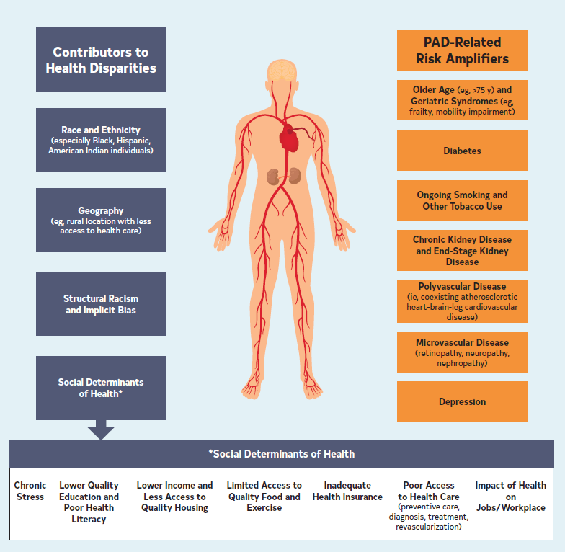
Figure 3. Health Disparities and PAD-Related Risk Amplifiers Increase Risk of MACE and MALE.
MACE indicates major adverse cardiovascular events; MALE, major adverse limb events; and PAD, peripheral artery disease.

Slide 55
Health Disparities in PAD
 | Recommendation for Health Disparities in PAD
COR | LOE | Recommendation
1 | C-EO | Clinicians and health care systems should actively pursue evidence of health disparities in diagnosis, treatment, and outcomes for patients with PAD and use efforts to limit the impact of these disparities on clinical outcomes.

Slide 56
Considerations in Management of PAD in Older Patients
Recommendation for Management of PAD in Older Patients Referenced studies that support the recommendation are summarized in the Online Data Supplement.
COR | LOE | Recommendation
2a | B-NR | In older patients (ie, ≥75 years of age) with PAD, assessment for geriatric syndromes (Table 10), such as frailty, sarcopenia, malnutrition, and mobility impairment, can be useful to identify high-risk patients, including before revascularization, and to provide safe and goal-concordant care.

Slide 57
Table 10. Geriatric Syndromes and Considerations in the Management of PAD in Older Patients
Consideration | Description and Characterization
Frailty | Can be assessed among patients with PAD using measures such as the Clinical Frailty Scale, the modified Frailty Index, the Risk Analysis Index, and others. Elevated rates of MACE associated with frailty and claudication. Two-y survival rate was reduced depending on degree of frailty in patients undergoing revascularization for CLTI. Frailty is highly predictive of 30-d mortality rate for all PAD revascularization procedures.
Sarcopenia | Age-related loss of muscle mass Sarcopenia was 10 times more prevalent in those with PAD than age-matched controls without PAD. Sarcopenia is associated with lower survival rate and higher risk of MACE and MALE. Patients with sarcopenia are at increased risk for muscle mass loss in the lower extremities.
ACE indicates angiotensin-enzyme converting; ARB, angiotensin-receptor blocker; CLTI, chronic limb-threatening ischemia; GDMT, guideline-directed management and therapy; GNRI, Geriatric Nutritional Risk Index; MACE, major adverse cardiovascular events; MALE, major adverse limb events; PAD, peripheral artery disease; and QOL, quality of life.

Slide 58
Table 10. Geriatric Syndromes and Considerations in the Management of PAD in Older Patients (con’t.)
Malnutrition | Common in older patients with PAD, affecting up to 50% of individuals. Five-y survival rate in those with PAD is directly related to GNRI stratification of nutritional risk. In patients with CLTI, 30-d mortality was 5 times higher in those with severe malnutrition compared with those with moderate or no malnutrition. Five-y amputation-free survival rate in patients undergoing surgical revascularization for CLTI was worsened relative to poorer nutritional status.
Mobility impairment | The presence of PAD was associated with poor physical function compared with those without PAD. Ambulatory patients >75 y of age with PAD were 13.51-fold more likely to experience functionally limiting pain than those without PAD. Patients >65 y of age with PAD had a more rapid decline in life-space mobility and a higher mortality rate than those without PAD.
ACE indicates angiotensin-enzyme converting; ARB, angiotensin-receptor blocker; CLTI, chronic limb-threatening ischemia; GDMT, guideline-directed management and therapy; GNRI, Geriatric Nutritional Risk Index; MACE, major adverse cardiovascular events; MALE, major adverse limb events; PAD, peripheral artery disease; and QOL, quality of life.

Slide 59
Table 10. Geriatric Syndromes and Considerations in the Management of PAD in Older Patients (con’t.)
Revascularization considerations | Age >80 y was associated with an increased mortality rate after endovascular or surgical revascularization for infrainguinal PAD. Among patients >70 y of age with CLTI, those with dependent functional status had a higher mortality rate than those with independent functional status after infrainguinal bypass surgery. Older patients were less likely to be prescribed GDMT (including antiplatelet therapy, statin, and ACE inhibitor/ARB) than those 10 y younger after endovascular revascularization. In patients >70 y of age with CLTI and <2-y predicted survival, a comparison of treatment with medical therapy, endovascular, or surgical revascularization showed no difference in QOL or health status outcomes.
ACE indicates angiotensin-enzyme converting; ARB, angiotensin-receptor blocker; CLTI, chronic limb-threatening ischemia; GDMT, guideline-directed management and therapy; GNRI, Geriatric Nutritional Risk Index; MACE, major adverse cardiovascular events; MALE, major adverse limb events; PAD, peripheral artery disease; and QOL, quality of life.

Slide 60
Table 10. Geriatric Syndromes and Considerations in the Management of PAD in Older Patients (con’t.)
Impact of amputation | Morbidity and mortality rates associated with amputation in older patients are exceptionally high, and mortality rates increased by approximately 4% for every year of age. In older patients with CLTI at high risk for surgery, infrainguinal bypass conferred lower risk of a 30-d mortality rate than amputation. In patients >70 y of age treated for CLTI, 46 of 200 patients underwent amputation within 1 y (23%), with significant improvement in QOL at 6 and 12 mo but no difference in objective measures of health status.
Polypharmacy | Typically described as prescribing ≥5 medications. Increasingly common in older patients (24% of older patients in 2000, and 39% of older adults in 2012). Tailoring of medical therapies and shared decision-making are strategies to minimize impact of polypharmacy in older patients with PAD.
ACE indicates angiotensin-enzyme converting; ARB, angiotensin-receptor blocker; CLTI, chronic limb-threatening ischemia; GDMT, guideline-directed management and therapy; GNRI, Geriatric Nutritional Risk Index; MACE, major adverse cardiovascular events; MALE, major adverse limb events; PAD, peripheral artery disease; and QOL, quality of life.

Slide 61
Medical Therapy and Preventive Footcare for Patients With PAD

Slide 62
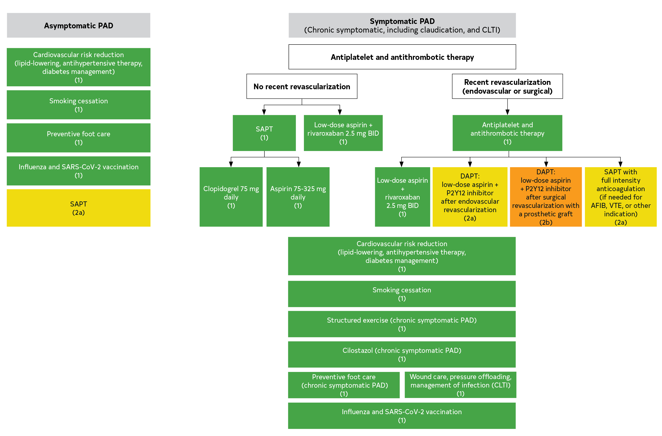
Figure 4. Medical Therapy and Foot Care for PAD.
Colors correspond to Table 3.

Slide 63
Antiplatelet and Antithrombotic Therapy for PAD
Recommendations for Antiplatelet and Antithrombotic Therapy for PAD Referenced studies that support the recommendations are summarized in the Online Data Supplement.
COR | LOE | Recommendations
1 | A | In patients with symptomatic PAD, single antiplatelet therapy is recommended to reduce the risk of MACE.
1 | B-R | In patients with symptomatic PAD, single antiplatelet therapy with clopidogrel alone (75 mg daily) is recommended to reduce the risk of MACE.
1 | C-LD | In patients with symptomatic PAD, single antiplatelet therapy with aspirin alone (range, 75–325 mg daily) is recommended to reduce the risk of MACE.

Slide 64
Antiplatelet and Antithrombotic Therapy for PAD (con’t.)
1 | A | In patients with symptomatic PAD, low-dose rivaroxaban (2.5 mg twice daily) combined with low-dose aspirin is effective to reduce the risk of MACE and MALE.
1 | B-R | After endovascular or surgical revascularization for PAD, antiplatelet therapy is recommended.
1 | A | After endovascular or surgical revascularization for PAD, low-dose rivaroxaban (2.5 mg twice daily) combined with low-dose aspirin is recommended to reduce the risk of MACE and MALE.
2a | C-LD | After endovascular revascularization for PAD, dual antiplatelet therapy with a P2Y12 antagonist and low-dose aspirin is reasonable for at least 1 to 6 months.

Slide 65
Antiplatelet and Antithrombotic Therapy for PAD (con’t.)
2a | C-LD | After endovascular or surgical revascularization in patients with PAD who require full-intensity anticoagulation for another indication and are not at high risk of bleeding, adding single antiplatelet therapy is reasonable.
2a | C-EO | In patients with asymptomatic PAD single antiplatelet therapy is reasonable to reduce the risk of MACE.
2b | B-R | In patients with symptomatic PAD without recent revascularization, the benefit of dual antiplatelet therapy is uncertain.
2b | B-R | In patients with symptomatic PAD, the benefit of vorapaxar added to existing antiplatelet therapy is uncertain.

Slide 66
Antiplatelet and Antithrombotic Therapy for PAD (con’t.)
2b | B-R | After surgical revascularization for PAD with a prosthetic graft, dual antiplatelet therapy with a P2Y12 antagonist and low-dose aspirin may be reasonable for at least 1 month.
3: Harm | A | In patients with PAD without another indication (eg, atrial fibrillation), full-intensity oral anticoagulation should not be used to reduce the risk of MACE and MALE.

Slide 67
Lipid-Lowering Therapy for PAD
Recommendations for Lipid-Lowering Therapy for PAD Referenced studies that support the recommendations are summarized in the Online Data Supplement.
COR | LOE | Recommendations
1 | A | In patients with PAD, treatment with high-intensity statin therapy is indicated, with an aim of achieving a ≥50% reduction in low-density lipoprotein cholesterol (LDL-C) level.
2a | B-R | In patients with PAD who are on maximally tolerated statin therapy and have an LDL-C level of ≥70 mg/dL, it is reasonable to add PCSK9 inhibitor therapy.
2a | B-R | In patients with PAD who are on maximally tolerated statin therapy and have an LDL-C level of ≥70 mg/dL, it is reasonable to add ezetimibe therapy.

Slide 68
Table 11. High-, Moderate-, and Low-Intensity Statin Therapy*
 | High Intensity | Moderate Intensity | Low Intensity
LDL-C lowering† | ≥50% | 30%–49% | <30%
Statins | Atorvastatin 40 mg-80 mg Rosuvastatin 20 mg-40 mg | Atorvastatin 10 mg–20 mg Rosuvastatin 5 mg–10 mg Simvastatin 20mg–40 mg‡ | Simvastatin 10 mg
 |  | Pravastatin 40 mg–80 mg Lovastatin 40 mg-80 mg Fluvastatin XL 80 mg Fluvastatin 40 mg twice daily Pitavastatin 1 mg–4 mg | Pravastatin 10mg–20 mg Lovastatin 20 mg Fluvastatin 20mg–40 mg
*Percent reductions are estimates from data across large populations. Individual responses to statin therapy varied in the RCTs and should be expected to vary in clinical practice.
†LDL-C lowering that should occur with the dosage listed below each intensity.
‡Although simvastatin 80 mg was evaluated in RCTs, initiation of simvastatin 80 mg or titration to 80 mg is not recommended by the FDA because of the increased risk of myopathy, including rhabdomyolysis.

Slide 69
Table 11. High-, Moderate-, and Low-Intensity Statin Therapy* (con’t.)
Percent LDL-C reductions with the statin medications used in clinical practice (atorvastatin, rosuvastatin, simvastatin) were estimated using the median reduction in LDL-C from the VOYAGER database. Reductions in LDL-C for other statin medications (fluvastatin, lovastatin, pitavastatin, pravastatin) were identified according to FDA-approved product labeling in adults with dyslipidemia, primary hypercholesterolemia, and mixed dyslipidemia.
FDA indicates US Food and Drug Administration; LDL-C, low-density lipoprotein cholesterol; RCT, randomized controlled trial; and VOYAGER PAD, Vascular Outcomes Study of ASA [acetylsalicylic acid] Along with Rivaroxaban in Endovascular or Surgical Limb Revascularization for Peripheral Artery Disease.

Slide 70
Antihypertensive Therapy for PAD
Recommendations for Antihypertensive Therapy for PAD Referenced studies that support the recommendations are summarized in the Online Data Supplement.
COR | LOE | Recommendations
1 | A | In patients with PAD and hypertension, antihypertensive therapy should be administered to reduce the risk of MACE.
1 | B-R | In patients with PAD and hypertension, a systolic blood pressure (SBP) goal of <130 mm Hg and a diastolic blood pressure target of <80 mm Hg is recommended.
1 | B-R | In patients with PAD and hypertension, the selective use of angiotensin-converting enzyme (ACE) inhibitors or angiotensin-receptor blockers is recommended to reduce the risk of MACE.

Slide 71
Smoking Cessation for PAD
Recommendations for Smoking Cessation for PAD Referenced studies that support the recommendations are summarized in the Online Data Supplement.
COR | LOE | Recommendations
1 | A | Patients with PAD who smoke cigarettes or use any other forms of tobacco should be advised at every visit to quit or encouraged to maintain cessation.
1 | A | Patients with PAD who smoke cigarettes or use any other forms of tobacco should be assisted in developing a plan for quitting that includes pharmacotherapy (ie, varenicline, bupropion, and/or nicotine replacement therapies) combined with counseling, and/or referral to a smoking cessation program.
1 | B-NR | Patients with PAD should be advised to avoid exposure to secondhand tobacco smoke in all indoor or enclosed spaces, including work, home, transportation vehicles, and public places.

Slide 72
Diabetes Management for PAD
Recommendations for Diabetes Management for PAD Referenced studies that support the recommendations are summarized in the Online Data Supplement.
COR | LOE | Recommendations
1 | A | In patients with PAD and type 2 diabetes, use of glucagon-like peptide–1 agonists (liraglutide and semaglutide) and sodium-glucose cotransporter-2 (SGLT-2) inhibitors (canagliflozin, dapagliflozin, and empagliflozin) are effective to reduce the risk of MACE.
1 | C-EO | In patients with PAD, management of diabetes should be coordinated among members of the health care team.
2b | B-NR | In patients with PAD and diabetes, glycemic control may be beneficial to improve limb outcomes.

Slide 73
Other Medical Therapies for Cardiovascular Risk Reduction in PAD
Recommendations for Other Medical Therapies for Cardiovascular Risk Reduction in PAD Referenced studies that support the recommendations are summarized in the Online Data Supplement.
COR | LOE | Recommendations
1 | C-LD | Patients with PAD should receive an annual influenza vaccination.
1 | C-EO | Patients with PAD should receive the severe acute respiratory syndrome coronavirus 2 (SARS-CoV-2) vaccination sequence, including the booster(s).
2a | B-R | In patients at high cardiovascular risk, a diet emphasizing intake of vegetables, fruits, legumes, nuts, whole grains, and fish can be beneficial for reducing the risk of developing PAD and the risk of MACE.

Slide 74
Other Medical Therapies for Cardiovascular Risk Reduction in PAD (con’t.)
3: No Benefit | B-R | In patients with PAD, B-complex vitamin supplementation to lower homocysteine levels is not beneficial for prevention of MACE.
3: No Benefit | B-R | In patients with PAD, chelation therapy (eg, EDTA) is not beneficial for prevention of MACE.
3: No Benefit | B-R | In patients with PAD, vitamin D supplementation is not beneficial for prevention of MACE.

Slide 75
Medications for Leg Symptoms in Chronic Symptomatic PAD
Recommendations for Medications for Leg Symptoms in Chronic Symptomatic PAD Referenced studies that support the recommendations are summarized in the Online Data Supplement.
COR | LOE | Recommendations
Cilostazol
1 | A | In patients with claudication, cilostazol is recommended to improve leg symptoms and increase walking distance.
2b | B-R | In patients with PAD, cilostazol may be useful to reduce restenosis after endovascular therapy for femoropopliteal disease.
3: Harm | C-LD | In patients with PAD and congestive heart failure of any severity, cilostazol should not be administered.

Slide 76
Medications for Leg Symptoms in Chronic Symptomatic PAD (con’t.)
Pentoxifylline
3: No Benefit | B-R | In patients with chronic symptomatic PAD, pentoxifylline is not recommended for treatment of claudication.
Chelation Therapy
3: No Benefit | B-R | In patients with chronic symptomatic PAD, chelation therapy is not recommended for treatment of claudication.

Slide 77
Preventive Foot Care for PAD
Recommendations for Preventive Foot Care for PAD Referenced studies that support the recommendations are summarized in the Online Data Supplement.
COR | LOE | Recommendations
1 | C-LD | In patients with PAD, providing general preventive foot self-care education to patients and their family members and support persons is recommended.
1 | C-EO | In patients with PAD, foot inspection by a clinician at every visit is recommended.

Slide 78
Preventive Foot Care for PAD (con’t.)
1 | C-LD | In patients with PAD at high risk for ulcers and amputation (Table 12), therapeutic footwear is recommended.
1 | C-EO | In patients with PAD, a comprehensive foot evaluation (Table 13) should be performed at least annually to identify risk factors for ulcers and amputation.
2a | B-NR | In patients with PAD, referral to a foot care specialist, when available, is reasonable for ongoing preventive care and longitudinal surveillance.

Slide 79
Table 12. Risk Factors for Development of Foot Ulcers or Amputation Among Patients With PAD
History of previous foot ulcer(s) or amputation (minor or major) Charcot or other foot deformities Diabetes with poor glycemic control CKD (especially if ESKD) Peripheral neuropathy (especially with loss of protective sensation) Corns or calluses on the feet (considered preulcerous lesions in patients with PAD) Ongoing smoking
CKD indicates chronic kidney disease; ESKD, end-stage kidney disease; and PAD, peripheral artery disease.

Slide 80
Table 13. Components of a Comprehensive Foot Evaluation for Patients With PAD
History | Previous foot ulcer(s) or CLTI, amputation, Charcot deformity, calluses
 | Current symptoms of PAD or CLTI: claudication or other leg fatigue with walking, rest pain, foot ulcers
 | Lower extremity revascularization (endovascular or surgical procedures)
 | Cigarette or other tobacco use (current, past)
 | Diabetes
 | Retinopathy or visual impairment
 | CKD
 | Symptoms of neuropathy (ie, pain, burning, numbness in feet)
 | History of other CVD (eg, CAD, heart failure, cerebrovascular disease)
CAD indicates coronary artery disease; CKD, chronic kidney disease; CLTI, chronic limb-threatening ischemia; CVD, cardiovascular disease, and PAD, peripheral artery disease.

Slide 81
Table 13. Components of a Comprehensive Foot Evaluation for Patients With PAD (con’t.)
Physical examination | Evaluate skin integrity, including presence of any ulcers, calluses, or corns. Visual inspection includes the whole foot and in between all toes
 | Examine for foot deformity (eg, bunion, hammertoe or claw toe, abnormal foot arch, Charcot deformity)
 | Perform neurological assessment: 10-g monoﬁlament testing with at least 1 other measurement: pinprick, temperature, or vibration
 | Evaluate (palpate) pulses in the legs and feet
Other assessments | Footwear: Is it ill-fitting, inadequate, or is there lack of footwear?
 | Does patient have poor foot hygiene (eg, improperly cut toenails, unwashed feet, superficial fungal infection, or unclean socks)?
 | Does the patient have physical limitations that may hinder foot self-care (eg, visual impairment, obesity, inability to reach feet)?
 | Does the patient know the components of and perform self-foot care?
CAD indicates coronary artery disease; CKD, chronic kidney disease; CLTI, chronic limb-threatening ischemia; CVD, cardiovascular disease, and PAD, peripheral artery disease.

Slide 82
Exercise Therapy for PAD

Slide 83
Exercise Therapy for PAD
Recommendations for Exercise Therapy for PAD Referenced studies that support the recommendations are summarized in the Online Data Supplement.
COR | LOE | Recommendations
1 | A | In patients with chronic symptomatic PAD, SET is recommended to improve walking performance, functional status, and QOL.
1 | A | In patients with chronic symptomatic PAD, a structured community-based exercise program with behavioral change techniques is effective to improve walking performance, functional status, and QOL.
1 | A | In patients who have undergone revascularization for chronic symptomatic PAD, SET after revascularization is effective to improve walking performance, functional status, and QOL.

Slide 84
Exercise Therapy for PAD (con’t.)
1 | B-R | In patients with functionally limiting claudication, SET or a structured community-based exercise program should be offered as an initial treatment option.
2a | A | In patients with chronic symptomatic PAD, alternative programs of nonwalking structured exercise therapy (eg, arm ergometry, recumbent stepping) can be beneficial to improve walking performance, functional status, and QOL.
2b | B-R | In patients with chronic symptomatic PAD, the usefulness of structured walking exercise therapy that avoids moderate to severe ischemic symptoms is uncertain.
2b | B-R | In patients with chronic symptomatic PAD, the usefulness of unstructured exercise to improve walking performance, functional status, and QOL is uncertain.

Slide 85
Table 14. Structured Exercise Programs for PAD
Supervised Exercise Therapy
Primarily focuses on intermittent walking exercise on a treadmill, interspersed with rest periods when pain becomes moderate or severe.
Program takes place in a hospital or outpatient facility and is often placed within a cardiac rehabilitation program setting; can be standalone if necessary.
Program is directly supervised by qualified health care professional(s); generally clinical exercise physiologists or nurses with exercise training experience.
Training is performed for a minimum of 30–45 min per 60-min session. Supervised sessions are performed at least 3 times/wk for a minimum of 12 wk.
Training involves intermittent bouts of walking to moderate-to-maximum claudication pain or discomfort, alternating with periods of rest, with incremental increases as function and symptoms improve. Goal is to progress to 30–45 minutes of active walking exercise during each session.
Nontreadmill modalities (eg, stationary bicycle) can used when appropriate and continually assessed to determine when or if the patient can use a treadmill.
Supervised exercise therapy is a covered benefit by Medicare and most commercial insurances.
Structured exercise programs are planned by qualified health care professional(s) and provide recommendations for exercise training with a goal of improving functional status over time. Structured exercise programs for PAD are classified as SET or a structured community-based exercise program. Structured community-based exercise programs include home-based programs.
PAD indicates peripheral artery disease.

Slide 86
Table 14. Structured Exercise Programs for PAD (con’t.)
Structured Community-Based Exercise Program
Program takes place in the personal setting (eg, home, community, neighborhood) of the patient rather than in a clinical setting.
Qualified health care professional(s) prescribe an exercise regimen similar to that of a supervised program.
Program is self-directed with the guidance of qualified health care professional(s) and is generally walking-based.
Patient counseling ensures understanding of how to begin and maintain the program and how to progress the difficulty of the walking (by increasing distance or speed).
Program may incorporate behavioral change techniques, delivered by in-person or virtual health coaching or the use of activity monitors.
Program may include periodic supervised exercise sessions to assess progress, reinforce adherence, and make exercise prescription alterations when appropriate.
Structured exercise programs are planned by qualified health care professional(s) and provide recommendations for exercise training with a goal of improving functional status over time. Structured exercise programs for PAD are classified as SET or a structured community-based exercise program. Structured community-based exercise programs include home-based programs.
PAD indicates peripheral artery disease.

Slide 87
Revascularization for Asymptomatic PAD

Slide 88
Revascularization for Asymptomatic PAD
Recommendations for Revascularization for Asymptomatic PAD Referenced studies that support the recommendations are summarized in the Online Data Supplement.
COR | LOE | Recommendations
2a | B-NR | In patients with asymptomatic PAD, it is reasonable to perform revascularization procedures (endovascular or surgical) to reconstruct diseased arteries if needed for the safety, feasibility, or effectiveness of other procedures (eg, transfemoral aortic valve replacement, mechanical circulatory support, endovascular aortic aneurysm repair).
3: Harm | B-NR | In patients with asymptomatic PAD, revascularization procedures (endovascular or surgical) should not be performed solely to prevent progression of disease.

Slide 89
Revascularization for Claudication (Chronic Symptomatic PAD)

Slide 90
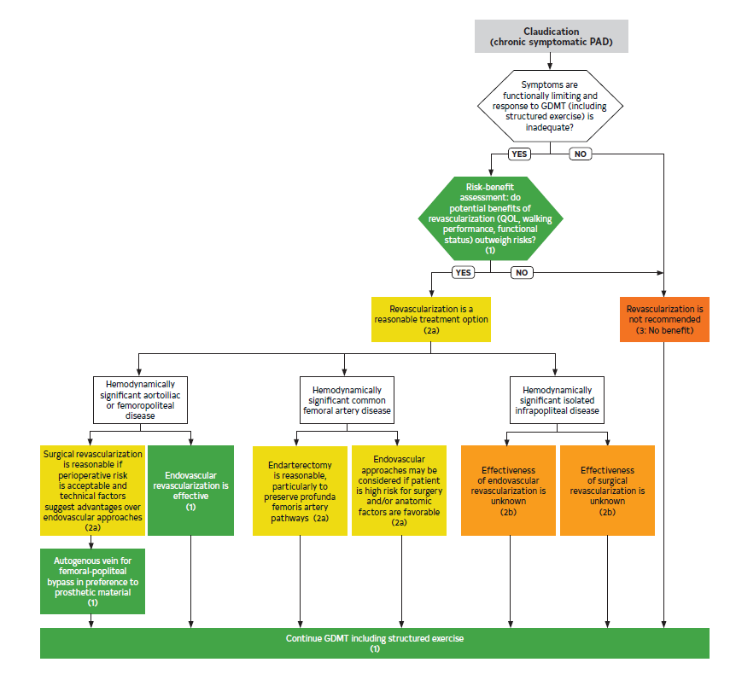
Figure 5. Algorithm for Revascularization for Claudication (Chronic Symptomatic PAD).
Colors correspond to Table 3.
GDMT indicates guideline-directed management and therapy; PAD, peripheral artery disease; and QOL, quality of life.

Slide 91
Recommendations for Revascularization for Claudication Referenced studies that support the recommendations are summarized in the Online Data Supplement.
COR | LOE | Recommendations
Revascularization for Claudication: Initial Decision-Making
1 | B-NR | In patients with functionally limiting claudication who are being considered for revascularization, potential benefits with respect to QOL, walking performance, and overall functional status should be weighed against the risks and durability of intervention and possible need for repeated procedures.
2a | B-R | In patients with functionally limiting claudication and an inadequate response to GDMT (including structured exercise), revascularization is a reasonable treatment option to improve walking function and QOL.
3: No Benefit | C-EO | In patients with claudication who have had an adequate clinical response to GDMT (including structured exercise), revascularization is not recommended.

Slide 92
Revascularization for Claudication (con’t.)
Revascularization for Claudication: Aortoiliac Disease and Femoropopliteal Disease (Excluding Common Femoral Artery Disease)
1 | A | In patients with functionally limiting claudication and hemodynamically significant aortoiliac or femoropopliteal disease with inadequate response to GDMT (including structured exercise), endovascular revascularization is effective to improve walking performance and QOL.
2a | B-NR | In patients with functionally limiting claudication and hemodynamically significant aortoiliac or femoropopliteal disease with inadequate response to GDMT (including structured exercise), surgical revascularization is reasonable if perioperative risk is acceptable and technical factors suggest advantages over endovascular approaches.

Slide 93
Revascularization for Claudication (con’t.)
Revascularization for Claudication: Common Femoral Artery Disease
2a | B-R | In patients with functionally limiting claudication and hemodynamically significant common femoral artery disease with inadequate response to GDMT (including structured exercise), surgical endarterectomy is reasonable, especially if endovascular approaches adversely affect profunda femoris artery pathways.
2b | B-R | In patients with functionally limiting claudication and hemodynamically significant common femoral artery disease with inadequate response to GDMT (including structured exercise), endovascular approaches may be considered in those at high risk for surgical revascularization and/or if anatomical factors are favorable (ie, no adverse effect on profunda femoris artery pathways).

Slide 94
Revascularization for Claudication (con’t.)
Revascularization for Claudication: Infrapopliteal Disease
2b | C-LD | In patients with functionally limiting claudication and isolated hemodynamically significant infrapopliteal disease with inadequate response to GDMT (including structured exercise), the effectiveness of endovascular revascularization is unknown.
2b | C-LD | In patients with functionally limiting claudication and isolated hemodynamically significant infrapopliteal disease with inadequate response to GDMT (including structured exercise), the effectiveness of surgical revascularization is unknown.

Slide 95
Conduit for Surgical Revascularization for Femoropopliteal Disease
Recommendation for Conduit for Surgical Revascularization for Femoropopliteal Disease Referenced studies that support the recommendation are summarized in the Online Data Supplement.
COR | LOE | Recommendation
1 | A | In patients who are undergoing surgical revascularization for functionally limiting claudication and hemodynamically significant femoropopliteal disease, bypass to the popliteal artery with autogenous vein is recommended in preference to prosthetic graft material.

Slide 96
Management of CLTI

Slide 97
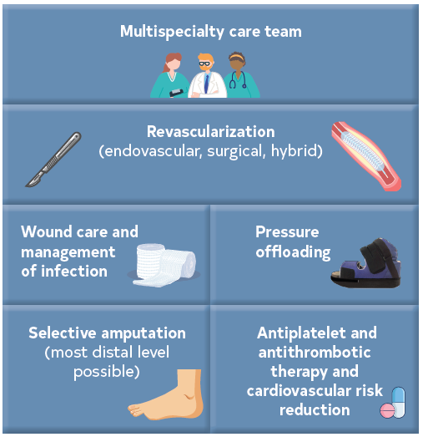
Figure 6. Components of Care for CLTI.
CLTI indicates chronic limb-threatening ischemia.

Slide 98
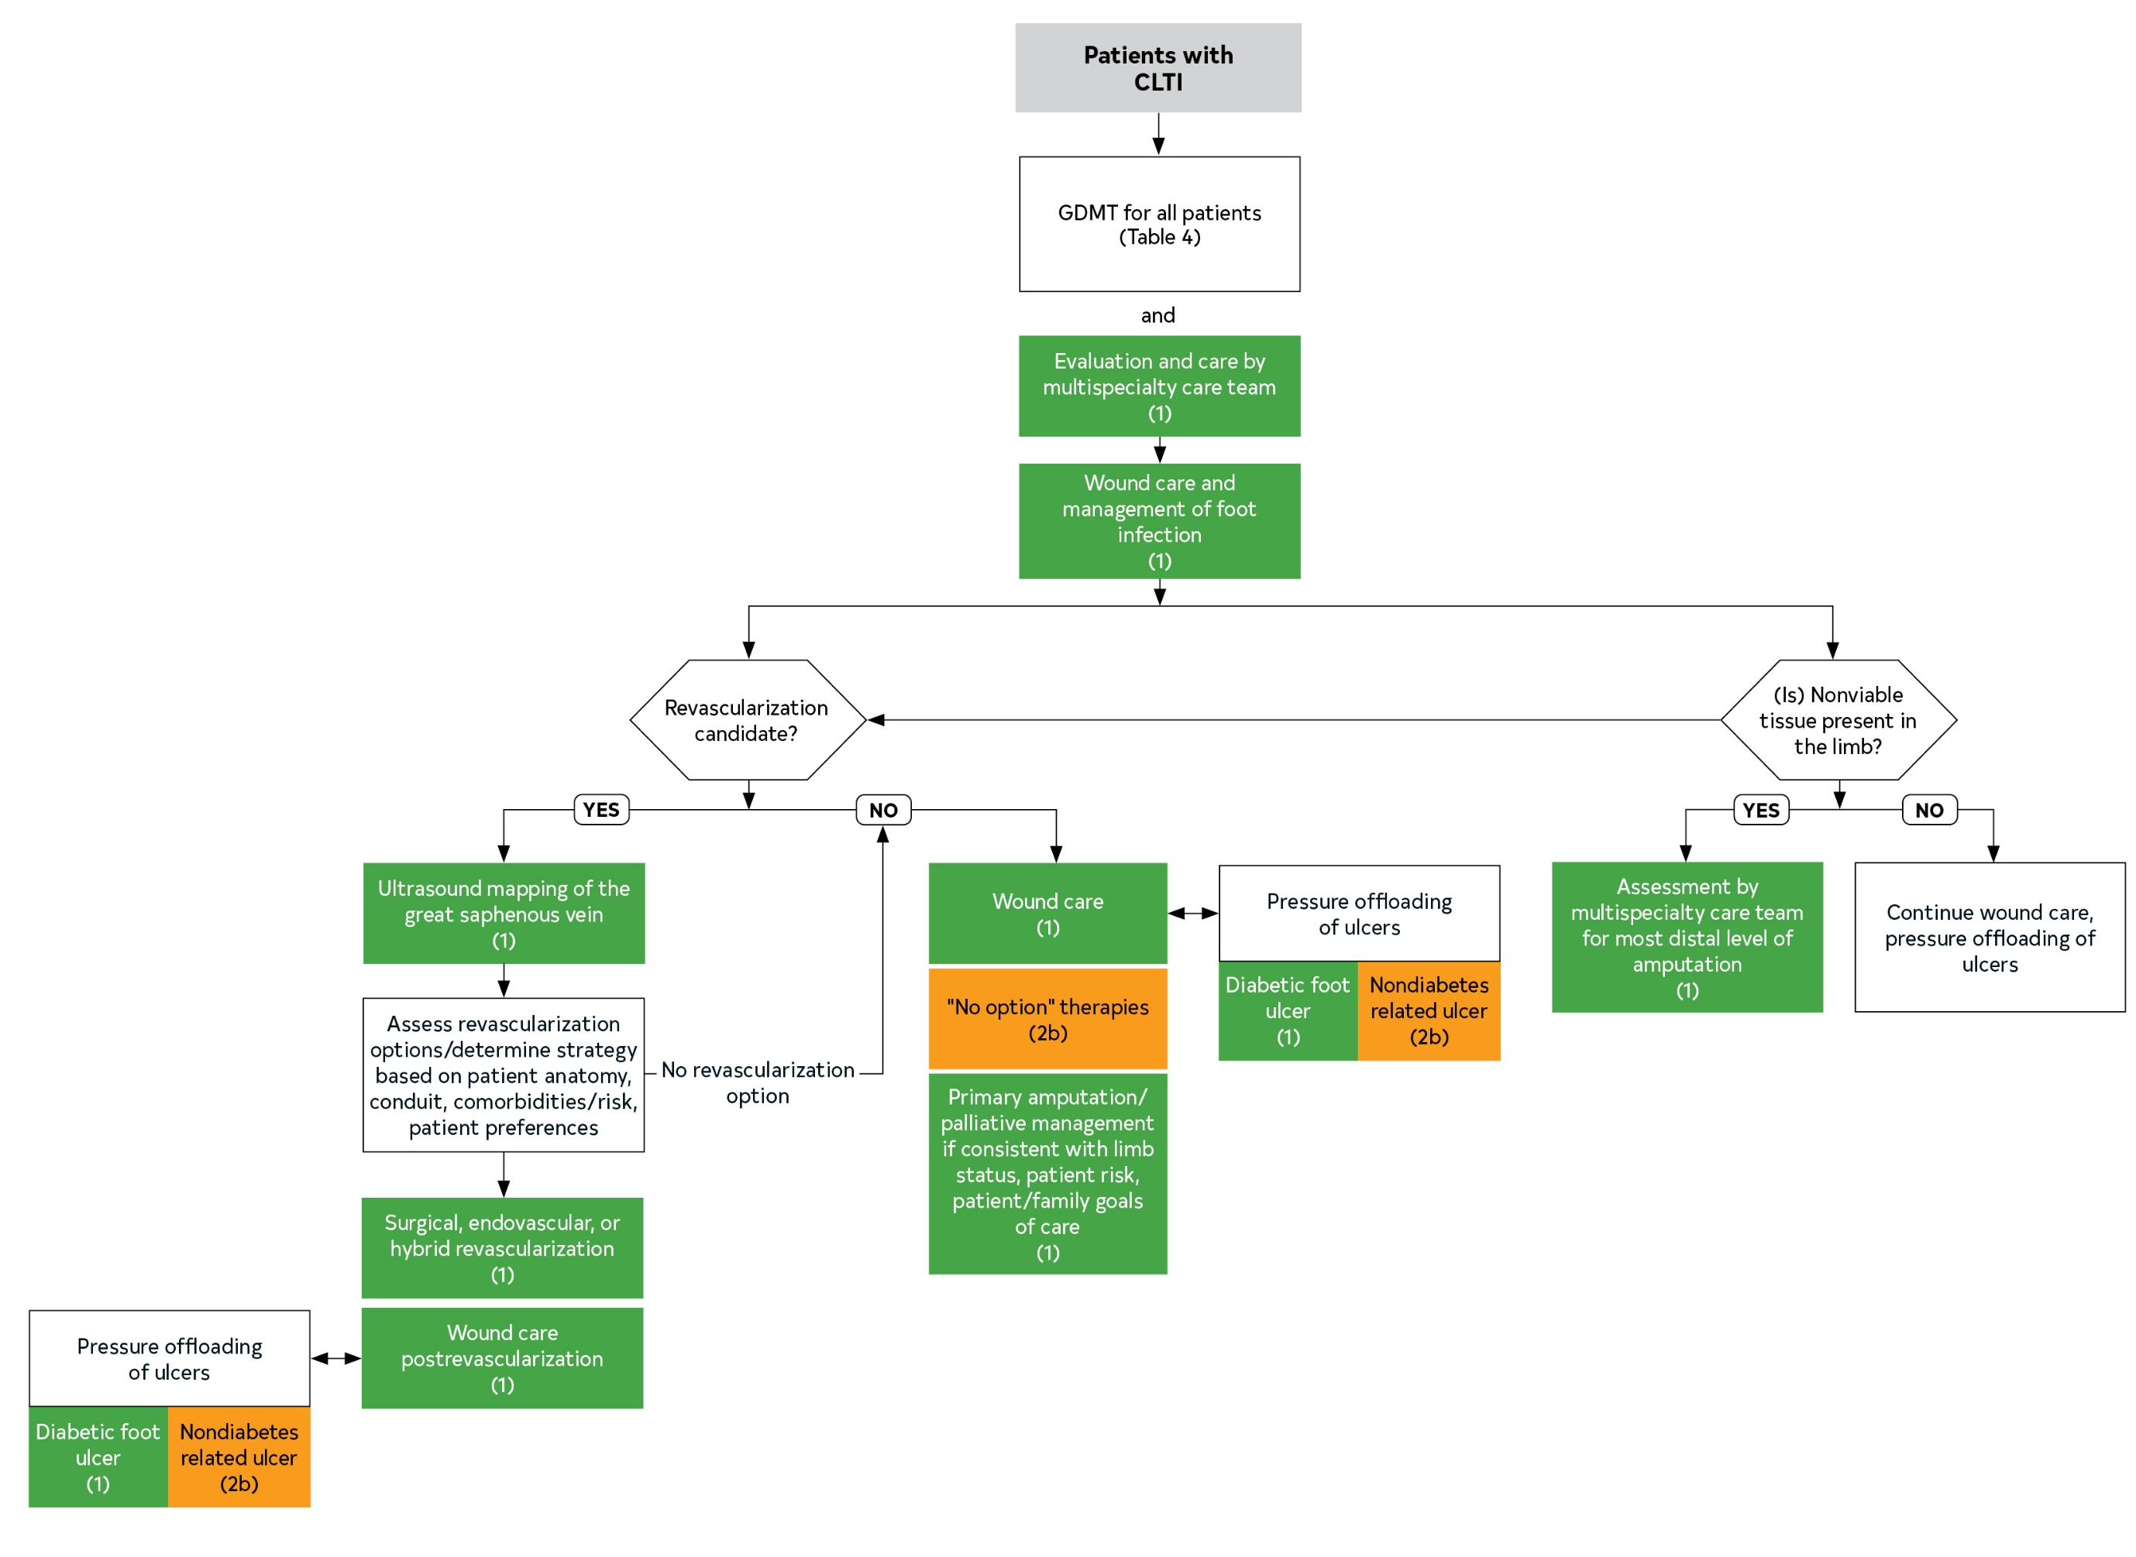
Figure 7. Algorithm for Management of CLTI.
Colors correspond to Table 3.
CLTI indicates chronic limb-threatening ischemia, GDMT, guideline-directed management and therapy; PAD, peripheral artery disease; and QOL, quality of life.

Slide 99
Team-Based Care for CLTI
Recommendation for Team-Based Care for CLTI Referenced studies that support the recommendation are summarized in the Online Data Supplement.
COR | LOE | Recommendation
1 | B-NR | In patients with CLTI, a multispecialty care team should evaluate and provide comprehensive care with goals of complete wound healing, minimizing tissue loss, and preservation of ambulatory status.

Slide 100
Table 15. Multispecialty Care Team for PAD
A team of professionals representing different specialties and disciplines to assist in the evaluation and management of the patient with PAD. For the care of patients who also have CLTI, the team should include individuals who are skilled in endovascular revascularization, surgical revascularization, wound-healing therapies and foot surgery, and medical evaluation and care.
Interdisciplinary care team members may include:
Vascular medical and surgical specialists (ie, vascular medicine, vascular surgery, vascular interventional radiology, interventional cardiology)
Advance Practice Provider (APP) – Nurse Practitioners/Physician Assistants
Nurses
Podiatrists, orthopedic surgeons, or both
Wound care specialists
Endocrinologists
Internal medicine specialists
Infectious disease specialists
Diagnostic radiologists and other vascular imaging specialists
Pharmacists
Physical medicine and rehabilitation clinicians
Social workers
Clinical exercise physiologists
Physical and occupational therapists
Nutritionists and dieticians
Patients and family members (collaborate with multispecialty care team)
CLTI indicates chronic limb-threatening ischemia; and PAD, peripheral artery disease.

Slide 101
Table 16. Factors That May Influence Revascularization Strategy for CLTI
Factors That May Influence Optimal Revascularization Modality | Clinical Examples (Other Factors Being Equal)
Anatomy | Strategy for current revascularization considers history of failed previous revascularization procedures (surgical, endovascular, or both) Anatomic characteristics that may favor surgical revascularization include: lesions involving both the common femoral artery and origin of the profunda femoris artery multilevel chronic total occlusions lesions in which endovascular treatment would adversely impact future surgical bypass options lesions that are long segment, involving the below-knee popliteal and infrapopliteal arteries
CKD indicates chronic kidney disease; and CLTI, chronic limb-threatening ischemia.

Slide 102
Table 16. Factors That May Influence Revascularization Strategy for CLTI (con’t.)
Factors That May Influence Optimal Revascularization Modality | Clinical Examples (Other Factors Being Equal)
Available conduit | Absence of suitable autogenous vein (eg, due to previous harvest for coronary artery bypass surgery) may favor endovascular revascularization.
Patient comorbidities | High estimated perioperative risk (eg, coronary ischemia, cardiomyopathy and heart failure, severe lung disease, CKD, and frailty) may favor endovascular revascularization.
Patient preferences | Patient preference for 1 revascularization modality (surgical or endovascular) over the other, after participating in shared decision-making.
CKD indicates chronic kidney disease; and CLTI, chronic limb-threatening ischemia.

Slide 103
Revascularization for CLTI
Recommendations for Revascularization for CLTI Referenced studies that support the recommendations are summarized in the Online Data Supplement.
COR | LOE | Recommendations
Revascularization Goals for CLTI
1 | B-R | In patients with CLTI, surgical, endovascular, or hybrid revascularization techniques are recommended, when feasible, to minimize tissue loss, heal wounds, relieve pain, and preserve a functional limb.
1 | C-EO | In patients with CLTI, an evaluation for revascularization options by a multispecialty care team is recommended before amputation (Table 15).

Slide 104
Revascularization for CLTI (con’t.)
Revascularization Strategy for CLTI
1 | A | In patients undergoing surgical revascularization for CLTI, bypass to the popliteal or infrapopliteal arteries (ie, tibial, pedal) should be constructed with autogenous vein if available.
1 | B-R | In patients with CLTI due to infrainguinal disease, anatomy, available conduit, patient comorbidities, and patient preferences should be considered in selecting the optimal first revascularization strategy (surgical bypass or endovascular revascularization) (Table 16).

Slide 105
Revascularization for CLTI (con’t.)
1 | B-R | In patients with CLTI who are candidates for surgical bypass and endovascular revascularization, ultrasound mapping of the great saphenous vein is recommended.
2a | B-NR | In patients with CLTI for whom a surgical approach is selected and a suitable autogenous vein is unavailable, alternative conduits such as prosthetic or cadaveric grafts can be effective for bypass to the popliteal and tibial arteries.
2a | B-NR | In patients with CLTI and nonhealing wounds or gangrene, revascularization in a manner that achieves in-line blood flow or maximizes perfusion to the wound bed can be beneficial.

Slide 106
Pressure Offloading for CLTI
Recommendations for Pressure Offloading for CLTI Referenced studies that support the recommendations are summarized in the Online Data Supplement.
COR | LOE | Recommendations
1 | A | Patients with CLTI and diabetic foot ulcers should receive pressure offloading, when possible, to promote tissue growth and wound healing.
1 | B-R | Patients with PAD and previous diabetic foot ulcers should be referred for customized footwear that accommodates, protects, and fits the shape of their feet.
2b | C-EO | Patients with CLTI and foot ulcers who do not have diabetes may be considered for pressure offloading to promote tissue growth and wound healing.

Slide 107
Wound Care and Management of Infection for CLTI
Recommendations for Wound Care and Management of Infection for CLTI Referenced studies that support the recommendations are summarized in the Online Data Supplement.
COR | LOE | Recommendations
1 | B-NR | In patients with CLTI, prompt management of foot infection with antibiotics, debridement, and other surgical management is recommended.
1 | C-LD | In patients with CLTI with nonhealing wounds, wound care should be provided to optimize the wound-healing environment after revascularization with the goal of complete wound healing.
2b | B-NR | In patients with CLTI with nonhealing diabetic foot ulcers, hyperbaric oxygen therapy may be considered to assist in wound healing after revascularization.

Slide 108
Table 17. Components of Wound Care for Patients With CLTI
Revascularization for adequate perfusion (see Section 10.2, “Revascularization for CLTI”)
Debridement of nonviable tissue
Management of infection, inflammation, or both
Pressure offloading, when appropriate (see Section 10.3.1, “Pressure Offloading for CLTI”)
Maintaining conducive wound-healing environment (ie, local wound care, dressings) (see Section 10.3.2, “Wound Care and Management of Infection for CLTI”)
Pain control
Medical optimization of host factors (eg, smoking cessation, glycemic control) (see Section 5, “Medical Therapy and Preventive Footcare for Patients with PAD”)
Optimization of tissue growth
Control of edema

Slide 109
Approach to the “No Option” Patient With CLTI
Recommendations for Approach to the “No Option” Patient With CLTI Referenced studies that support the recommendations are summarized in the Online Data Supplement.
COR | LOE | Recommendations
2b | B-R | In patients with CLTI for whom revascularization is not an option and a lack of outflow to the foot is observed, the usefulness of prostanoids is uncertain.
2b | B-NR | In patients with CLTI for whom revascularization is not an option, arterial intermittent pneumatic compression devices may be considered to augment wound healing or ameliorate ischemic rest pain.
2b | B-NR | In patients with CLTI for whom arterial revascularization is not an option and a lack of outflow to the foot is observed, venous arterialization may be considered for limb preservation.

Slide 110
Anatomic Classification of the No-Option Patient With CLTI
Type | Conventional Revascularization Options | No or Poor Option | Description
I. Desert foot pedal anatomy | No | No option | No patent pedal vessels Should be staged with the WIfI and GLASS staging classifications (including pedal modifier)
II. Inadequate venous conduit | No | No option | Patent pedal target without adequate venous conduit for bypass No endovascular options
III. Extensive tissue loss | Yes | Poor option | Tissue loss with exposure of vital structures precluding limb salvage of a functional foot
CLTI indicates chronic limb-threatening ischemia; GLASS, Global Limb Anatomic Staging System; and WIfI, wound, ischemia, and foot infection.

Slide 111
Amputation for CLTI
Recommendations for Amputation for CLTI Referenced studies that support the recommendations are summarized in the Online Data Supplement.
COR | LOE | Recommendations
1 | B-NR | In patients with CLTI who require amputation, evaluation should be performed by a multispecialty care team (Table 15) to assess for the most distal level of amputation that facilitates healing and provides maximal functional ability.
1 | C-EO | In patients with CLTI, primary amputation is indicated when life over limb is the prevailing consideration and clinical factors suggest the threatened limb to be the cause of the patient’s instability (eg, ischemia, metabolic derangement, or advanced infection).

Slide 112
Amputation for CLTI (con’t.)
1 | C-EO | In patients with CLTI, a patient-centered approach using objective classification of the threatened limb, patient risk, and anatomic pattern of disease combined with patient and family goals is recommended to identify those patients in whom primary amputation or palliative management is appropriate.
1 | C-EO | In patients with CLTI undergoing minor amputation (ie, inframalleolar level), a customized program of follow-up care that can include local wound care, pressure offloading, serial evaluation of foot biomechanics, and use of therapeutic footwear is recommended to prevent wound recurrence.
2a | C-EO | For patients with CLTI, retrospective assessment of institutional outcomes (including amputation) with objective limb threat classification tools can be useful for quality improvement.

Slide 113
Table 19. Major Factors Influencing QOL Among Amputees
Patient factors
Higher QOL
Walking with prosthesis
Above knee (versus below knee) amputation
Female sex (especially if age <60 y)
Living at home
Lower QOL
Age >65 y
Presence of diabetes
Isolation (being homebound)
Professional-controlled factors
Timing of amputation
Informed decision making
Postamputation support
QOL indicates quality of life.

Slide 114
Acute Limb Ischemia

Slide 115
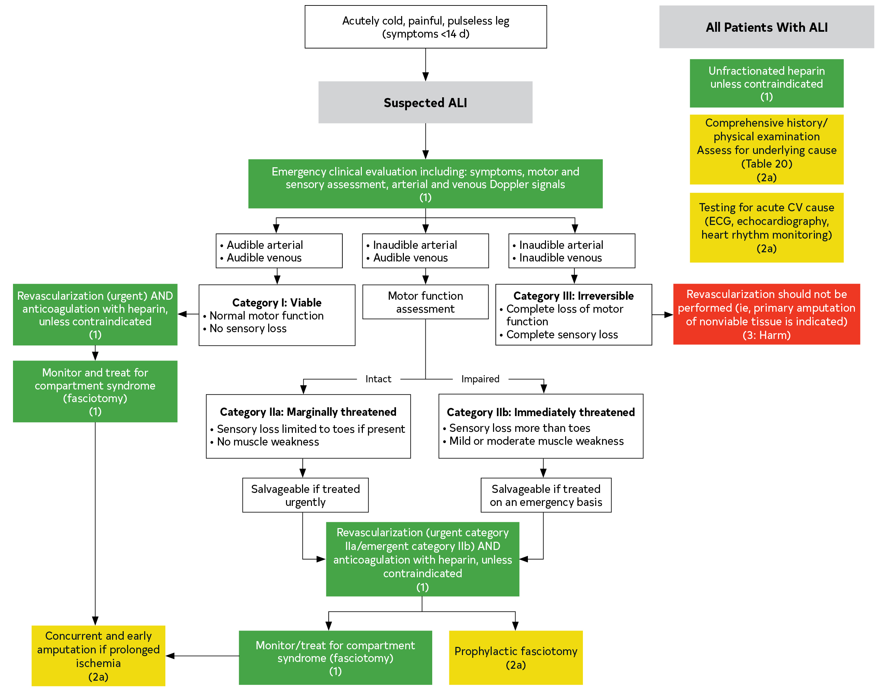
Figure 8. Algorithm for Diagnosis and Management of ALI.
Colors correspond to Table 3.
ALI indicates acute limb ischemia; CV, cardiovascular; and ECG, electrocardiogram.

Slide 116
Initial Clinical Evaluation and Diagnostic Approach to ALI
Recommendations for the Initial Clinical Evaluation and Diagnostic Approach to ALI
COR | LOE | Recommendations
1 | C-EO | Patients with ALI should be evaluated on an emergency basis by a clinician with sufficient experience to assess limb viability and implement appropriate therapy.
1 | C-LD | In patients with suspected ALI, the initial clinical evaluation should rapidly assess limb viability and potential for salvage and can be achieved without noninvasive imaging (ie, duplex ultrasound, CTA, or MRA).
2b | C-EO | In patients with ALI who have a complicated history of revascularization procedures, it may be reasonable to obtain noninvasive imaging (ie, duplex ultrasound, CTA, or MRA) before deciding to proceed with revascularization.

Slide 117
Revascularization for ALI
Recommendations for Revascularization for ALI Referenced studies that support the recommendations are summarized in the Online Data Supplement.
COR | LOE | Recommendations
1 | A | In patients with ALI and a salvageable limb, revascularization (endovascular or surgical, including catheter-directed thrombolysis) is indicated to prevent amputation.
2a | C-EO | In patients with ALI and a salvageable limb who are treated with catheter-directed thrombolysis, adjunctive revascularization (ie, endovascular, or surgical) procedures can be useful.

Slide 118
Revascularization for ALI (con’t.)
2b | C-LD | In patients presenting with ALI from chemotherapeutic or prothrombotic viral states, it may be reasonable to take a more deliberate planning strategy before engaging in a definitive revascularization or medical treatment plan.
3: Harm | C-EO | In patients with ALI with a nonsalvageable limb, revascularization of nonviable tissue should not be performed.

Slide 119
Adjunctive Therapies to Minimize Tissue Loss in ALI
Recommendations for Adjunctive Therapies to Minimize Tissue Loss in ALI Referenced studies that support the recommendations are summarized in the Online Data Supplement.
Recommendations
1 | C-EO | Patients with ALI should be monitored and treated for compartment syndrome with fasciotomy after revascularization (endovascular or surgical, including catheter-directed thrombolysis) to prevent the sequelae of reperfusion injury and need for amputation.
2a | B-NR | In patients with ALI with a threatened but salvageable limb (ie, category IIa or IIb), prophylactic fasciotomy is reasonable based on the clinical findings.^{1,2}
2a | C-EO | In patients with ALI and prolonged ischemia in whom revascularization (endovascular or surgical, including catheter-directed thrombolysis) is performed, concurrent and early amputation can be beneficial to avoid the morbidity of reperfusion.

Slide 120
Anticoagulation for ALI
Recommendation for Anticoagulation for ALI
COR | LOE | Recommendation
1 | C-EO | In patients with ALI, regardless of cause or anatomic level of occlusion, systemic anticoagulation with unfractionated heparin should be administered on diagnosis unless contraindicated.

Slide 121
Diagnostic Evaluation for the Cause of ALI
Recommendations for Diagnostic Evaluation for the Cause of ALI
COR | LOE | Recommendations
1 | C-EO | In patients with ALI, a comprehensive medical history and physical examination should be performed to determine the cause of thrombosis or embolization.
2a | C-LD | In patients with ALI, testing for a cardiovascular cause of thromboembolism can be useful.

Slide 122
Table 20. Underlying Causes of ALI
Underlying PAD with acute thrombosis
Thrombosis at sites of arterial stenosis
Artery to artery embolization
Thrombosis of previous bypass grafts
Arterial stent thrombosis
Cardiac embolization
Atrial fibrillation (ie, left atrial/appendage thrombus)
Other intracardiac thrombus (eg, left ventricular thrombus due to cardiomyopathy)
Infective endocarditis
Valvular heart disease (eg, mitral stenosis)
Intracardiac shunt including paradoxical embolization across a patent foramen ovale
Iatrogenic/access site-related thrombosis (eg, postfemoral access for catheterization)
Aortic or arterial dissection
Arterial trauma
Arterial aneurysm-related thromboembolism (eg, popliteal artery)
ALI indicates acute limb ischemia; COVID-19, coronavirus disease 2019; and PAD, peripheral artery disease.

Slide 123
Table 20. Underlying Causes of ALI (con’t.)
Hypercoagulable states
Antiphospholipid antibody syndrome
Heparin-induced thrombocytopenia
Cancer-associated arterial thrombosis
Others
Cancer therapy–associated thrombosis
Platinum-based chemotherapy
Tyrosine kinase inhibitors
Others
Other systemic proinflammatory states
Vasculitis
Sepsis
Viral illness, including COVID-19
Other infectious processes
Popliteal artery entrapment syndrome
ALI indicates acute limb ischemia; COVID-19, coronavirus disease 2019; and PAD, peripheral artery disease.

Slide 124
Longitudinal Follow-Up of PAD

Slide 125
Longitudinal Follow-Up of PAD
Recommendations for Longitudinal Follow-Up of PAD Referenced studies that support the recommendations are summarized in the Online Data Supplement.
COR | LOE | Recommendations
General Principles
1 | C-EO | In patients with PAD, with or without revascularization, longitudinal follow-up with routine clinical evaluation, including assessment of limb symptoms and functional status, lower extremity pulse and foot assessment, and progress of risk factor management is recommended.
1 | C-EO | In patients with PAD, coordination of care among clinicians to improve the management of PAD and comorbid conditions and to optimize patient outcomes is recommended.
Functional Status and QOL
1 | B-NR | In patients with PAD, with or without revascularization, periodic assessment of functional status as well as overall health-related QOL as a component of longitudinal follow-up is recommended.

Slide 126
Longitudinal Follow-Up of PAD (con’t.)
Medical Therapy
1 | A | In patients with PAD, long-term use of GDMT to prevent MACE and MALE is recommended.
Postrevascularization Follow-Up
1 | C-LD | In patients with PAD who have undergone lower extremity revascularization (ie, surgical and/or endovascular), longitudinal follow-up that includes periodic clinical evaluation of lower extremity symptoms and pulse and foot assessment is recommended.
1 | C-LD | In patients with PAD who have undergone lower extremity revascularization (ie, surgical, endovascular, or both) with new lower extremity signs or symptoms, ABI and arterial duplex ultrasound is recommended.^{14,17-20}
2a | B-R | In patients with PAD who have undergone infrainguinal, autogenous vein bypass graft(s) without new lower extremity signs or symptoms, it is reasonable to perform ABI and arterial duplex ultrasound surveillance within the first 1 to 3 months postprocedure, then repeat at 6 and 12 months, and then annually.

Slide 127
Longitudinal Follow-Up of PAD (con’t.)
2a | C-LD | In patients with PAD who have undergone endovascular procedures without new lower extremity signs or symptoms, it is reasonable to perform ABI and arterial duplex ultrasound surveillance within the first 1 to 3 months postprocedure, then repeat at 6 and 12 months, and then annually.
2b | B-NR | In patients with PAD who have undergone infrainguinal, prosthetic bypass graft(s) without new lower extremity signs or symptoms, the effectiveness of ABI and arterial duplex ultrasound surveillance is uncertain.
Telehealth
2a | C-LD | For patients with PAD, telehealth can be an alternative mode for vascular evaluation and management and longitudinal follow-up, but the use of these visits should be consistent with the urgency of presenting symptoms.

Slide 128
Abbreviations
Abbreviation | Meaning/Phrase
6MWT | 6-minute walk test
ABI | ankle-brachial index
ACE | angiotensin-converting enzyme
ALI | acute limb ischemia
CAD | coronary artery disease
CKD | chronic kidney disease
CLTI | chronic limb-threatening ischemia
COVID-19 | coronavirus disease 2019
CTA | computed tomography angiography
CVD | cardiovascular disease
ESKD | end-stage kidney disease
GDMT | guideline-directed management and therapy
LDL-C | low-density lipoprotein-cholesterol

Slide 129
Abbreviations (con’t.)
MACE | major adverse cardiovascular events
MALE | major adverse limb events
MI | myocardial infarction
MRA | magnetic resonance angiography
NPWT | negative pressure wound therapy
PAD | peripheral artery disease
PTA | percutaneous transluminal angioplasty
PVR | pulse volume recording
QOL | quality of life
RCT | randomized controlled trial
SARS-CoV-2 | severe acute respiratory syndrome coronavirus 2
SET | supervised exercise therapy
SBP | systolic blood pressure
SPP | skin perfusion pressure
TBI | toe-brachial index
TcPO₂ | transcutaneous oxygen pressure
WIfI | wound, ischemia, and foot infection

