Slide 1
2023 AHA/ACC Guideline for the Management of Patients with Chronic Coronary Disease
Developed in Collaboration with and Endorsed by the American College of Clinical Pharmacy, American Society for Preventive Cardiology, National Lipid Association and Preventive Cardiovascular Nurses Association
Endorsed by Society for Cardiovascular Angiography and Interventions

Slide 2
Citation
This slide set is adapted from the 2023 AHA/ACC Guideline for Chronic Coronary Disease. Published online ahead of print July 20, 2023, available at: Circulation. https://www.ahajournals.org/doi/10.1161/CIR.0000000000001168 And Journal of the American College of Cardiology published online ahead of print July 20, 2023. J Am Coll Cardiol. https://www.jacc.org/doi/10.1016/j.jacc.2023.04.003
© 2023 the American Heart Association, Inc. and the American College of Cardiology Foundation. All rights reserved. This article has been published in Circulation and the Journal of the American College of Cardiology.

Slide 3
2023 Writing Committee Members*
Salim S. Virani, MD, PhD, FACC, FAHA, FASPC, Chair†
L. Kristin Newby, MD, MHS, FACC, FAHA, Vice Chair†
Suzanne V. Arnold, MD, MHA, FAHA
Vera Bittner, MD, MSPH, FACC, FAHA, MNLA‡
LaPrincess C. Brewer, MD, MPH, FACC, FASPC
Susan Halli Demeter, DNP, FNLA, FPCNA§
Dave L. Dixon, PharmD, FAHA, FACC, FCCP, FNLA║
William F. Fearon, MD, FAHA, FACC
Beverly Hess, MSW¶
Heather M. Johnson, MD, MS, FAHA, FACC, FASPC**#
Dhruv Kazi, MD, MSc, MS, FAHA, FACC
Dhaval Kolte, MD, PhD, FACC† †
Dharam J. Kumbhani, MD, SM, FAHA, FACC
Jim LoFaso¶
Daniel B. Mark, MD, MPH, FACC, FAHA║
Dhruv Mahtta, DO, MBA
Margo Minissian, PhD, ACNP, FAHA
Ann Marie Navar, MD, PhD, FAHA, FACC, FASCP
Amit R. Patel, MD, FACC
Mariann R. Piano, RN, PhD, FAHA║
Fatima Rodriguez, MD, MPH, FACC, FAHA
Amy W. Talbot, MPH†
Viviany R. Taqueti, MD, MPH, FACC, FAHA
Randal J. Thomas, MD, MS, FACC, FAHA
Sean van Diepen, MD, MSc, FAHA
Barbara Wiggins, PharmD, MBA, FACC, FNLA, FCCP‡‡
Marlene S. Williams, MD, FACC§§
*Writing committee members are required to recuse themselves from voting on sections to which their specific relationships with industry may apply; see Appendix 1 for detailed information. †ACC/AHA representative. **AHA/ACC Joint Committee on Clinical Practice Guidelines. §§AHA/ACC Joint Committee on Performance Measures. ††AHA/ACC Joint Committee on Clinical Data Standards. ║Former Joint Committee on Clinical Practice Guideline member; current member during the writing effort. ‡‡American College of Clinical Pharmacy representative. #American Society for Preventive Cardiology representative. ‡National Lipid Association representative. ¶Patient representative/lay stakeholder. §Preventive Cardiovascular Nurses Association representative.

Slide 4
Top 10 Take-Home Messages
2023 Guideline for Chronic Coronary Disease

Slide 5
Top 10 Take Home Messages
1. Emphasis is on team-based, patient-centered care that considers social determinants of health along with associated costs while incorporating shared decision-making in risk assessment, testing, and treatment.

Slide 6
Top 10 Take Home Messages
2. Nonpharmacologic therapies, including healthy dietary habits and exercise, are recommended for all patients with chronic coronary disease (CCD).

Slide 7
Top 10 Take Home Messages
3. Patients with CCD who are free from contraindications are encouraged to participate in habitual physical activity, including activities to reduce sitting time and to increase aerobic and resistance exercise. Cardiac rehabilitation for eligible patients provides significant cardiovascular benefits, including decreased morbidity and mortality outcomes.

Slide 8
Top 10 Take Home Messages
4. Use of sodium glucose cotransporter 2 inhibitors and glucagon-like peptide-1 receptor agonists are recommended for select groups of patients with CCD, including groups without diabetes.

Slide 9
Top 10 Take Home Messages
5. New recommendations for beta-blocker use in patients with CCD: (a) Long-term beta-blocker therapy is not recommended to improve outcomes in patients with CCD in the absence of myocardial infarction in the past year, left ventricular ejection fraction ≤50%, or another primary indication for beta-blocker therapy; and (b) Either a calcium channel blocker or beta blocker is recommended as first-line antianginal therapy.

Slide 10
Top 10 Take Home Messages
6. Statins remain first line therapy for lipid lowering in patients with CCD. Several adjunctive therapies (eg, ezetimibe, PCSK9 [proprotein convertase subtilisin/kexin type 9] inhibitors, inclisiran, bempedoic acid) may be used in select populations, although clinical outcomes data are unavailable for novel agents such as inclisiran.

Slide 11
Top 10 Take Home Messages
7. Shorter durations of dual antiplatelet therapy are safe and effective in many circumstances, particularly when the risk of bleeding is high and the ischemic risk is low to moderate.

Slide 12
Top 10 Take Home Messages
8. The use of nonprescription or dietary supplements, including fish oil and omega-3 fatty acids or vitamins, is not recommended in patients with CCD given the lack of benefit in reducing cardiovascular events.

Slide 13
Top 10 Take Home Messages
9. Routine periodic anatomic or ischemic testing without a change in clinical or functional status is not recommended for risk stratification or to guide therapeutic decision-making in patients with CCD.

Slide 14
Top 10 Take Home Messages
10. Although e-cigarettes increase the likelihood of successful smoking cessation compared with nicotine replacement therapy, because of the lack of long-term safety data and risks of sustained use, e-cigarettes are not recommended as first-line therapy for smoking cessation.

Slide 15
Table 1. Level of Value for Clinical Guideline Recommendations*
Level of Value for Clinical Guideline Recommendations*
Level of Value
High value: Better outcomes at lower cost or ICER <$50,000 per QALY gained Intermediate value: $50,000 to <$150,000 per QALY gained Low value: ≥$150,000 per QALY gained Uncertain value: Value examined but data are insufficient to draw a conclusion because of no studies, low-quality studies, conflicting studies, or prior studies that are no longer relevant Not assessed: Value not assessed by the writing committee
Proposed abbreviations for each value recommendation: Level of Value: H indicates high value; I, intermediate value; L, low value; U, uncertain value; and NA, value not assessed.
*Figures used in this table are based on US GDP data from 2012 and were obtained from WHO-CHOICE Cost-Effectiveness Thresholds.2 *Figures used in this table are based on US GDP data from 2012 and were obtained from WHO-CHOICE Cost-Effectiveness Thresholds.2
GDP indicates gross domestic product; ICER, incremental cost-effectiveness ratio; QALY, quality-adjusted life-years; and WHO-CHOICE, World Health Organization Choosing Interventions that are Cost-Effective.

Slide 16
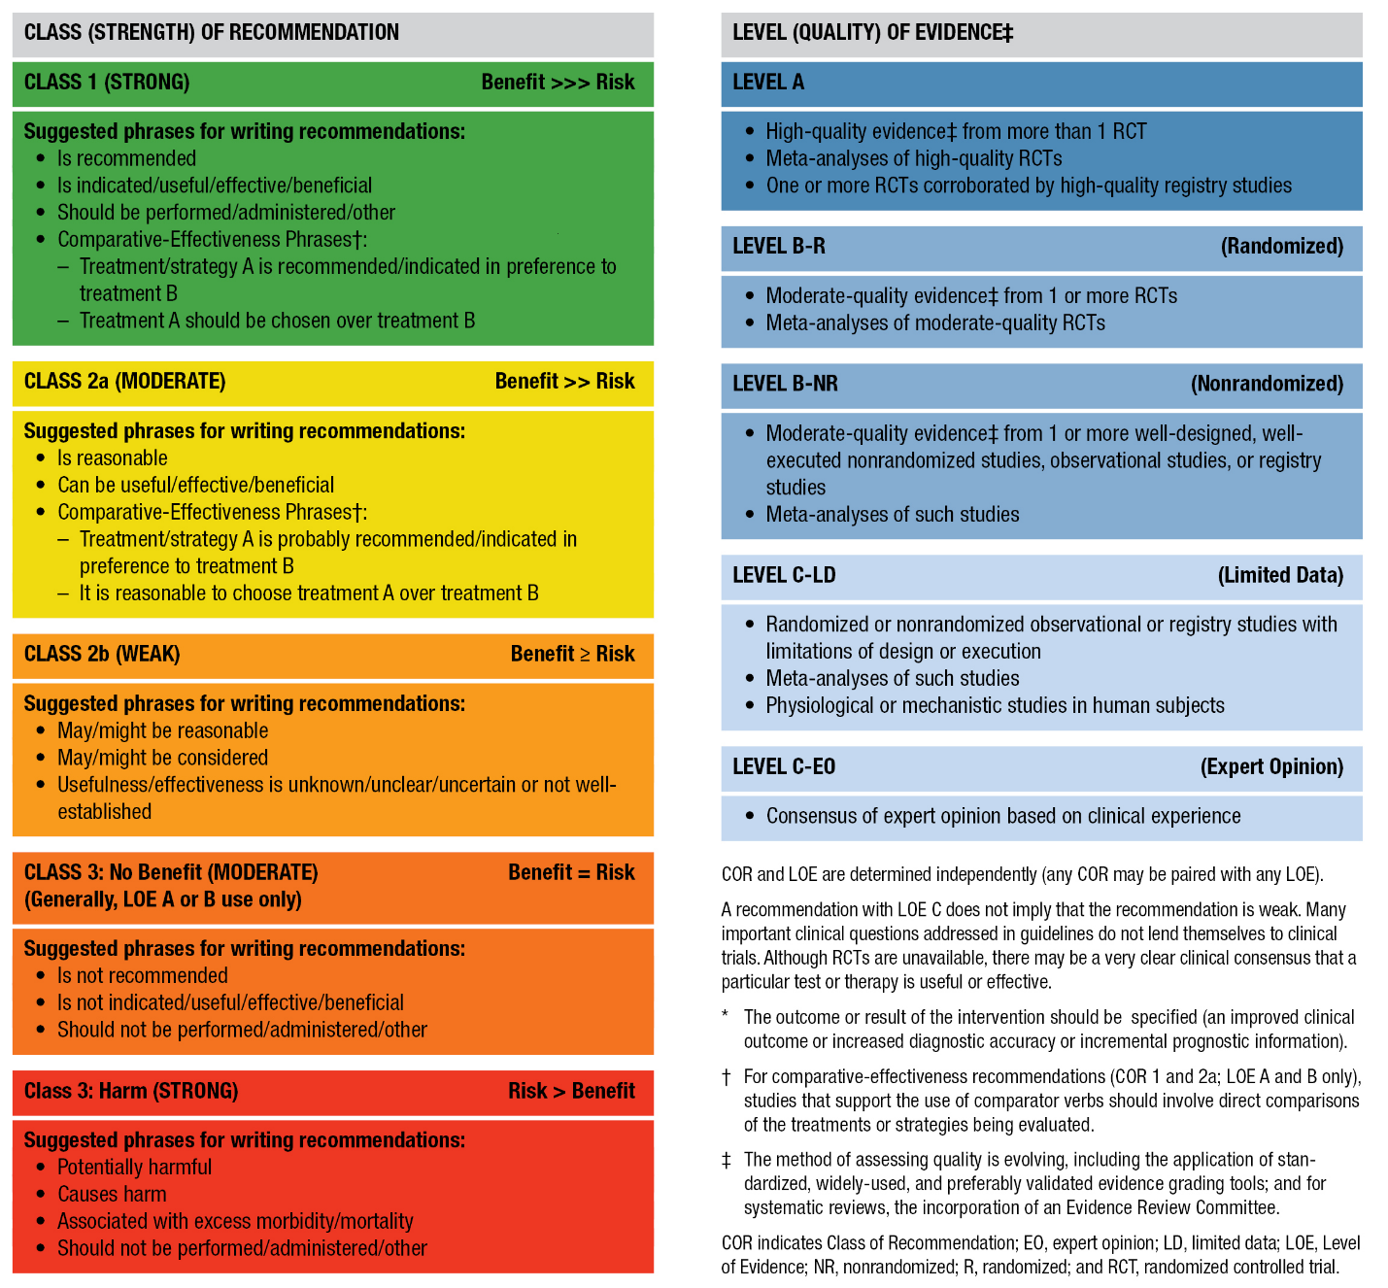
Table 3. Applying American College of Cardiology/American Heart Association Class of Recommendation and Level of Evidence to Clinical Strategies, Interventions, Treatments, or Diagnostic Testing in Patient Care (Updated May 2019)*

Slide 17
Table 4. US Heart Disease Prevalence, by Age, Race, Ethnicity, and Sex, 2015–2018
Population Group | Prevalence, CHD, 2015–2018, ≥20 y | Prevalence, MI, 2015–2018, ≥20 y | Prevalence, AP,* 2015–2018, ≥20 y
Both sexes | 20.1 million (7.2% [95% CI, 6.5–7.9]) | 8.8 million (3.1% [95% CI, 2.7–3.6]) | 11 million (4.1%)
Men | 11 million (8.3%) | 5.8 million (4.3%) | 5.3 million (4.2%)
Women | 9.1 million (6.2%) | 3 million (2.1%) | 5.7 million (4.0%)
NH White men | 8.7% | 4.4% | 4.5%
NH White women | 6.0% | 2.0% | 4.0%
NH Black men | 6.7% | 3.9% | 3.3%
NH Black women | 7.2% | 2.3% | 4.7%
AP indicates angina pectoris; CHD, coronary heart disease; CI, confidence interval; MI, myocardial infarction; and NH, non-Hispanic.
*AP is chest pain or discomfort that results from insufficient blood flow to the heart muscle. Stable AP is predictable chest pain on exertion or under mental or emotional stress. The incidence estimate is for AP without MI.

Slide 18
Table 4. US Heart Disease Prevalence, by Age, Race, Ethnicity, and Sex, 2015–2018 (con’t.)
Population Group | Prevalence, CHD, 2015–2018, age ≥20 y | Prevalence, MI, 2015–2018, age ≥20 y | Prevalence, AP,* 2015–2018, age ≥20 y
Hispanic men | 6.8% | 3.7% | 3.5%
Hispanic women | 6.4% | 2.1% | 4.3%
NH Asian men | 5.0% | 2.7% | 2.1%
NH Asian women | 3.2% | 0.7% | 2.2%
NH Native American/Alaska Native | --- | --- | ---
AP indicates angina pectoris; CHD, coronary heart disease; CI, confidence interval; MI, myocardial infarction; and NH, non-Hispanic.
*AP is chest pain or discomfort that results from insufficient blood flow to the heart muscle. Stable AP is predictable chest pain on exertion or under mental or emotional stress. The incidence estimate is for AP without MI.

Slide 19
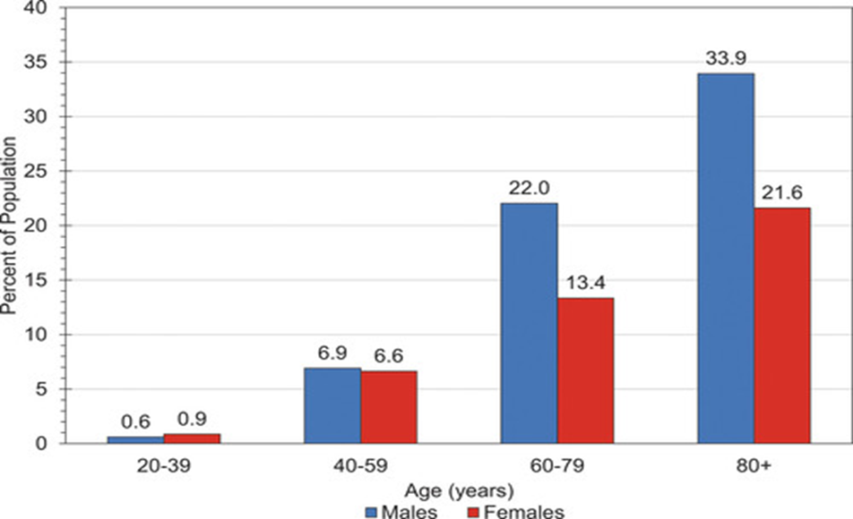
Figure 1. US Prevalence of CHD per 100,000, by Age and Sex (NHANES 2015–2018)
CHD indicates coronary heart disease.

Slide 20
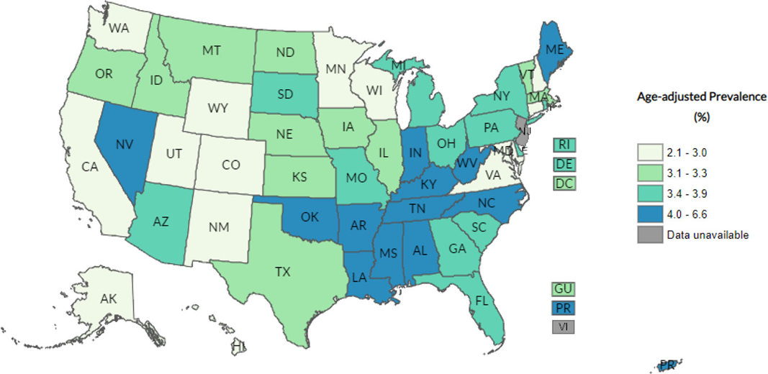
Figure 2. “Ever Told You Had Angina or CHD?” Age-Adjusted US Prevalence, by State (BRFSS Prevalence and Trends Data, 2019)
BRFSS indicates Behavioral Risk Factor Surveillance System; and CHD, coronary heart disease.

Slide 21
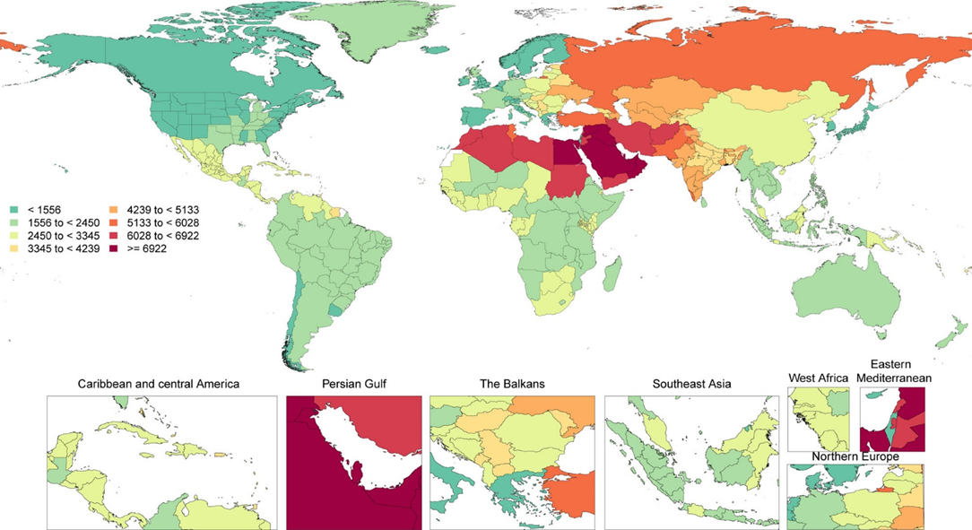
Figure 3. Global Age-Adjusted Prevalence of CCD per 100,000, by Sex, 2020
CCD indicates chronic coronary disease.

Slide 22
Evaluation, Diagnosis, and Risk Stratification

Slide 23
Diagnostic Evaluation
Recommendations for Diagnostic Evaluation Referenced studies that support the recommendations are summarized in the Online Data Supplement.
COR | LOE | Recommendations
1 | B-NR | In patients with CCD and a change in symptoms or functional capacity that persists despite GDMT, stress positron emission tomography/single photon emission CT myocardial perfusion imaging (PET/SPECT MPI), cardiovascular magnetic resonance (CMR) imaging, or stress echocardiography is recommended to detect the presence and extent of myocardial ischemia, estimate risk of major adverse cardiovascular events (MACE), and guide therapeutic decision-making.*
*Modified from the recommendations in the 2021 AHA/ACC/Multisociety Chest Pain Guideline

Slide 24
Diagnostic Evaluation (con’t.)
1 | B-R | In patients with CCD and a change in symptoms or functional capacity that persists despite GDMT, invasive coronary angiography (ICA) is recommended for guiding therapeutic decision-making with the goal of improving anginal symptoms.*
2a | B-R | In patients with CCD and a change in symptoms or functional capacity that persists despite GDMT, when selected for rest/stress nuclear MPI, PET is reasonable in preference to SPECT, if available, to improve diagnostic accuracy and decrease the rate of nondiagnostic test results.*
2a | B-NR | In patients with CCD and a change in symptoms or functional capacity that persists despite GDMT, exercise treadmill testing can be useful to determine whether the symptoms are consistent with angina pectoris, assess the severity of symptoms, evaluate functional capacity, and guide management.*
*Modified from the recommendations in the 2021 AHA/ACC/Multisociety Chest Pain Guideline

Slide 25
Diagnostic Evaluation (con’t.)
2a | B-NR | In patients with CCD undergoing stress PET MPI or stress CMR imaging, the addition of myocardial blood flow reserve (MBFR) can be useful to improve diagnostic accuracy and enhance risk stratification.*
2a | B-NR | In patients with CCD and a change in symptoms or functional capacity that persists despite GDMT, and who have had previous coronary revascularization, coronary CT angiography (CCTA) is reasonable to evaluate bypass graft or stent patency (for stents ≥3 mm).*
*Modified from the recommendations in the 2021 AHA/ACC/Multisociety Chest Pain Guideline

Slide 26
Risk Stratification and Relationship to Treatment Selection
Recommendations for Risk Stratification and Relationship to Treatment Selection Referenced studies that support the recommendations are summarized in the Online Data Supplement.
COR | LOE | Recommendations
Risk Stratification and Prognosis
1 | B-NR | 1. In patients with CCD, it is recommended that risk stratification incorporate all available information, including noninvasive, invasive, or both cardiovascular diagnostic testing results or use validated risk scores to classify patients as low (<1%), intermediate (1%-3%), or high (>3%) yearly risk for cardiovascular death or nonfatal MI.

Slide 27
Risk Stratification and Relationship to Treatment Selection (con’t.)
1 | A | 2. In patients with CCD, optimization of GDMT is recommended to reduce MACE.*
1 | A | 3. In patients with CCD with newly reduced LV systolic function, clinical heart failure, or both, ICA is recommended to assess coronary anatomy and guide potential revascularization.
3: No benefit | A | 4. In patients with CCD, ICA for risk stratification is not routinely recommended in patients without LV systolic dysfunction, heart failure, stable chest pain refractory to GDMT, and/or noninvasive testing suggestive of significant (>50%) left main disease.
*Modified from the 2021 AHA/ACC/Multisociety Chest Pain Guideline

Slide 28
Table 5. Potential Features Associated With a Higher Risk of MACE Among Patients With Established CCD
Demographics and Socioeconomic Status (also see Section 4.1.4, “Social Determinants of Health”)
Age
Male
Poor social support
Poverty or lack of health care access
Past or Concurrent Medical, Mental Health Conditions
Elevated body mass index
Previous MI, PCI, or CABG
HF
Atrial fibrillation or flutter
Diabetes
CABG indicates coronary artery bypass graft; CCD, chronic coronary disease; HF, heart failure; MI, myocardial infarction; PCI, percutaneous coronary intervention.

Slide 29
Table 5. Potential Features Associated With a Higher Risk of MACE Among Patients With Established CCD (con’t.)
Dyslipidemia
Chronic kidney disease
Current or former smoker
Peripheral artery disease
Depression
Poor adherence with goal-directed pharmacotherapy
Ancillary Cardiac Testing or Imaging
Inability to exercise
Angina with stress
ECG: left bundle branch block, left ventricular hypertrophy, higher resting heart rate
Echocardiography: reduced left ventricular ejection fraction, left ventricular hypertrophy
EST: higher DTS, higher resting heart rate, achieved heart rate <85% predicted
CCD, chronic coronary disease; ECG, electrocardiogram; EST, exercise stress test.

Slide 30
Table 5. Potential Features Associated With a Higher Risk of MACE Among Patients With Established CCD (con’t.)
Exercise or dobutamine stress echocardiography: higher DTS, lower exercise workload, peak rate-pressure product <15,000, coronary flow reserve <2, no change or increase in left ventricular end-systolic volume, reduced ejection fraction, ischemic electrocardiographic changes with stress
SPECT or PET: Percentage fixed myocardium on SPECT, transient ischemic dilation with stress, reduced coronary flow reserve, ischemic electrocardiographic changes with stress
Higher calcium score: alone and in addition to functional imaging
CCTA: total plaque burden, high-risk plaque (positive remodeling [remodeling index >1.1], low attenuation [mean CT number <30 HU], or napkin-ring sign), reduced CT-fractional flow reserve
CMR: reduced left and/or right ventricular ejection fraction, left ventricular hypertrophy, scar or infarct, reduced myocardial perfusion reserve, myocardial blood flow at stress
Biomarkers
High-sensitivity troponin, B-type natriuretic peptide
CCD, chronic coronary disease; CCTA, coronary computed tomography angiography; CMR, cardiovascular magnetic resonance imaging; CT, computed tomography; DTS, Duke Treadmill Score; HU, Hounsfield units; MACE, major adverse cardiovascular events; MI, myocardial infarction; PET, positron emission tomography; and SPECT, single-photon emission computed tomography.

Slide 31
Treatment

Slide 32
General Approach to Treatment Decisions
 | Recommendations for General Approach to Treatment Decisions Referenced studies that support the recommendations are summarized in the Online Data Supplement.
COR | LOE | Recommendations
1 | C-LD | In patients with CCD, clinical follow-up at least annually is recommended to assess for symptoms, change in functional status, adherence to and adequacy of lifestyle and medical interventions, and monitoring for complications of CCD and its treatments.
2b | B-NR | In patients with CCD, use of a validated CCD-specific patient-reported health status measure may be reasonable to assess symptoms, functional status, and QOL.

Slide 33
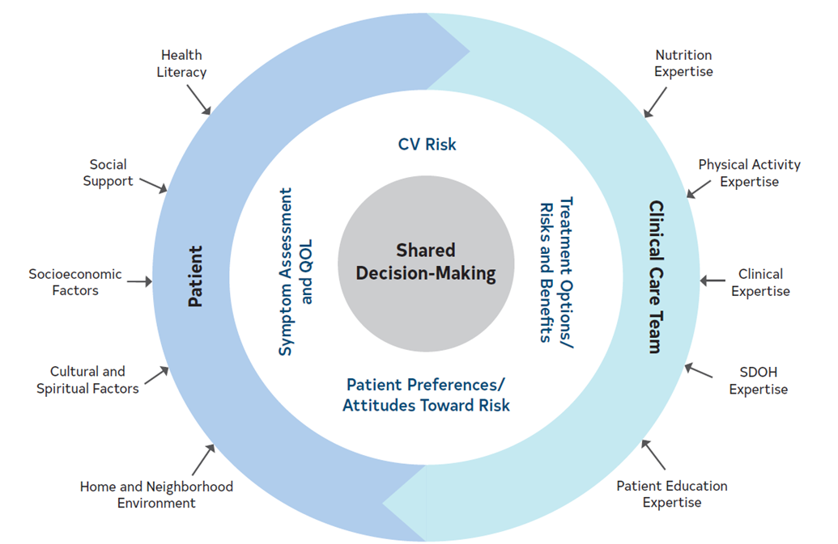
Figure 4. Domains to Consider When Seeing a Patient With CCD
CCD indicates chronic coronary disease; CV, cardiovascular; SDOH, social determinants of health; and QOL, quality of life.

Slide 34
Team-Based Approach
 | Recommendation for Team-Based Approach Referenced studies that support the recommendation are summarized in the Online Data Supplement.
COR | LOE | Recommendation
1 | A | In patients with CCD, a multidisciplinary team-based approach is recommended to improve health outcomes, facilitate modification of ASCVD risk factors, and improve health service utilization.*
*Modified from the 2019 ACC/AHA Primary Prevention of Cardiovascular Disease Guideline

Slide 35
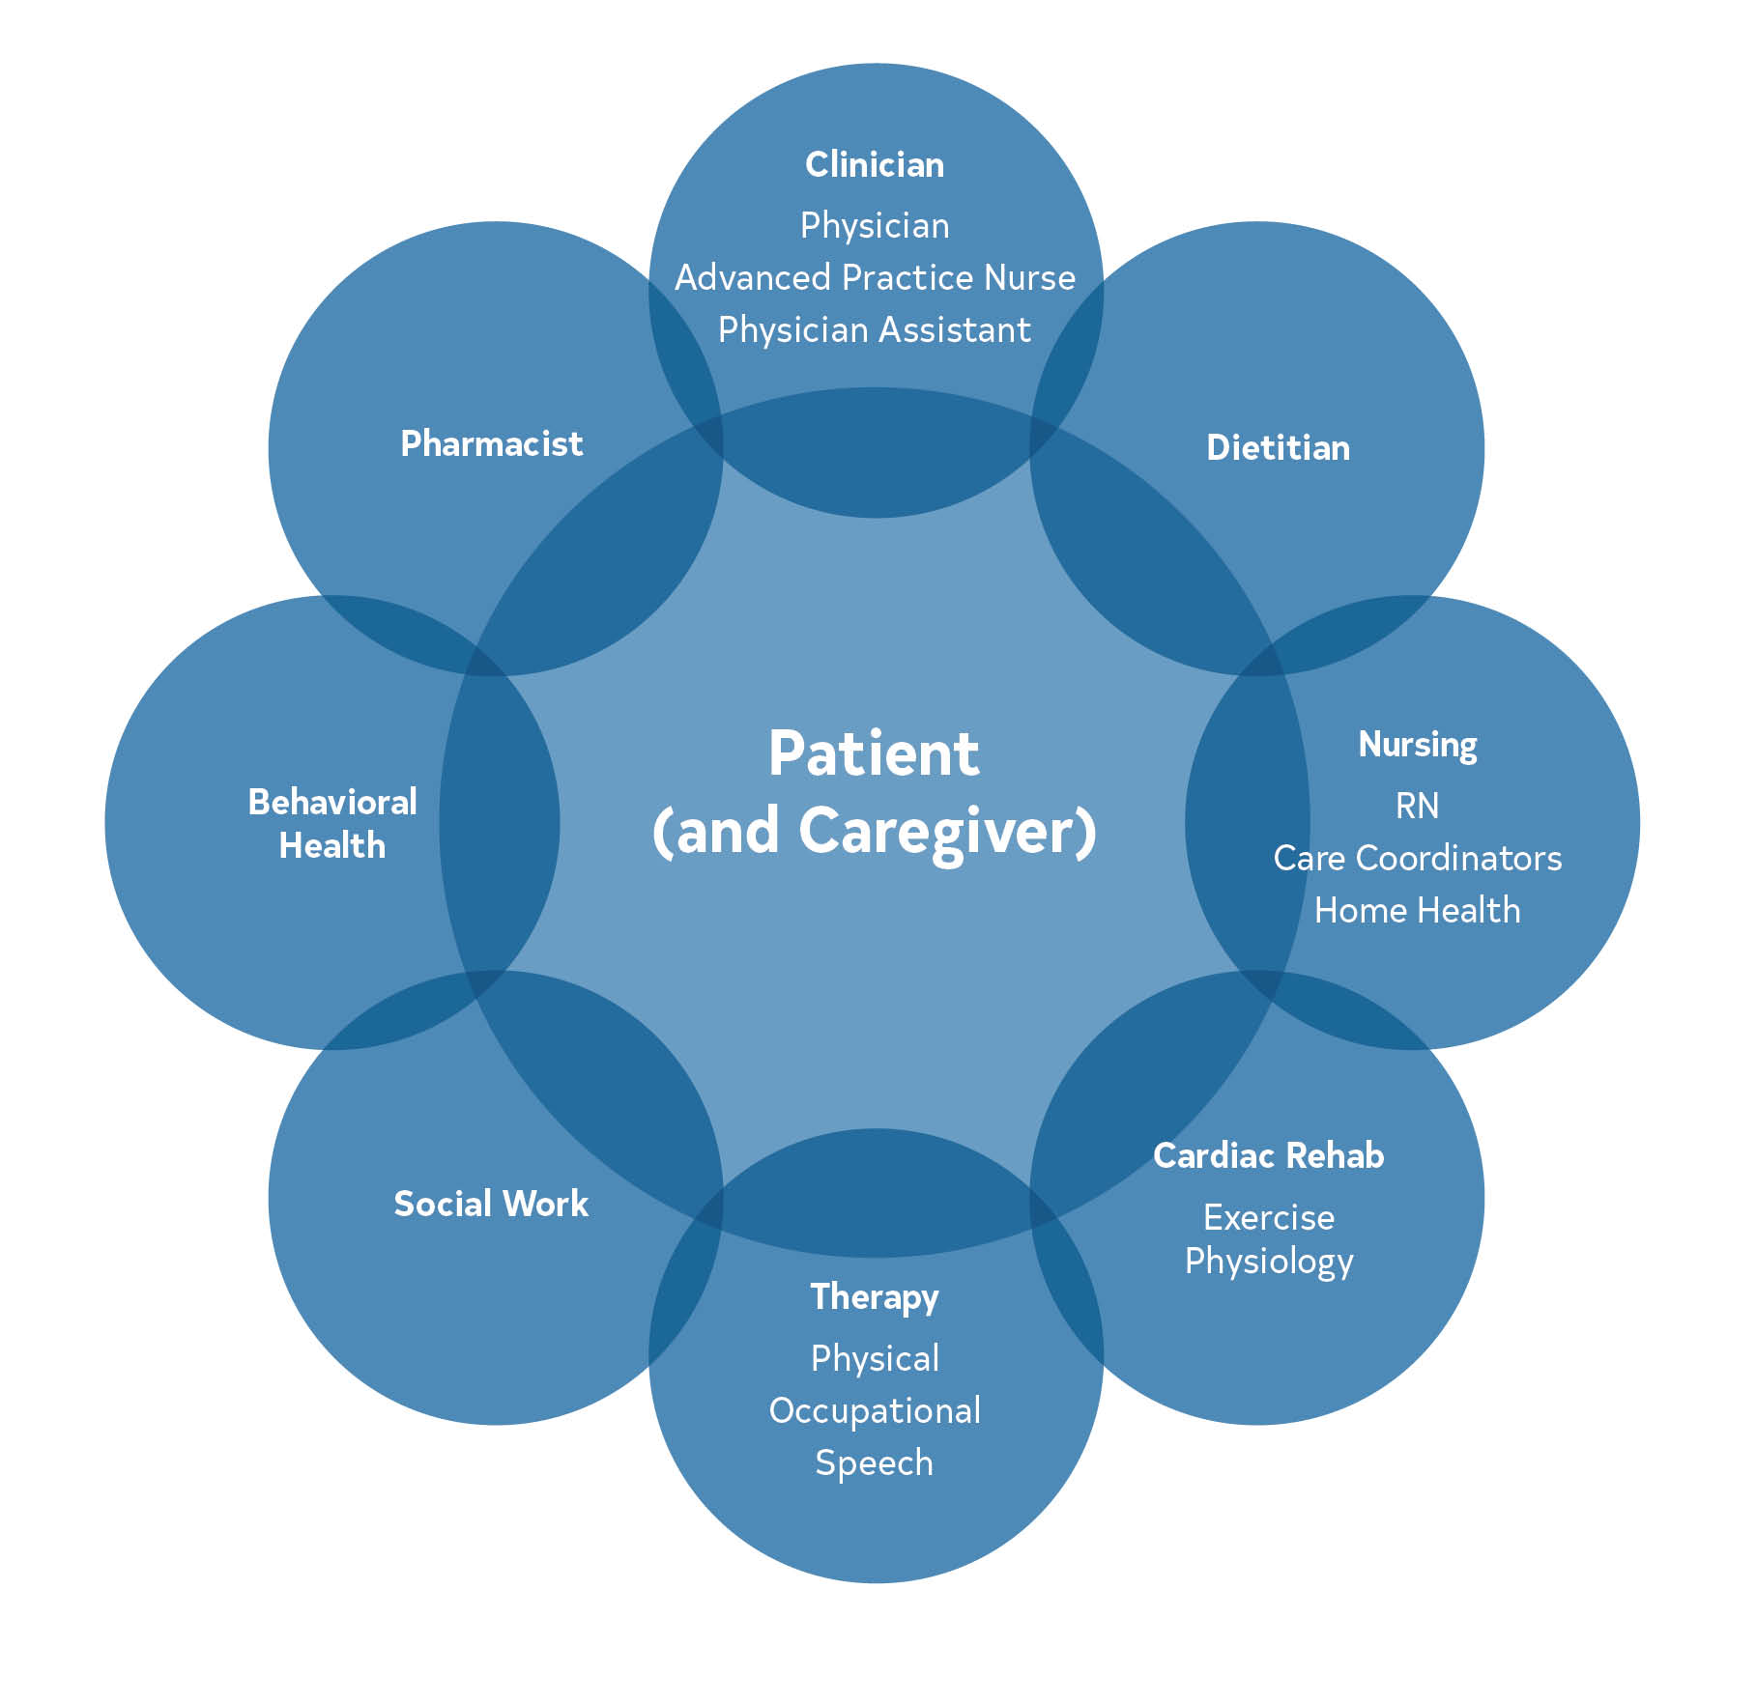
Figure 5. Team-Based Approach Reflective of Interconnectedness and Communication
RN indicates registered nurse.

Slide 36
Patient Education
 | Recommendations for Patient Education Referenced studies that support the recommendations are summarized in Online Data Supplement.
COR | LOE | Recommendations
1 | C-LD | Patients with CCD should receive ongoing individualized education on symptom management, lifestyle changes, and SDOH risk factors to improve knowledge and facilitate behavior change.
1 | C-LD | Patients with CCD should receive ongoing individualized education on medication adherence to improve knowledge and facilitate behavior change.

Slide 37
Shared Decision-Making
 | Recommendations for Shared Decision-Making Referenced studies that support the recommendations are summarized in the Online Data Supplement.
COR | LOE | Recommendations
1 | C-LD | Patients with CCD and their clinicians should engage in shared decision-making particularly when evidence is unclear on the optimal diagnostic or treatment strategy, or when a significant risk or benefit tradeoff exists.
2b | B-R | For patients with CCD and angina on GDMT who are engaged in shared decision-making regarding revascularization, a validated decision aid may be considered to improve patient understanding and knowledge about treatment options.

Slide 38
Social Determinants of Health (SDOH)
 | Recommendation for SDOH Referenced studies that support the recommendation are summarized in the Online Data Supplement.
COR | LOE | Recommendation
1 | B-R | In patients with CCD, routine assessment by clinicians and the care team for SDOH is recommended to inform patient-centered treatment decisions and lifestyle change recommendations.*
*Modified from the 2019 ACC/AHA Primary Prevention of CVD Guideline

Slide 39
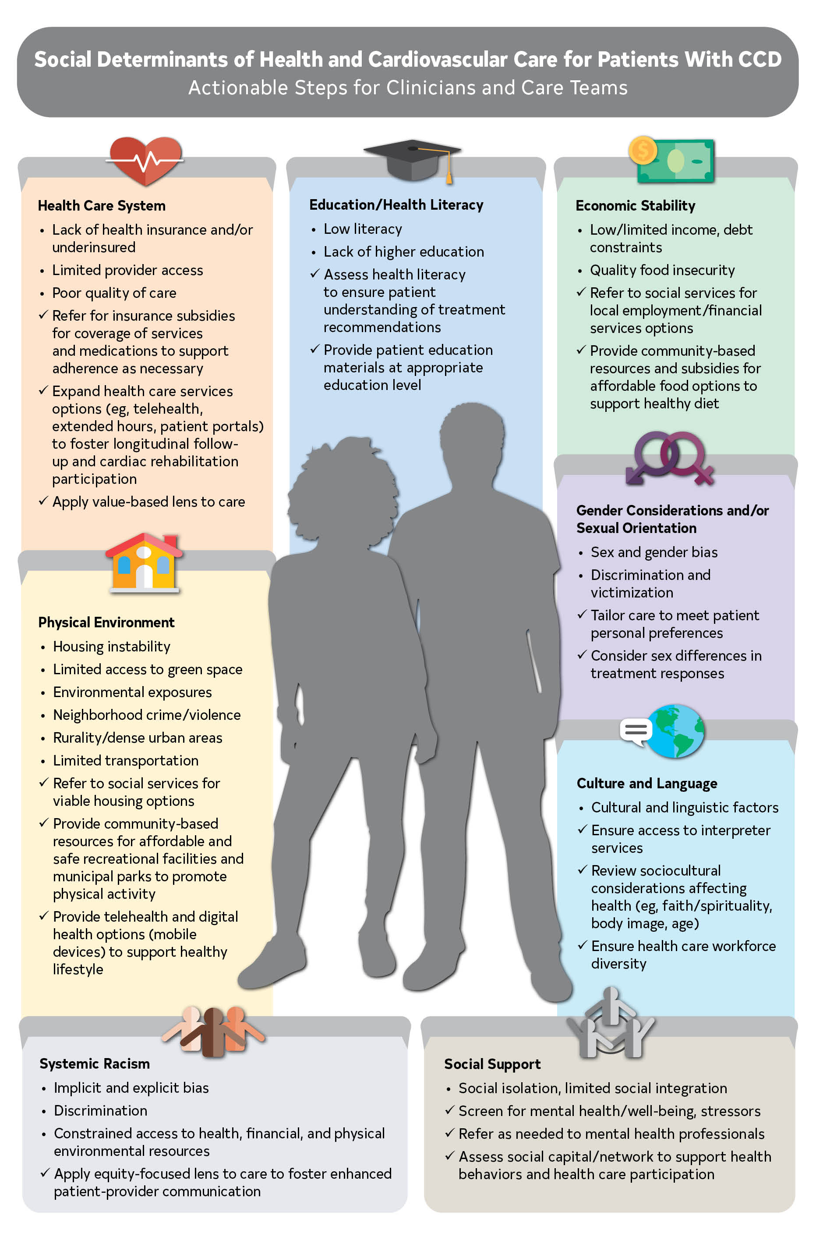
Figure 6. Social Determinants of Health and Cardiovascular Care for Patients With CCD
Identifies SDOH issue.
Considerations for clinicians and care teams
CCD indicates chronic coronary disease, and SDOH, social determinants of health.

Slide 40
Guideline-Directed Management and Therapy
Nutrition, Including Supplements
 | Recommendations for Nutrition, Including Supplements Referenced studies that support the recommendations are summarized in Online Data Supplement.
Recommendations
COR | LOE | Nutrition
1 | B-R | In patients with CCD, a diet emphasizing vegetables, fruits, legumes, nuts, whole grains, and lean protein is recommended to reduce the risk of CVD events.*
2a | B-NR | In patients with CCD, reducing the percentage of calories from saturated fat (<6% of total calories) and replacing with dietary monounsaturated and polyunsaturated fat, complex carbohydrates, and dietary fiber can be beneficial to reduce the risk of CVD events.*
2a | B-NR | In patients with CCD, minimization of sodium (<2,300 mg/d; optimally 1,500 mg/d) and minimization of processed meats (eg, cured bacon, hot dogs) can be beneficial to reduce the risk of CVD events.*
*Modified from the 2019 ACC/AHA Primary Prevention of CVD Guideline

Slide 41
Nutrition, Including Supplements (con’t.)
2a | B-NR | In patients with CCD, limiting refined carbohydrates (eg, containing <25% whole grain by weight, including refined cold ready-to-eat breakfast cereal, white bread, white rice), and sugar-sweetened beverages (eg, soft drinks, energy drinks, fruit drinks with added sugars) can be beneficial to reduce the risk of CVD events.*
3: Harm | B-NR | In patients with CCD, the intake of trans fat should be avoided because trans fat is associated with increased morbidity and mortality rates.*
 | Nutrition Supplements
3: No Benefit | B-NR | In patients with CCD, the use of nonprescription or dietary supplements, including omega-3 fatty acid, vitamins C, D, E, beta-carotene, and calcium, is not beneficial to reduce the risk of acute CVD events.
*Modified from the 2019 ACC/AHA Primary Prevention of CVD Guideline

Slide 42
Figure 7. Recommended Nutrition

Slide 43
Mental Health Conditions
 | Recommendations for Mental Health Conditions Referenced studies that support the recommendations are summarized in the Online Data Supplement.
COR | LOE | Recommendations
2a | B-R | In patients with CCD, targeted discussions and screening for mental health is reasonable for clinicians to assess and to refer for additional mental health evaluation and management.
2a | B-R | In patients with CCD, treatment for mental health conditions with either pharmacologic or nonpharmacologic therapies, or both, is reasonable to improve cardiovascular outcomes.

Slide 44
Table 6. Suggested Screening Tool to Assess Psychological Distress: Patient Health
Questionnaire-2 Depression Screen
Over the past 2 weeks, how often have you been bothered by the following problems? | Not at all | Several days | More than half the days | Nearly every day
Little interest or pleasure in doing things | 0 | 1 | 2 | 3
Feeling down, depressed, or hopeless | 0 | 1 | 2 | 3
Total score of ≥3 warrants further assessment for depression.

Slide 45
Table 7. Suggested Screening Questions to Assess Psychological Health
Well-being parameter | Question
Health-related optimism | How do you think things will go with your health moving forward?
Positive affect | How often do you experience pleasure or happiness in your life?
Gratitude | Do you ever feel grateful about your health? Do you ever feel grateful about other things in your life?

Slide 46
Tobacco Products
Recommendations for Tobacco Products Referenced studies that support the recommendations are summarized in the Online Data Supplement.
COR | LOE | Recommendations
1 | A | In patients with CCD, tobacco use should be assessed at every health care visit to facilitate identification of those who may benefit from behavioral or pharmacologic interventions.*
1 | A | Patients with CCD who regularly smoke tobacco should be advised to quit at every visit.*
1 | A | In patients with CCD who regularly smoke tobacco, behavioral interventions are recommended to maximize cessation rates in combination with pharmacotherapy, including bupropion, varenicline, or combination long- and short-acting nicotine replacement therapy (NRT).*
*Modified from the 2019 AHA/ACC Primary Prevention of CVD Guideline

Slide 47
Tobacco Products (con’t.)
2b | B-R | In patients with CCD who regularly smoke tobacco, varenicline may be considered versus bupropion or NRT to increase cessation rates.
2b | B-R | In patients with CCD who regularly smoke tobacco, the short-term use of nicotine-containing e-cigarettes may be considered to aid smoking cessation, although the risk of sustained use and unknown long-term safety may outweigh the benefits.
3: Harm | B-NR | Patients with CCD should avoid secondhand smoke exposure to reduce risk of cardiovascular events.*
*Modified from the 2019 AHA/ACC Primary Prevention of CVD Guideline

Slide 48
Table 8. Behavioral Resources for Smoking Cessation
Resource | Description
Telephone-based: Quitline English: 1-800-QUIT-NOW (1-800-784-8669) Spanish: 1-855-DÉJELO-YA (1-855-335-3569) Mandarin and Cantonese: 1-800-838-8917 Korean: 1-800-556-5564 Vietnamese: 1-800-778-8440 | Counseling by telephone from a trained tobacco coach who offers support via a series of scheduled telephone calls before and after a smoker’s quit date. Patients can self-refer to the Quitline, or providers can refer patients, with their consent, proactively. Quitline services vary by state, can include text messaging and web coaching support, and may provide free samples of nicotine replacement therapy. State-by-state information about Quitline services is available at https://www.cdc.gov/tobacco/patient-care/quitlines-other/index.html

Slide 49
Table 8. Behavioral Resources for Smoking Cessation (con’t.)
Web-based: American Lung Association Freedom From Smoking https://www.lung.org/quit-smoking/join-freedom-from-smoking | Created by the American Lung Association to support smoking cessation in persons who want to quit. The program also provides information about NRT and pharmacotherapy. Multiple modes of support available to patients, including group clinics, a telephone-based “Lung HelpLine”, a self-help guide, and a web-based interactive customized program. Interactive program available for computer, tablet, or smartphone interface.
Web-based: National Cancer Institute English: Smokefree.gov Spanish: https://espanol.smokefree.gov/Spanish | Supported by the US Department of Health and Human Services and National Institutes of Health, created by the National Cancer Institute. Website contains information about quitting and resources for quitting and allows users to create a personalized quit plan. Specific websites are also available for women, teens, Veterans, and those >60 y of age. Programs available through the website include: SmokefreeTXT (text messaging program), QuitGuide, and quitSTART (mobile phone apps).

Slide 50
Table 8. Behavioral Resources for Smoking Cessation (con’t.)
Web-based: Asian Smokers’ Quitline Mandarin, Cantonese, Korean, and Vietnamese Speakers https://www.asiansmokersquitline.org/ | Operated by the Moores Cancer Center at the University of California, San Diego, funded by a grant from the US Centers for Disease Control and Prevention. Created to support tobacco cessation for persons who speak Mandarin, Cantonese, Korean, and Vietnamese across the United States. Some participants may be eligible for a 2-wk starter kit of nicotine patches. Telephone counseling developed to deliver a quit plan and support quitting, and printed self-help materials sent to participants.

Slide 51
Table 8. Behavioral Resources for Smoking Cessation (con’t.)
Web-based: BecomeAnEX Available in English and Spanish https://www.becomeanex.org | Created by the Truth Initiative, a nonprofit public education in partnership with the Mayo Clinic Nicotine Dependence Center. Website with information about cessation of smoking, vaping, or use of smokeless tobacco, with resources to build an individualized quit plan. Includes support from experts and an online community, and a text message–based program for quitting vaping focused on teens and young adults, “This is Quitting.” An employer-based program, the EX Program, is also available through the Truth Initiative.

Slide 52
Alcohol and Substance Use
 | Recommendations for Alcohol and Substance Use Referenced studies that support the recommendations are summarized in the Online Data Supplement.
COR | LOE | Recommendations
1 | C-LD | Patients with CCD should be routinely asked and counseled about substance use to reduce ASCVD events.
2a | B-NR | In patients with CCD who consume alcohol, it is reasonable to limit alcohol intake (≤1 drink/d for women, ≤2 drinks/d for men) to reduce cardiovascular and all-cause death.
3: No Benefit | B-NR | Patients with CCD should not be advised to consume alcohol for the purpose of cardiovascular protection.

Slide 53
Table 9. Substances With Abuse Potential and Adverse Cardiovascular Effects for Patients With CCD*
Substance | Potential Adverse Cardiovascular Effects
Alcohol | J-shaped relationship between alcohol intake and cardiovascular risk in observational studies but limited by confounding. Heavy alcohol use and binge drinking associated with increased morbidity and mortality rates. May increase serum triglycerides. Potential drug-drug interactions with cardiovascular therapies.
Cocaine, methamphetamine | Stimulation of the sympathetic nervous system. Platelet activation and aggregation. Increased myocardial oxygen demand. Can present with cocaine-associated chest pain. MI risk independent of route of administration.

Slide 54
Table 9. Substances With Abuse Potential and Adverse Cardiovascular Effects for Patients With CCD* (con’t.)
Opioids | Possible association with risk of MI in chronic use. High potential for dependence and abuse with chronic use. Potential for drug-drug interactions with cardiovascular therapies.
Marijuana | Stimulation of the sympathetic nervous system. Platelet activation. Endothelial dysfunction. Carbon monoxide toxicity from smoking and inhalatation. Route of administration may impact toxicity, with edible products associated with fewer acute cardiovascular symptoms.
CCD indicates chronic coronary disease; and MI, myocardial infarction. *List is not all inclusive.

Slide 55
Sexual Health and Activity
 | Recommendations for Sexual Health and Activity Referenced studies that support the recommendations are summarized in the Online Data Supplement.
COR | LOE | Recommendations
2a | B-NR | In patients with CCD, it is reasonable to individualize resumption of sexual activity based on type of sexual activity, exercise capacity, and postprocedural healing.*
2a | B-NR | In patients with CCD, cardiac rehabilitation and regular exercise can be useful to reduce the risk of cardiovascular complications with sexual activity.*
3: Harm | B-NR | In patients with CCD, phosphodiesterase type 5 inhibitors should not be used concomitantly with nitrate medications because of risk for severe hypotension.*
*Modified from the 2012 AHA Scientific Statement on Sexual Activity and CVD

Slide 56
Lipid Management
 | Recommendations for Lipid Management Referenced studies that support the recommendations are summarized in the Online Data Supplement.
COR | LOE | Recommendations
1 | A | In patients with CCD, high-intensity statin therapy is recommended with the aim of achieving a ≥50% reduction in LDL-C levels to reduce the risk of MACE.*
1 | A | In patients in whom high-intensity statin therapy is contraindicated or not tolerated, moderate-intensity statin therapy is recommended with the aim of achieving a 30% to 49% reduction in LDL-C levels to reduce the risk of MACE.*
1 | A | In patients with CCD, adherence to changes in lifestyle and effects of lipid-lowering medication should be assessed by measurement of fasting lipids in 4 to 12 weeks after statin initiation or dose adjustment and then every 3 to 12 months thereafter based on need to assess response or adherence to therapy.*
*Modified from the 2018 AHA/ACC Cholesterol Guideline

Slide 57
Lipid Management (con’t.)
Cost Value Statement: High Value | B-NR | In patients with CCD, the use of generic formulations of maximally tolerated statin therapy is projected to be cost saving.
2a | B-R | In patients with CCD who are judged to be at very high risk (Table 10) and on maximally tolerated statin therapy with an LDL-C level ≥70 mg/dL (≥1.8 mmol/L), ezetimibe can be beneficial to further reduce the risk of MACE.*
Cost Value Statement: High Value | B-NR | In patients with CCD, addition of generic ezetimibe to maximally tolerated statin therapy in appropriately selected patients is projected to be of high economic value at US prices.
*Modified from the 2018 AHA/ACC Cholesterol Guideline

Slide 58
Lipid Management (con’t.)
2a | A | In patients with CCD who are judged to be at very high risk (Table 10) and who have an LDL-C level ≥70 mg/dL (≥1.8 mmol/L), or a non–high-density lipoprotein cholesterol (HDL-C) level ≥100 mg/dL (≥2.6 mmol/L), on maximally tolerated statin and ezetimibe, a PCSK9 monoclonal antibody can be beneficial to further reduce the risk of MACE.*
Cost Value Statement: Uncertain | B-NR | In patients with CCD who are very high risk, the use of PCSK9 monoclonal antibodies is projected to be of uncertain economic value at US prices
2b | B-R | In patients with CCD on maximally tolerated statin therapy with an LDL-C level <100 mg/dL (<2.6 mmol/L) and a persistent fasting triglyceride level of 150 to 499 mg/dL (1.7–5.6 mmol/L) after addressing secondary causes, icosapent ethyl may be considered to further reduce the risk of MACE and cardiovascular death.
*Modified from the 2018 AHA/ACC Cholesterol Guideline

Slide 59
Lipid Management (con’t.)
2b | B-R | In patients with CCD who are not at very high risk and on maximally tolerated statin therapy with an LDL-C level ≥70 mg/dL (≥1.8 mmol/L), it may be reasonable to add ezetimibe to further reduce the risk of MACE.*
2b | B-R | In patients with CCD on maximally tolerated statin therapy who have an LDL-C level ≥70 mg/dL (≥1.8 mmol/L), and in whom ezetimibe and PCSK9 monoclonal antibody are deemed insufficient or not tolerated, it may be reasonable to add bempedoic acid or inclisiran (in place of PCSK9 monoclonal antibody) to further reduce LDL-C levels.
3: No Benefit | B-R | In patients with CCD receiving statin therapy, adding niacin, or fenofibrate or dietary supplements containing omega-3 fatty acids, are not beneficial in reducing cardiovascular risk.
*Modified from the 2018 AHA/ACC/Multisociety Blood Cholesterol Guideline

Slide 60
Table 10. Very High-Risk* of Future ASCVD Events
Definition of Very High-Risk*
History of multiple major ASCVD events OR One major ASCVD event AND ≥2 high-risk conditions
Major ASCVD Events
Recent ACS (within the past 12 mo)
History of MI (other than recent ACS events listed above)
History of ischemic stroke
Symptomatic peripheral artery disease (history of claudication with ABI <0.85, or previous revascularization or amputation)
ABI indicates ankle brachial index; ACS, acute coronary syndrome; ASCVD, atherosclerotic cardiovascular disease; CKD, chronic kidney disease; eGFR, estimated glomerular filtration rate; LDL-C, low-density lipoprotein cholesterol; and MI, myocardial infarction.
*Very high-risk includes a history of multiple major ASCVD events or 1 major ASCVD event and multiple high-risk conditions.

Slide 61
Table 10. Very High-Risk* of Future ASCVD Events
High-Risk Conditions
Age ≥65 y
Familial hypercholesterolemia†
History of previous coronary artery bypass graft surgery or percutaneous coronary intervention outside of the major ASCVD event(s)
Diabetes
Hypertension
Chronic kidney disease (eGFR, 15–59 mL/min/1.73m²)
Current tobacco smoking
Persistently elevated LDL-C ≥100 mg/dL despite maximally tolerated statin therapy and ezetimibe
History of congestive heart failure
†Management of patients with familial hypercholesterolemia often requires combination lipid lowering therapy and referral to a lipid specialist, and possibly lipoprotein apheresis.
ABI indicates ankle brachial index; ACS, acute coronary syndrome; ASCVD, atherosclerotic cardiovascular disease; CKD, chronic kidney disease; eGFR, estimated glomerular filtration rate; LDL-C, low-density lipoprotein cholesterol; and MI, myocardial infarction.
*Very high-risk includes a history of multiple major ASCVD events or 1 major ASCVD event and multiple high-risk conditions.

Slide 62
Table 11. High-, Moderate-, and Low-Intensity Statin Therapy*
 | High Intensity | Moderate Intensity | Low Intensity
LDL-C Lowering† | ≥50% | 30%-49% | <30%
Statins | Atorvastatin (40 mg‡), 80 mg Rosuvastatin 20 mg (40 mg) | Atorvastatin 10 mg (20 mg) Rosuvastatin (5 mg) 10 mg Simvastatin 20-40 mg§ | Simvastatin 10 mg
 |  | Pravastatin 40 mg (80 mg) Lovastatin 40 mg (80 mg) Fluvastatin XL 80 mg Fluvastatin 40 mg BID Pitavastatin 1-4 mg | Pravastatin 10-20 mg Lovastatin 20 mg Fluvastatin 20-40 mg

Slide 63
Table 11. High-, Moderate-, and Low-Intensity Statin Therapy* (con’t.)
Percent LDL-C reductions with the primary statin medications used in clinical practice (atorvastatin, rosuvastatin, simvastatin) were estimated using the median reduction in LDL-C from the VOYAGER database. Reductions in LDL-C for other statin medications (fluvastatin, lovastatin, pitavastatin, pravastatin) were identified according to FDA-approved product labeling in adults with hyperlipidemia, primary hypercholesterolemia, and mixed dyslipidemia.
Boldface type indicates specific statins and doses that were evaluated in RCTs and the Cholesterol Treatment Trialists’ 2010 meta-analysis. These RCTs demonstrated a reduction in major cardiovascular events.

Slide 64
Table 11. High-, Moderate-, and Low-Intensity Statin Therapy* (con’t.)
*Percent reductions are estimates from data across large populations. Individual responses to statin therapy varied in the RCTs and should be expected to vary in clinical practice.
†LDL-C lowering that should occur with the dosage listed below each intensity.
‡Evidence from 1 RCT only: down titration if unable to tolerate atorvastatin 80 mg in the IDEAL (Incremental Decrease through Aggressive Lipid Lowering) study.
§Although simvastatin 80 mg was evaluated in RCTs, initiation of simvastatin 80 mg or titration to 80 mg is not recommended by the FDA because of the increased risk of myopathy, including rhabdomyolysis.
FDA indicates US Food and Drug Administration; LDL-C, low-density lipoprotein cholesterol; RCT, randomized controlled trial; VOYAGER, an indiVidual patient data meta-analysis Of statin therapY in At risk Groups: Effects of Rosuvastatin, atorvastatin and simvastatin; and XL, extended release.

Slide 65
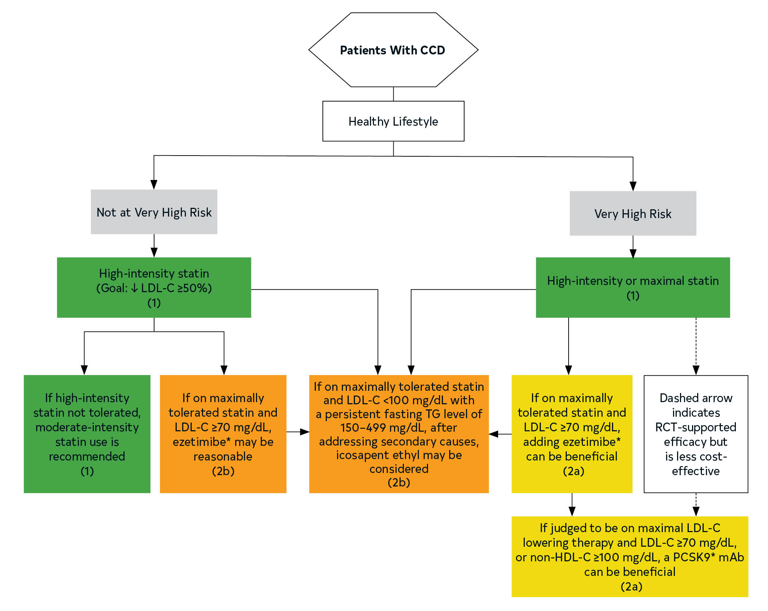
Figure 8. Lipid Management in Patients With CCD
*Only when ezetimibe and PCSK9 mAb are deemed insufficient or not tolerated should bempedoic acid or inclisiran (in place of PCSK9 mAb) be considered to further reduce LDL-C levels. The effect of bempedoic acid and inclisiran on MACE is being evaluated.
Very high-risk includes a history of multiple major ASCVD events or 1 major ASCVD event and multiple high-risk conditions.
LDL-C indicates low-density lipoprotein cholesterol; HDL-C, high-density lipoprotein cholesterol; PCSK9 mAb, PCSK9 monoclonal antibody; RCT, randomized controlled trial; and TG, triglycerides.
Colors correspond to Class of Recommendation in Table 3.

Slide 66
Blood Pressure Management
 | Recommendations for Blood Pressure Management Referenced studies that support the recommendations are summarized in the Online Data Supplement.
COR | LOE | Recommendations
1 | A | In adults with CCD, nonpharmacologic strategies are recommended as first-line therapy to lower BP in those with elevated BP (120-129/<80 mm Hg) (see Table 12).*
1 | B-R | In adults with CCD who have hypertension, a BP target of <130/<80 mm Hg is recommended to reduce CVD events and all-cause death.*
*Modified from the 2017 ACC/AHA/Multisociety High Blood Pressure in Adults Guideline.

Slide 67
Blood Pressure Management (con’t.)
1 | B-R | In adults with CCD and hypertension (systolic BP ≥130 and/or diastolic BP ≥80 mm Hg), in addition to nonpharmacological strategies, GDMT angiotensin-converting enzyme (ACE) inhibitors, angiotensin-receptor blockers (ARB), or beta blockers are recommended as first-line therapy for compelling indications (eg, recent MI or angina), with additional antihypertensive medications (eg, dihydropyridine calcium channel blockers [CCB], long-acting thiazide diuretics, and/or mineralocorticoid receptor antagonists) added as needed to optimize BP control.*
*Modified from the 2017 ACC/AHA/Multisociety High Blood Pressure in Adults Guideline.

Slide 68
Table 12. Nonpharmacologic Strategies for Blood Pressure Management
Nonpharmacologic Intervention |  | Dose | Approximate Impact on SBP
 |  |  | Hypertension | Normotension
Weight loss | Weight/body fat | Best goal is ideal body weight but aim for at least a 1-kg reduction in body weight for most adults who are overweight. Expect about 1 mm Hg for every 1-kg reduction in body weight. | -5 mm Hg | -2–3 mm Hg
Healthy diet | DASH dietary pattern | Consume a diet rich in fruits, vegetables, whole grains, and low-fat dairy products, with reduced content of saturated and total fat. | -11 mm Hg | -3 mm Hg
Reduced intake of dietary sodium | Dietary sodium | Optimal goal is <1,500 mg/d but aim for at least a 1,000-mg/d reduction in most adults. | -5/6 mm Hg | -2–3 mm Hg
*Type, dose, and expected impact on BP in adults with a normal BP and with hypertension. †In the United States, 1 “standard” drink contains roughly 14 g of pure alcohol, which is typically found in 12 oz of regular beer (usually about 5% alcohol), 5 oz of wine (usually about 12% alcohol), and 1.5 oz of distilled spirits (usually about 40% alcohol).

Slide 69
Table 12. Nonpharmacologic Strategies for Blood Pressure Management (con’t.)
Enhanced intake of dietary potassium | Dietary potassium | Aim for 3,500–5,000 mg/d, preferably by consumption of a diet rich in potassium. | -4–5 mm Hg | -2 mm Hg
Physical activity | Aerobic | ● 90–150 min/wk ● 65%–75% heart rate reserve | -5–8 mm Hg | -2–4 mm Hg
 | Dynamic resistance | ● 90–150 min/wk ● 50%–80% of 1 repetition maximum ● 6 exercises, 3 sets/exercise, 10 repetitions/set | -4 mm Hg | -2 mm Hg
 | Isometric resistance | ● 4 × 2 min (hand grip), 1 min rest between exercises, 30%–40% maximum voluntary contraction, 3 sessions/wk ● 8–10 wk | -5 mm Hg | -4 mm Hg
Moderation in alcohol intake | Alcohol consumption | In individuals who drink alcohol, limit alcohol† to: ● Men: ≤2 drinks daily ● Women: ≤1 drink daily | -4 mm Hg | -3 mm Hg
*Type, dose, and expected impact on BP in adults with a normal BP and with hypertension.

Slide 70
SGLT2 Inhibitors and GLP-1 Receptor Agonists
 | Recommendations for Use of SGLT2 Inhibitors and GLP-1 Receptor Agonists Referenced studies that support the recommendations are summarized in the Online Data Supplement.
COR | LOE | Recommendations
1 | A | In patients with CCD who have type 2 diabetes, the use of either an SGLT2 inhibitor or a GLP-1 receptor agonist with proven cardiovascular benefit is recommended to reduce the risk of MACE.
Cost Value Statement: High Value | B-NR | In patients with CCD and type 2 diabetes, addition of a GLP-1 receptor agonist at US prices is projected to be of high value compared with standard of care.
Cost Value Statement: Intermediate Value | B-NR | In patients with CCD and type 2 diabetes, addition of an SGLT2 inhibitor at US prices is projected to be of intermediate value compared with standard of care.

Slide 71
SGLT2 Inhibitors and GLP-1 Receptor Agonists (con’t.)
1 | A | In patients with CCD and heart failure with LVEF ≤40%, use of an SGLT2 inhibitor is recommended to reduce the risk of cardiovascular death and heart failure hospitalization and to improve QOL, irrespective of diabetes status.*
Cost Value Statement: Intermediate Value | B-NR | In patients with CCD and heart failure with LVEF ≤40%, addition of an SGLT2 inhibitor to GDMT, irrespective of diabetes status, is projected to be of intermediate value at US prices.
2a | B-R | In patients with CCD and heart failure with LVEF >40%, use of an SGLT2 inhibitor can be beneficial in decreasing heart failure hospitalizations and to improve QOL, irrespective of diabetes status.
Cost Value Statement: Intermediate Value | B-NR | In patients with CCD and heart failure with LVEF >40%, addition of an SGLT2 inhibitor to GDMT, irrespective of diabetes status, is projected to be of uncertain value at US prices.
*Modified from the 2022 AHA/ACC/HFSA Heart Failure Guideline

Slide 72
Weight Management
 | Recommendations for Weight Management Referenced studies that support the recommendations are summarized in the Online Data Supplement.
COR | LOE | Recommendations
1 | C-EO | In patients with CCD, assessment of BMI with or without waist circumference is recommended during routine clinical follow-up.
1 | B-NR | Patients with CCD and overweight or obesity should receive counseling on diet, lifestyle, and goals for weight loss.
2a | B-R | For patients with CCD and overweight or obesity in whom pharmacologic therapy is warranted for further weight reduction, a GLP-1 receptor agonist can be beneficial in addition to counseling for diet and physical activity, and it is reasonable to choose semaglutide over liraglutide.

Slide 73
Weight Management (con’t.)
2a | B-NR | In patients with CCD and severe obesity who have not met weight loss goals with lifestyle and pharmacologic intervention, and who have acceptable surgical risk, referral for consideration of a bariatric procedure is reasonable for weight loss and cardiovascular risk factor reduction.
3: Harm | B-R | In patients with CCD, use of sympathomimetic weight loss drugs is potentially harmful.

Slide 74
Cardiac Rehabilitation
 | Recommendation for Cardiac Rehabilitation Referenced studies that support the recommendation are summarized in the Online Data Supplement.
COR | LOE | Recommendation
1 | A* | All patients with CCD and appropriate indications*†‡ should be referred to a cardiac rehabilitation program to improve outcomes.
 | B-R†
 | C-LD‡
*After recent MI, PCI, or CABG.¹⁻⁵ †With stable angina^{2,3,6,7} or after heart transplant.⁸⁻¹³ ‡After recent spontaneous coronary artery dissection event.¹⁴⁻¹⁷

Slide 75
Table 13. Core Components of CR
Patient assessment
Nutritional counseling
Weight management
Blood pressure management
Lipid management
Diabetes management
Tobacco cessation
Psychosocial management
Physical activity counseling
Exercise training
CR indicates cardiac rehabilitation

Slide 76
Physical Activity
Recommendations for Physical Activity Referenced studies that support the recommendations are summarized in the Online Data Supplement.
COR | LOE | Recommendations
1 | A | For patients with CCD who do not have contraindications, an exercise regimen is recommended, including ≥150 minutes/wk of moderate-intensity aerobic activities or ≥75 minutes/wk of higher-intensity aerobic activities to improve functional capacity and QOL, and to reduce hospital admission and mortality rates.

Slide 77
Physical Activity (con’t.)
1 | B-R | For patients with CCD who do not have contraindications, resistance (strength) training exercises are recommended on ≥2 days/wk to improve muscle strength, functional capacity, and cardiovascular risk factor control.
2a | B-NR | For patients with CCD who do not have contraindications, lower-intensity lifestyle activities (eg, walking breaks at work) to reduce sedentary behavior (ie, sitting time) are reasonable to improve functional capacity and reduce cardiovascular risk, especially in individuals with low levels of habitual leisure time physical activity.

Slide 78
Environmental Exposures
 | Recommendations for Environmental Exposures Referenced studies that support the recommendations are summarized in the Online Data Supplement.
COR | LOE | Recommendations
2a | B-NR | In patients with CCD, minimization of exposure to ambient air pollution is reasonable to reduce the risk of cardiovascular events.
2b | B-NR | In patients with CCD, minimization of climate-related exposures (eg, extreme temperatures, wildfire smoke) may be reasonable to reduce the risk of cardiovascular events.

Slide 79
Medical Therapy to Prevent Cardiovascular Events and Manage Symptoms
Antiplatelet Therapy and Oral Anticoagulants (OAC)
 | Recommendations for Antiplatelet Therapy and OAC Referenced studies that support the recommendations are summarized in the Online Data Supplements.
COR | LOE | Recommendations
Antiplatelet Therapy Without OAC
1 | A | In patients with CCD and no indication for OAC therapy, low-dose aspirin 81 mg (75-100 mg) is recommended to reduce atherosclerotic events.*
1 | A | In patients with CCD treated with PCI, dual antiplatelet therapy (DAPT) consisting of aspirin and clopidogrel for 6 months post PCI followed by single antiplatelet therapy (SAPT) is indicated to reduce MACE and bleeding events.*
2a | A | In select patients with CCD treated with PCI and a drug-eluting stent (DES) who have completed a 1- to 3-month course of DAPT, P2Y12 inhibitor monotherapy for at least 12 months is reasonable to reduce bleeding risk.
*Modified from the 2016 ACC/AHA Focused Update on DAPT

Slide 80
Antiplatelet Therapy and Oral Anticoagulants (OAC)
(con’t.)
2b | A | In patients with CCD who have had a previous MI and are at low bleeding risk, extended DAPT beyond 12 months for a period of up to 3 years may be reasonable to reduce MACE.*
2b | B-R | In patients with CCD and a previous history of MI without a history of stroke, TIA, or ICH, vorapaxar may be added to aspirin therapy to reduce MACE.
2b | B-R | In patients with CCD, the use of DAPT after CABG may be useful to reduce the incidence of saphenous vein graft occlusion.
3: No benefit | A | In patients with CCD without recent ACS or a PCI-related indication for DAPT, the addition of clopidogrel to aspirin therapy is not useful to reduce MACE.
3: Harm | A | In patients with CCD and previous stroke, TIA, or ICH, vorapaxar should not be added to DAPT because of increased risk of major bleeding and ICH.
*Modified from the 2016 ACC/AHA Focused Update on DAPT

Slide 81
Antiplatelet Therapy and Oral Anticoagulants (OAC)
(con’t.)
3: Harm | B-R | In patients with CCD and previous stroke, TIA, or ICH , prasugrel should not be used because of risk of significant or fatal bleeding.
3: Harm | B-R | In patients with CCD, chronic nonsteroidal anti-inflammatory drugs should not be used because of increased cardiovascular and bleeding complications.*
 |  | Antiplatelet Therapy With Direct OAC (DOAC)
1 | B-R | In patients with CCD who have undergone elective PCI and who require oral anticoagulant therapy, DAPT for 1 to 4 weeks followed by clopidogrel alone for 6 months should be administered in addition to DOAC.†
2a | B-R | In patients with CCD who have undergone PCI and who require oral anticoagulant therapy, continuing aspirin in addition to clopidogrel for up to 1 month is reasonable if the patient has a high thrombotic risk and low bleeding risk.*
*Modified from the 2016 ACC/AHA Focused Update on DAPT; †Modified from the 2021 ACC/AHA/SCAI Coronary Revascularization Guideline

Slide 82
Antiplatelet Therapy and Oral Anticoagulants (OAC)
(con’t.)
2b | B-R | In patients with CCD who require oral anticoagulation and have a low atherothrombotic risk, discontinuation of aspirin therapy with continuation of DOAC alone may be considered 1 year after PCI to reduce bleeding risk.*
2b | C-LD | In patients with CCD who require oral anticoagulation, DOAC monotherapy may be considered if there is no acute indication for concomitant antiplatelet therapy.
*Modified from the 2016 ACC/AHA Focused Update on DAPT

Slide 83
Antiplatelet Therapy and Oral Anticoagulants (OAC)
(con’t.)
Antiplatelet Therapy and Low-Dose DOAC |  | Antiplatelet Therapy and Low-Dose DOAC
2a | B-R | In patients with CCD without an indication for therapeutic DOAC or DAPT and who are at high risk of recurrent ischemic events but low-to-moderate bleeding risk, the addition of low-dose rivaroxaban 2.5 mg twice daily to aspirin 81 mg daily is reasonable for long-term reduction of risk for MACE.
DAPT and Proton Pump Inhibitor (PPI) |  | DAPT and Proton Pump Inhibitor (PPI)
2a | B-R | In patients with CCD on DAPT, the use of a PPI can be effective in reducing gastrointestinal bleeding risk.*
*Modified from the 2016 ACC/AHA Focused Update on DAPT

Slide 84
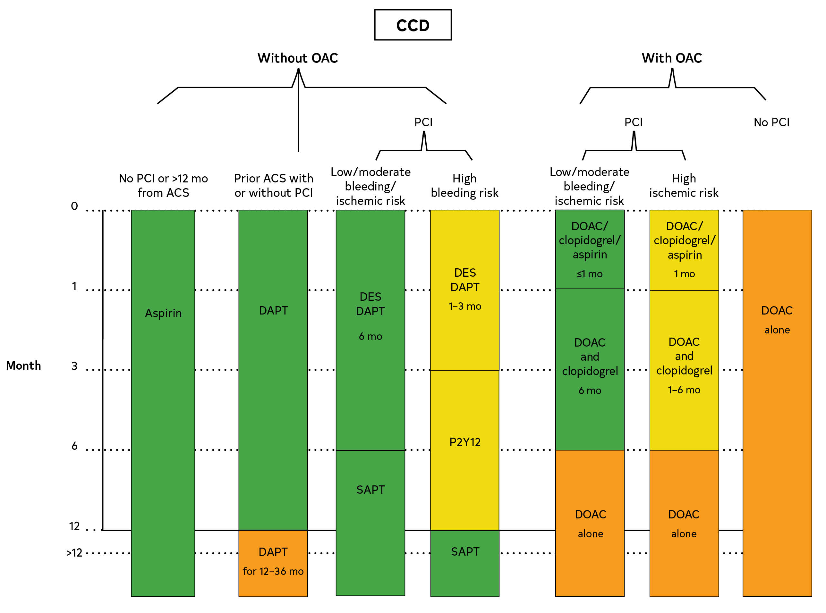
Figure 9. Recommended Duration of Antiplatelet Therapy
ACS indicates acute coronary syndrome; ASA, aspirin; CCD, chronic coronary disease; DAPT, dual antiplatelet therapy; DES, drug-eluting stent; DOAC, direct oral anticoagulants; MI, myocardial infarction; OAC, oral anticoagulants; PCI, percutaneous coronary intervention; SAPT, single antiplatelet therapy.
*Colors correspond to Class of Recommendation in Table 3

Slide 85
Beta Blockers
 | Recommendations for Beta Blockers Referenced studies that support the recommendations are summarized in the Online Data Supplement.
COR | LOE | Recommendations
1 | A | In patients with CCD and LVEF ≤40% with or without previous MI, the use of beta-blocker therapy is recommended to reduce the risk of future MACE, including cardiovascular death.
1 | A | In patients with CCD and LVEF <50%, the use of sustained release metoprolol succinate, carvedilol, or bisoprolol with titration to target doses is recommended in preference to other beta blockers.*
*Modified from the 2022 AHA/ACC/HFSA Heart Failure Guideline

Slide 86
Beta Blockers (con’t.)
2b | B-NR | In patients with CCD who were initiated on beta-blocker therapy for previous MI without a history of or current LVEF ≤50%, angina, arrhythmias, or uncontrolled hypertension, it may be reasonable to reassess the indication for long-term (>1 year) use of beta-blocker therapy for reducing MACE.
3: No Benefit | B-NR | In patients with CCD without previous MI or LVEF ≤50%, the use of beta-blocker therapy is not beneficial in reducing MACE, in the absence of another primary indication for beta-blocker therapy.†
†Adapted from the 2021 ACC/AHA/SCAI Coronary Revascularization Guideline

Slide 87
Renin-Angiotensin-Aldosterone Inhibitors
 | Recommendations for Renin-Angiotensin-Aldosterone Inhibitors Referenced studies that support the recommendations are summarized in the Online Data Supplement.
COR | LOE | Recommendations
1 | A | In patients with CCD who also have hypertension, diabetes, LVEF ≤40%, or CKD, the use of ACE inhibitors, or ARBs if ACE inhibitor–intolerant, is recommended to reduce cardiovascular events.
2b | B-R | In patients with CCD without hypertension, diabetes, or CKD and LVEF >40%, the use of ACE inhibitors or ARBs may be considered to reduce cardiovascular events.

Slide 88
Colchicine
 | Recommendation for Colchicine Referenced studies that support the recommendation are summarized in the Online Data Supplement.
COR | LOE | Recommendation
2b | B-R | In patients with CCD, the addition of colchicine for secondary prevention may be considered to reduce recurrent ASCVD events.

Slide 89
Immunizations
 | Recommendations for Immunizations Referenced studies that support the recommendations are summarized in the Online Data Supplement.
COR | LOE | Recommendations
1 | A | In patients with CCD, an annual influenza vaccination is recommended to reduce cardiovascular morbidity, cardiovascular death, and all-cause death.
1 | C-EO | In patients with CCD, coronavirus disease 2019 (COVID-19) vaccination is recommended per public health guidelines to reduce COVID-19 complications.
2a | B-NR | In patients with CCD, a pneumococcal vaccine is reasonable to reduce cardiovascular morbidity and mortality and all-cause death.

Slide 90
Medical Therapy for Relief of Angina
 | Recommendations for Medical Therapy for Relief of Angina Referenced studies that support the recommendations are summarized in the Online Data Supplement.
COR | LOE | Recommendations
1 | B-R | In patients with CCD and angina, antianginal therapy with either a beta blocker, CCB, or long-acting nitrate is recommended for relief of angina or equivalent symptoms.*
1 | B-R | In patients with CCD and angina who remain symptomatic after initial treatment, addition of a second antianginal agent from a different therapeutic class (beta blockers, CCB, long-acting nitrates) is recommended for relief of angina or equivalent symptoms.*
*Modified from the ACC/AHA/Multisociety 2012 SIHD Guideline

Slide 91
Medical Therapy for Relief of Angina (con’t.)
1 | B-R | In patients with CCD, ranolazine is recommended in patients who remain symptomatic despite treatment with beta blockers, CCB, or long-acting nitrate therapies.*
1 | B-NR | In patients with CCD, sublingual nitroglycerin or nitroglycerin spray is recommended for immediate short-term relief of angina or equivalent symptoms.*
3: Harm | B-R | In patients with CCD and normal LV function, the addition of ivabradine to standard anti-anginal therapy is potentially harmful.*
*Modified from the ACC/AHA 2012 SIHD Guideline

Slide 92
Management of Refractory Angina
 | Recommendation for Management of Refractory Angina Referenced studies that support the recommendation are summarized in the Online Data Supplement.
COR | LOE | Recommendation
2b | B-R | In patients with CCD, refractory angina, and no other treatment options, enhanced external counterpulsation may be considered for relief of symptoms.*
*Modified from the ACC/AHA/Multisociety 2012 SIHD Guideline

Slide 93
Revascularization

Slide 94
Revascularization
 | Recommendations for Revascularization Referenced studies that support the recommendations are summarized in the Online Data Supplement.
COR | LOE | Recommendations
Goals of Revascularization
1 | A | In patients with CCD and lifestyle-limiting angina despite GDMT and with significant coronary artery stenoses amenable to revascularization, revascularization is recommended to improve symptoms.*
1 | B-R | In patients with CCD who have significant left main disease or multivessel disease with severe LV dysfunction (LVEF ≤ 35%), CABG in addition to medical therapy is recommended over medical therapy alone to improve survival.*
*Modified from the 2021 ACC/AHA/SCAI Coronary Revascularization Guideline

Slide 95
Revascularization (con’t.)
Cost Value Statement: Intermediate Value | B-NR | In patients with CCD and multivessel disease with severe LV dysfunction, CABG added to optimal medical therapy is of intermediate economic value compared with medical therapy alone.
2a | B-R | In patients with CCD and multivessel CAD appropriate for either CABG or PCI, revascularization in addition to GDMT is reasonable to lower the risk of cardiovascular events such as spontaneous MI, unplanned urgent revascularizations, or cardiac death.*
2a | B-NR | In selected patients with CCD and significant left main stenosis for whom PCI can provide equivalent revascularization to that possible with CABG, PCI is reasonable to improve survival.*
*Modified from the 2021 ACC/AHA/SCAI Coronary Revascularization Guideline

Slide 96
Revascularization (con’t.)
Decision-Making for Revascularization
1 | A | In patients with CCD who have angina or an anginal equivalent, no previous evaluation for ischemia, and angiographically intermediate stenoses, the use of FFR or other proven nonhyperemic pressure ratios (eg, iFR) is recommended before proceeding with PCI.*
Cost Value Statement: High Value | B-NR | In patients with CCD undergoing coronary angiography without previous stress testing, the use of invasive FFR to evaluate angiographically intermediate coronary stenoses before proceeding with PCI is a high economic value intervention.
1 | B-NR | In patients with CCD with complex 3-vessel disease or for whom the optimal treatment strategy is unclear, a Heart Team approach that includes representatives from interventional cardiology and cardiac surgery is recommended to improve patient outcomes.*
*Modified from the 2021 ACC/AHA/SCAI Coronary Revascularization Guideline

Slide 97
Revascularization: PCI Versus CABG
Recommendations for Revascularization: PCI Versus CABG Referenced studies that support the recommendations are summarized in the Online Data Supplement.
COR | LOE | Recommendations
Patients With CCD
1 | B-R | In patients with CCD who require revascularization for significant left main involvement associated with high-complexity CAD, CABG is recommended in preference to PCI to improve survival.*
2a | B-R | In patients with CCD who require revascularization for multivessel CAD with complex and diffuse CAD (eg, SYNTAX score >33), it is reasonable to choose CABG over PCI to improve survival.*
*Modified from the 2021 ACC/AHA/SCAI Coronary Revascularization Guideline

Slide 98
Revascularization: PCI Versus CABG (con’t.)
 |  | Patients With CCD at High Surgical Risk
2a | B-NR | In patients with CCD who are appropriate for revascularization but poor candidates for surgery, it is reasonable to choose PCI over CABG to improve symptoms and reduce MACE.
 |  | Patients With CCD and Diabetes
1 | A | In patients with CCD, diabetes, and multivessel CAD with involvement of the left anterior descending artery who are appropriate candidates for CABG, CABG (with a left internal mammary artery to the left anterior descending artery) is recommended in preference to PCI to reduce mortality and repeat revascularizations.*
2b | B-R | In patients with CCD and diabetes who have left main stenosis and low- or intermediate-complexity CAD (eg, SYNTAX score ≤33), PCI may be considered as an alternative to CABG to reduce MACE.*
*Modified from the 2021 ACC/AHA/SCAI Coronary Revascularization Guideline

Slide 99
Special Populations

Slide 100
Existing Heart Disease and Conditions
Chronic Management After SCAD
 | Recommendations for Chronic Management After SCAD Referenced studies that support the recommendations are summarized in the Online Data Supplement.
COR | LOE | Recommendations
1 | C-LD | In patients with CCD who have experienced SCAD, counseling should be provided regarding potential triggers and risk of SCAD recurrence.
2a | C-LD | In patients with CCD who have experienced SCAD, evaluation for underlying vasculopathies is reasonable to identify abnormalities in other vascular beds.
2b | C-LD | In patients with CCD who have experienced SCAD, beta- blocker therapy may be reasonable to reduce the incidence of recurrent SCAD.

Slide 101
Table 14. Screening Questions for SCAD-Associated Arteriopathies and Connective Tissue Disorders
Personal history (Have you ever been diagnosed with or experienced any of the following?)
Early-onset hypertension
Stroke or transient ischemic attack
Pulsatile tinnitus
Migraine headaches
Renal infarction
Subarachnoid hemorrhage
Aneurysm (aortic, peripheral, brain)
Dissection (aortic, peripheral)
SCAD indicates spontaneous coronary artery dissection.

Slide 102
Table 14. Screening Questions for SCAD-Associated Arteriopathies and Connective Tissue Disorders (con’t.)
Rupture of hollow organs (intestinal, bladder, uterine)
Pneumothorax
Tendon or muscle rupture
Joint dislocation
Talipes equinovarus (clubfoot)
Umbilical or inguinal hernia
Scoliosis or pectus deformity
Pregnancy complications (cervical incompetence, hemorrhage, uterine prolapse, hypertension)
Poor wound healing
SCAD indicates spontaneous coronary artery dissection.

Slide 103
Table 14. Screening Questions for SCAD-Associated Arteriopathies and Connective Tissue Disorders (con’t.)
Ectopia lentis
Myopia
Detached retina, early glaucoma, or early cataracts
Tall stature
Abnormality of cardiac valve
Systemic inflammatory disease
Family history (Does anyone in your family have the following?)
Dissection (coronary, aortic, peripheral)
Inherited arteriopathy or connective tissue disorder (eg, vascular Ehlers-Danlos syndrome, Marfan syndrome, Loeys-Dietz syndrome)
SCAD indicates spontaneous coronary artery dissection.

Slide 104
Table 14. Screening Questions for SCAD-Associated Arteriopathies and Connective Tissue Disorders (con’t.)
Early stroke, early myocardial infarction, sudden cardiac death
Review of systems (Are you currently experiencing any of the following?)
Headaches
Pulsatile tinnitus
Postprandial abdominal pain
Flank pain
Claudication
Easy bruising
Joint hypermobility or laxity
SCAD indicates spontaneous coronary artery dissection.

Slide 105
Ischemia With Nonobstructive Coronary Arteries
 | Recommendation for INOCA Referenced studies that support the recommendation are summarized in the Online Data Supplement.
COR | LOE | Recommendation
2a | B-R | In symptomatic patients with nonobstructive CAD, a strategy of stratified medical therapy* guided by invasive coronary physiologic testing can be useful for improving angina severity and QOL.

Slide 106
Table 15. Clinical Criteria for Suspecting Microvascular Angina*
Criteria | Evidence | Diagnostic Parameters
1 | Symptoms of myocardial ischemia | Effort or rest angina; exertional dyspnea
2 | Absence of obstructive CAD (<50% diameter reduction or FFR >0.80) | Coronary CTA; invasive coronary angiography
3 | Objective evidence of myocardial ischemia | Ischemic changes on ECG during an episode of chest pain; stress-induced chest pain and/or ischemic changes on ECG in the presence or absence of transient/reversible abnormal myocardial perfusion and/or wall motion abnormality
4 | Evidence of impaired coronary microvascular function | Impaired coronary flow reserve (cut-off value depending on methodology between ≤0.20 and ≤0.25); coronary microvascular spasm, defined as reproduction of symptoms, ischemic shifts on ECG but no epicardial spasm during acetylcholine testing; abnormal coronary microvascular resistance indices (eg, IMR >25); coronary slow flow phenomenon, defined as TIMI frame count >25
*Definitive microvascular angina is only diagnosed if all 4 criteria are present for a diagnosis of microvascular angina.
CAD indicates coronary artery disease; CFR, coronary flow reserve; CTA, computed tomographic angiography; ECG, electrocardiogram; FFR, fractional flow reserve; and IMR, index of microcirculatory resistance.

Slide 107
Table 16. Diagnostic Criteria for Vasospastic Angina
Nitrate-responsive angina: during spontaneous episode, with at least 1 of the following: Rest angina, especially between night and early morning Marked diurnal variation in exercise tolerance, reduced in morning Hyperventilation can precipitate an episode Calcium channel blockers (not beta blockers) suppress episodes
Transient ischemic electrocardiographic changes: during spontaneous episode, including any of the following in at least 2 contiguous leads: ST segment elevation ≥0.1 mV ST segment depression ≥0.1 mV New negative U waves
Coronary artery spasm: defined as transient total or subtotal coronary artery occlusion (>90% constriction) with angina and ischemic electrocardiographic changes either spontaneously or in response to a provocative stimulus (typically acetylcholine, ergot, or hyperventilation)
“Definitive” vasospastic angina is diagnosed if nitrate-responsive angina is evident during spontaneous episodes and either the transient ischemic ECG changed during the spontaneous episodes or coronary artery spasm criteria are fulfilled.
“Suspected” vasospastic angina is diagnosed if nitrate-responsive angina is evident during spontaneous episodes but transient ischemic electrocardiographic changes are equivocal or unavailable and coronary artery spasm criteria are equivocal.
ECG indicates electrocardiogram.

Slide 108
Table 17. Invasive Coronary Function Testing Definition and Linked Pharmacotherapy for INOCA Endotypes
Endotype | Disorder of Coronary Artery Function |  | Linked Pharmacotherapy
Microvascular angina (nonobstructive CAD and proven CMD) | ↑ Microvascular resistance ↓ Coronary vasorelaxation ↓Microvasodilator capacity Microvascular spasm | IMR ≥25. IMR is a quantitative method for specifically assessing microvascular function independent resting hemodynamics. IMR is distal coronary pressure* transmit time (average time for 3 saline bolus runs at hyperemia). CFR by thermodilution<2.0. This reflects the inability to increase coronary flow above 2 times the resting flow. Resistive reserve ratio <2.0. This reflects the vasodilator capacity of the microcirculation to change from baseline to hyperemia (resistance at rest divided by resistance at hyperemia). Angina during acetylcholine infusion or bolus with typical ischemic ST-segment changes and epicardial coronary constriction <90% reduction in epicardial coronary artery diameter. Represents inappropriate susceptibility microvascular constriction. | Baseline therapy: Consider aspirin, statin, and ACEi therapy in all patients. Sublingual nitroglycerin as needed. Smoking cessation and lifestyle changes. Antianginal Rx First line: Beta blocker (eg, carvedilol 6.25 mg BID uptitrated) Second line: CCB substituted (non DHP [eg, verapamil 40 mg BID titrated]) where beta blockers are not tolerated or ineffective. Third line: Add-in therapy CCB-DHP (eg, amlodipine)- only for those on beta blockers Nicorandil* (5 mg BID, uptitrated) Ranolazine (375 mg BID, uptitrated)
ACEi indicates angiotensin converting enzyme inhibitor; CAD, coronary artery disease; CCB, calcium channel blocker; CFR, coronary flow reserve; CMD, coronary macrovascular disease; DHP, dihydropyridine; ECG, electrocardiogram; FFR, fractional flow reserve; IMR, index of microvascular resistance; MVA, microvascular angina; and VSA, vasospastic angina.
*Currently unavailable in the United States.

Slide 109
Table 17. Invasive Coronary Function Testing Definition and Linked Pharmacotherapy for INOCA Endotypes (con’t.)
Vasospastic angina | Epicardial spasm | Epicardial coronary artery spasm is defined as reduction in coronary diameter >90% after intracoronary acetylcholine in comparison with baseline resting condition after intracoronary glyceryl trinitrate (nitroglycerin) administration in any epicardial coronary artery segment together with symptoms and ST-segment deviation on the ECG. | Baseline therapy: If atherosclerosis or endothelial impairment, aspirin and statin should be considered. Sublingual nitroglycerin as needed. Smoking cessation and lifestyle changes. Antianginal Rx First line: CCB (eg, verapamil 40 mg BID uptitrated) Second line: Add long-acting nitrate (eg, isosorbide monotitrate 10 mg BID) Third line: Change nitrate to nicorandil* (eg, nicorandil 5 mg BID)
Mixed MVA/VSA | CMD and epicardial vasospasm | Epicardial spasm plus any abnormality of: Microvascular resistance Coronary vasorelaxation Microvasodilator capacity | Baseline therapy: Consider aspirin, statin and ACEi therapy in all patients. Sublingual nitroglycerin as needed.
ACEi indicates angiotensin converting enzyme inhibitor; CAD, coronary artery disease; CCB, calcium channel blocker; CFR, coronary flow reserve; CMD, coronary macrovascular disease; DHP, dihydropyridine; ECG, electrocardiogram; FFR, fractional flow reserve; IMR, index of microvascular resistance; MVA, microvascular angina; and VSA, vasospastic angina.
*Currently unavailable in the United States.

Slide 110
Table 17. Invasive Coronary Function Testing Definition and Linked Pharmacotherapy for INOCA Endotypes (con’t.)
Obstructive CAD |  | >50% lesion by diameter stenosis in epicardial artery >2.5 mm or a FFR ≤0.80 | Baseline therapy: If atherosclerosis or endothelial impairment, patients should be considered for aspirin, statin, and ACEi. Consideration of revascularization, antianginal therapy as per guidelines
Noncardiac | None | Exclusion of diffuse or obstructive epicardial coronary disease (FFR >0.8) without any of the after abnormalities of coronary function: CFR <2.0, IMR ≥25 or functional angina/spasm during acetylcholine. | Cessation of antianginal therapy. Stop antiplatelet and statins unless other indication. Consider noncardiac investigation or referral where appropriate (eg, psychology, gastroenterology)
ACEi indicates angiotensin converting enzyme inhibitor; CAD, coronary artery disease; CCB, calcium channel blocker; CFR, coronary flow reserve; CMD, coronary macrovascular disease; DHP, dihydropyridine; ECG, electrocardiogram; FFR, fractional flow reserve; IMR, index of microvascular resistance; MVA, microvascular angina; and VSA, vasospastic angina.

Slide 111
Young Adults
 | Recommendation for Young Adults Referenced studies that support the recommendation are summarized in the Online Data Supplement.
COR | LOE | Recommendation
2a | C-LD | In young adults with CCD, after optimization of traditional cardiovascular risk factors, a comprehensive evaluation and treatment of nontraditional cardiovascular risk factors can be beneficial in reducing the risk of cardiovascular events.

Slide 112
Table 18. Traditional and Nontraditional Risk Factors Associated With CCD in Young Adults
Traditional Risk Factors | Nontraditional Risk Factors
Hypertension (Section 4.2.7, “Blood Pressure Management”) | HIV and ART (Section 6.8, “HIV/Autoimmune Disorders”)
Obesity and metabolic syndrome (Section 4.2.9, “Weight Management”) | Recreational substance use (cocaine and marijuana) (Section 4.2.4, “Alcohol and Substance Use”)
Diabetes (Section 4.2.8, “Sodium Glucose Cotransporter 2 Inhibitors and Glucagon Peptide-1 Receptor Agonists”) | Systemic inflammatory disorders (IBD, SLE, RA, gout, PsA, AS) and vasculitides
ART indicates antiretroviral therapy; AS, ankylosing spondylitis; CCD, chronic coronary disease; Ch9p21, chromosome 9p21 locus; HDP, hypertensive disorders of pregnancy; HIV, human immunodeficiency virus; IBD, inflammatory bowel disease; IUGR, intrauterine growth retardation; LDL-C, low-density lipoprotein cholesterol; Lp(a), lipoprotein (a); PsA, psoriatic arthritis; RA, rheumatoid arthritis; and SLE, systemic lupus erythematosus.

Slide 113
Table 18. Traditional and Nontraditional Risk Factors Associated With CCD in Young Adults (con’t.)
Traditional Risk Factors | Nontraditional Risk Factors
Unhealthy diet and physical inactivity (Section 4.2.1, “Nutrition, including Supplements,” and Section 4.2.11, physical activity) | Pregnancy-related complications (IUGR, HDP, gestational diabetes) (Section 6.5, “Women, Including Pregnancy and Hormone Therapy”)
Hyperlipidemia (LDL-C, Lp(a)) (Section 4.2.6, “Lipid Management”) | Familial hypercholesterolemia
Tobacco use (Section 4.2.3, “Tobacco Products”) | Miscellaneous (psychological well-being, sleep quality, social determinants of health (Section 4.1.4, “Social Determinants of Health,” and Section 4.2.2, “Mental Health”)
Family history of premature CAD | History of chest radiation
ART indicates antiretroviral therapy; AS, ankylosing spondylitis; CCD, chronic coronary disease; Ch9p21, chromosome 9p21 locus; HDP, hypertensive disorders of pregnancy; HIV, human immunodeficiency virus; IBD, inflammatory bowel disease; IUGR, intrauterine growth retardation; LDL-C, low-density lipoprotein cholesterol; Lp(a), lipoprotein (a); PsA, psoriatic arthritis; RA, rheumatoid arthritis; and SLE, systemic lupus erythematosus.

Slide 114
Table 19. Nonatherosclerotic Causes of CCD in Young Adults: Evaluation and Management
Cause | Presentation | Management
Kawasaki’s disease | Late sequelae: coronary artery aneurysm, stenosis, thrombosis, or fistula | Lifelong follow-up with quantitative assessment of luminal dimensions. Low-dose aspirin therapy for small- or medium-sized coronary artery aneurysms. Low-dose aspirin plus anticoagulant therapy for large coronary artery aneurysms.
Coronary artery anomalies | Anomalous left coronary artery from the pulmonary artery Anomalous origin of the coronary artery from the opposite sinus of Valsalva with an interarterial course | Surgical repair – translocation of left coronary artery to aortic root for anomalous left coronary artery from the pulmonary artery. Surgical correction among young adults with interarterial course of coronary artery originating from opposite sinus of Valsalva and symptoms during exercise suggestive of myocardial ischemia.
Myocardial bridging | Exercise-induced ischemia Coronary artery vasospasm Sudden cardiac death | Beta-adrenergic blocking agents in symptomatic patients. Restriction to low-intensity sports. Surgical correction if symptoms refractory to medical therapy.
CCD indicates chronic coronary disease.

Slide 115
Cancer
 | Recommendation for Cancer Referenced studies that support the recommendation are summarized in the Online Data Supplement.
COR | LOE | Recommendation
1 | C-LD | In patients with CCD and cancer, a multidisciplinary team including cardiology and oncology expertise is recommended to improve long-term CVD outcomes.

Slide 116
Women, Including Pregnancy and Postmenopausal Hormone Therapy
 | Recommendations for Women, Including Pregnancy and Postmenopausal Hormone Therapy Referenced studies that support the recommendations are summarized in the Online Data Supplement.
COR | LOE | Recommendations
Pregnancy
1 | C-LD | Women with CCD who are contemplating pregnancy or who are pregnant should be risk-stratified and counseled regarding risks of adverse maternal, obstetric, and fetal outcomes.
1 | C-LD | Women with CCD who are contemplating pregnancy or who are pregnant should receive care from a multidisciplinary cardio-obstetric care team beginning before conception and continuing throughout pregnancy, delivery, and postpartum to improve maternal and fetal outcomes.

Slide 117
Women, Including Pregnancy and Postmenopausal Hormone Therapy (con’t.)
2b | C-LD | In women with CCD, continuation of statin use during pregnancy may be considered.
3: Harm | C-LD | Women with CCD who are contemplating pregnancy or who are pregnant should not use ACE inhibitors, ARBs, direct renin inhibitors, angiotensin receptor-neprilysin inhibitors, or aldosterone antagonists during pregnancy to prevent harm to the fetus.
 |  | Postmenopausal Hormone Therapy
3: Harm | A | Women with CCD should not receive systemic postmenopausal hormone therapy because of a lack of benefit on MACE and mortality, and an increased risk of venous thromboembolism.

Slide 118
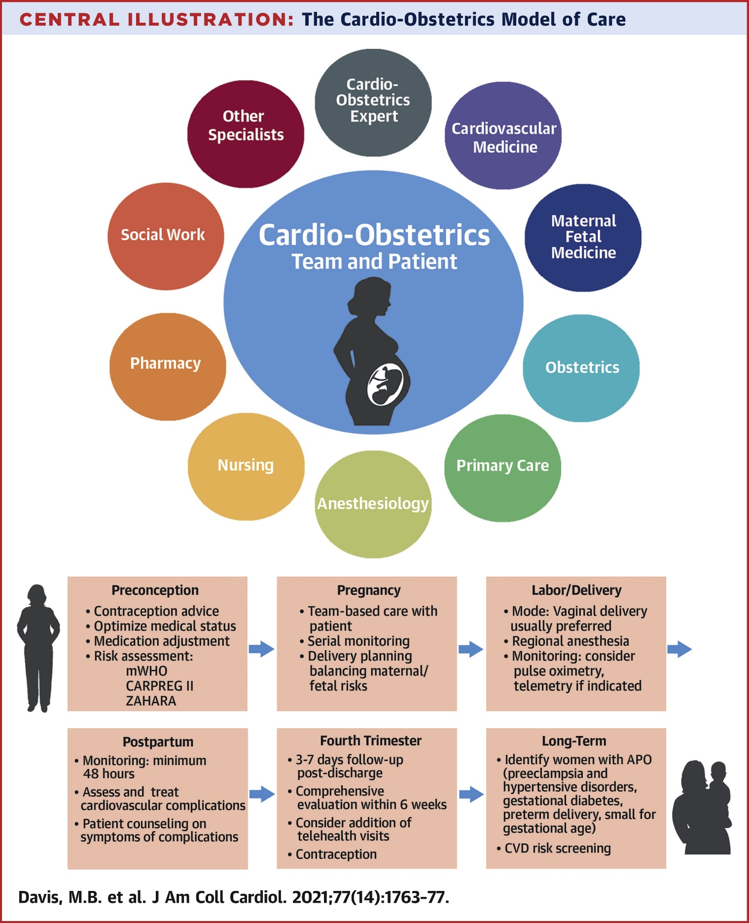
Figure 10. Team-Based Cardio-Obstetrics Model of Care.
The cardio-obstetrics model of care involves multiple specialists working together and with the patient to address issues from preconception, through pregnancy and delivery, and the postpartum period.
APO indicates adverse pregnancy outcomes; CARPREG II, Cardiac Disease in Pregnancy study; CVD, cardiovascular disease; mWHO, modified World Health Organization; ZAHARA, Zwangerschap bij Aangeboren HARtAfwijking (Pregnancy in Women With Congenital Heart Disease) study.

Slide 119
Table 20. CARPREG II Risk Prediction Model
CARPREG II Predictors | Points
Previous cardiac event or arrhythmia | 3
Baseline NYHA functional class III to IV or cyanosis | 3
Mechanical valve | 3
Ventricular dysfunction | 2
High-risk left-sided valve disease and LVOT obstruction | 2
Pulmonary hypertension | 2
CAD | 2
High-risk aortopathy | 2
No previous cardiac intervention | 1
Late pregnancy assessment | 1
CAD indicates coronary artery disease; HF, heart failure; LVOT, left ventricular outflow tract; MI, myocardial infarction; NYHA, New York Heart Association; and TIA, transient ischemic attack.
*Primary cardiac events were defined as any of these: maternal cardiac death; cardiac arrest; sustained arrhythmia requiring treatment; left-sided HF defined as pulmonary edema; right-sided HF; stroke or TIA; cardiac thromboembolism; MI; and vascular dissection.
The CARPREG (Cardiac Disease in Pregnancy Study) II risk score is based on 10 predictors, shown in the box. Each predictor is assigned a weighted point score. The sum of points represents the risk score. Risk scores are categorized into 5 groups.

Slide 120
Table 20. CARPREG II Risk Prediction Model (con’t.)
CARPREG II Score | Predicted Risk, %
0 to 1 | 5
2 | 10
3 | 15
4 | 22
>4 | 41
CAD indicates coronary artery disease; HF, heart failure; LVOT, left ventricular outflow tract; MI, myocardial infarction; NYHA, New York Heart Association; and TIA, transient ischemic attack.
*Primary cardiac events were defined as any of these: maternal cardiac death; cardiac arrest; sustained arrhythmia requiring treatment; left-sided HF defined as pulmonary edema; right-sided HF; stroke or TIA; cardiac thromboembolism; MI; and vascular dissection.

Slide 121
Table 21. Safety of Cardiovascular Medications During Pregnancy and Lactation
Medication | Safety in Pregnancy | Safety in Lactation
Arrhythmias
Adenosine | S | LD
Metoprolol/propranolol | S | LD
Digoxin | S | S
Lidocaine | S | S
Verapamil | LD | LD
Diltiazem | LD | U
Procainamide | LD | LD
Sotalol | LD | U
Flecainide | LD | LD
Propafenone | LD | LD
Amiodarone* | C | C
Color key: C, contraindicated; LD, limited data, use with caution; S, considered safe; and U, conflicting data, unknown.
*May be used if other therapies fail.

Slide 122
Table 21. Safety of Cardiovascular Medications During Pregnancy and Lactation (con’t.)
Medication | Safety in Pregnancy | Safety in Lactation
Heart Failure
Metoprolol | S | LD
Carvedilol | S | U
Furosemide | S | LD
Bumetanide | S | U
Dopamine | S | U
Dobutamine | S | U
Norepinephrine | S | U
Hydralazine | LD | S
Nitroglycerine | LD | U
Isosorbide dinitrate | LD | U
Torsemide | LD | U
Metolazone | LD | U
Color key: C, contraindicated; LD, limited data, use with caution; S, considered safe; and U, conflicting data, unknown.

Slide 123
Table 21. Safety of Cardiovascular Medications During Pregnancy and Lactation (con’t.)
Medication | Safety in Pregnancy | Safety in Lactation
Anticoagulants
Warfarin | LD | S
Unfractionated heparin | S | S
Enoxaparin | S | S
Fondaparinux | LD | U
Argatroban | LD | U
Bivalirudin | LD | U
Antiplatelets
Aspirin (low dose) | LD | LD
Clopidogrel | LD | LD
Prasugrel | LD | U
Ticagrelor | LD | U
Thrombolytics
Alteplase | LD | U
Streptokinase | LD | U
Color key: C, contraindicated; LD, limited data, use with caution; S, considered safe; and U, conflicting data, unknown.

Slide 124
Table 21. Safety of Cardiovascular Medications During Pregnancy and Lactation (con’t.)
Medication | Safety in Pregnancy | Safety in Lactation
Hypertension
Labetalol | S | LD
Nifedipine | S | S
Alpha-methyldopa (oral) | S | S
Hydralazine | LD | S
Nitroglycerin | LD | U
Nitroprusside | LD | LD
Isosorbide dinitrate | LD | U
Amlodipine | LD | LD
Furosemide | S | LD
Hydrochlorothiazide | LD | S
Clonidine | LD | U
Color key: C, contraindicated; LD, limited data, use with caution; S, considered safe; and U, conflicting data, unknown.

Slide 125
Table 21. Safety of Cardiovascular Medications During Pregnancy and Lactation (con’t.)
Medication | Safety in Pregnancy | Safety in Lactation
Cautionary Use and Contraindicated in Pregnancy
Atenolol | C | LD
ACE inhibitor class† | C | LD
ARB class | C | U
Aldosterone antagonists | C | C
Statin class | LD | C
DOAC | C | C
ERAs (eg, bosentan) | C | C
ACE indicates angiotensin-converting enzyme; ARB, angiotensin receptor blocker; DOACs, direct oral anticoagulants; and ERA, endothelin-receptor antagonists.
Color key: C, contraindicated; LD, limited data, use with caution; S, considered safe; and U, conflicting data, unknown.
†Captopril, benazepril, and enalapril are considered safe during lactation.

Slide 126
Table 22. The Geriatric 5 Ms
MIND | Mentation, dementia, delirium, depression
MOBILITY | Impaired gait and balance, fall injury prevention
MEDICATIONS | Polypharmacy, deprescribing, optimal prescribing Adverse medication effects and medication burden
MULTICOMPLEXITY | Multimorbidity Complex biopsychosocial situations
MATTERS MOST | Each individual’s own meaningful health outcome goals and care preferences

Slide 127
Chronic Kidney Disease
 | Recommendation for CKD Referenced studies that support the recommendation are summarized in the Online Data Supplement.
COR | LOE | Recommendation
1 | C-LD | In patients with CCD and CKD, measures should be taken to minimize the risk of treatment-related acute kidney injury.*
*Modified from the 2021 ACC/AHA/SCAI Coronary Revascularization Guideline

Slide 128
HIV and Autoimmune Disorders
 | Recommendations for HIV and Autoimmune Disorders Referenced studies that support the recommendations are summarized in the Online Data Supplement.
COR | LOE | Recommendations
HIV
1 | B-R | In adults with CCD and HIV, antiretroviral therapy is beneficial to decrease the risk of cardiovascular events.
2a | B-R | In adults with CCD and HIV, it is reasonable to choose antiretroviral therapy regimens associated with more favorable lipid and cardiovascular risk profiles with consideration of drug-drug interactions.
3: Harm | C-LD | In adults with CCD and HIV, lovastatin or simvastatin should not be administered with protease inhibitors as this may cause harm.

Slide 129
HIV and Autoimmune Disorders (con’t.)
 |  | Autoimmune Disorders in CCD
2a | C-LD | In adults with CCD and rheumatoid arthritis, initiation and maintenance of disease modifying anti-rheumatoid drugs is beneficial to decrease the risk of cardiovascular events.
2b | C-LD | In adults with CCD and autoimmune diseases, treatment with biologics and other immune modulating therapies that reduce disease activity may be considered to decrease the risk of cardiovascular events.
3: Harm | C-LD | In patients with CCD and rheumatoid arthritis, high-dose glucocorticoids should not be used long term if alternative therapies are available because of increased cardiovascular risk.

Slide 130
Table 23. Common Antiretroviral Therapy Drugs and Effects on Lipid Levels
HDL indicates high-density lipoprotein; HDL-C, high-density lipoprotein cholesterol; low-density lipoprotein; LDL-C, low-density lipoprotein cholesterol; NNRTI, nonnucleoside reverse-transcriptase inhibitor; and NRTI, nucleoside reverse-transcriptase inhibitor.
Class | Drug | Effect on Blood Lipids
Protease inhibitors | Atazanavir | Increases HDL-C and decreases LDL-C levels
 | Darunavir | Increases HDL-C levels
 | Fosamprenavir | Hypertriglyceridemia
 | Ritonavir* | Increases HDL-C levels
 | Saquinavir | Neutral
 | Tipranavir | Dyslipidemia
NRTIs | Abacavir | Increases total cholesterol, LDL-C, and HDL-C levels
 | Lamivudine | Increases total cholesterol, LDL-C, and HDL-C levels
 | Tenofovir fumarate disoproxil | Lowers LDL levels
 | Zidovudine | Hypertriglyceridemia
*Although ritonavir is a protease inhibitor, this drug is generally used as a pharmacokinetic enhancer.

Slide 131
Table 23. Common Antiretroviral Therapy Drugs and Effects on Lipid Levels (con’t.)
NNRTIs | Efavirenz | Increases total cholesterol, LDL-C, HDL-C, and triglyceride levels
 | Nevirapine | Neutral or decreases lipid levels
 | Rilpivirine | Neutral
Integrase inhibitors | Dolutegravir | Neutral
 | Raltegravir | Increases HDL levels
HDL indicates high-density lipoprotein; HDL-C, high-density lipoprotein cholesterol; low-density lipoprotein; LDL-C, low-density lipoprotein cholesterol; NNRTI, nonnucleoside reverse-transcriptase inhibitor; and NRTI, nucleoside reverse-transcriptase inhibitor.
*Although ritonavir is a protease inhibitor, this drug is generally used as a pharmacokinetic enhancer.

Slide 132
Cardiac Allograft Vasculopathy in Heart Transplant Recipients
 | Recommendations for Management of Cardiac Allograft Vasculopathy in Heart Transplant Recipients Referenced studies that support the recommendations are summarized in the Online Data Supplement.
COR | LOE | Recommendations
1 | C-LD | In patients with cardiac allograft vasculopathy, statins are recommended for secondary prevention to reduce MACE.
2a | C-LD | In patients with cardiac allograft vasculopathy, aspirin can be beneficial for secondary prevention to reduce MACE.
2a | C-LD | In patients with severe cardiac allograft vasculopathy, revascularization is reasonable in those with suitable anatomy to potentially mitigate the adverse long-term consequences of cardiac allograft vasculopathy.*
*Modified from the 2021 ACC/AHA/SCAI Coronary Revascularization Guideline

Slide 133
Table 24. Drug-Drug Interactions With Statins and Immunosuppressants and Recommendations for Management
Immunosuppressant | Statin | Effect | Magnitude | Recommendation
Cyclosporine/ tacrolimus/ everolimus/ sirolimus* | Atorvastatin | Increased statin exposure through multiple mechanisms. Increased risk for muscle-related toxicity. | Severe 6- to 15-fold increase in AUC of atorvastatin | Limit dose of atorvastatin to 10 mg daily
 | Rosuvastatin |  | Severe 7-fold increase in AUC of rosuvastatin | Limit dose of rosuvastatin to 5 mg daily
 | Pravastatin |  | Severe 5- to 10-fold increase in AUC of pravastatin | Limit dose of pravastatin to 40 mg daily
*Changes in magnitude of statin AUC are reported with cyclosporine. Limited data exist with tacrolimus, everolimus, and sirolimus.
AUC indicates area under the curve.

Slide 134
Table 24. Drug-Drug Interactions With Statins and Immunosuppressants and Recommendations for Management (con’t).
Immunosuppressant | Statin | Effect | Magnitude | Recommendation
Fluvastatin |  | Moderate 2- to 4-fold increase in AUC of fluvastatin | Limit dose of fluvastatin 40 mg daily
Simvastatin |  | Severe 6- to 8-fold increase in AUC of simvastatin | Avoid combination
Lovastatin |  | Severe 5- to 20-fold increase in AUC of lovastatin | Avoid combination
Pitavastatin |  | Severe 5-fold increase in AUC of pitavastatin | Avoid combination
AUC indicates area under the curve.

Slide 135
Patient Follow-Up: Monitoring and Managing Symptoms

Slide 136
Follow-Up Plan and Testing in Stable Patients
 | Recommendations for Follow-Up Plan and Testing in Stable Patients Referenced studies that support the recommendations are summarized in the Online Data Supplement.
COR | LOE | Recommendations
2b | B-R | In stable patients with CCD and with previous ACS or coronary revascularization, referral to telehealth programs, community-based programs, or both for lifestyle interventions may be reasonable as an adjunct to usual care to improve management of cardiovascular risk factors.
3: No benefit | B-R | In patients with CCD without a change in clinical or functional status on optimized GDMT, routine periodic testing with coronary CTA or stress testing with or without imaging is not recommended to guide therapeutic decision-making.

Slide 137
Follow-Up Plan and Testing in Stable Patients (con’t.)
3: No benefit | B-R | In patients with CCD without a change in clinical or functional status, routine periodic reassessment of LV function is not recommended to guide therapeutic decision-making.
3: Harm | B-NR | In patients with CCD without a change in clinical or functional status, routine periodic invasive coronary angiography should not be performed to guide therapeutic decision-making.

Slide 138
Other Important Considerations

Slide 139
Cost and Value Considerations
 | Recommendation for Cost and Value Considerations Referenced studies that support the recommendation are summarized in the Online Data Supplement.
COR | LOE | Recommendation
1 | B-NR | When discussing treatment and prevention with patients who have CCD, it is recommended that the health care team discuss out-of-pocket costs for medications at the time of initiating a new medication and at least annually thereafter to preempt cost-related nonadherence.

Slide 140
Abbreviations
Abbreviation | Meaning/Phrase
ACE | angiotensin-converting enzyme
ACS | acute coronary syndrome
AF | atrial fibrillation
ARB | angiotensin-receptor blocker
ASCVD | atherosclerotic cardiovascular disease
BMI | body mass index
BP | blood pressure
CABG | coronary artery bypass grafting
CAD | coronary artery disease
CCB | calcium channel blocker
CCD | chronic coronary disease
CHD | coronary heart disease
CKD | chronic kidney disease
CMR | cardiovascular magnetic resonance
COVID-19 | coronavirus disease 2019

Slide 141
Abbreviations (con’t.)
CR | cardiac rehabilitation
CVD | cardiovascular disease
CTA | computed tomography angiography
CCTA | coronary CT angiography
DAPT | dual antiplatelet therapy
DOAC | direct oral anticoagulant
ECG | electrocardiogram
eGFR | estimated glomerular filtration rate
FDA | US Food and Drug Administration
FH | familial hypercholesterolemia
FFR | fractional flow reserve
GDMT | guideline-directed medical therapy
GLP-1 | glucagon-like peptide-1
HDL | high-density lipoprotein
HF | heart failure
HIV | human immunodeficiency virus

Slide 142
Abbreviations (con’t.)
iFR | instantaneous wave-free ratio
INOCA | ischemia with nonobstructive coronary artery
LDL | low-density lipoprotein
LV | left ventricular
LVEF | left ventricular ejection fraction
MACE | major adverse cardiovascular event
MBFR | myocardial blood flow reserve
MPI | myocardial perfusion imaging
MI | myocardial infarction
NRT | nicotine replacement therapy
P2Y12 | platelet adenosine diphosphate receptor
PET | positron emission tomography
PCI | percutaneous coronary intervention
PCSK9 | proprotein convertase subtilisin/kexin type 9
PPI | proton pump inhibitor
QOL | quality of life

Slide 143
Abbreviations (con’t.)
RAASi | renin-angiotensin-aldosterone system inhibitor
RCT | randomized controlled trial
SAPT | single antiplatelet therapy
SCAD | spontaneous coronary artery dissection
SDOH | social determinants of health
SGLT2 | sodium glucose cotransporter 2
SPECT | single-photon emission computed tomography
TIA | transient ischemic attack

