Slide 1

Early Career Matters
that Matter
Co-Sponsored by the Iowa ACC Chapter and the ACC Early Career Section

Slide 2
Moderator
Aditya Bharadwaj, MD, FACC
ACC Early Career Leadership Council,
Early Career Chair of ACC California Chapter,
Interventional Cardiologist, Associate Professor of Medicine,
Associate Program Director of Cardiology Fellowship
Loma Linda University

Slide 3
Agenda
Compensation Models
How to Get What You Want: Negotiating with Your Boss!
Work-Life Balance: Is it a Myth?
Involvement with Professional Societies- Why Start Early?

Slide 4
Moderator
Ketan Koranne, MD, FACC
Early Career Chair of ACC Iowa Chapter,
Cardiologist and Cardiac Electrophysiologist,
Program Director of Cardiology Fellowship,
MercyOne North Iowa Medical Center, Mason City, Iowa

Slide 5
Panelists
Brenton Bauer, MD, FACC
ACC Early Career Leadership Council,
Cor Healthcare Medical Association
Torrance, California
Michael Cullen, MD, FACC
ACC Early Career Leadership Council, Associate Professor of Medicine,
Associate Program Director of Cardiology Fellowship, Mayo Clinic
Rochester, Minnesota

Slide 6
Compensation Models
Sara Peterson
Vice President of Service Line Operations
MercyOne North Iowa Medical Center

Slide 7
Objectives
Review practice models and their impact on compensation
Understand how compensation is calculated and reported
Discuss different payment models and opportunities to increase compensation

Slide 8
Solo Private Practice
Independence is valued above all else
Compensation comes after expenses are paid
Risk in earning comparable compensation to others within same specialty
Notes:
Solo private practice:
This person is an independent practitioner
Physician compensation is identified after all expenses have been paid. Expenses include support staff, medical supplies, occupancy, etc.
The revenue or total cash compensation comes from the documented work billed to and paid by insurance companies.
Pros= independence
Cons=quality of life can be significantly impacted based upon lack of coverage and high oversight requirements
It’s estimated that approx. 10 percent of all cardiologists today are in solo private practice.

Slide 9
Group Private Practice
Two common options: Single specialty and multi-specialty
Single specialty groups= increased financial stability
Multi-specialty groups= more dynamics
Notes:
Single specialty cardiology groups can tend to make more in compensation than their employed counterparts. Group size is typically 10 providers or less. In each type, size matters.
Single specialty groups typically have increased flexibility, lighter call and greater ability to subspecialize.
Multi-specialty groups there are more dynamics. These groups can tend to have heavier support for primary care, so it's important for multi-specialty groups to be aware and in some areas its helpful to create “specialty pods” where cardiologists have higher degrees of autonomy and their own involvement in organizational government, quality decision making, and can also be a good career path for cardiologists who have an interest in leadership development.
Many group private practices are in varying degrees of “Professional Services Agreements” with local hospital systems which can support them in gaining hospital resources and can support certain profit sharing opportunities.

Slide 10
Hospital owned practice
Agreed upon salary typically comes from annual market assessments of wages for same specialty
Physician participation in decision making is important
Notes:
Physicians in these setting should be wary of initial contracts vs. renewal contracts with less perks and more restrictive covenants. Cardiologists should also be aware of billing changes and whether bonuses are paid on productivity or value-metrics. An example of this is a new physician can sign on for a 3 year agreement with a hospital and that initial contract can outline a guaranteed base salary with opportunities to incent if rvus exceed the base (we will discuss these specifics in a bit), however, once the initial 3 year agreement has ended, some hospitals already have planned structures in place to shift physicians to a solely production based model. Its important to pay attention to what the market is doing in these scenarios and understand your competition and ability to produce.

Slide 11
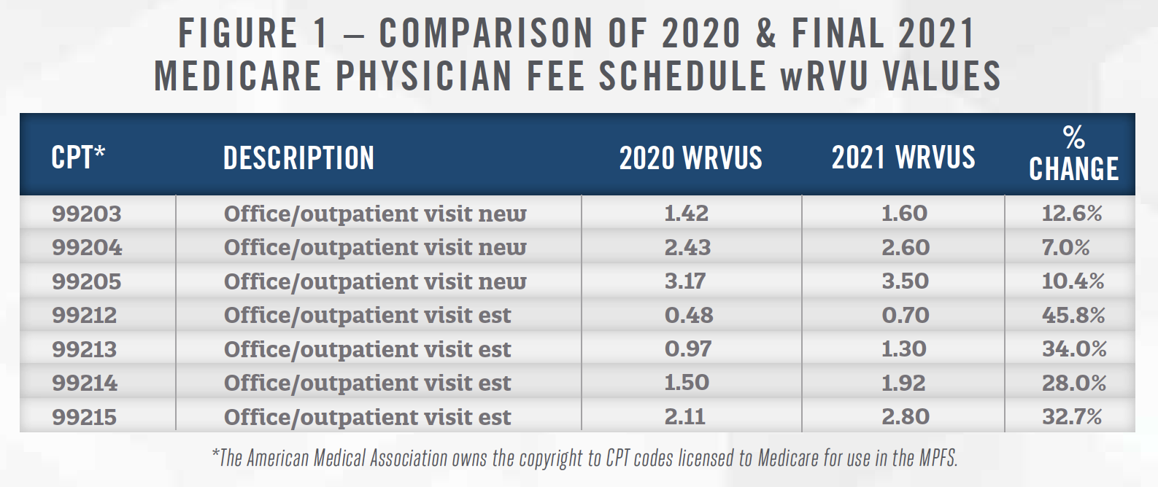
Calculating Compensation
Notes:
Every year CMS publishes a new physician fee schedule that provides a RVUs assigned to procedures or patient visit types. wRVU means “Resource Based Relative Value Units”. This table is just one of many tools utilized that make up physician comp calculations.
As you can see in this chart, we saw significant changes in the way physicians had to complete outpatient visits due to covid, including increased screening resources, adjusting to telehealth, increased risk, and more. CMS’s way of recognizing this was to add wRVU’s to these outpatient visit CPTs. Interesting fact, unfortunately their payment recognized per some of these CPT’s codes went down, however, which poses challenges.

Slide 12
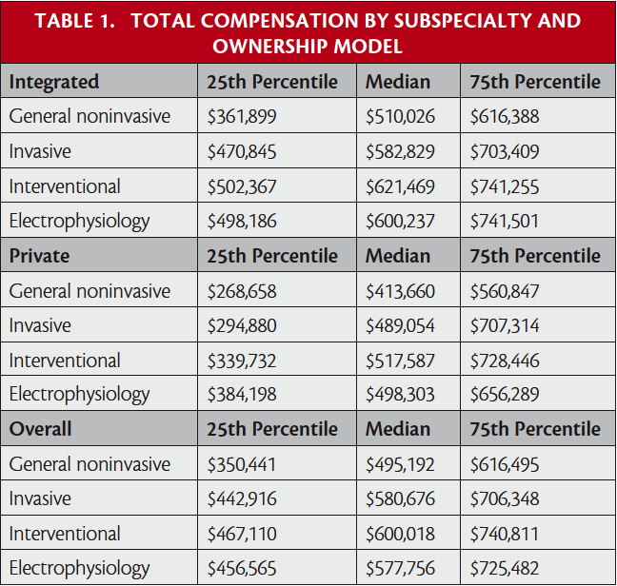
Notes:
There are many national surveys and tools that aid in understanding percentile ranking for physician pay. Above is an example of one table that both physicians and hospitals have access too. ACC does have a physician fee schedule calculator as of Dec 2020 and I would assume will continue to be updated as data changes, which is a nice resource for physicians.

Slide 13
Compensation Reporting
Hospitals use various physician compensation reporting systems to aid in decision making:
AMGA- American Medical Group Association MGMA-Medical Group Management Association
Notes:
Utilizing these reporting mechanisms helps ensure there is an alignment between performance and compensation, recruitment packages keep pace with the market, among other data driven tools that aid in decision making or negotiations.

Slide 14
Reporting Tools Include:
Total pay percentile ranking
Productivity measures, wRVUs, Total RVUs, professional collections and charges
Benefit metrics (ex. hours worked)
Notes:
For total pay percentile ranking- total pay includes guaranteed base compensation + any incentives or bonuses
Productivity benchmarking - Work RVUs, total RVUs, professional collections and charges
Benefit benchmarking - Hours worked per week/year and weeks of vacation.
Hospitals often use these as a guide when making an offer to a new physician or when negotiating a contract renewal.
wRVU is the unit assigned every CPT code, Total RVU is practice expenses+ insurance payment + wRVU.

Slide 15
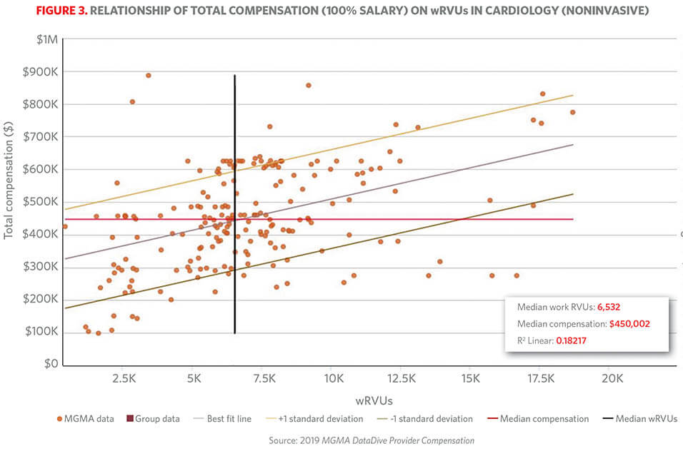
Notes:
With use of these reporting tools, this is a graph that shows another example of how physicians salaries are ranked in comparison to their wRVU’s. These are typically large, nationwide samples that again help ensure the salary offer is in alignment with the work produced.

Slide 16
Payment Models
Production model
Guaranteed compensation model
Guaranteed base salary + incentive opportunity
+/- call pay
Notes:
In a production model, physicians are paid a percentage of either billings or collections, or they are paid based on the resource-based relative value scale (RBRVS) units assigned to procedures or patient-visit types
A guarantee is a compensation payment made in addition to base salary that is paid regardless of performance. Even if the actual incentive earnings do not exceed the draw amount, the monies are not owed to the company by the individual.
Call pay is another payment structure that can be added to either of these models and is increasingly something that is valued and negotiated.

Slide 17
Opportunities for Increased Compensation
Sign on bonus
Moving expenses
Student loan repayment (typically paid over several years)
Medical Directorships
Notes:
It’s important to understand as we discussed previously total cash compensation, some of these additional opportunities can or will be factored into “total cash compensation” when modeling percentiles for reimbursement. For example, if a physician wants to ensure his earnings are above the 50th%tile, it’s important to understand that it will typically mean his base salary + any medical directorships, student loan repayments, etc. are totaling the 50th%tile or higher as a combined measure. Again, as discussed previously, it's important to understand what that agreement looks like year over year and engage in conversations with your admin contact.

Slide 18
Additional Opportunities
Profit sharing with hospital on quality
CME and travel reimbursement
Fellowship sponsors
Many things are negotiable-
it doesn’t hurt to ask!
Notes:
Friendly tip: engage with your administrative and clinical teams and discuss openly your quality incentive opportunities. It’s amazing how attainable some of these targets are when we all use the right resources.
And finally, its important to remember, many, if not all of these items discussed are open for discussion and negotiable, it doesn’t hurt to ask anything!

Slide 19
References
Private Practice Today For Early Career Cardiologists - American College of Cardiology (acc.org)
Physician salary report 2021: Doctor’s compensation steady (weatherbyhealthcare.com)
how-to-use-mgma-compensation-data-r-report-june-2016.pdf

Slide 20

How to Get What You Want-
Negotiating with Your Boss!
Jamal S. Rana MD, PhD, FACC
President California ACC
Assistant Physician-in-Chief
Medical Specialties, Interventional Services & Wellness Operations
Chief of Cardiology, East Bay
Adjunct Investigator, Division of Research
Kaiser Permanente Northern California
@JamalRanaMD

Slide 21

ne·go·ti·a·tion: discussion aimed at reaching an agreement
Many people don’t tackle negotiations in a proactive way; instead, they simply react to moves the other side makes. While that approach may work in a lot of instances, complex deals demand a much more strategic approach.
The best negotiators look beyond their immediate counterparts to see if other constituencies have a stake in the deal’s outcome or value to contribute; rethink the scope and timing of talks; and search for connections across multiple deals. They also get creative about the process and framing of negotiations, ditching the binary thinking that can lock negotiators into unproductive zero-sum postures.
Applying such strategic techniques will allow dealmakers to find novel sources of leverage, realize bigger opportunities, and achieve outcomes that maximize value for both sides
(Harvard Business Review)

Slide 22


Slide 23
Art of Negotiation
"Despite the importance of crucial conversations, we often back away from them because we fear we'll make matters worse. We've become masters at avoiding tough conversations”.
(Crucial Conversations)

Slide 24
Art of Negotiation
"The method of principled negotiation is to decide issues on their merits rather than through a haggling process focused on what each side says it will and won't do. Look for mutual gains whenever possible, and that where your interests conflict, you should insist that the result be based upon some fair standards independent of the will of either side.”
(Getting to Yes)

Slide 25
Art of Negotiation
“ …humans all suffer from Cognitive Bias, that is, unconscious--and irrational--brain processes that literally distorts the way we see the world.”
(Never split the difference)

Slide 26
PURPOSE
Prepare (plan ahead)
Understand (all aspects of the group practice)
Reason (why you)
Prioritize (pick 1-2)
Options (not static)
Strategize (together, skin in the game)
Emotional (intelligence)

Slide 27
What to Do If Your Boss Says No
Approach the conversation with curiosity
Ask good questions
Ask the time to process
Take a day or two to reflect
Adapt your proposal
Don’t let the perfect the enemy of the good
(John Coleman)

Slide 28
Know your raison d ’etre

Slide 29
Work-Life Balance:
Is it a myth?
Mahi L. Ashwath MD, MBA, FACC
President, Iowa ACC

Slide 30
Professional Reality
Prolonged Training:
  Medical School
  Residency
  Cardiology Fellowship
  Advanced Fellowship
Work Responsibilities
  Clinical Care
  Research
  Administrative
  Societies/ Committees
  Volunteer/ Promotion

Slide 31
Personal Reality
Young families
Financial Responsibilities
High expectations for ourselves

Slide 32
Can You Have It All?
How Do You Balance?
Pick your priorities
Delegate
Be kind to yourself

Slide 33
Pick Your Priorities
Evaluate your choices for a job:
  Academic/ Private
  Full time/ part time
  On call obligations
  Weekend duties
  Travel Requirements
  Financial reward

Slide 34
Pick Your Priorities
Be flexible with changing priorities / Reevaluate
  Talks
  Research
  Meetings
  Learn to say no – Pick your work
  Plan with educational goals and milestones in mind
Set boundaries – when are you going to catch up with work/ work related stuff? Kids in activities/ in bed

Slide 35
Delegate/ Outsource
Learn to ask for help – might be hard
Lean on partner, family, friends
Plan Ahead and Organize – shared calendar
Personal - House cleaning, online grocery, cooking/ meals, kids drop offs, car pooling, family support
Professional - Nurse calling patients
Notes:
keep your ultimate goals

Slide 36
Be Kind to Yourself
It is okay not to be A+ at everything
Personal time to take care of yourself
  Health
  Exercise
  Hobbies
Vacations

Slide 37
Burnout / Wellness
Watch for signs of burnout
Wellness is not just lack of burnout
Remember why you are here
Look at the big picture
Align your goals and values

Slide 38
Make Time for Kids
Don’t ignore your kids to do work
Take time off and spend it with your family (vacations etc.)
Teach Your kids to be kind, smart, and how to cook, or other things
By: The Kid

Slide 39
Can You Have It All?
How Do You Balance?
Pick your priorities
Delegate
Be kind to yourself

Slide 40
Involvement with Professional Societies- Why Start Early?
Poonam Velagapudi, MD, MS, FACC
Structural and Interventional Cardiologist; Assistant Professor of Medicine
Associate Program Director for Cardiology Fellowship
University of Nebraska Medical Center, Omaha, NE
Twitter: @pooh_Velagapudi

Slide 41
Disclosures
Abiomed
Opsens
Sanofi
Boston Scientific
Chiesi
Medtronic
Phillips

Slide 42
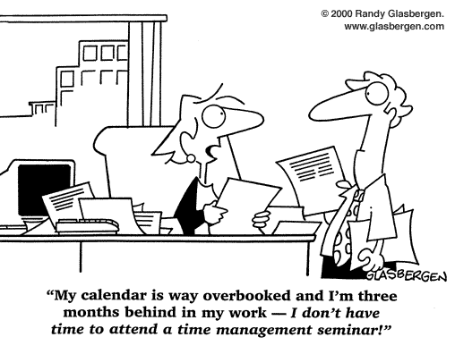
TIME
CLINICAL DUTIES
FAMILY RESPONSIBILITIES
ME TIME
MENTORSHIP
RESEARCH
WORK
ADMINISTRATIVE RESPONSIBILITIES

Slide 44
WHY START EARLY?
To stay connected and build a network
For education and lifelong learning
To build leadership and other non-clinical skills
For publications and other scientific contributions
To remain open to opportunity

Slide 45
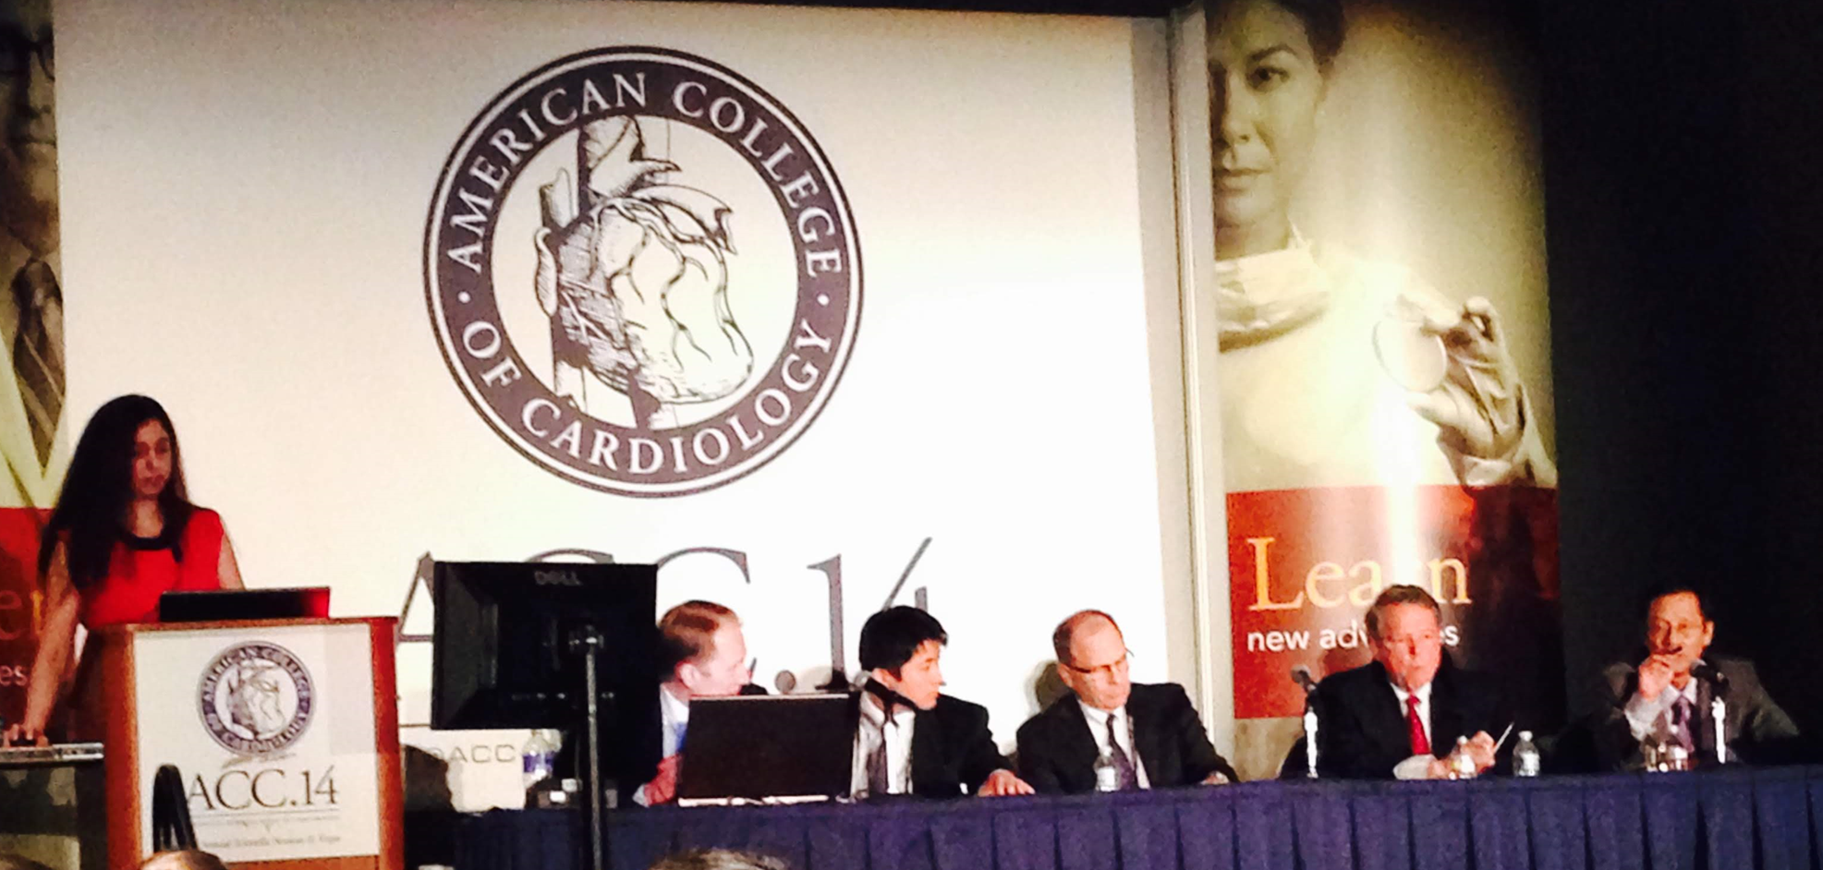
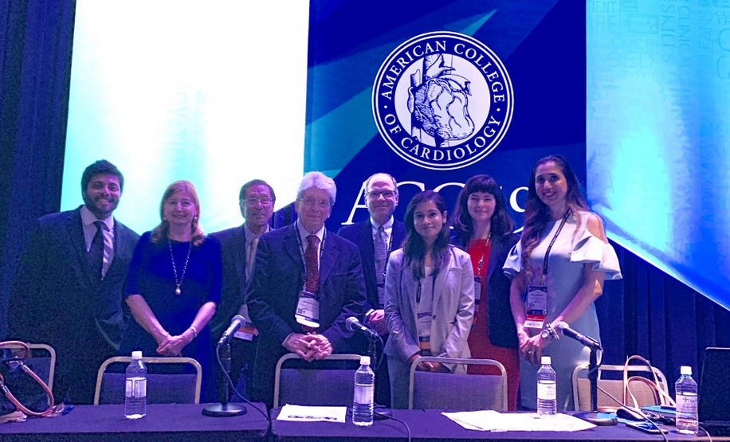
To Stay Connected and Build a Network
ACC.14: FIT ‘Stump the Professor’ presenter
ACC 2017-18: Chair, FIT Section, Co-moderator of ‘Stump the Professor’- reviewed abstracts, provided feedback to selected FIT presenters
ACC 2020-22: Chair, ACC MD/PhD & Interventional Challenging Cases
ACC 2020-23: Chair, ACC Early Career Section, Section Steering Committee
Notes:
FIT session at the ACC Annual Scientific Sessions
FITs submit cases as abstracts
FITs whose abstracts are selected for oral presentations are mentored by FIT Leadership council members (Chair and Past Chair) as they prepare for their presentations: tips on PowerPoint
Cases are discussed by panel of eminent faculty, Chair and Past Chair of the ACC FIT section
Great experience, meet other FITs (cohort) and faculty mentors
I met faculty: Dr. Rick Nishimura, Dr. Pat Ogara, FIT Chair: Mike Cullen, Cohort: Marysia Tweet
2018 and 2019: comoderated with Akhil Narang and Ada Stofanesci

Slide 46
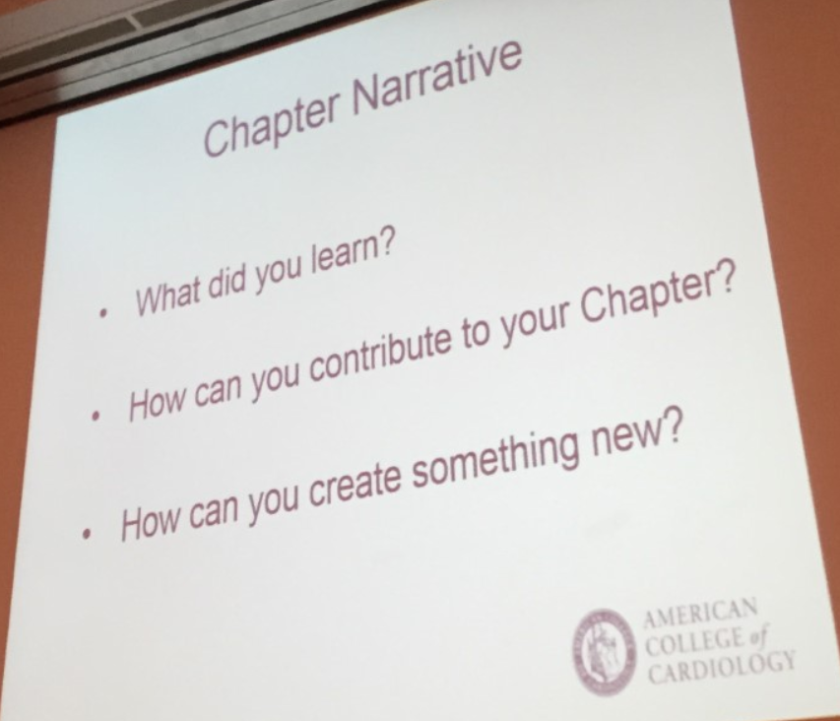
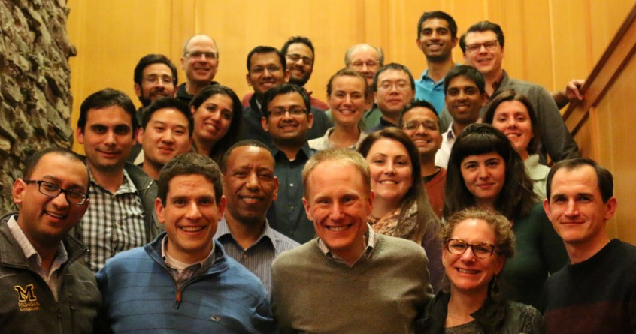
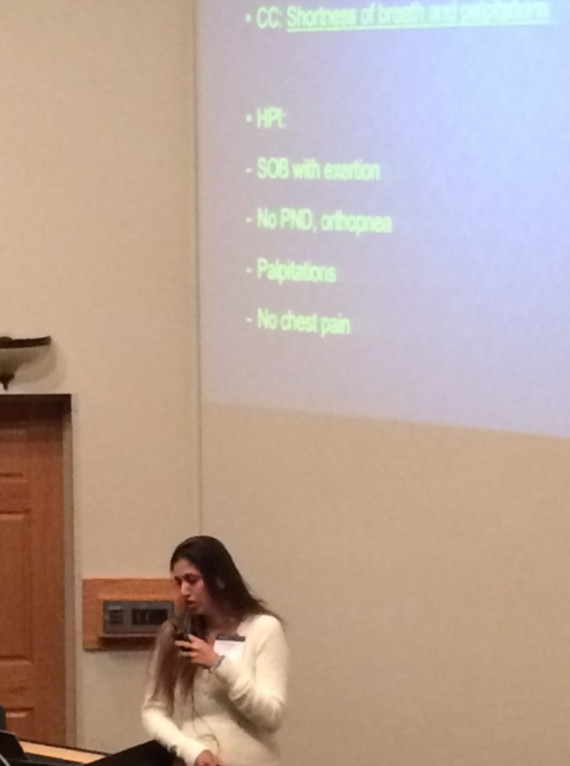
Education and Lifelong Learning
2016: Teaching Tomorrow’s Teachers (T3) at Big Sky (group activity, how to be a good educator, how to engage your audience by presenting in a clear & concise manner)
2018: Presentations at several meetings; Educating house staff
2022: Selected for the ACC Early Career Emerging Faculty program, Washington DC
Notes:
Program developed by Shashank Sinha, Mike Cullen and Craig Alpert (FIT leaders), Marty Tam joined a year later when Shashank left
Annual program, FITs across the country are invited to apply, selected by thorough review
FITs are paired with master educators, allotted a topic for presentation, mentored by the faculty
Drs. Pat Ogara and Kim Eagle were the faculty mentors for the T3 conference

Slide 47

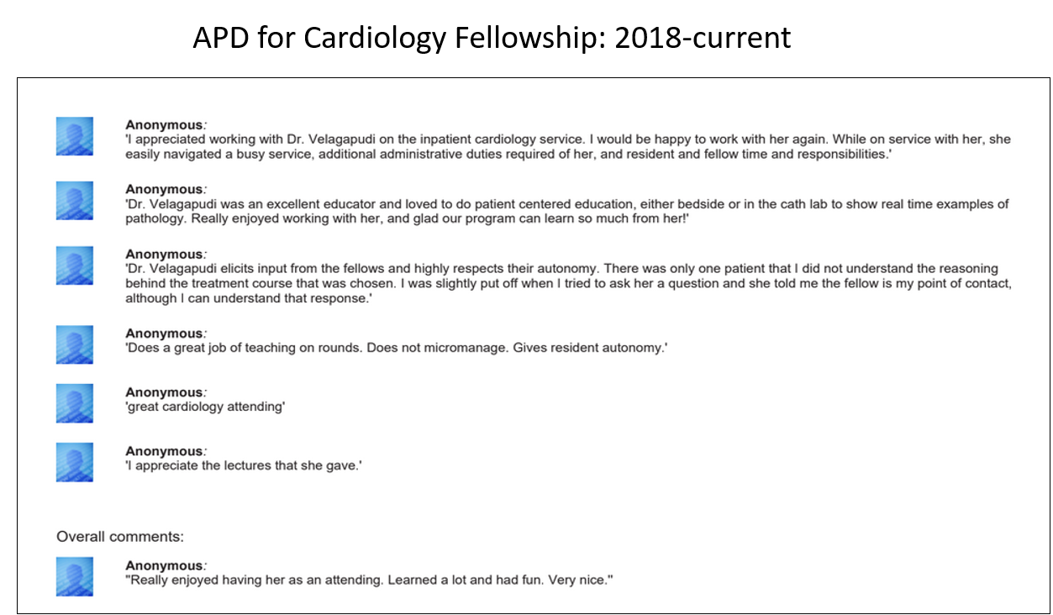
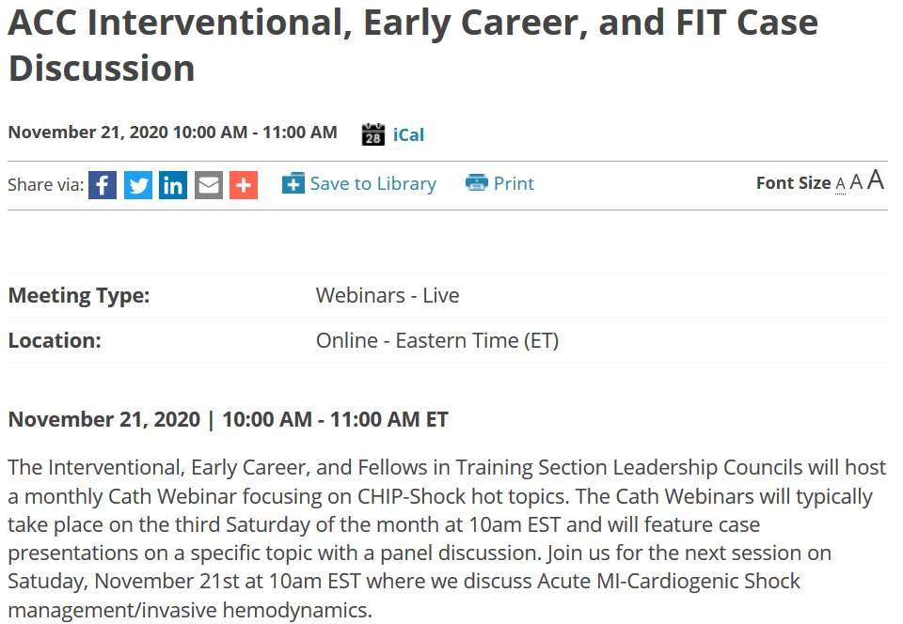
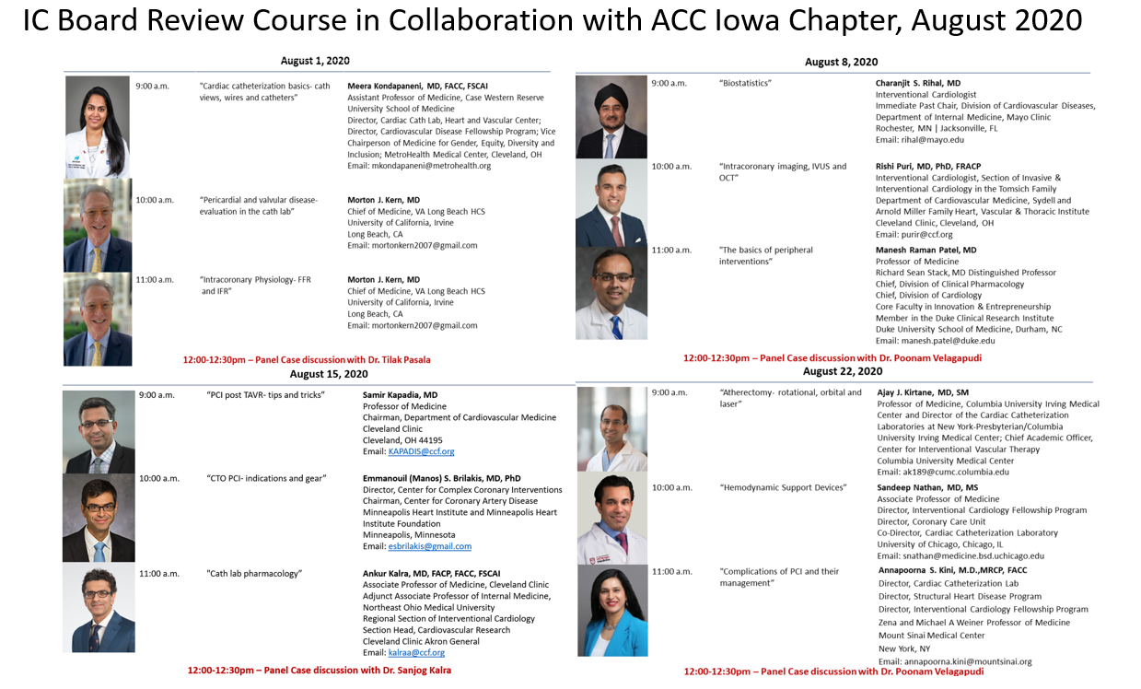
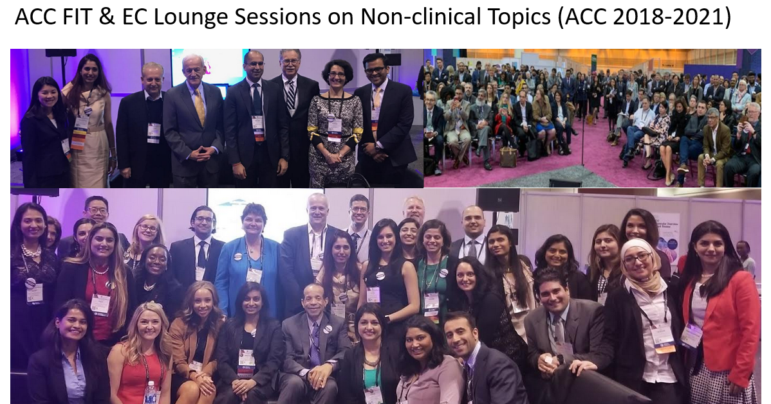
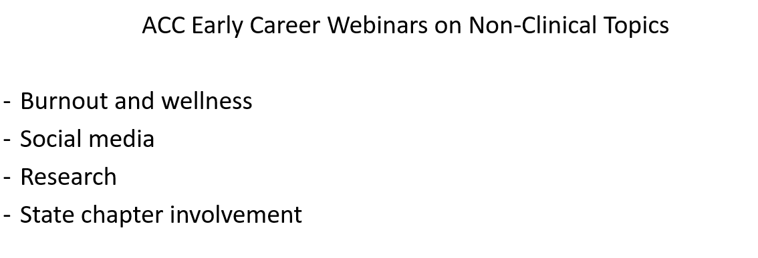
Notes:
Lectures for fellows and residents; feedback to fellows on a timely fashion; adequate independence during rotations
4 weekends of lectures on IC topics followed by case presentations
Virtual course with 20 faculty and 20 lectures covering topics related to cardiology and issues pertinent to women leaders
Early Career and FIT case presentations with panel discussion by renowned members of the interventional cardiology community
Lounge sessions: Wellness, Research, Social Media, PD meeting, etc
Lectures for fellows and residents; timely feedback

Slide 48
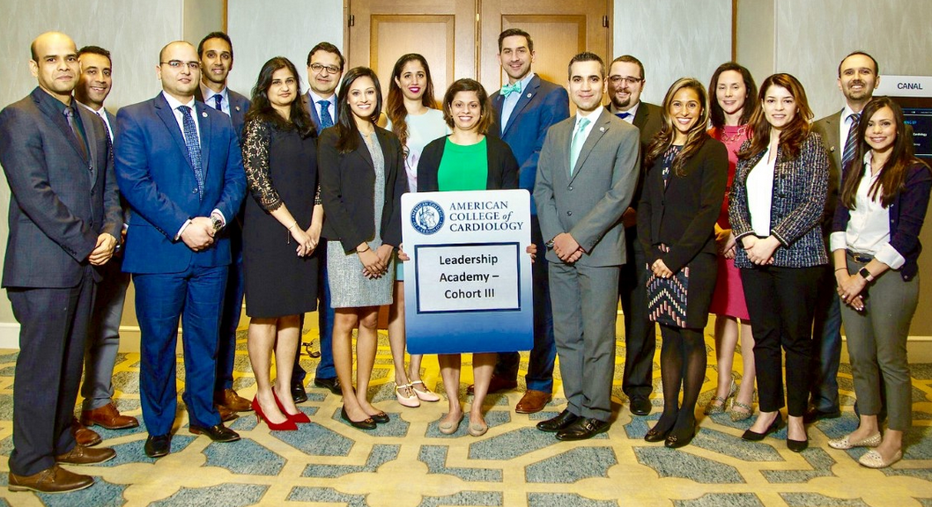
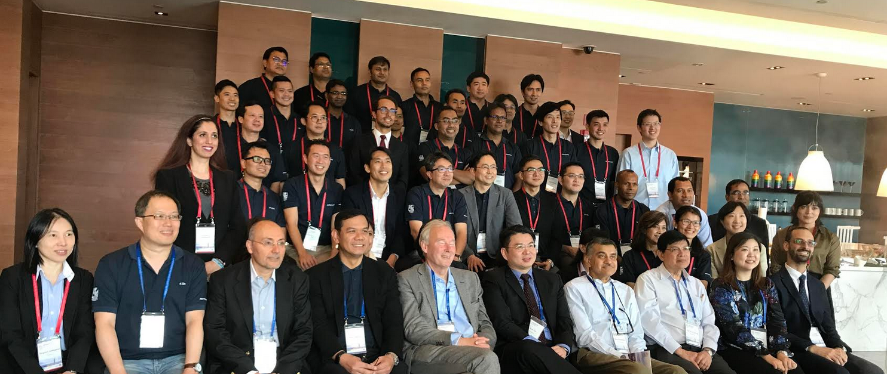
Building Leadership and Other Non-clinical Skills
- 2018 to 2020: ACC Leadership Academy
Emotional intelligence, giving timely & constructive feedback, 360 evaluations
Capstone Project with assigned mentors: Toolkit on burnout
- 2018: 2nd Fondazione Internazionale Menarini Emerging Leaders Scholarship Program in conjunction with the Asia Pacific Society of Cardiology Congress, Taipei
Notes:
Rosanne Nelson leads the course, 2 year commitment and attendance at ACC meetings, aimed to develop emotional intelligence and other qualities that are essential to be successful as leaders; 360 degree evaluation from peers, HOW TO GIVE FEEDBACK, etc; Capstone project was to create a wellness toolkit for the early career members and mentors were Drs. Akshay Khandelwal and Robert Shor
Annual program, FITs across the country are invited to apply, selected by thorough review
FITs are paired with master educators, allotted a topic for presentation, mentored by the faculty

Slide 49
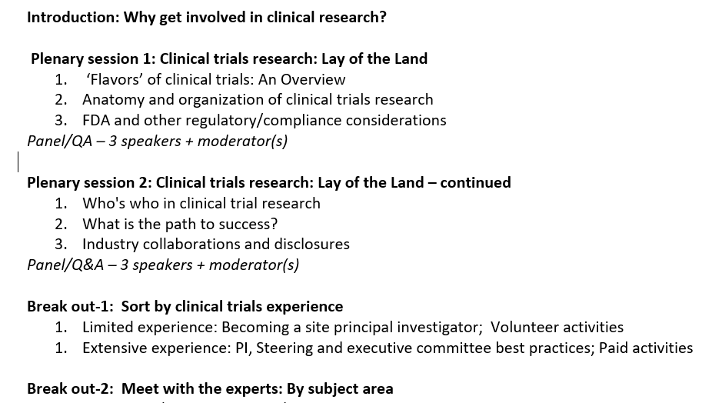
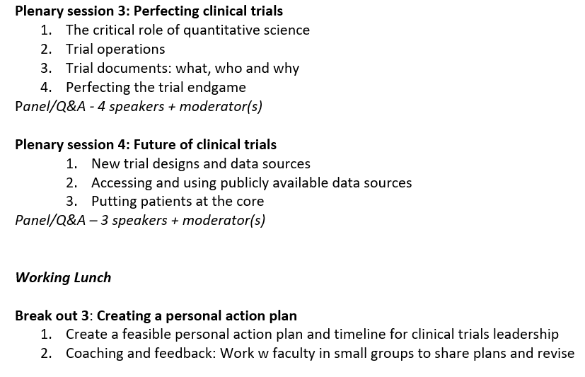
Building Leadership and Other Non-clinical Skills
- 2019: ACC Clinical Trials Research: Upping Your Game program
Education regarding clinical trials research
Creating a personal action plan
Participation in clinical trial enrollment
Notes:
Rosanne Nelson leads the course, 2 year commitment and attendance at ACC meetings, aimed to develop emotional intelligence and other qualities that are essential to be successful as leaders; 360 degree evaluation from peers, HOW TO GIVE FEEDBACK, etc; Capstone project was to create a wellness toolkit for the early career members and mentors were Drs. Akshay Khandelwal and Robert Shor
Annual program, FITs across the country are invited to apply, selected by thorough review
FITs are paired with master educators, allotted a topic for presentation, mentored by the faculty

Slide 50
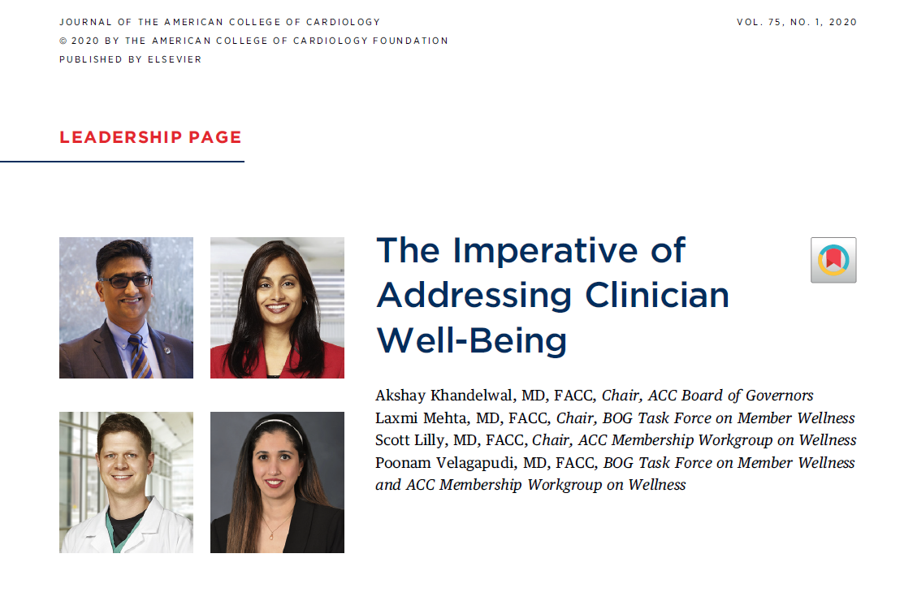
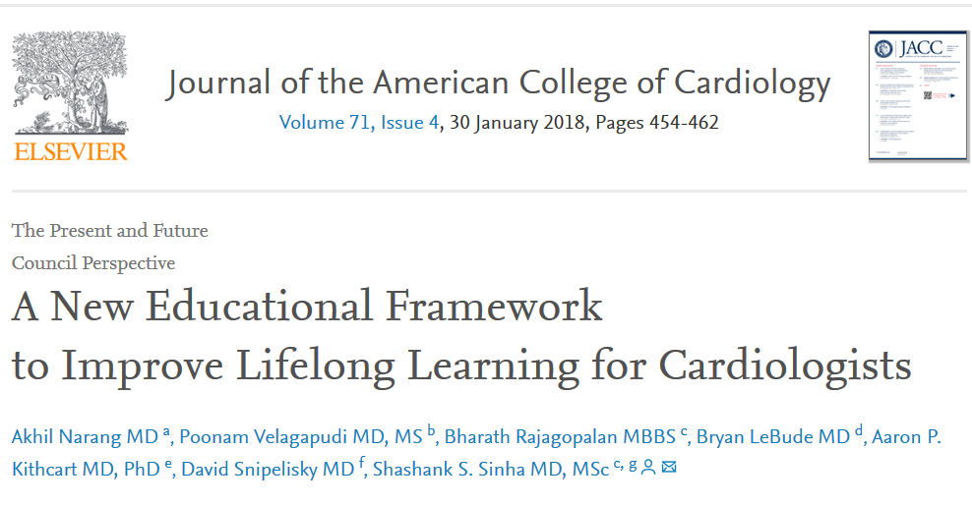
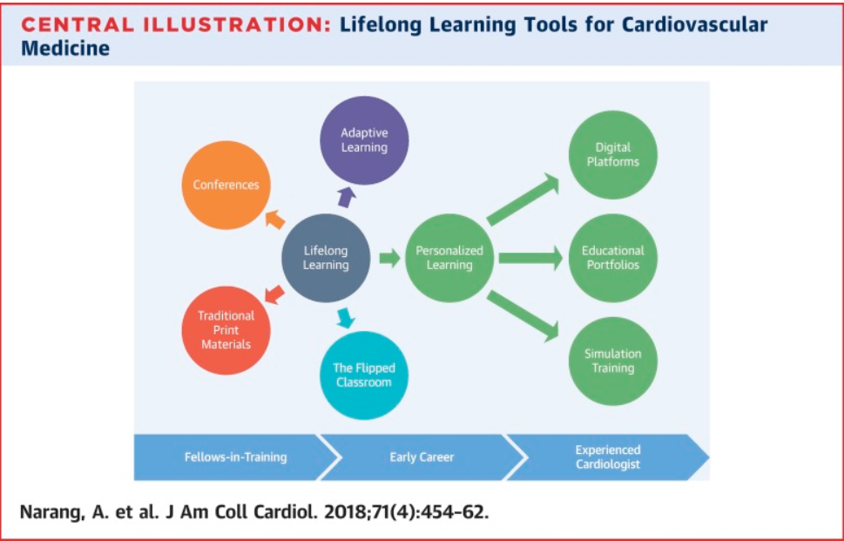
Publications and Scientific Contributions
2018: ACC FIT Section- ‘A New Educational Framework to Improve Lifelong Learning for Cardiologists’ in JACC
2020: Member, ACC BOG Task Force on ‘Well being’- ‘The Imperative of Addressing Clinician Well-Being’ in JACC
2022: ACC Early Career Section- Article on ‘Early Career Parenting challenges’ (accepted for publication in JACC)

Slide 51


Opportunities
You will find out there are several things you were not taught in fellowship
Knowledge/learning beyond fellowship
Collaborate- clinical trials, manuscripts, reviewing
Faculty roles
Job opportunities
Give back- mentor trainees

Slide 53
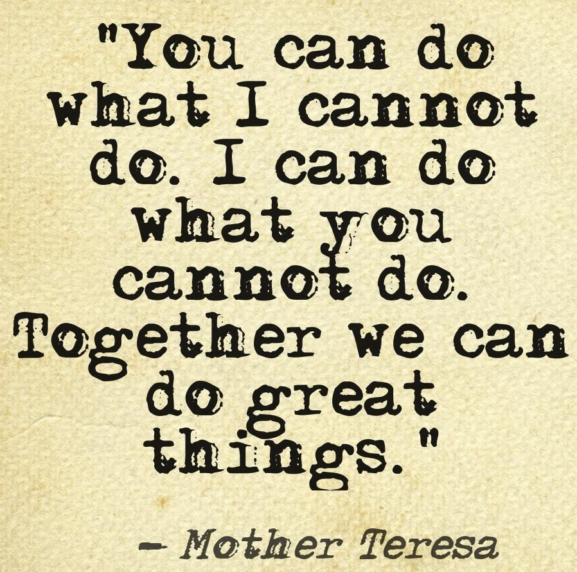
Why is involvement with professional societies important and why start early?

Slide 54


