Slide 1
When the Going Gets Tough: Shocking Cases for the Early Career Cardiologist
by the International Work Group of
the Early Career Section

Slide 2
Learning Objectives
Managing your first critically ill patient as an early career cardiologist
2) Navigating the challenges of an early career cardiologist as part of a multidisciplinary shock team, in a new work environment

Slide 3
Moderators
Sena Kilic, MD
St. John Medical Center, Longview, WA
and
Poonam Velagapudi, MD, MS, FACC
University of Nebraska, Omaha, NE

Slide 4
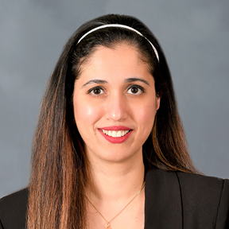
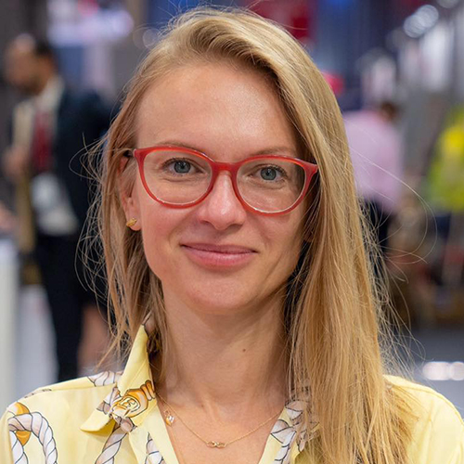
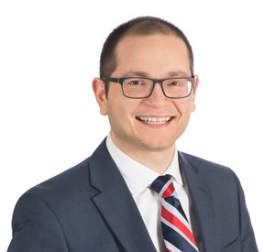
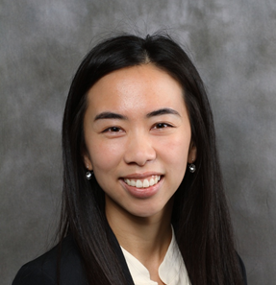
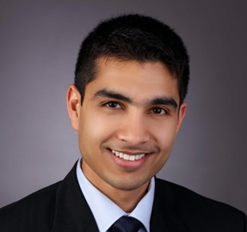
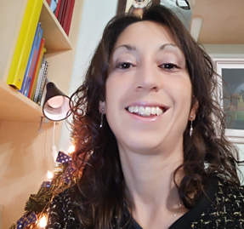
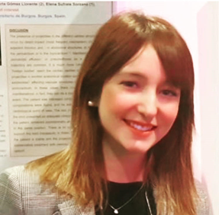
International Early Career Work Group
Tami Atkinson, MD USA
Poonam Velagapudi, MD, MS, FACC, USA
Kasia Czerwińska-Jelonkiewicz, MD, PhD, Poland
Sotirios Nedios, MD, PhD, FACC
Germany
Sheila Klassen, MD, FACC, Canada
Rasha Al-Bawardy, MD, MSc., FACC, Saudi Arabia
Auras R. Atreya, MD, MPH, FACC, India
Monica Verdoia, MD, Phd
Italy
Sara Moscatelli, MD
England

Slide 5
Panelists
Stanley Chetcuti, MD, FACC
University of Michigan, Ann Arbor, MI
Mirvat Alasnag, MBBS, FACC
King Fahd Armed Forces Hospital, Jeddah, Saudi Arabia
Ravinder Singh Rao, MBBS, FACC
Rajasthan Hospital Heart Center, Jaipur, India

Slide 6
When the Going Gets Tough: Shocking Cases for the Early Career Cardiologist Case # 1
Auras R. Atreya MD, MPH, FACC
AIG Institute of Cardiac Sciences and Research
No disclosures

Slide 7
Patient Presentation
58 y/o male with long standing HTN
Diagnosed with 2vD (LCX 50%, LAD 50%) and severe AS, EF 50% 1 year prior at OSH
Refused surgery and started taking alternative medications

Slide 8
Patient Presentation
Presented with drug induced liver injury (AST/ALT 3000s)
ADHF with reduced EF 20-30%
Progressive cardiogenic shock (SCAI Stage C/D), escalating pressors
AKI —> creatinine 1.65

Slide 9
Patient Presentation
Severe AS Vmax 4.6 m/s, MG 48 mm Hg, AVA 0.7 cm² in setting of low EF, cardiogenic shock on Pressors
ECG: sinus tachycardia, RBBB

Slide 10
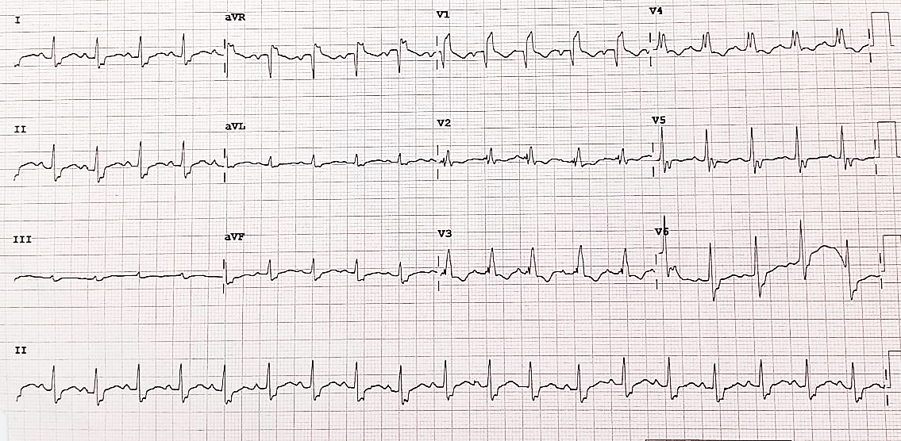

Slide 12
Decision Making
Improvement in liver injury
Unable to wean off inotropes
Decision-making for urgent valve replacement
SAVR vs TAVR (vs. BAV + SAVR)
STS risk of mortality: 13%
Modifiers (sPAP60-80 mm Hg): 5%
---------------------------------------------------------
Modified STS risk of death: 18% Prohibitive Risk
Euroscore In-hospital Mortality: 31%

Slide 13
CT TAVR Protocol
Madukauwa-David MS et al. CCI 2018.

Slide 14
CT TAVR Protocol

Slide 15
Femoral Vascular Anatomy

Slide 16
Procedural Planning
Coronary Management
Valve Type: Self Expanding vs. Balloon-Expandable
General vs. Moderate Sedation
Access: Primary vs. Secondary
TEE vs. TTE guidance

Slide 17
Multidisciplinary Meeting
Access – OK for ~16 F delivery system B/L; right common iliac has some stenosis (still 6.6 x 6cm) + high bifurcation
Tricuspid AV
Calcified along leaflet edges (more on NCC)—plan for BAV
Annulus ~ 24 mm
LVOT -25.6 mm
Sinus of Valsalva: 34 x31 x34
Coronary height. RCA (15.4) & LM (13.3)
Annulus: 24 mm
Perimeter: 76.6
Area of annulus (MDT read): 485
Implanter's View: RAO 22/ Caudal 51
Co-planar view – LAO 4/ Caudal 24
Cusp-Overlap View- RAO 4/ Caudal 36
Ao-LV angle ~ 48◦
29mm Evolut Pro based on CT analysis

Slide 20
Post TAVR EKG

Slide 22
Panel Discussion

Slide 23
Shocking Cases for the Early Career Cardiologist Case # 2
Rasha Al-Bawardy, MD, MSc., FACC
Interventional Cardiology Consultant
National Guard Health Affairs, Jeddah, Saudi Arabia
No disclosures

Slide 24
History
58 year-old male with CAD/MI s/p PCI to LAD and subsequent CABG with ischemic cardiomyopathy, LV thrombus and paroxysmal atrial fibrillation (on apixaban) with progressive SOB, NYHA class III with severe secondary MR.
Meds: maximum tolerated doses of lisinopril, bisoprolol and spironolactone. BP 97/68

Slide 25
Presentation
ADHF in shock (BP 70/50, HR 110)
Had Aflutter with RVR afterwards and was given a DCCV and converted to sinus tachycardia
Started on vasopressors and taken to cath lab

Slide 26
Discussion Question
Would you use mechanical circulatory support?

Slide 27
Cath
Patent free arterial graft to LAD and SVG-RCA, severe 3 V CAD.
Inserted an IABP

Slide 29
What Would You Do?
Would you call for an urgent heart team meeting?
What is your backup plan if you need help overnight?

Slide 31
TEE

Slide 32
Hospital Course
Stabilized, IABP removed
Started on milrinone and sacubitril/valsartan along with continuing furosemide boluses
Narrow QRS, not a candidate for CRT
Discussed in heart team meeting and decision was to proceed with MitraClip

Slide 33
TEE Pre-Clip (Same Day)

Slide 34
Initial Clip Attempt

Slide 35
What Would You Do?
Leave this clip and proceed with a second clip?
Adjust the clip for an attempt to do one clip only?

Slide 36
Re-Attempted Laterally

Slide 37
After Releasing the Clip

Slide 38
MitraClip
1 XTR clip
Mean mitral gradient post was 1 mmHg
Post clip with Trace MR
Pre LA pressure was 29 mmHg (V =57) → post mean LA was 8mmHg (V = 14).
Milrinone was stopped and he was discharged 2 days post-procedure

Slide 39
Panel Discussion

Slide 40
Thank you

