Slide 1
Diversity, Equity and Inclusion- Role of Early Career Cardiologists Part 2: Nurturing the Culture Wednesday, September 29, 2021

Slide 2
Moderators
Nosheen Reza, MD, FACC
University of Pennsylvania
Philadelphia, PA
Howard Julien, MD, MPH, FACC
University of Pennsylvania
Philadelphia, PA

Slide 3
Objectives
Identifying factors that influence DEI in the cardiovascular workforce
Explore the options available to early career cardiologist to improve engagement
Examine evidence base that DEI improves patient care and offers competitive advantage

Slide 4
Agenda
Career Diversity to Reduce Health Care Disparities
Best Strategies of Integrating DEI in Department of Cardiology- Promoting A Society of Belonging
Power of Social and Digital Media in Amplifying Diverse Voices

Slide 5
Career Diversity to Reduce Healthcare Disparities
Claire S. Duvernoy, MD, FACC
Professor of Medicine, University of Michigan
Trustee, American College of Cardiology

Slide 6
CV Outcomes among marginalized Americans
CVD mortality is highest among Black and Indigenous Americans
Medical distrust, high psychosocial stress, experiences of discrimination all associated with poor CV health
Systemic barriers exist which exacerbate race-based health differences.
Johnson et al. J Am Coll Cardiol 2021

Slide 7
Achieving Health Equity
Achieving equitable health outcomes requires the establishment of inclusive health care environments
Care of diverse patient populations is optimized
Increased racial/ethnic diversity among providers allows CV workforce to reflect pts for whom we provide care.
Johnson et al. J Am Coll Cardiol 2021

Slide 8
Underrepresentation among cardiologists
Mehta et al. JAMA Cardiol 2019
Notes:
Percentages of female adult cardiology fellows and adult cardiologists increased from 2006 to 2016, but remained low. For fellows, the percentages were 16.7% in 2006 to 20.2% in 2016; for adult cardiologists the percentages went from 8.9% to 12.6% during that period.

Slide 9
Mehta et al. JAMA Cardiol 2019

Slide 10
% URM adult cardiologists slightly increased (5.3% to 7.5%) from 2006 through 2016
% Asian adult cardiologists increased from 10.9% to 19.9% from 2006 to 2016
Black/AA adult cardiologists % remain below 5%.
Mehta et al. JAMA Cardiol 2019

Slide 11
Questions to ask yourself as you begin your career journey
Where do I see myself in 1 year, 5 yrs, 10 yrs?
What is my dream job in Cardiology?
Are there role models that look like me/are doing what I want to do?
How do my life goals fit with my career goals?

Slide 12
… And related to those questions
Can my career choices improve CV health and health equity across diverse populations in the U.S.?
What can I do to improve diversity in my profession?

Slide 13
Career Choices to Improve Diversity, foster Health Equity
Consider less traditional career paths
VA, Indian Health Service, other Federal careers provide care to higher proportion of underrepresented patients
Seek out mentors pursuing alternate career paths
Promote Cardiology as a career choice among underrepresented communities, young people

Slide 14
ACC D&I Efforts
Engage, leverage diverse talent via strategies affecting deep pipeline, recruitment, retention, and leadership
Create culture of inclusion within the field of cardiology
Improve culture, increase mentorship, promote work-life balance to help attract more diverse group of individuals to pursue cardiology training
Notes:
Very intentional -- Leadership academy, Section leadership, Leadership positions within the college, awards to URM/women, white papers on pay equity, flexible work choices, research workshop targeting women and URM

Slide 15
ACC Career Flexibility Statement
Document currently in press; will address best practices/principles of career flexibility at every stage of cardiologists' careers, in every subspecialty
Many principles overlap with compensation equity, i.e. transparency of process, prospectively determined, minimize unwarranted systemic differences based solely on hours, hold leadership accountable for implementing best practices.

Slide 16
ACC Career Flexibility Statement
Discussion of strategies to achieve flexibility and reconcile demands of training with the demands of parenthood, other aspects of life outside of work.
Policies and support systems to mitigate burnout, incorporate physician wellness plans, combat poor work-life balance.

Slide 17
Gender-equalizing Family Policies
Mandatory parental leave policies, with expected paternal leave as an integrated component
Equalization of wages over the life-time careers of men and women
More equal unpaid (domestic) work sharing
More active fatherhood role for men
Expanded access to high-quality, affordable daycare options
Support and explicit time provided for breastfeeding/pumping at work
Rønsen,Kitterød: Feminist Economics 2015

Slide 18
Fixing the Parent Trap for Resident/EC Physicians
Develop institutional “return-to-work” policies for new parents
Specify relief from overnight shifts, unscheduled call, >3 shifts in a row for 6 weeks after return from parental leave
Lactation policies, spaces (commandeer call rooms, add fridge & chair) – spell out ability to step out of long cases to pump
Properly interpret ACGME/ABMS policies for trainees
(i.e. 1 month= 5 weeks, not 4, additional month possible per ABIM Deficits in Required Training Time Policy)
Stanford/Kaiser Emergency Medicine Residency Program
Michigan Medicine Surgery Lactating Resident Policy
Kuehn B: JAMA 2020

Slide 19
10 Actions Toward Advancement of Women in Cardiology
Sharma G et al: JACC 2019

Slide 20
Enhancing Diversity in Cardiology Training
Duvernoy&Capers:Circ Quality&Outcomes 2020

Slide 21
Enhancing Diversity in Cardiology Training
Duvernoy&Capers:Circ Quality&Outcomes 2020

Slide 22
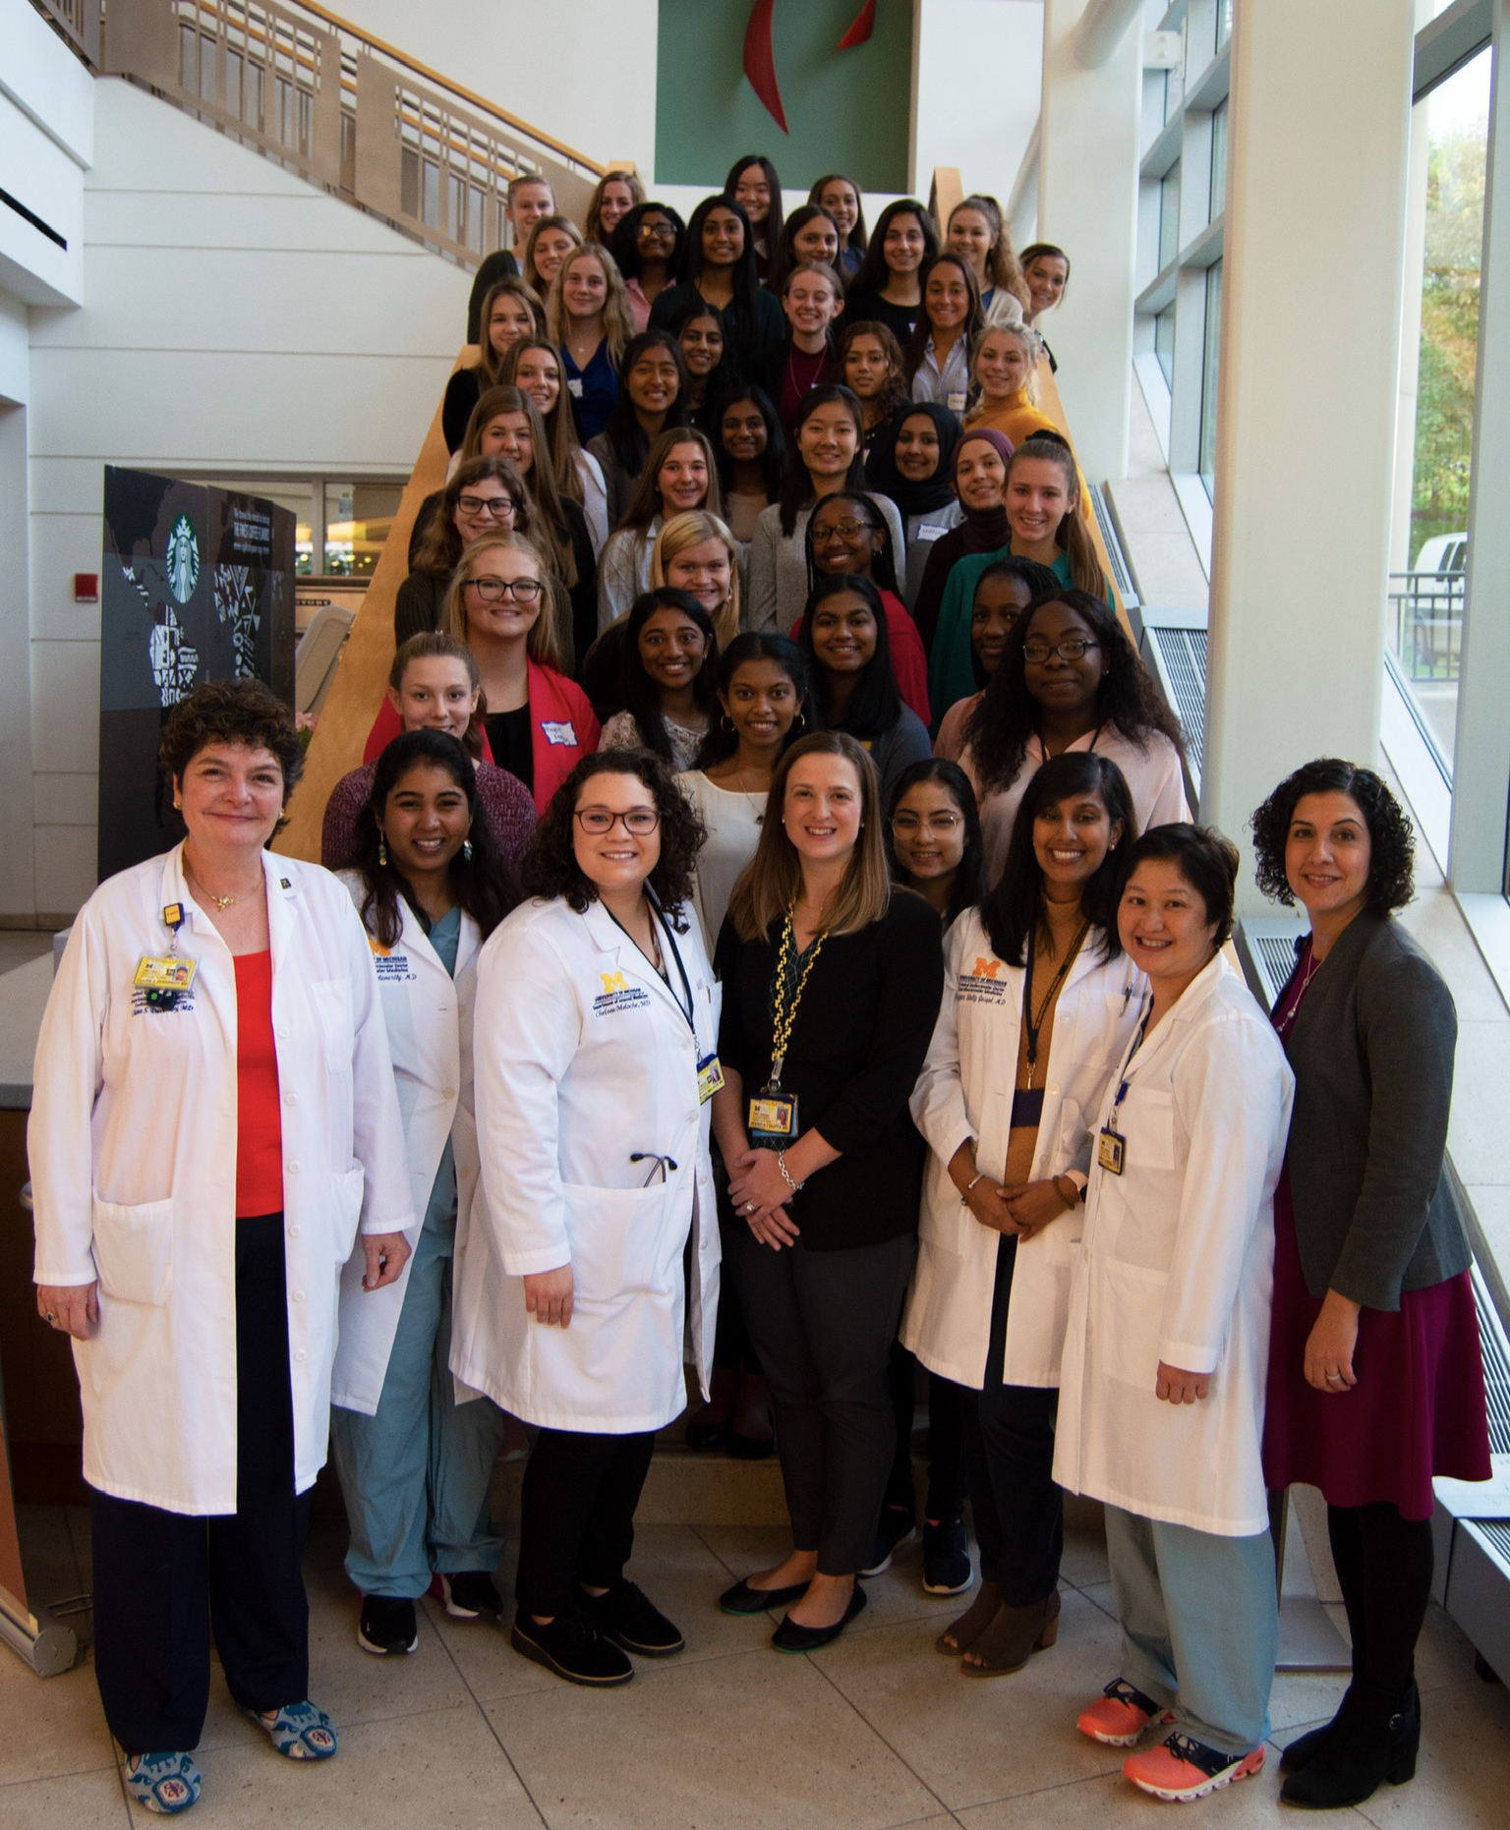
Building the pipeline
#shelookslikeacardiologist
Notes:
1-day event for high school girls, originally planned for 30-35 girls; received 140 applications! Open to juniors and seniors who completed an application; modeled on an event at the University of Pittsburgh
Now building a regional event with a video in the works so that it can be exported to many communities

Slide 23
Key areas to achieve diversity
Culture
Compensation
Policy
Mentoring
Teamwork
Professional Societies
Recognition

Slide 24
Best Strategies of Integrating DEI in
the Department of Cardiology:
Promoting A Society of Belonging
William Zoghbi, MD, MACC
Professor and Chairman, Department of Cardiology
Elkins Family Distinguished Chair in Cardiac Health
Houston Methodist DeBakey Heart & Cardiovascular Center

Slide 26
Belonging is the experience of being accepted, included, and valued by others.
A fundamental human motivation---belonging positively influences an individual’s health, abilities, relationships, and overall well-being.
Baumeister, RF, Leary MR. Psychological Bulletin 1995;117:497-529

Slide 27
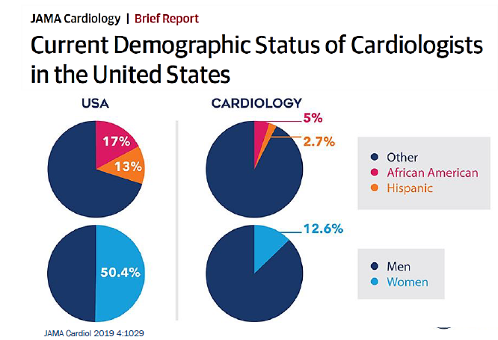
Med School:
~ 50/50
Int Med:
~ 55/45

Slide 29
Diversity = Better Outcomes
African American/Black, Hispanic/Latinx, and Native/Indigenous Americans are at an increased risk of CV disease and are less likely to receive high-quality, evidence-based medical care as compared with their White American counterparts.
Care provided by physicians from racially diverse backgrounds is associated with better quality, both for minoritized patients and for majority patients.
Not only is CV workforce diversity associated with improvements in health care quality, but racial diversity among academic teams and research scientists is linked with research quality.
https://doi.org/10.1161/CIRCULATIONAHA.121.053566 |Circulation. 2021;143:2395–2405

Slide 30
Taking Action towards More DEIB
A first step toward remedying the situation is to acknowledge the problem & commit to doing better.
Everyone can help! ACC and cardiology training program directors, academic centers, community hospitals, and even individual cardiologists.
Listen to trainees in internal medicine and cardiology; make sure that the voices of URMs are heard and attended to.
It starts at the Top! An integral focus of the mission of an Institution or Department
Modified from Douglas PS, Walsh MN. JACC. 2020;76(10):1223-1225.

Slide 31
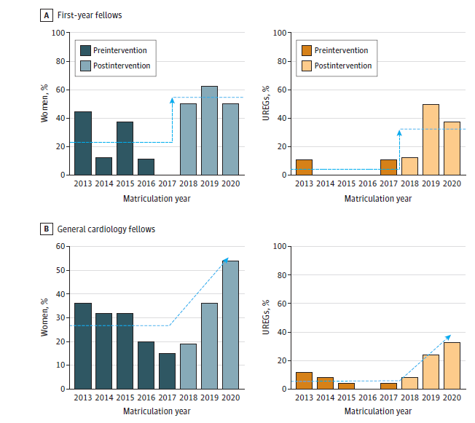
Effect of DEIB Intervention on CV Fellowship Recruitment & Composition
Rymer J JAMA Network Open 2021

Slide 35
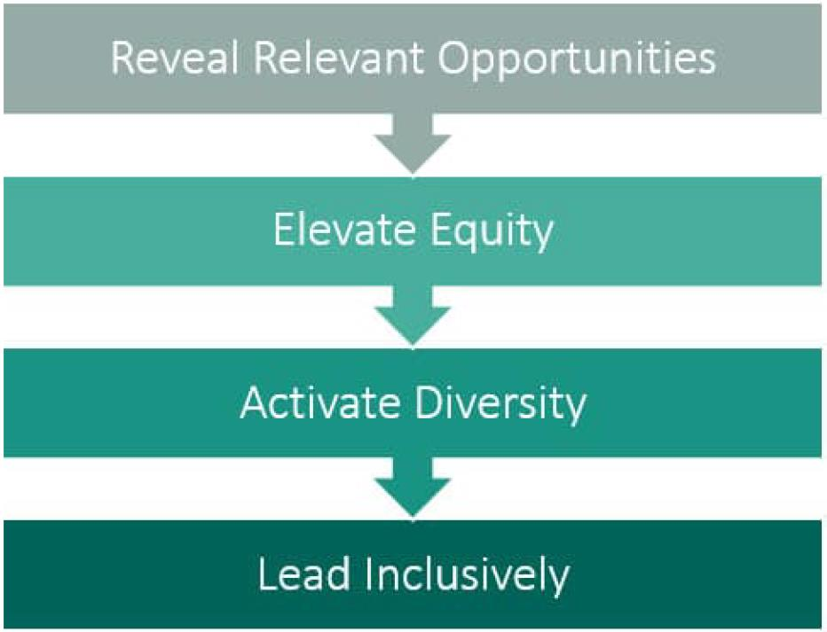
Overall Action Plan & Approach
View everything through a DEIB lens
Organizational and departmental recruitment
Fellowship Programs
Mentorship Programs
Research/Education
Image: Center for Creative Leadership’s REAL framework

Slide 36
Promote equal opportunities
Review Compensation & benefits equity
Review/update organizational policies
Image: Center for Creative Leadership’s REAL framework

Slide 37
An active process at every level
Include diverse holidays
Identify and initiate collaborative opportunities
Perfect “focused listening*” skills
*redirect what is going on inside of your head to what is actually being said.
Image: Center for Creative Leadership’s REAL framework

Slide 38
All domains of DEIB are essential to the Mission
Commitment from the highest level/top-down
Get buy-in
Be Inclusive
Focus on Onboarding /training
Image: Center for Creative Leadership’s REAL framework

Slide 39
Other Imperatives for Success
Dedicate resources –human, financial, political
Create interlocking DEIB entities that include Faculty Affairs, Data Analytics, Education, Communications, Marketing…
Embed DEIB in all personnel activities
Acknowledge and Reward DEIB sensitive behavior
Focus on Culture within your Department and the Institution

Slide 40
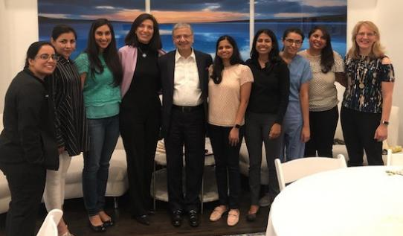
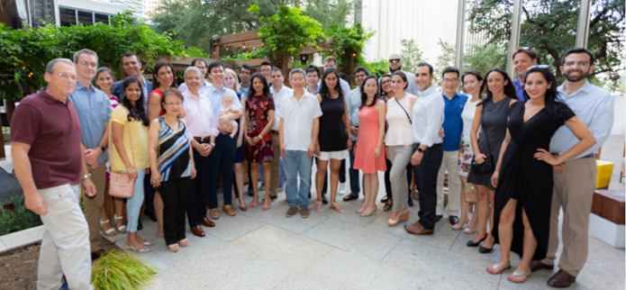
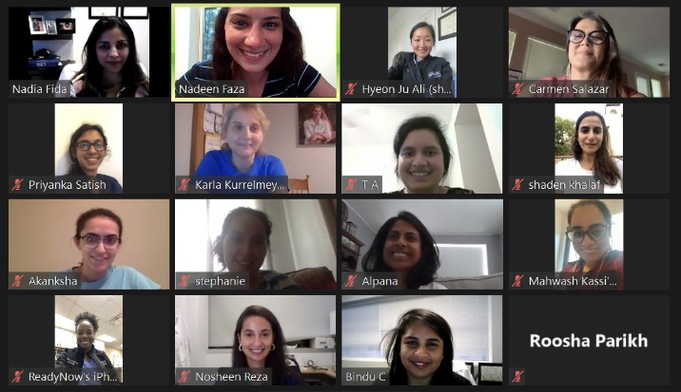
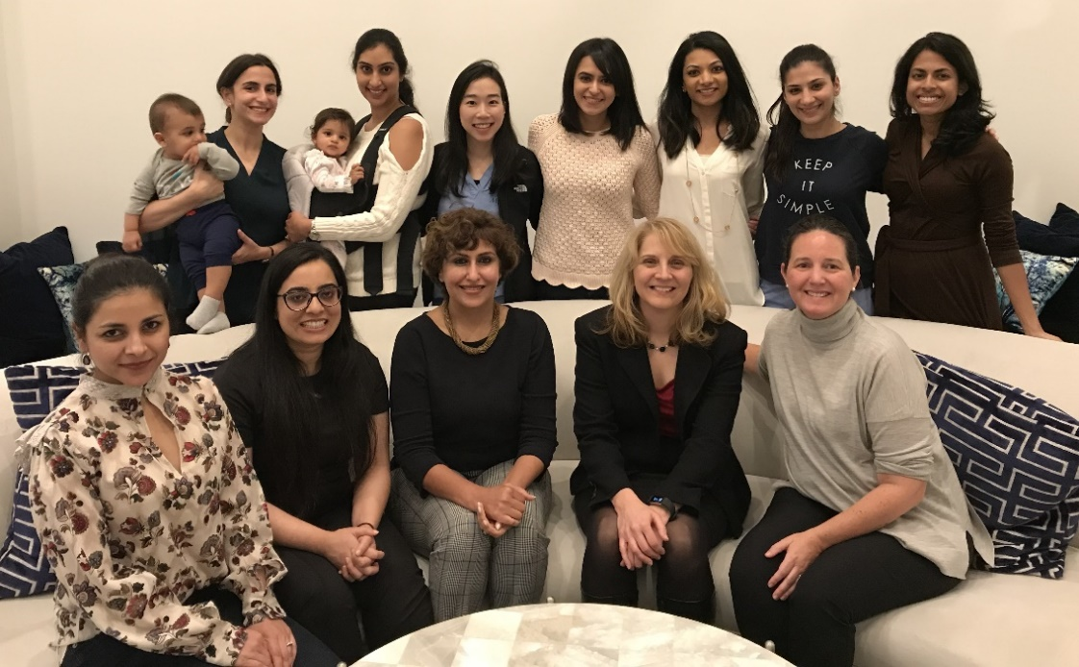
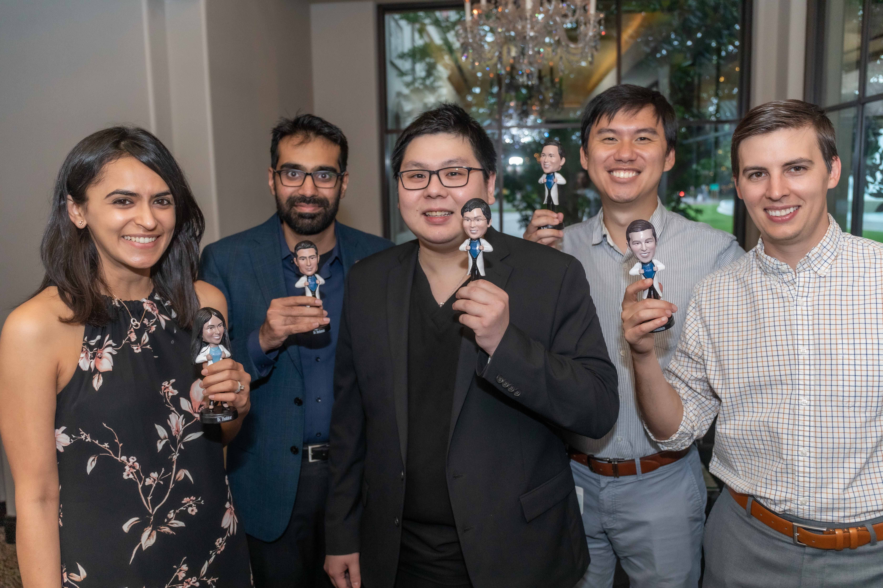
Promote Engagement, Inclusion & Belonging

Slide 41
Time for Action…

Slide 42
Power of Social and Digital Media in Amplifying Diverse Voices
Mirza Umair Khalid, MD, FACC
Assistant Professor of Medicine-Cardiology
Baylor College of Medicine
#ACCEarlyCareer Social Media Team

Slide 43
Outline
Global use of social & digital media
Role of social media in promoting DEI in cardiology
How other forms of digital media amplify diverse voices in cardiology

Slide 44
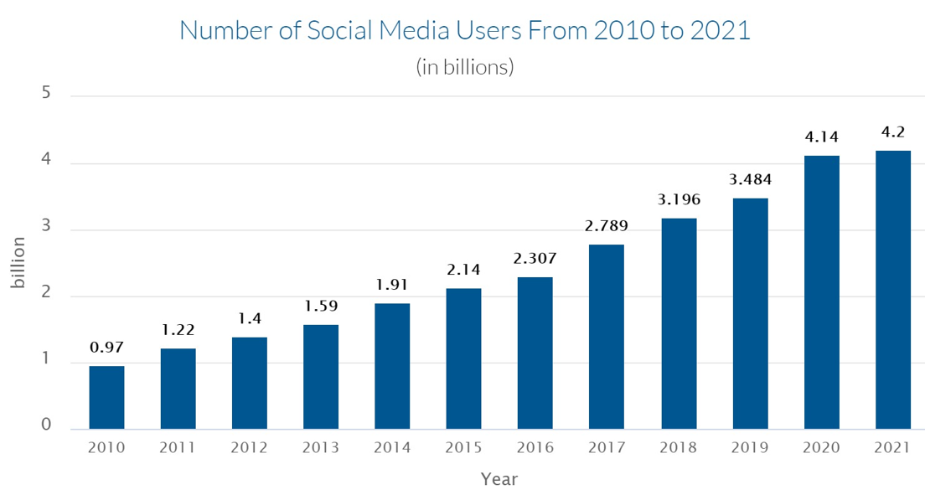
Source: Statista, Data Reportal, & eMarketer

Slide 45
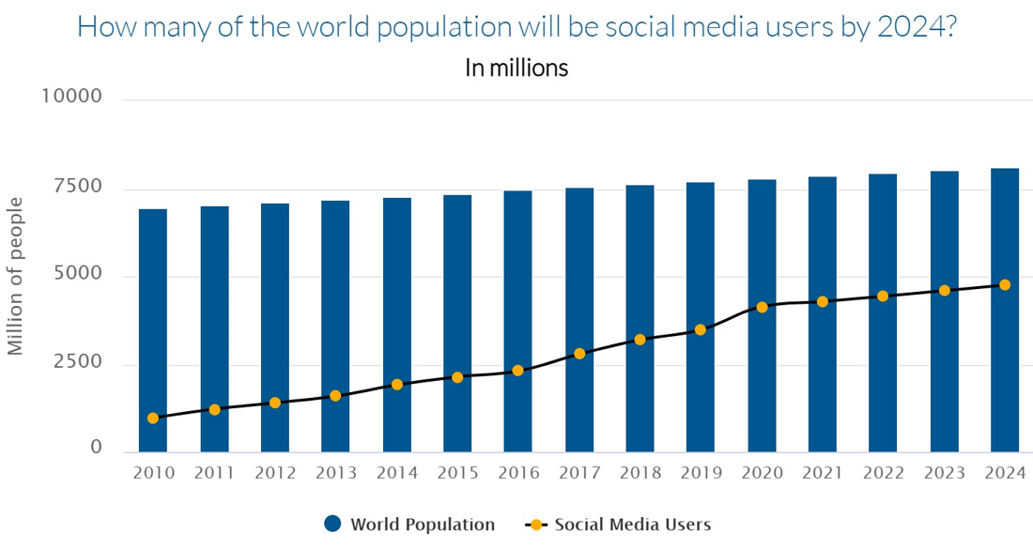
Source: Statista, Finances Online market projection
Notes:
55% penetration now, 60% projected penetration by 2024

Slide 46
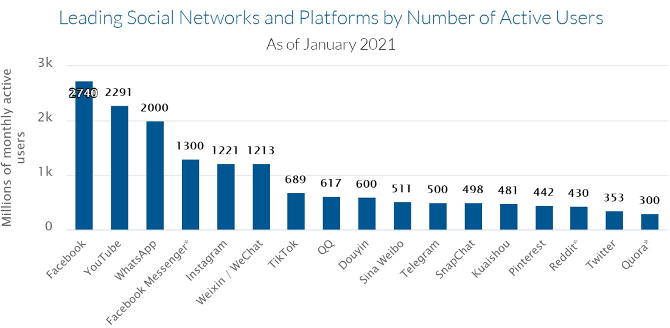
Source: Data Reportal, 2021

Slide 47
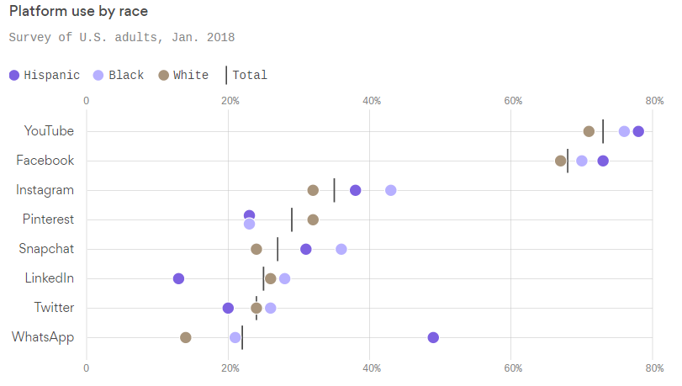
Use of Social Media usage by Race
The percentage of social media use versus the total population by race for the US population is:
80% Hispanic
77% Black
69% White
Source: PEW Research, Data Reportal, Brandwatch, Social media platforms & Kepio’s Analysis

Slide 48
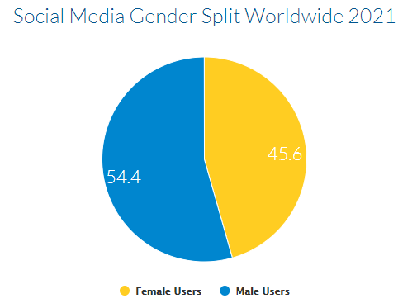
Gender distribution of social media audiences worldwide
Source: Data Reportal, Statista 2021

Slide 49
Social Media for Diverse Voices
Everyone on social media has a voice through an electronic device
Underrepresented populations may be using social media platforms even more
Tag anyone or any topic

Slide 50
Social Media for Diverse Voices
“…worldwide average of 2 hours and 25 minutes of time spent on social media spans the lowest of 51 minutes a day on average in Japan, and the highest of 4 hours and 15 minutes a day on average in the Philippines….”. Source: Data Reportal, 2021

Slide 51
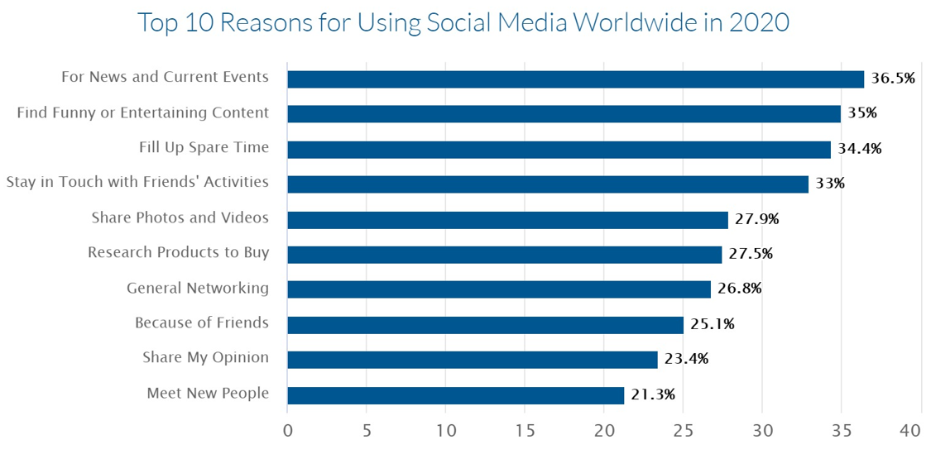
To Connect with others
Source: PEW Research, Data Reportal, Brandwatch, Social media platforms & Kepio’s Analysis

Slide 52
So far, we have concluded that:
A lot of people from all backgrounds spent time on social media (>4 billion users)
They spent a lot of time on Social Media
Most important reason is to connect with people with all backgrounds

Slide 53
How can diverse voices in cardiology be promoted using social media platforms
Share personal experiences (give us a window into what life really is like for people other than ourselves)
Community building
Proactive mentoring
Advocacy
Supporting scholarly success of diverse individuals (i.e. dissemination of success / research etc)

Slide 54
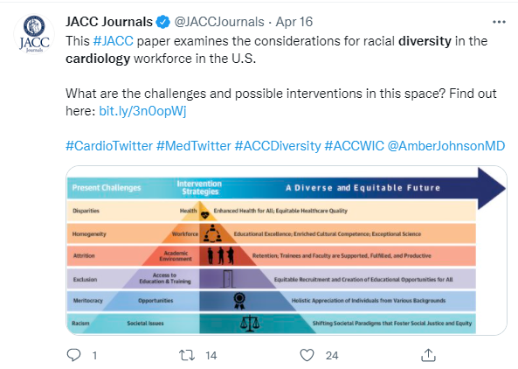
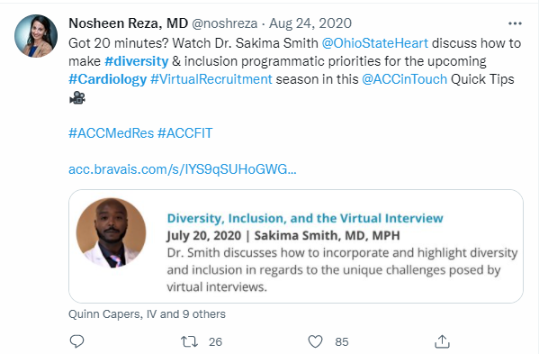
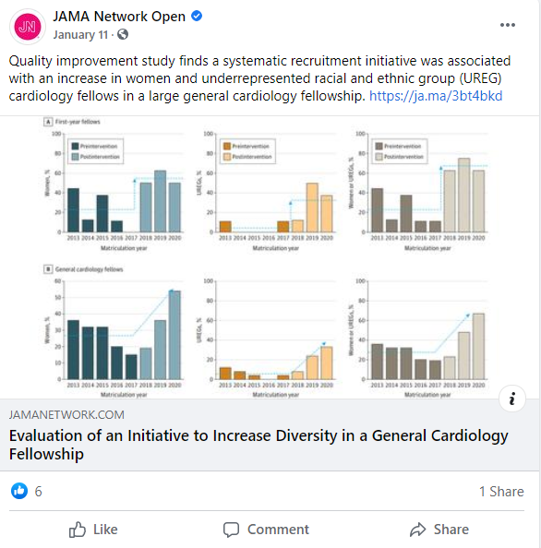
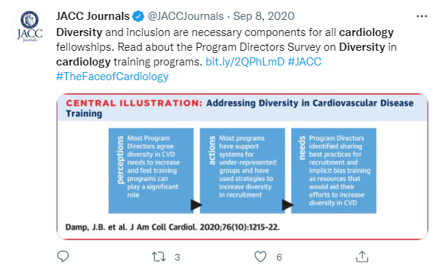
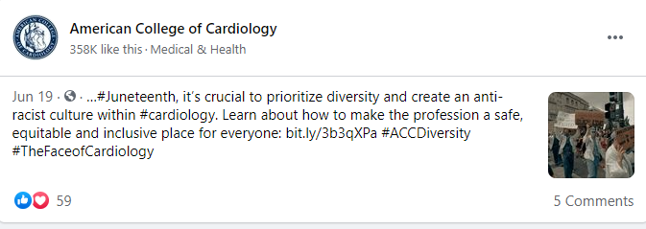
Role of social media to promote DEI in Cardiology

Slide 55
Role of other forms of digital media in amplifying diverse voices in cardiology

Slide 56
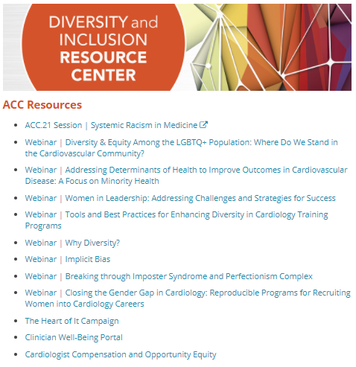
ACC’s mission to support DEI, using online tools

Slide 57
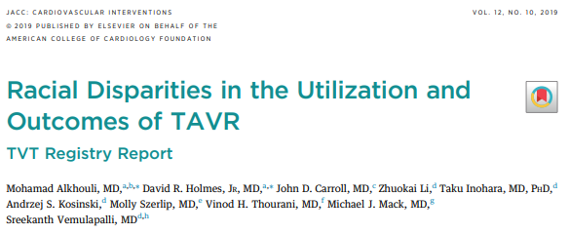
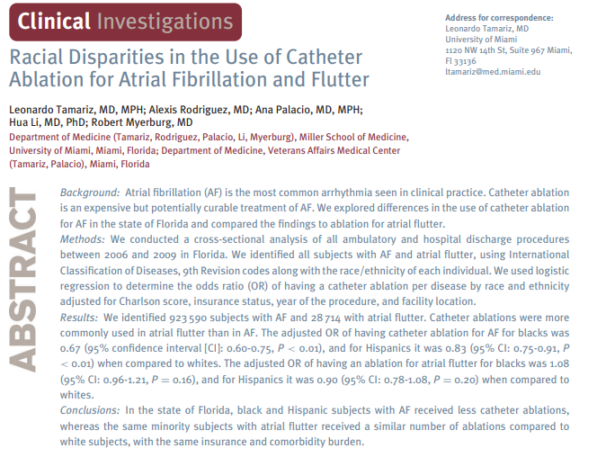
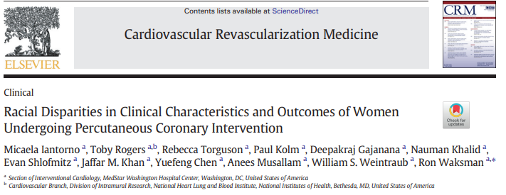
How digital media can highlight areas of health care disparities

Slide 58
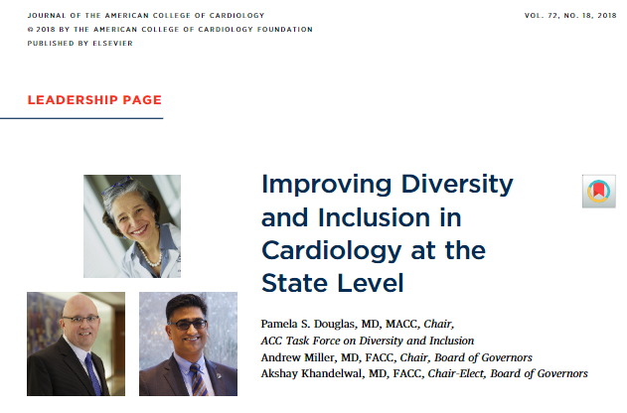
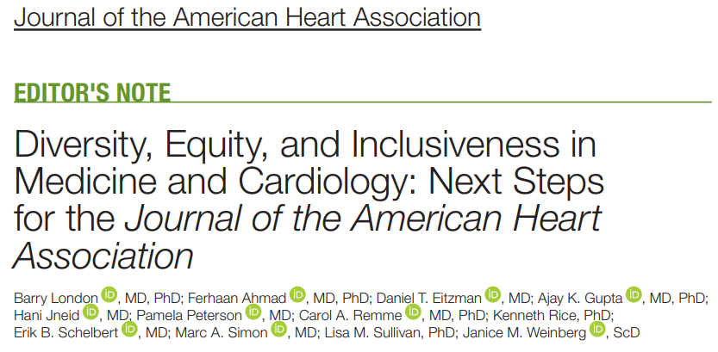
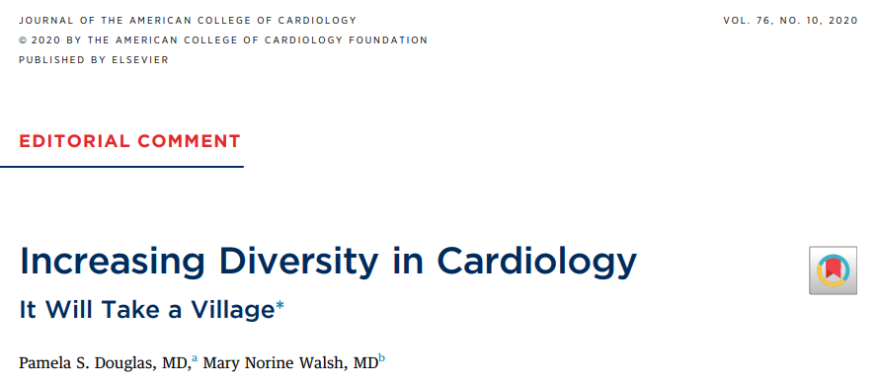
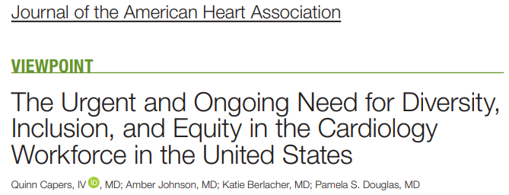
Scientific Literature promoting DEI in Cardiology

Slide 59
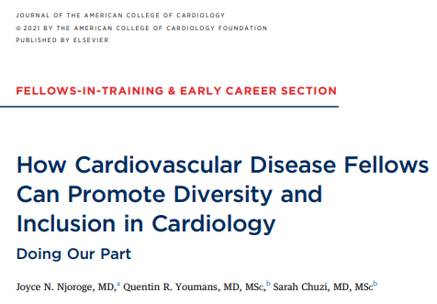
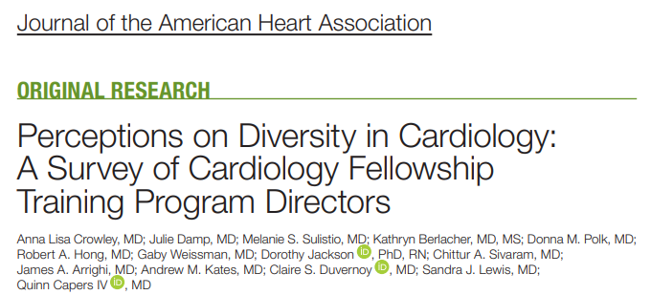
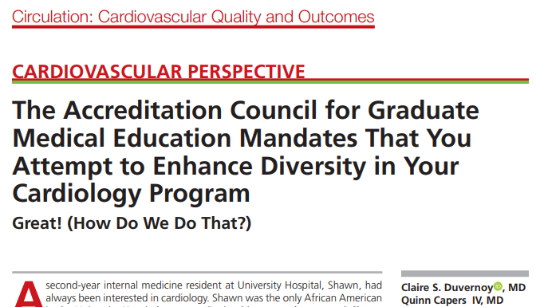
Promoting DEI in Cardiology Fellowship

Slide 60
Njoroge JN, et al. J Am Coll Cardiol. 2021 Sep 14;78(11):1188-1192.

Slide 61
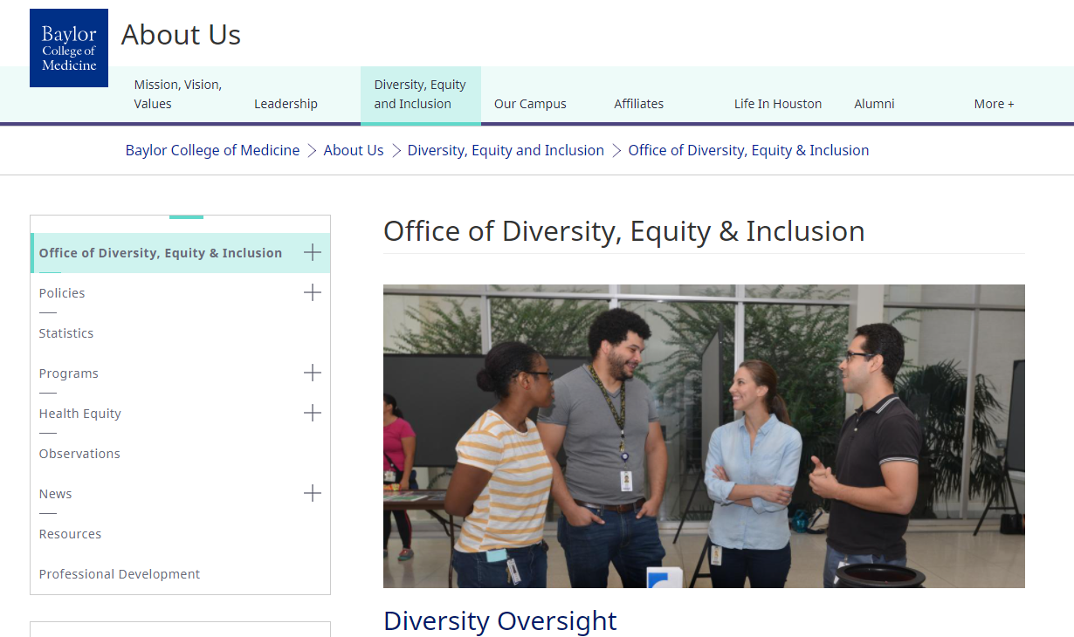
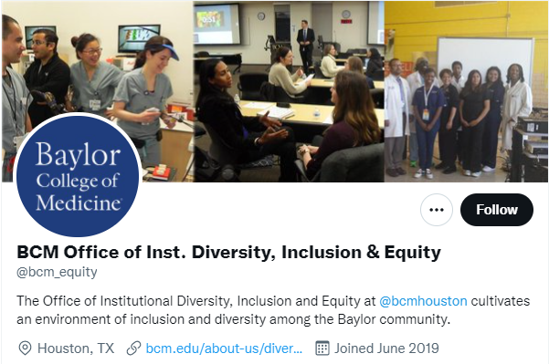
Promotion for DEI via digital media at an institutional level
https://www.bcm.edu/about-us/diversity-equity-and-inclusion/office-of-diversity-equity-inclusion

Slide 62
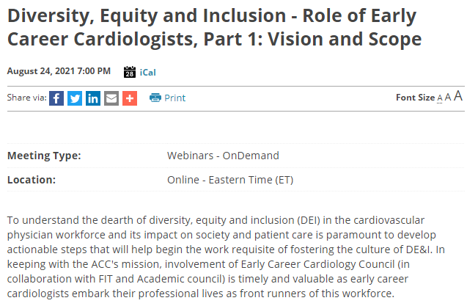
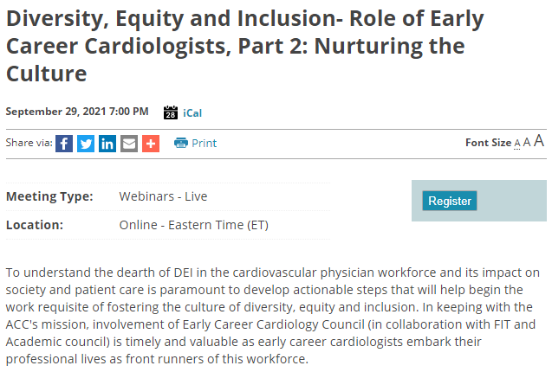
Webinars to promote DEI at Early Career Cardiology Level

Slide 63
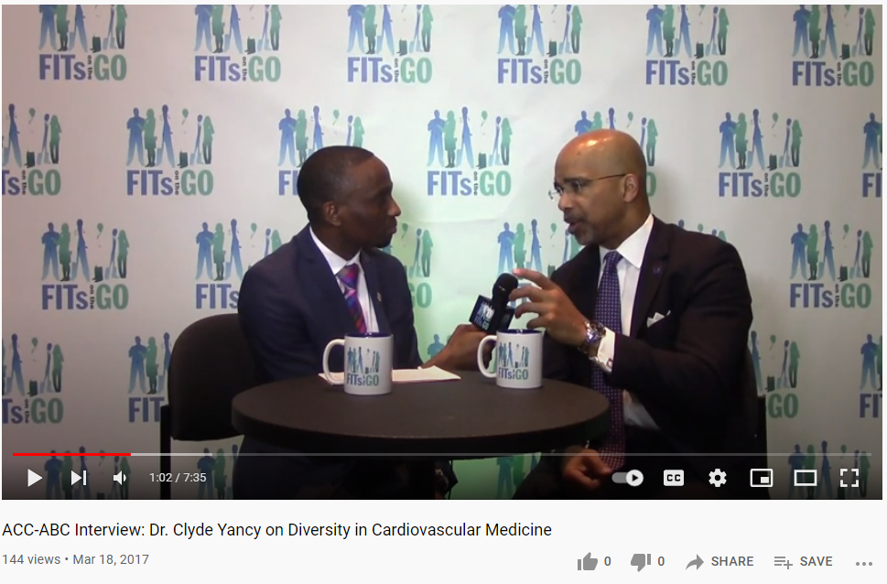
Use of online videos to promote diversity in Cardiology

Slide 64
Conclusions
Use of Social & Digital Media has expanded exponentially over the years
Urgent need for diversity, equity and inclusion among cardiovascular workforce should be addressed through these channels

