Slide 1
Building Respect, Civility, and Inclusion in the Cardiovascular Workplace
An Introduction to the 2022 ACC Workforce Health Policy Statement
Notes:
Speaker Note:
This presentation supports the 2022 ACC Health Policy Statement on Building Respect, Civility and Inclusion in the Cardiovascular Workplace and aims to provide an introduction and overview of the ACC principles for the augmentation of respect, civility, and inclusion, and minimization of bias, discrimination, bullying and harassment.
In commissioning this Workforce Health Policy Statement, ACC recognizes the breadth of the problem in cardiovascular medicine, its responsibility to address it, and accepts accountability for this work

Slide 2
Special Thanks To:
Slide Set Authors
Natalie Stokes, MD and Pamela S. Douglas, MD
2022 ACC Workforce Health Policy Statement on Building Respect, Civility, and Inclusion in the Cardiovascular Workplace Writing Committee
Pamela S. Douglas, MD, MACC, Co-Chair
Michael J. Mack, MD, MACC, Co-Chair
David A. Acosta, MD
Emelia J. Benjamin, MD, ScM, FACC
Cathleen Biga, MSM, RN, FACC
Lisa Jay-Fuchs, MSN, MBA, RN
Sharonne N. Hayes, MD, FACC
Nkechinyere Nwamaka Ijioma, MBBS, FACC
Akshay K. Khandelwal, MD, FACC
John A. McPherson, MD, FACC
Jennifer H. Mieres, MD, FACC
Robert O. Roswell, MD, FACC, FACP
Partho P. Sengupta, MD, FACC
Natalie Stokes, MD, MPhil
Enid A. Wade, JD
Clyde W. Yancy, MD, MACC
Notes:
Speaker Note: The writing group was co-chaired by Drs Douglas and Mack

Slide 3
Citation
This slide set was adapted from the ACC 2022 Health Policy Statement on Building Respect, Civility, and Inclusion in the Cardiovascular Workplace (Journal of the American College of Cardiology 2022).
The Statement was published ahead of print on March 17, 2022.
The published document is also available at: ACC.org/Guidelines.

Slide 4
Disclaimer
This slide set/presentation:
Is provided for informational purposes only and does not provide legal advice; please consult with your own counsel for legal guidance on compliance with applicable laws and regulations.
Sets forth best practices and recommendations of the writing group; please consult with your human resources, legal, management and other advisors before adopting policies set forth in this document.

Slide 5
Notes:
Speaker Note: This graphic illustrates the spectrum of behaviors and situations that are often present in the cardiovascular workplace.
The ACC believes that civil behavior and respect are inherent in its core values of Teamwork and Collaboration and Professionalism and are essential to its mission of “transforming cardiovascular care and improving heart health”. The Health Policy Document aims to provide the background, business case, and a foundational knowledge and guidance to help start addressing these uncivil behaviors and begin the journey towards Excellence. Emphasizing positive behaviors is a critical preventive step in reducing adverse behaviors and should be prioritized.
ACC also believes that all organizations and individuals providing cardiovascular care, education, and/or research should be familiar with the breadth and severity of negative consequences of the behaviors on the bottom section of this graphic and acknowledge their substantial adverse impact on well-being, patient safety, and organizational success.

Slide 6
Definitions
Bias
  A preference or aversion toward a person or category of person
Bullying
  An abuse of power or position. Deliberate, disrespectful and repeated toward a target to undermine, criticize, hurt or humiliate
  Not subject to legal ramifications unless it rises to the level of harassment or discrimination
Discrimination
  Inequitable treatment or impact of policies and practices promulgated by member(s) of group(s) upon member(s) of different group(s) that result in contrived advantages or disadvantages
Harassment
  Any conduct that is unwelcome to the targeted individual based on race, color, religion, sex (including sexual orientation, gender identify, or pregnancy), national origin, age, disability, or genetic information
Notes:
Speaker Note: So that everyone is on the same page, here are key definitions related to this health policy statement. Within the document itself there is a comprehensive glossary of terms to use as a resource.

Slide 7
Why a Statement on Respect, Civility and Inclusion?
Inherent in ACC core values of Teamwork, Collaboration and Professionalism.
Uncivil behavior is ubiquitous across the continuum of bias, discrimination, bullying and harassment (BDBH) and can have severe negative consequences of BDBH including adverse impact on well-being, patient safety, and organizational success.
Organizations and individuals must both contribute to be successful.
Notes:
Speaker Note:
Addressing bias, discrimination, bullying and harassment within cardiovascular medicine is of critical importance. These experiences are highly prevalent, regardless of individual or organizational demographics or locale and it’s not only the individuals or groups who are targeted for these behaviors who are harmed. Patient care outcomes can be adversely impacted when the environment in which cardiovascular team members learn and practice is hostile or non-inclusive. Organizations with high levels of uncivil behavior are at risk for increased staff burnout and turnover, higher employment and care costs, and are at risk for litigation.
The HPS document makes the case that addressing these behavior and creating a more welcoming and inclusive cardiovascular workforce is everyone’s responsibility- because it’s everyone’s problem. There is an important role for leadership, but also individuals, who must recognize that reporting uncivil behavior, practicing allyship and being upstanders can improve the work environment. Additionally, there is also a special role for the American College of Cardiology and other professional societies.
These organizational and individual changes and activities cannot happen without leadership support and their modeling a culture of respect and having an organizational structure with adequate resources that can be dedicated to addressing these behaviors. Those tasked to work in these structures must have proper subject matter expertise.
----------------------------------------------------------
Prevalence of BDBH [References]
1. Jaijee SK, Kamau-Mitchell C, Mikhail GW, et al. Sexism experienced by consultant cardiologists in the United Kingdom. Heart. 2021;107:895-901.
2. Mehta LS, Lewis SJ, Duvernoy CS, et al. Burnout and career satisfaction among U.S. cardiologists. J Am Coll Cardiol. 2019;73:3345-8.
3. Sharma G, Douglas PS, Hayes SN, et al. Global prevalence and impact of hostility, discrimination, and harassment in the cardiology workplace. J Am Coll Cardiol. 2021;77:2398-409

Slide 8
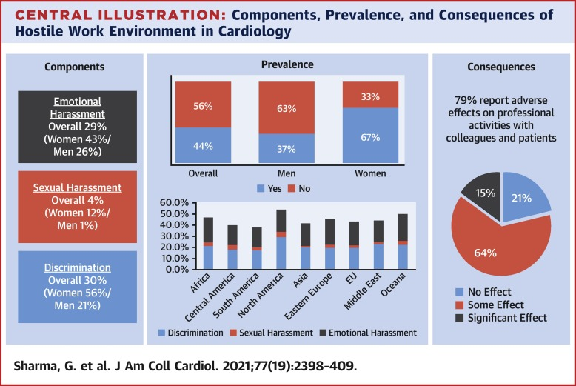
Hostile CV Work Environments Are Common Across the Globe
Notes:
Speaker Note:
Among the 12 principles set forth by the ACC is that it is essential for organizations and individuals providing cardiovascular care to recognize the ubiquity of uncivil behavior and the continuum of bias, discrimination, bullying and harassment which characterize it. The representative figure depicted is from a global survey analysis of nearly 6000 cardiologists done by Dr Sharma et al establishing a high global prevalence of bias, discrimination, bullying and harassment. Further, these uncivil behaviors have adverse effect on professional and patient interactions, influencing both well-being and patient care. This is reflective of data on hostile workplace environments in medicine at large, and specifically within cardiology.
Selected citations:
Sharma G, Douglas PS, Hayes SN, et al. Global prevalence and impact of hostility, discrimination, and harassment in the cardiology workplace. J Am Coll Cardiol. 2021;77:2398-409.
Grissinger M. Disrespectful Behavior in Health Care: Its Impact, Why It Arises and Persists, And How to Address It-Part 2. P T. 2017;42:74-7.
Averbuch T, Eliya Y, Van Spall HGC. Systematic review of academic bullying in medical settings: dynamics and consequences. BMJ Open. 2021;11:e043256.
Douglas PS, Rzeszut AK, Bairey Merz CN, et al. Career preferences and perceptions of cardiology among US internal medicine trainees: factors influencing cardiology career choice. JAMA Cardiol. 2018;3:682-91.

Slide 9
Principles #1-3: The ACC believes…
Civil behavior and respect are inherent in its core values of Teamwork, Collaboration and Professionalism and are essential to its mission of “transforming cardiovascular care and improving heart health.”
It is essential for organizations and individuals providing cardiovascular care, education, and/or research to recognize the ubiquity of uncivil behavior and the continuum of bias, discrimination, bullying, and harassment (BDBH) which characterize it.
It is essential for organizations and individuals providing cardiovascular care, education, and/or research to be familiar with the breadth and severity of negative consequences of BDBH and their substantial adverse impact on well-being, patient safety, and organizational success.
Notes:
Speaker Note:
These are the first three principles featured in the statement.

Slide 10
HPS Overview - 1
12 ACC Principles that support a culture of respect and efforts to reduce uncivil behaviors: The ACC believes…..
Background and significance
General approach to building respect, civility, and inclusion
  Special role of medical societies and the ACC
  Defining a meaningful response to Bias, Discrimination, Bullying, Harassment (BDBH)
  Institutional responsibilities and structures
  Institutional policies and environment
  Organizational consequences of inaction: Institutional harms, and legal considerations
Notes:
Speaker Note:
The ACC Health Policy Statement on Building Respect, Civility and Inclusion in the Cardiovascular Workplace include 12 principles that outline beliefs and recommended strategies and Best Practices to support a culture of respect And outlines a general approach to building respect, stability and inclusion in cardiovascular organizations and practices. This includes high level outlines of what is a meaningful ( as opposed to empty /in affect) responses to bias, discrimination, bullying and harassment as well as what structures and policies and procedures may need to be put in place in order to achieve goals.
This slide and the following list the outline of the HPS, beginning with a general approach (this slide) followed by (next slide)…

Slide 11
HPS Overview - 2
Strategies to address bias, discrimination, bullying, and harassment (BDBH)
  Education and training
  Unbiased, objective hiring strategies, evaluations, and reviews of individuals and departments
  Confidential reporting systems for BDBH with transparency, consequences, and support for targeted individuals
Web resources and tools. See www. ACC.org/Guidelines
  Bibliography
  Slide decks
  Advice to people who feel they are experiencing uncivil behavior
  Sample policies
  More!!
Notes:
Speaker Note: …..specific strategies to address BDBH
Importantly, in addition to the document, there are a suite of web tools and resources available at ACC.org/Guidelines that include….

Slide 12
Building Respect, Civility, and Inclusion Requires Contributions From Organizations….
Organizations should ensure freedom from BDBH in their fabric and values, including policies, procedures, and programs.
Leadership should work to establishing a culture and climate of respect including the elimination of harassment and bullying
Essential components include:
  Commitment: Strong visible
  Planning: Strategic, including longitudinal goals and metrics
  Dedicated structures and resources (financial and personnel)
  Subject matter expertise
Notes:
Speaker Note: Organizations and their leaders need to establish that they value respect, teamwork, and civility in work-related interactions and will not tolerate their absence.

Slide 13
Notes:
Speaker Note: this graphic represents a number of the components, both of foundations and the pillars necessary to start the journey of improving organizational climate, promoting diversity, equity, inclusion, and belongings and eliminating bias, discrimination, bullying and harassment in our organizations. The ultimate goal is a positive, respectful culture and climate.
Foundations include (read horizontal bars) and pillars include (read vertical bars)

Slide 14
Principles #4-5: The ACC believes…
Organizations providing cardiovascular care, education, and/or research should prioritize ensuring freedom from BDBH in their fabric and values, including policies, procedures, and programs. Establishing a culture and climate of respect includes eliminating harassment and bullying and ensures that the workforce has the necessary skills to achieve these aims.
Individuals engaged in cardiovascular care, education, and/or research should actively work to ensure freedom from BDBH in their own personal behaviors and actions and seek to assist others in creating an environment free from BDBH, including practicing allyship and upstander behaviors, and supporting institutional efforts.
Notes:
Speaker Note:
These are principles 4 and 5 featured in the statement.

Slide 15
Organizational Policies and Procedures
Statement of commitment
Addressing patient-initiated BDBH
Definitions & scope
Anticipated harms
Enforcement roles & regulations
Reporting & monitoring with prohibition of retaliation
Notes:
Speaker Note:
To optimally support and improve anti-BDBH efforts in cardiovascular practices and organizations, certain structures, expertise, and accountabilities must be in place. The ACC holds that organizations providing cardiovascular care, education, and/or research should have a set of effective, clear, and implementable policies and procedures to address workplace BDBH which follow established best practices. These policies should include a statement of commitment, definitions and scope, anticipated harms, enforcement roles and responsibilities, reporting and monitoring with prohibition of retaliation, and address patient-initiated BDBH

Slide 16
Subject Matter Expertise
Importance of respect and civil behavior
Principles of diversity, equity, and inclusion
Human relations
Personnel management
Title IX and mandatory reporting
Regulatory (ACGME), accreditation (TJC) and funding (NIH) policies and requirements
Educational design
Communications
Notes:
Speaker Note:
Structure(s) to support mutual respect and reduce BDBH should be consistent and integrated across the organization or practice, leveraging centrally located resources and subject matter expertise to inform action. Areas of subject matter expertise essential to optimizing organizational proficiency include…

Slide 17
Principle #6: The ACC believes…
Successfully addressing BDBH requires a dedicated organizational structure which has strong support from leadership and adequate financial and personnel resources. It also requires subject matter expertise in human relations and personnel management; familiarity with legal/Title IX and other relevant regulatory, accreditation and funding policies; data access and analytics, educational design; and the principles of diversity, equity, and inclusion & belonging.
Notes:
Speaker Note:
This is principle 6 featured in the statement.

Slide 18
Principles #7-8: The ACC believes…
To effectively address workplace BDBH requires a comprehensive initiative supported by:
    A strategic plan
    Longitudinal metrics
    Complete and accurate data collection
    Transparent reporting of results
    Tracking progress to inform future policy and interventions.
Independent evaluation of institutional culture and efforts to reduce BDBH is strongly encouraged.
Organizations providing cardiovascular care, education, and/or research should have a set of effective, clear, and implementable policies and procedures to address workplace BDBH which follow established best practices.
Notes:
Speaker Note:
These are the principles 7 and 8 featured in the statement.

Slide 19
Building Respect, Civility, and Inclusion Requires Contributions From Individuals…
Individuals should ensure freedom from BDBH in their own personal behaviors and actions and assist others by practicing allyship and upstander behaviors, and by supporting institutional efforts.
Individuals should work to establishing a culture and climate of respect including the elimination of harassment and bullying
The workforce must have (and be able to use) the necessary skills and tools to achieve these goals.
Notes:
Speaker Note: For cultures of civility to thrive at an organizational level, individuals need to have awareness of their own behaviors, and further practice allyship and upstander behaviors. Tools to empower individuals should be made readily available and known…
Definition of upstander: An individual who actively defends a cause or belief or intervenes when someone is being bullied, mistreated, or is the target of a microaggressor/harasser; distinct from a ‘bystander’ who witnesses incivility or BDBH but takes no action.
Citation:
Yarbrough J. From the schoolyard to the bullpen: bullies in the workplace. Medical Economics. Available at: https://www.medicaleconomics.com/view/schoolyard-bullpen-bullies-workplace. Accessed: June 6, 2021

Slide 20
Notes:
Speaker Notes
The A.C.T.I.O.N. framework is a practical communication (Speak-Up) approach which can be used by targets or witnesses of microaggressions, racist or discriminatory statements. It is less useful for true bullying and harassment. Here’s what the letters stand for and some examples:
A- Ask clarifying questions to help understand the intention e.g. “I would like to understand what you just said. Are you saying that …”
C – Curiosity instead of judgment: this involves actively listening to the explanation provided. If a different meaning is provided than what was originally perceived by the witness/target, the conversation can be ended. However, if a “backtracking” explanation is provided, consider making a statement to explain how the original statement is uncivil e.g. “It is great to learn that I misunderstood your initial statement, because as you know, such statements can be …” If the speaker agrees with your paraphrased statement, then continue the conversation to further explore the intent behind their statement e.g. “Please help me understand what you hope to convey with that statement”
T- Tell the facts you observed: e.g. “I observed that …”
I – Intention vs impact: ask or state the potential impact of the statement/action on others e.g. “Such a statement makes people think/assume…. “
O – Own your thoughts, share your reactions: e.g. “Your statement makes me think/feel …”
N – Next steps: request appropriate action to be taken e.g. “I’d appreciate it if you would refrain from stating xxx or using the terms xxx as it is inappropriate (unhealthy/uncivil)”
Reference – Brooks-Hurst E. Responding to microaggressions in the classroom. Diversity, Equity, and Inclusive Teaching Initiatives at Texas Tech University. Available at: https://www.depts.ttu.edu/tlpdc/Responding_Microaggressions_Handout.pdf Accessed February 21, 2022

Slide 21
Specific Programs Addressing BDBH
Each organization should have robust education/training designed to reduce BDBH for all individuals, especially leadership
Performance reviews and hiring and promotions processes should
  Assess respect and civility
  Reward those showing excellence in behaviors that reduce BDBH
Each organization should have mechanisms for comprehensive and confidential reporting and investigation of incidents without retaliation
Notes:
Speaker notes:
Specific programs are critical to accomplish the goal of building a culture of respect and reducing toxic behaviors. Programs must include specific action items such as education, unbiased reviews, and confidential reporting. There is no “one size fits all” for all organizations, the basic tenets are consistent.
Education and awareness is essential. Some specific things to offer include: Implicit bias testing, training and mitigation, as well as upstander and allyship training.
Performance reviews and reporting and investigation mechanisms are necessary and to speak on this further…

Slide 22
Notes:
Speaker notes: Improving the evaluation process to reduce bias in performance evaluations can be labor-intensive and time-consuming; organizational and institutional support of these initiatives is crucial.
Cycle of improvement in hiring and promotions: Prioritizing diversity improves the work/training environment, resulting in improved staff retention and more equitable opportunities for advancement. This results in a positive feedback loop, with more diverse and effective recruitment/selection committees, leading to continued improvement of the clinical and training environment.
Citations:
McKay PF, Avery DR, Tonidandel S, et al. Racial differences in employee retention: Are diversity climate perceptions the key? Pers Psychol. 2007;60:35-62.

Slide 23
Notes:
Speaker Notes:
A Just Culture matches the response to the behavior, including escalating response when behavior is repeated despite prior notification. (horizontal axis; Escalating Concerns and Culpability).
Responses can range from recognition and reward for positive behaviors, through documentation, coaching, warnings and suspension/termination. (vertical axis; Escalating Consequences and Corrective Actions)
Behavior that is egregious, reckless, or intentional escalates the response. (center dotted arrows)

Slide 24
Notes:
Speaker notes:
Data collection needs to be performed regularly, be accurate and complete, and preserve confidentiality. Data analytics are essential to ensure the creation of actionable knowledge and conclusions from the results.
Institutions can collect BDBH data from trainings, multi-rater reviews, exit interviews, climate studies.
Regularly issued reports should be transparent, widely accessible and substantive, providing sufficient detail to evaluate progress. Such evaluations are essential to guide future planning/efforts while transparency helps to ensure visibility and engagement.

Slide 25
Principles #9-11: The ACC believes…
Each cardiovascular organization should promote objectivity, minimize bias, and ensure holistic review in hiring, evaluations, and departmental/program/center reviews by creating systems, procedures, and educational offerings enabling these goals, including readily available central resources.
Performance reviews (and related incentives) should routinely include assessments of personal behaviors related to respect and civility as well as support for institutional goals and initiatives addressing BDBH. Those who are exemplary in promoting and achieving excellence in reducing BDBH should be identified and celebrated.
Each cardiovascular organization should provide comprehensive, safe, fair, transparent, and confidential mechanisms for reporting incidents and investigating individuals and departments suspected of BDBH, without retaliation for those reporting or targeted by BDBH.
Notes:
Principles #1 and #2

Slide 26

Principle #12: Special Role of Professional Societies
Professional societies such as the ACC set standards of excellence, build communities and culture, and ensure professionalism.
Excellence and professionalism must extend to addressing BDBH.
The ACC welcomes this responsibility to lead and serve members by providing education, developing tools, and creating resources as needed to address BDBH.

Slide 27
Additional Resources
For more tools and resources, visit:
ACC.org/Guidelines
See especially the slide deck on
“Putting It Into Practice: Case Presentations and Discussion Guide”
Notes:
Speaker notes:
For engagement with case presentations and discussion guides, please access the slide deck on “Putting It Into Practice: A Case Discussion Guide.”
These cases are means of prompting opportunity to discuss the issues of the specific case related to BDBH, options for actions, including short and long-term risks and benefits to cardiovascular organizations

Slide 28


Slide 29
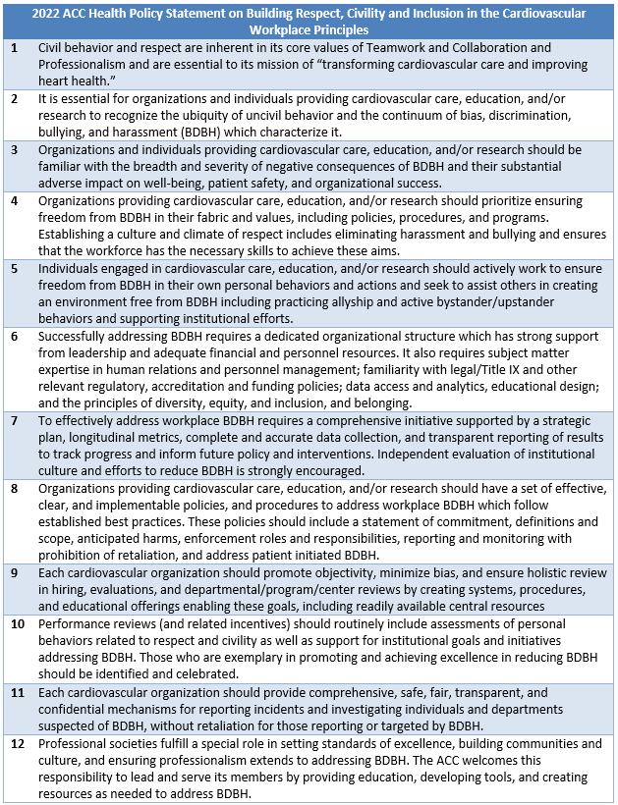
ACC Principles on Building Respect, Civility and Inclusion in the Cardiovascular Workplace
Notes:
Speaker Notes:
Listing of guiding principles incorporated in this ACC health policy statement

Slide 30


