Slide 1
Teaching in the Clinical Setting, Part II:
Using effective questioning to support learning and involve learners of all levels
Christy Kaiser, MD, FACC
MedStar Washington Hospital Center and Georgetown University Hospital
Associate Program Director of the Cardiovascular Disease Fellowship Program
Assistant Professor, Georgetown University School of Medicine
In conjunction with:
Dr. Tara Coles, Dr. Huzaifa Ahmad
No disclosures
Notes:
This is Part 2 of 2 of the Teaching in the Clinical Setting presentations. This part is on the use of effective questioning in clinical medicine, and gets more into detail of how we actually do the work of teaching.
Comments in the Notes section that are for the presenter and are not meant for part of the narration to the audience will be in italics. Almost all the slides in this set are animated to pull each teaching point in one at a time. You can click on “Animations” at the top of the Powerpoint platform to show the animation numbers listed on the slide. In this Notes section of the slides, there will be a number listed in parentheses next to each paragraph that shows which part of the slide text that narration correlates with. Text listed at the beginning of the Notes section without a number is to introduce the slide before getting started with the animated bullet points.
This class is given using the flipped classroom model. The pre-work assignments for this class were to:
Read the article ”12 tips for effective questioning in medical education.”
Read the article “The One Minute Preceptor: 5 Microskills for One-on-One Teaching” and then write a teaching script for one topic using this model.
Review the multilevel teaching techniques described in the article “Effective multilevel teaching techniques on attending rounds: A pilot survey and systematic review of the literature,” and then write down some examples of the “broadening” and “targeting” techniques.

Slide 2
Create a safe space for questioning
Explain early how you will use questioning
Ask questions at an appropriate level
Allow learners to ask for help or say I don’t know
Prompt when they don’t know an answer by starting with something they do know.
Nonverbal communication showing support
Notes:
There’s no doubt that the Socrative method is an effective way to teach; it’s a form of active learning. Studies have shown that if you ask the learner a question and they get it wrong, they’re more likely to remember it than if you ask them and they get it right, or if you were to not ask at all and just tell them the answer. So I think there’s something to be said for that little bit of pressure you feel when you have to verbally commit to an answer in front of others, but the key is to use questioning in a way that doesn’t tip over into the pimping or prodding approach, where the learner feels intimidation or significant embarrassment.
(1) A good way to start creating a safe space for this type of teaching is to state directly at the beginning what the learner can expect, and why you will be using this way to teach. So as I mentioned in Part I of Teaching in the Clinical Setting, when I set expectations for the learners, I tell them that I will teach by asking questions, and that if they get all the questions I asked right, that means I haven’t really taught them much. So there’s no reason to feel embarrassed about not knowing all the answers…that’s part of the learning process.
(2) In addition to setting the right stage at the beginning, of course we need to ask questions at the right level of difficulty, that are ultimately achievable and understandable for that level of learner.
(3) When a learner doesn’t know, a quick nod, or “That’s ok” can maintain the right tone
(4)) And then ideally, when the learner doesn’t know the answer, you can back up by asking the learner a question they are likely to know…and then lead them to the right answer
(5) Again, a nod or a smile (if unmasked) can go a long way to making the learner comfortable.

Slide 3

Use questions to “scaffold” learning
Scaffold = building support for the learner
Where is the learner starting? (Identify knowledge gaps.)
Where do I want my learners to be?
What questions can I ask that will help learners fill in knowledge gaps?
Notes:
Now that we’ve established a safe learning space, let’s get to how we will actually do the teaching. The article you read talked about scaffolding.
1) Scaffolding means to build support for the learner to lead them to understanding.
2) To build that scaffold we need to know “Where is my learner starting?” And “Where do they need to be at this stage of training?” The only way to know where a learner is starting is to ask them. So start with open-ended questions. Simply – What do you think? This also gets at the first step in the One Minute Preceptor (OMP) model of getting a commitment.
3) Once you realize where the flaw in the learner’s reasoning is, the best option if time permits is to ask them further questions to help them see these flaws, rather than just telling them the answer. Help them build a bridge from where they are to where you want them to be.

Slide 4
Scaffolding: Where is the learner starting?
Make sure the learner gives an assessment: “What do you think?”
  If learner jumps to the plan, ask them to take a step back
Give sufficient time for the learner to answer
  Uninterrupted silence for at least 3 seconds
Follow up your first question with a second one
  Based on learner responses, should I go back (reteach)
  or forward in my teaching?
Notes:
A few more comments on how to assess where the learner is starting.
First, make sure they give an assessment. Sometimes I find the learner will come to the A/P and forget the assessment part. For example they may say something like …”This 56y F with x,y,z, comorbidities presents with chest pain for 2d. And… I think we should order a stress test.” In that case my next question would be – “Ok so I hear your plan of doing a stress test, but what is your assessment? What do you think is causing the chest pain?” Because maybe this is someone in clinic and I think the patient is very low risk, with atypical chest pain, and we could first try reassuring the patient and suggest not doing further work up. So by asking the learner what they think is causing the chest pain, I can find out – does the learner actually think this atypical pain is likely ischemic because they don’t remember the characteristics of typical angina? Or do they recognize this is unlikely to be ischemia but think that all chest pain warrants some type of ischemic eval regardless of how low risk it may seem? These different possibilities would lead your teaching focus in very different directions.
Secondly - When trying to assess where the learner is starting, give time for the learner to think. Studies have shown on average educators give learners only one second to give an answer before they chime in. Waiting just 2 seconds longer will lead to a longer, more complex learner response that gives you more information about what the learner actually knows or doesn’t know.
(3) Most often, the most effective teaching approach is to follow up the learner response with another question rather than to just tell them the right answer. The learner’s response to the first question will help you decide what that second question should be. In other words, do you need to go back and teach a more fundamental concept first, or go forward because they already have a clear understanding of the first point?

Slide 5
Scaffolding: Bridging to where the learner should be
Tips for follow-up questions:
Whether right or wrong, ask “Why…?” (Why the learner came to that conclusion.)
For right answers: Nudge the learner further.
  What evidence do we have to support adding this medicine?
  “What if…?” questions: Invent a more challenging scenario
Notes:
Now after we get that initial response and commitment, how do we go about bridging the learner to the next level with our follow up questions?
First - whether the learner answers rightly or wrongly, make sure you understand why that is their answer. This is along the lines of the point from the last slide about understanding the assessment, not just the plan. This may require a 2nd question if the learner hasn’t already explained their thought process. So to use our earlier example again, something like E.g. “Why do you think we need a stress test?” Or “What do you think is causing the chest pain?”
For right answers you can then nudge the learner to the next level such as by…
Asking “What evidence do we have to support this practice?” E.g. Maybe when discussing a patient with heart failure, the learner suggests adding a beta blocker. You might say “That sounds like a good plan. What evidence do we have for doing this?”
Or use a “What if…?” question to ask about a more challenging scenario. For example, “What if this patient used cocaine, would you still recommend a beta-blocker?”

Slide 6
Scaffolding: Bridging to where the learner should be
Tips for follow-up questions:
Whether right or wrong, ask “Why…?” (Why the learner came to that conclusion.)
For wrong answers, you might:
  Ask about data that don’t fit
    How do you explain “x”?
  Ask the learner to take a step back.
    What other possible explanations are there for the presentation?
    What other options are there to work-up the problem?
  Ask the learner to think forward
    How will results of that test change your management?
Notes:
For wrong answers, here are a few strategies you can use to help the learner recognize the flaws in their reasoning:
2) Ask about data that don’t fit: Let’s say a patient is admitted with heart failure, very volume up, with AKI, and you have asked “What is causing the AKI?” and the learner says, “I think they are pre-renal because the urine lytes suggest they are pre-renal.” You might ask, ”Pre-renal meaning you think the patient is dehydrated?” That alone may be enough for them to see a flaw in their logic. But if they answer ”yes,” you can ask “Ok, so how would you explain the JVD and edema on exam?”
3) Ask the learner to take a step back in their reasoning and think more broadly before anchoring on an answer.
4) If the issue is a wrong diagnosis, ask them to consider other possible diagnoses to explain a patient’s presentation. E.g. Let’s say a patient presents with volume overload and has a normal EF, and the learner concludes that they have diastolic heart failure. However, you may think based on reviewing the echo that the patient has right heart failure from pulmonary arterial hypertension. You might say – “It’s true that diastolic dysfunction is a common cause of clinical heart failure when the EF is normal. But this is mainly a diagnosis of exclusion. So what are some other possibilities that we should consider first?”
5) Or, if the issue is a suboptimal plan for diagnostic testing, ask the learner to consider alternative testing options. For example, if a patient presents with chest pain and the learner suggests getting a stress test, but you think the patient is very high risk and so anatomic evaluation of the coronaries is the best approach, you might say “Ok a stress test is one option, and many people would go with that. But what other options do we have to evaluate chest pain and what would be arguments for or against choosing one of those?”
6) A third approach is to ask the learner to carry their thought process a few steps further, to lead them to the flaw is in their reasoning.
7) This is a good approach if a learner wants to order what you feel is an unnecessary test, or a suboptimal test for that setting. To take the example of the patient with typical chest pain who you feel would be best served by having an anatomic evaluation of the coronaries, but the learner suggests a stress test…you might ask, ”OK, lets say we do the stress test. If you get the stress test back and its abnormal, what will be your next step?” The learner will hopefully answer: “left heart catheterization.” Then you can follow up with, “And what if the stress test comes back negative, then what will you do? Are you comfortable sending the patient home?”
So to summarize these different approaches: You can ask the learner about data that don’t fit, ask them to take a step back and expand their options, or ask them to think forward to figure out if what they are suggesting will really get them to where they want to be.

Slide 7
Know when to stop questioning
Learners may be unable to answer questions even with prompts. At that point, options include:
Ask another (more senior) learner to explain.
Ask the learner to research it and report back.
Step in and explain the answer.
Notes:
But all that being said, there may arrive a point where the learner is just not understanding, or time simply doesn’t permit further efforts to continue the conversation. In that case, the educator can switch gears and use one of the following options:
Ask a more senior learner to explain the answer. This will keep the more senior learner engaged.
Ask the learner to research the problem and report back. This may be a good option if the learner has quite a large knowledge gap and time does not permit you to explain adequately on rounds; or to encourage the learner to take more initiative in their learning. The key though is to circle back with that learner later to follow up on what they learned.
Or of course you can simply explain the answer yourself.

Slide 8
The One Minute Preceptor Method
Notes:
Now we’ll switch gears slightly to talk about the OMP model, which we can use as a framework within which to ask these questions.

Slide 9
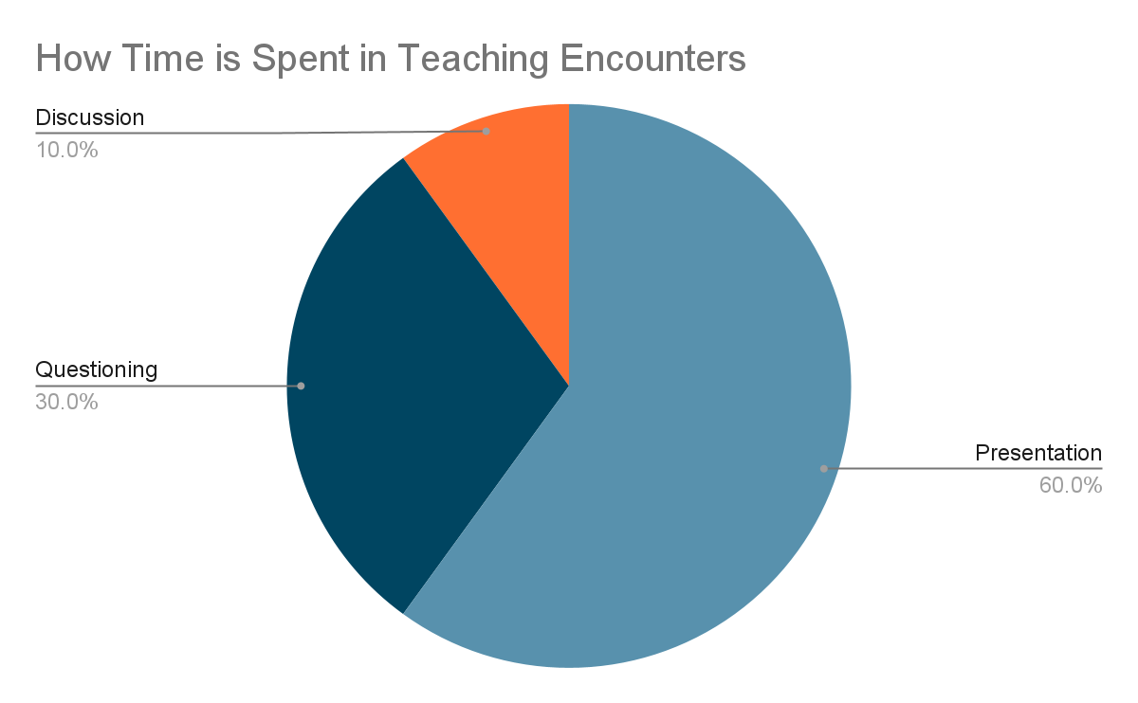
“The One Minute Preceptor: 5 Microskills for One-on-One Teaching”
Notes:
The OMP model originally was designed based on data showing that the average discussion about a patient in the clinic or hospital setting lasted 10 min. Most of the time – about 60% - was taken with the learner presenting information about the case. Another 30% was taken up with the attending asking clarifying questions while they developed their own opinion on what the plan should be. And then 10% of the time on average, or about 1 minute, was used for discussion and teaching about the case.
The reality is that depending on how deep into the subject matter you go, it would be very possible to spend much more than one minute using the strategy outlined here, but the idea is to have an efficient framework for teaching.

Slide 10
The One Minute Preceptor Method
Get a commitment
  “What do you think?”
Probe for supporting evidence
  ”Why do you think that?”
Reinforce what was done well
  Building a safe space
Give guidance about errors and omissions
  Ask about data that don’t fit, ask the learner to take a step back, or think forward
Teach a general principle
Notes:
You all read about these steps already, so we’ll just review them briefly here as a reminder. Who can tell me the first step? Etc…
(Here, each step is shown after it’s said by one of the learners in the audience. The bullet point below each numbered step is to tie in the questioning techniques we just discussed to the steps of this model. Ultimately we are trying to teach one cohesive approach to teaching.)

Slide 11
Brief role play of teaching scripts
Notes:
One option for how to do this:
You the presenter play the role of the learner. (You should have picked out a few scripts in advance and thought about how to play the part realistically – not an overly difficult or unusually brilliant learner.)
The learner plays the role of the attending, using the topic they wrote out on the teaching script assignment.
Then you can ask the rest of the group how they thought the role play went.
If there are any instances in which you think the learning objectives were not the best ones for the that level of learner, you may point that out as well.
Depending on time, you could do this for 2 or 3 cases.
The drawback to using this method as opposed to having everyone break into pairs to do it separately, is that only 2 or 3 learners actually get the practice of doing the teaching/questioning. But the downside of having people do this in pairs is that no one gets feedback on how they did (unless you have multiple proctors so that one could join each small group). So by staying as one large group and doing a couple cases, everyone can benefit from the feedback to those who did the activity.

Slide 12

Multilevel Teaching
Broadening
(What if…?)
Targeting
Up the ladder
Student as Teacher
Notes:
Now we’re shifting gears slightly again to multi-level teaching. Often our teams are often very diverse in terms of the types of learners we are teaching, just like this class in Finding Nemo where the stingray has to teach to all different species of sea creatures. We may have medical students, residents, fellows, and even some non-Internal Medicine learners.
During the reading you all read about various strategies that can be used to include all types of learners, and here we’ll touch on 4 that I think can be used effectively but some that may require some advance prep to begin incorporating them into your teaching practice.

Slide 13
Multilevel Teaching
Broadening (What if…?):
  Make a common case more interesting/challenging
    E.g. For a routine consult for pre-op evaluation: “What if this patient had a mechanical aortic valve. How would we advise the team to handle the anticoagulation peri-operatively?”
  Review options if patient deteriorates
    E.g. For a routine admission for CHF exacerbation with volume overload: ”What if as we try to diurese, the creatinine increases and there is poor UOP? – What should we consider as a cause and how would we evaluate?”
Examples?
Notes:
Let’s start with the broadening technique. Can someone tell us what that is and what the goal is of using it?...
(After someone describes the technique, show the animated points, reading through them one at a time.)
Then ask the group to share some examples they came up with.

Slide 14
Multilevel Teaching
Broadening (What if…?):
Targeting:
  For a given topic, ask a question of a different level of difficulty to each level of learner
    E.g. For a patient with systolic heart failure:
      To the resident: What classes of medications have mortality benefit in HFrEF?
      To the fellow: How do you decide if a patient with HFrEF should be referred for biventricular pacing?
  - Examples?
Up the ladder: Ask the same question to all learners
Student as Teacher
*Don’t forget to ask senior learner’s input
Notes:
Can someone describe what targeting is and give an example?
(1 and 2) Again, show the bullet points and your example after one of the learners summarizes the technique.
(3) Ask the group for some of their examples. This is another opportunity to discuss selecting appropriate learning objectives if there are examples that you don’t think would be appropriate for that level of learner or are not high-yield for patient care.
For the last two techniques, I will often describe them myself for time’s sake.
(4) For up the ladder, this is where – in contrast to targeting – the same question is asked to each learner individually. – Have any of you seen this done, and did you like it? What are some pros and cons to using it? (Advantage is people don’t zone out while a different learner is presenting. But you need to be careful to use this in a way that doesn’t embarrass learners if for example, one person doesn’t know the right answer and the others do. Best if you have a team of relatively confident learners, or it’s a question where there is not clearly one right answer.)
(5) Student as teacher is pretty self-explanatory. A more senior learner teaches the more junior learner. Not only does this engage more senior learners, but it can be a good way for you as the attending to write your addendum or review some information in the chart while the upper level teaches.
(6) And finally, I want to really emphasize to not neglect the senior learner. This is something I did not remember to do often enough during my first year as an attending. After discussing a case with the more junior learner presenting the patient, you should usually ask the supervising senior learner if they agree, especially if the A/P proposed was not quite right. That will give you the chance to find out if the senior has the correct reasoning, and will also keep them engaged and give them the opportunity to teach.

Slide 15
Wrap - Up
What are 3 things you plan to use in your practice going forward?
Notes:
To wrap up this session, we talked today about using effective questioning to teach, using teaching scripts as part of the OMP model, and using multilevel teaching techniques. What is something we covered that you plan to try to adopt into your practice?
I generally will wait until 3 people have given 3 different answers to this before closing the session. This is a way to build in repetition of the topics covered.

Slide 16
References
Pylman S & Ward A. 12 tips for effective questioning in medical education. Medical Teacher 2020. Link to article: https://doi.org/10.1080/0142159X.2020.1749583
“The One Minute Preceptor: 5 Microskills for One-on-One Teaching.” https://www.gvsu.edu/cms4/asset/E6494549-9D1E-60EB-2FAF608662526253/the_one_minute_preceptor.pdf
Weiss, L. (n.d.). Teaching Scripts. SOHM Library. Retrieved April 26, 2022, from https://www.sohmlibrary.org/teaching-scripts.html
Certain LK, Guarino AJ, Greenwald JL. Effective multilevel teaching techniques on attending rounds: A pilot survey and systematic review of the literature. Medical Teacher 2011;33(12):e644-650
*The worksheet given to learners to write their own examples of multilevel teaching questions is available on the ACC webpage next to these slides.

