Slide 1
ACC’s Health Equity Strategy

Slide 2
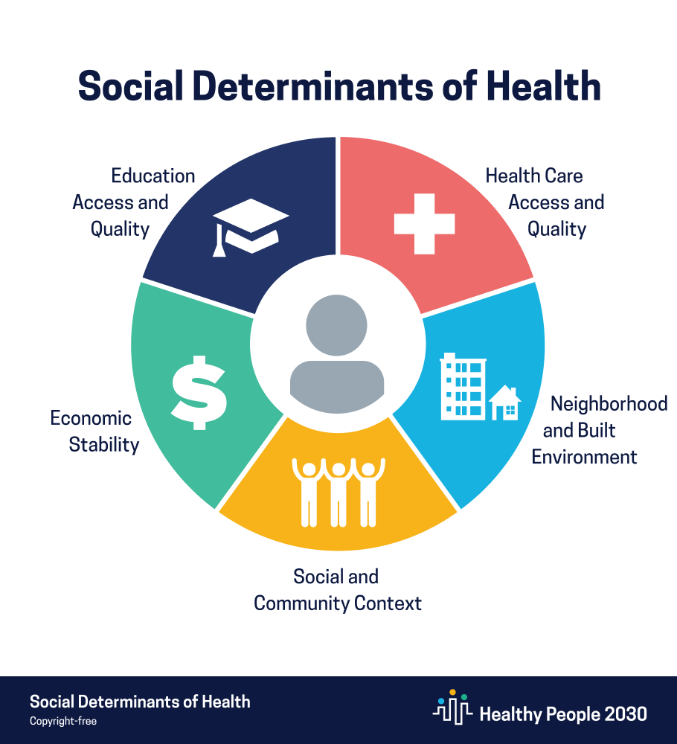
Social determinants of health (SDOH)
are the conditions in the environments where people are born, live, learn, work, play, worship, and age that affect a wide range of health, functioning, and quality-of-life outcomes and risks.
SDOH can be grouped into five domains:

